Slide 1
SAGE Dashboard: Proposal
Ruicong Xie and Tianci Zhong
Columbia University
FALL 2016

Slide 2
Outline
Motivation
Related Work
Proposal
Milestones
Future Work

Slide 3
Outline
Motivation
Related Work
Proposal
Milestones
Future Work

Slide 4
Motivation
Promote computational thinking¹
one of the fundamental skill that is critical to every child’s analytical ability
Quantify students action during assignment Scratch² and SAGE³
visualization of students’ study progression and their improvement of computational thinking through the dashboard on SAGE platform to assist both students and instructors
Provide more interaction between instructors and students
Enables students to receive formative feedback in real-time.
Enables instructors conveniently track each student’s progression and keep the student inside the Zone of Proximal Flow.
¹ J. M. Wing, "Computational thinking," Communications of the ACM, vol. 49, no. 3, p. 33, Mar. 2006.
² http://scratch.mit.edu
³ Bender, J. (2015). Developing a Collaborative Game-Based Learning System to Infuse Computational Thinking within Grade 6-8 Curricula.
Notes:
+Big picture
The goal
improve critical thinking skill for children
computational thinking involves solving abstract problems, decomposing large complex problem, approximating problems’ difficulty, forecasting potential risks and issues, considering the worst case scenarios, controlling the uncertainty and thinking recursively.
Issues exist
difficult to quantify student’s learning progression
the gap between students and instructors (lack of real time assistance)
how
The Zones of Proximal Flow is a concept combining Vygostsky’s Zone of Proximal Development and Csikszentmihalyi’s state of Flow. The concept of flow is focused on how one can have optimal experience by performing an activity at one’s limit. The Zone of Proximal Development is concentrated on what one can achieve with external help. The Zones of Proximal Flow aims at the point to keep the learner continually have optimal experience while pushing one’s limit with accessible external help (Murphy, C., Kaiser, G., Loveland, K., & Hasan, S. 2009).

Slide 5
Outline
Motivation
Related Work
Proposal
Milestones
Future Work

Slide 6
Related Work
Retina¹
Aggregates information about classroom programming activity to provide recommendations as students works on assignments.
GradeCraft²
a custom learning management system that supports game-inspired courses
REACT³
a real time graphic assessment tool that quickly gives teachers insight into students’ mastery of computational thinking construct.
¹ Murphy, C., Kaiser, G., Loveland, K., & Hasan, S. (2009). Retina: Helping Students and Instructors Based on Observed Programming Activities. SIGCSE (pp. 178-182). Chattanooga: ACM.
² Holman, C., Fishman, B., Aguilar, S. (2013). Designing a Game-Inspired Learning Management System. Poster for Games+Learning+Society Conference 9.0. University of Wisconsin- Madison. Madison, WI.
³ Koh, K., Basawapatna, A., Nickerson H., & Repenning A.(2014). Real Time Assessment of Computational Thinking. 2014 IEEE Symposium on Visual Languages and Human-Centric Computing(VL/HHC)
Notes:
Retina: collects students’ compilation time, compilation error, runtime errors, stack trace and so on.
We are adopting the similar concept that shows the attendance of the student. For good attendance, we will prize them.

Slide 7
Related Work
Open Learning Analytics⁴
categories for students to evaluate of the course and assignment and also serves as feedbacks for instructor to improve the course or assignment
⁴Siemens, G., Gasevic, D., Haythornthwaite, C., Dawson, S., Shum, S.B., Ferguson, R., Duval, E., Verbert, K., Baker, R.S.J.d. (2011) Open Learning Analytics: an integrated & modularized platform: Proposal to design, implement and evaluate an open platform to integrate heterogeneous learning analytics techniques. Athabasca, Alberta, Canada: Society for Learning Analytics Research..

Slide 8
Outline
Motivation
Related Work
Proposal
Milestones
Future Work

Slide 9
Proposal
Mock Dataset and Test Server
Construct a couple of mock data set in JSON and build test server that serves the mock data set to dashboard pages.
Design and Implementing Student Dashboard
Implementing mechanics and designing features that encourage students to take ownership of their learning progress, make learning progress more gameful.
Design and Implementing Instructor Dashboard
Implementing mechanics and designing features that help instructor identify struggling and overachieving students and make appropriate invention tools readily available to instructors

Slide 10
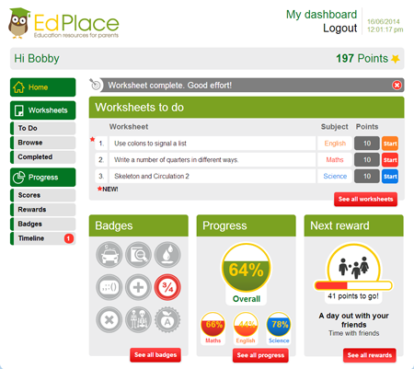
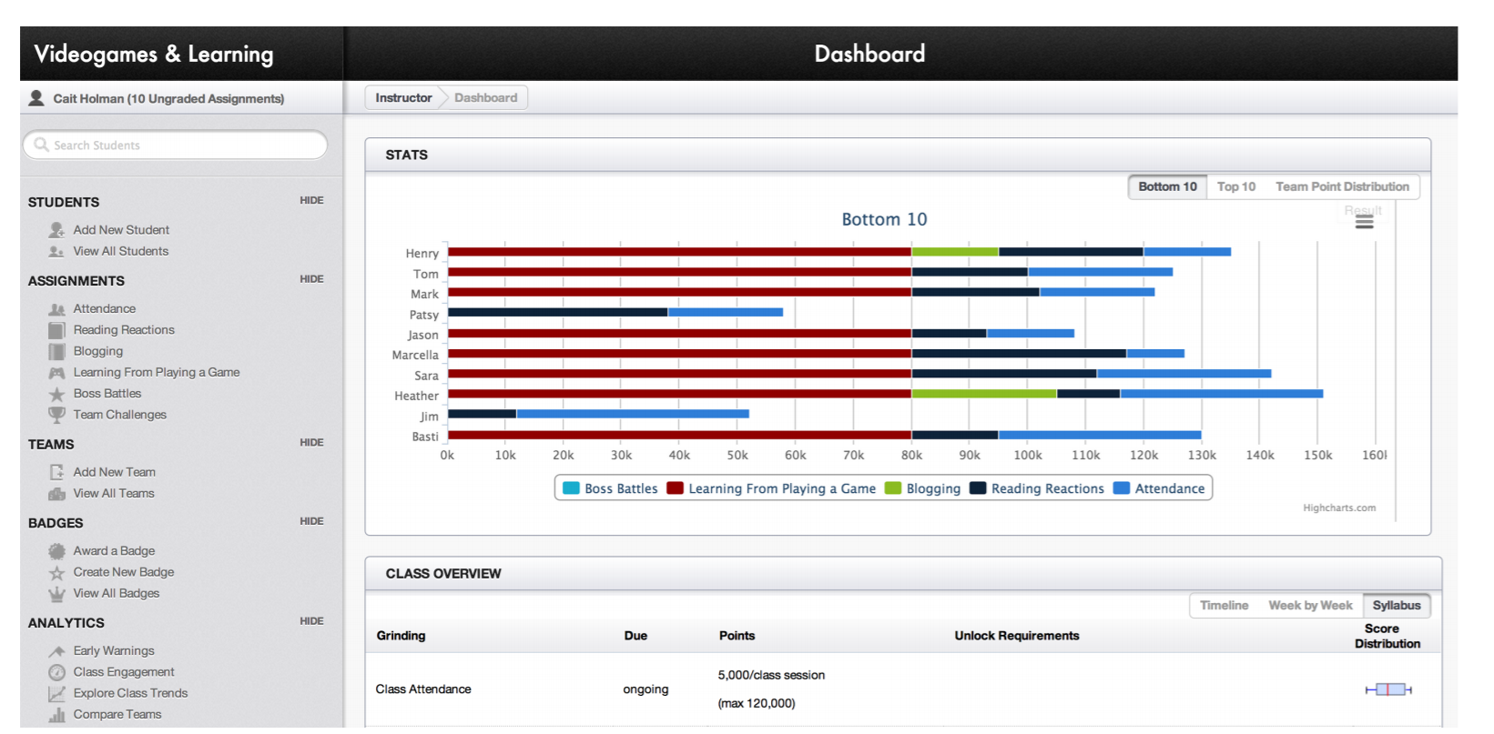

Proposal
Student Dashboard
Instructor Dashboard
Test Server
JSON response
JSON response
Mock Data

Slide 11
Outline
Motivation
Related Work
Proposal
Milestones
Future Work

Slide 12
Milestones
Milestone | Date
Tech stack review | October 7
Backend
Static mock dataset | October 14
Testing backend server | October 21
Student Dashboard
Design | October 28
Implementation | November 11
Midterm written progress report | November 18
Instructor Dashboard
Design | November 25
Implementation | December 9
Final written report and oral presentation | December 16

Slide 13
Outline
Motivation
Related Work
Proposal
Milestones
Future Work

Slide 14
Future Work
Validating Effectiveness
More field researches must be completed in order to evaluate and validate the effectiveness of the current design of the dashboard system for students and instructors
Additional Data collection
identify what additional sets of data can be collected that may be helpful for students and teacher in identifying problems and tracking progress.
Test alternative presentation of the dashboard data, so more comprehensive subsequent versions of the dashboard system can be implemented.

