Slide 1
formative sage assessments with parson’s programming
Coms e 6901, section 14
Fall 2016
30 SEPTEMBER 2016
Akanksha Gupta
Sudhanshu mohan

Slide 2
outline
MOTIVATION
COMPUTATIONAL THINKING
PARSON’S PROGRAMMING
RELATED WORK
PROPOSAL
MILESTONES
FUTURE WORK

Slide 3
MOTIVATION
The motivations behind this project are to include Computational thinking and Parson’s Programming puzzles with visual progress for assessment in SAGE (Bender, 2015) and improve students’ understanding of computational thinking (Barr & Stephenson, 2011) concepts via personalized feedback on how they perform on Parson’s puzzles.
Computational Thinking
Parson’s Programming

Slide 4
Computational thinking
Computational thinking is an approach to solving problems using concepts of abstraction, recursion, and iteration to process. Such concepts foster critical thinking in students at an early age.
Computational thinking is a way of solving problems, designing systems, and understanding human behavior that draws on concepts fundamental to computer science. I
Competitive world, focus on how people think, understand and perceive things.
Computational thinking inculcates engagement with the students.

Slide 5
Parson’s programming
The original Parson’s problems (Parsons & Haden, 2006) were created using a generic drag-and- drop exercise framework called Hot Potatoes.
Exercises created with the tool can be exported to HTML and JavaScript pages. Exercises are solved by dragging lines from right to left.
When feedback is requested, lines in (absolutely) correct positions are highlighted. One problem of this UI is that inserting a line between two existing lines is cumbersome. Student may need to move all lines after the insertion point to create a free slot where the new line can be inserted.

Slide 6
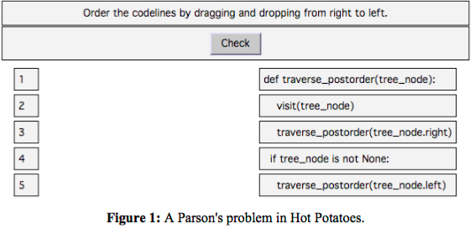
Related work
Hot Potatoes
The original Parson’s problems (Parsons & Haden, 2006) were created using a generic drag-and- drop exercise framework called Hot Potatoes.

Slide 7
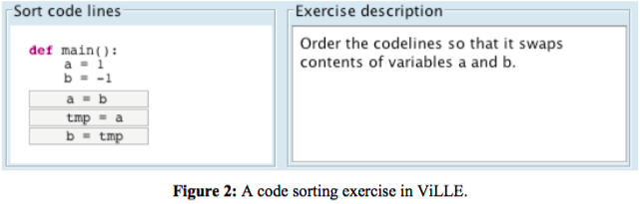
Related work
ViLLE (Rajala, Laakso, Kaila, & Salakoski, 2007)
It is a Java application/applet which allow context to be created around the editable code. Distractors are not supported.

Slide 8
Related work
CORT (Garner, 2007)
Used with Visual Basic programs so that students move lines from left to a part-complete solution on the right. Moving the lines is done by selecting a line and clicking arrow buttons to move it left or right. To get feedback, student can copy the code into Visual Basic interpreter and execute the code. CORT supports both distractors and context.

Slide 9
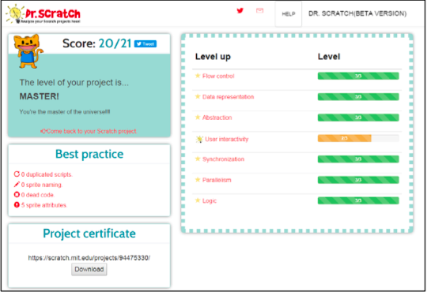
Related work
Dr. Scratch (Moreno-Leon, Robles, & Roman-Gonzalez, 2015)
A web application where Scratch project files can be uploaded for automated analysis. It serves as an analytical tool that evaluates Scratch projects in a variety of computational areas.

Slide 10
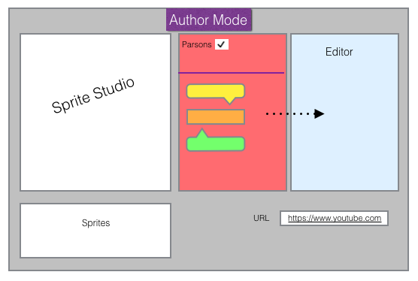
Proposal

Slide 11
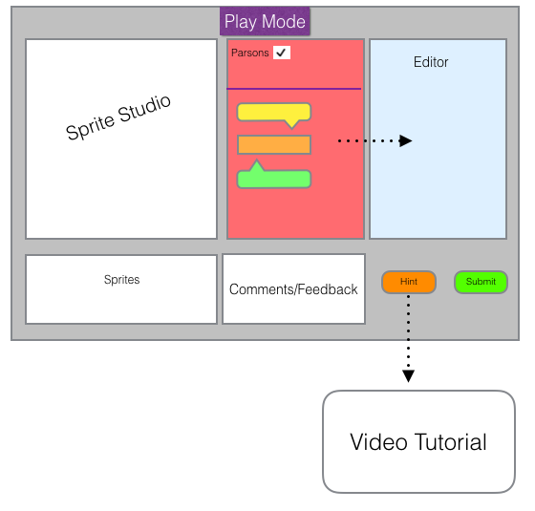
proposal

Slide 12
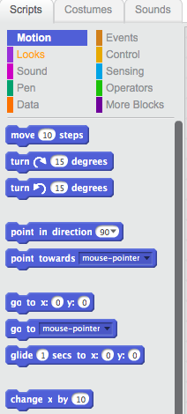
Parson’s Palette
There will be a separate palette for Parson’s programming. On selecting the Parson’s palette, the teacher will get the option to author Parson’s puzzle.

Slide 13
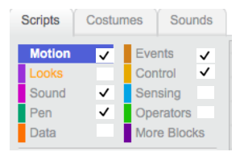
Palette restriction
On selecting the Parson’s palette, the teacher will get the option to author Parson’s puzzle.
All other palettes will become inactive on selection of Parson’s palette.
This will be a palette restriction that will be implemented so that student focuses only on those blocks of code which the teacher wants the student to focus.
There will be an option to selectively enable palettes which will increase the difficulty level for the students.

Slide 14
Interactive sprites
As the student orders the lines of code, sprites will move correspondingly in the left pane and show the progress of student. in the Sprite Studio.
Such interactive sprites will give hints to the student and also be gameful for the student.
This will ensure the student is not distracted and has active learning , enjoying the puzzle.

Slide 15
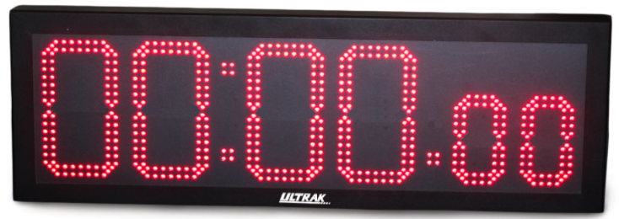
timer
Further there will be a timer in the play mode. This will help the teacher track the time taken by student to solve the problem. This result will also help assess the student and will have a marking scheme taking time taken by student to solve the puzzle into consideration. This will also help the student as well to time himself and focus more on problem and not get distracted.

Slide 16
final report
The results on the dashboard will indicate to the student which evaluations have passed successfully and which evaluations are not passing.
For those evaluations that are not passing, the student will need to continue to work.
The dashboard will, in cases where it is appropriate, display suggestions that will help the student work towards successful evaluations.

Slide 17
milestones
S.No | Milestone | Date
1. | Project Proposal | September 30, 2016
2. | Parson’s Palette | October 26, 2016
3. | Palette Restriction | November 4, 2016
4. | Interactive Sprites | November 11, 2016
5. | Timer | November 18, 2016
6. | Report Card | November 25, 2016
7. | Testing and Stabilization | December 9, 2016
8. | Final Presentation | December 16, 2016 (Tentative)

Slide 18
Future work
Two difficulty levels for solving the Parson’s puzzle. One will be easy and the other will be advanced level with
Int a=0,b=1; // correct version
Int a=0,,,b=1; // incorrect version-distractor
The user interface can be made more user interactive. The option for students to see talking avatars will be interactive as they log into the system.
Collect and analyze data for future study and apply analytics on them. This data may provide useful insights that can be mined to provide students with personalized recommendations.

Slide 19
thank you

