Slide 1
COMS W3998 Final Report: Enhanced Data Collection, Student Progress Modeling, and Intelligent Hinting in SAGE
Sambhav Anand & Allison Sawyer
May 9, 2017

Slide 2
Outline
Motivation
Related Work
Project Planning
Implementation
Demos
Future Work

Slide 3
Motivation: Hinting System
Enhance gameful nature of SAGE
Addictive
Social
Assist students with no teacher intervention required
Identify groups of students with similar problem-solving approaches
Model student progressions through an assignment

Slide 4
Motivation: User Data Collection
To be able to parse timestamped JSON files associated with a project to gather information about how many times a block is moved
To output the data in an easily readable CSV output file

Slide 5
Outline
Motivation
Related Work
Project Planning
Implementation
Demos
Future Work

Slide 6
Related Work: Modeling Student Progress & Behavior
“Modelling How Students Learn to Program” from Stanford
Snapshots of student progress through assignment
Clusters of student progressions
Predictive of midterm scores
“A Framework for Capturing Distinguishing User Interaction Behaviors in Novel Interfaces” from University of British Columbia
K-means clustering on user behavior features
Association rule mining to identify behaviors that defined each cluster
Difference in learning between clusters

Slide 7
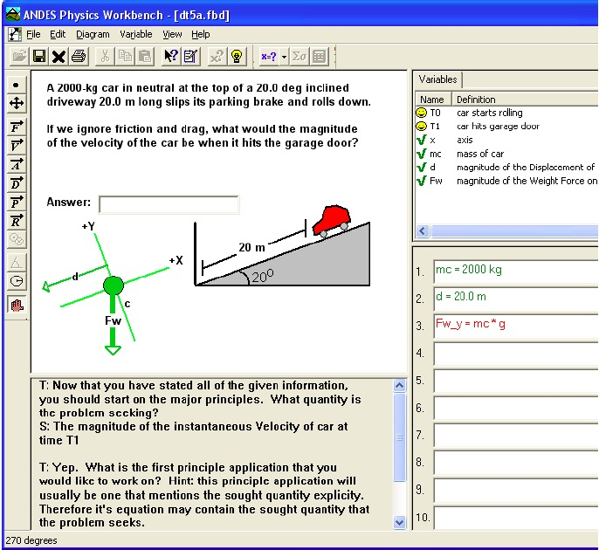
Related Work: Intelligent Tutoring Systems
DT Tutor
Probabilistic model of student reaction to different hints
Andes Physics Tutor
Granular mistake identification
Error-specific feedback
Both excellent models of advanced tutoring systems

Slide 8
Related Work: Sequential Pattern Mining
“Applying Web usage mining for personalizing hyperlinks in Web-based adaptive educational systems” from University of Córdoba & Eindhoven University of Technology
Sequential pattern mining to find patterns of webpages visited
Webpage recommendations
Analogously, we mined for sequential patterns of blocks in order to recommend next block

Slide 9
Outline
Motivation
Related Work
Project Planning
Implementation
Demos
Future Work

Slide 10
Planning: User Data Collection
Started off by trying to build on Jeff Bender’s ScratchAnalyzer code
Ended up building upon the ScratchExtractor class and implemented new features in a new class called ReadTree
Had to figure out a way to change the parsing mechanism to accommodate 100s of JSON files associated with each project, and the change in the JSON structure due to the addition of block IDs
Methods have been overloaded to account for parsing the data in the original ScratchAnalyzer (.sb2 file) format, and the new (JSON) format.

Slide 11
Planning: Hinting System
Leverage knowledge contained in existing complete, correct submissions
Cluster students based on high-level approach to solving project
Mine clusters for pattern-based “rules”

Slide 12
Outline
Motivation
Related Work
Project Planning
Implementation
Demos
Future Work

Slide 13
Code Repositories
Project aspect | Repository location | Branch name | Party responsible
User data processing with ScratchAnalyzer | https://github.com/cu-sage/scratch-analyzer | master | Sambhav
Machine learning scripts (integrated with Dashboard) | https://github.com/cu-sage/sage-frontend | machine-learning | Allison
Scratch Editor block ID and user interface modifications | https://github.com/cu-sage/sage-scratch | block-ids | Allison

Slide 14
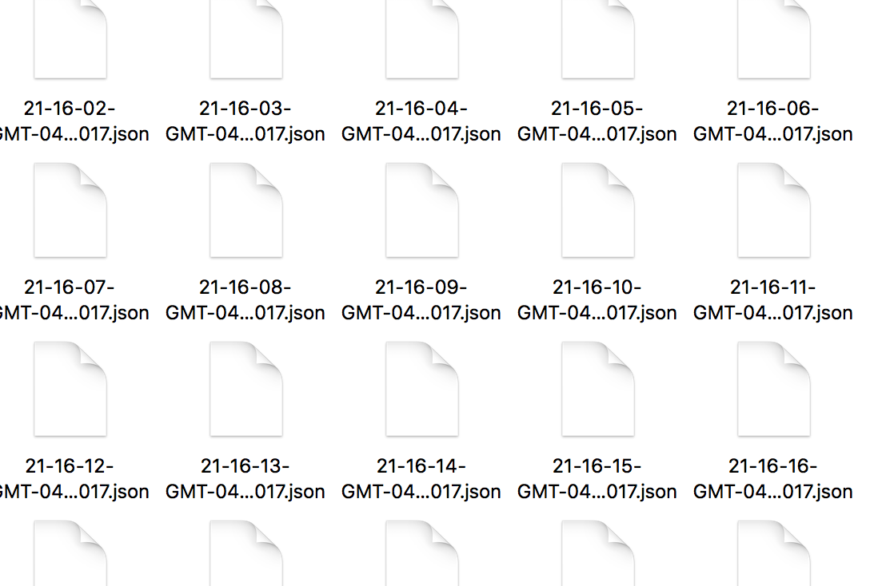


Implementation: User Data Collection
Each user has a unique integer user ID
Inside each user’s folder, there are a bunch of projects
Each project folder has lots of JSON files associated with it
Each JSON file represents a timestamped version of the project

Slide 15
Implementation: User Data Collection Continued
Keeps the original output format of ScratchExtractor
Converts each JSON file to an se file that keeps its tree structure
The main output of my work is the following CSV file. This includes the block ID and the number of times that the block is moved in a particular project.

Slide 16
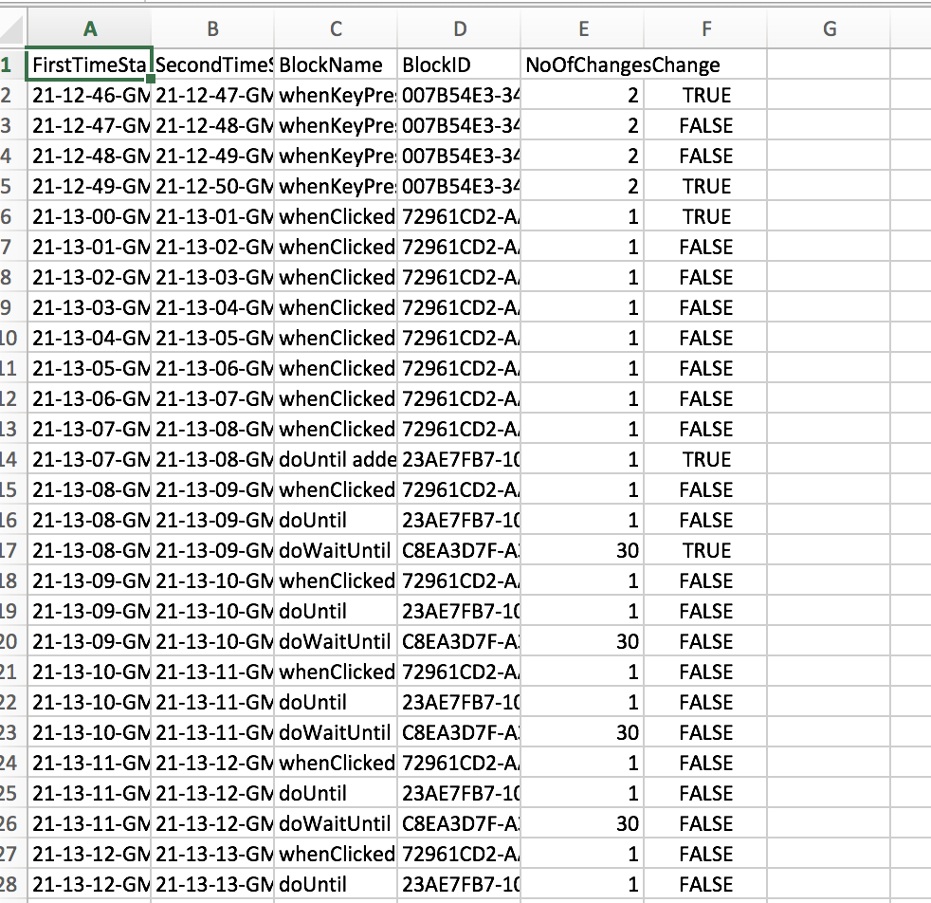
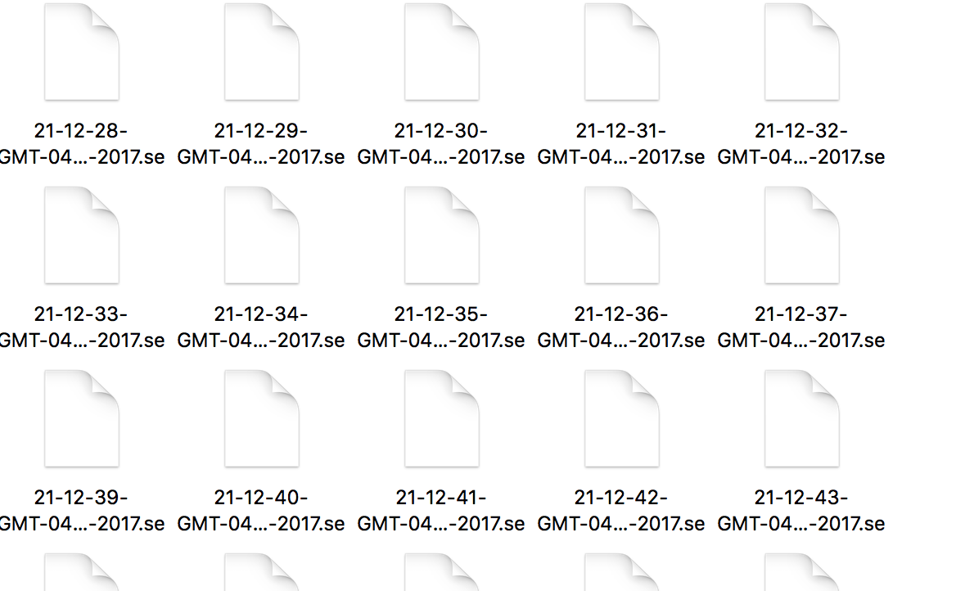
Implementation: User Data Collection Continued

Slide 17
Implementation: Hinting System
Machine learning approach:
Identify set of discrete, high-level project “milestones”
Cluster students according to the paths they take through the milestones
Perform sequential pattern mining within clusters to see which step likely comes next (for hinting)
Dashboard integration
Scratch Editor UI modifications

Slide 18
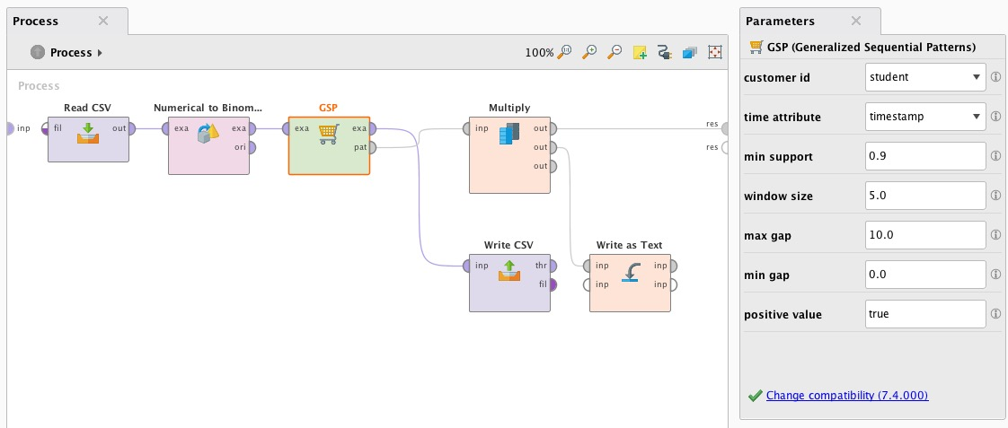
New Tool: RapidMiner

Slide 19
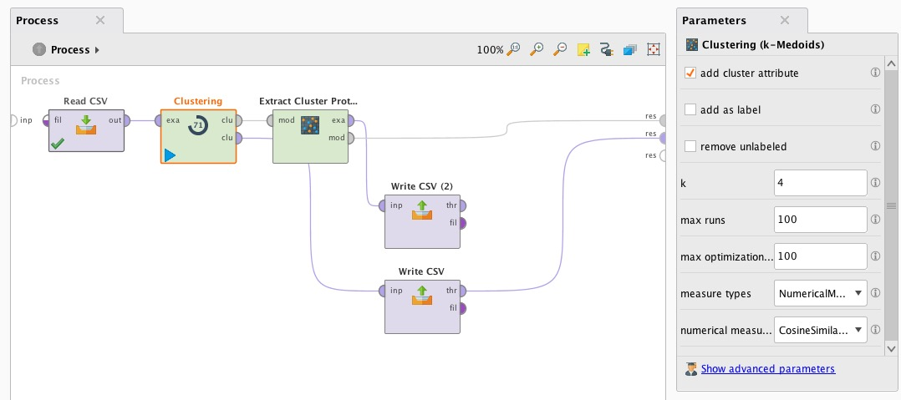
1. Identify Milestones (k-medoids Clustering)
Algorithm: k-medoids clustering
Features: Bag-of-Words (trigram) features from .se snapshots
Output: k clusters with centroids representing median snapshot of each generalized “milestone” in the project

Slide 20
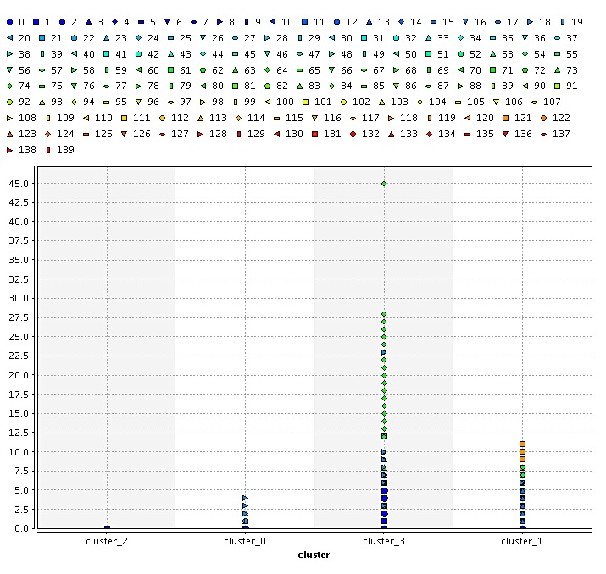
1. k-medoids Clustering: Trigram Features by Cluster

Slide 21
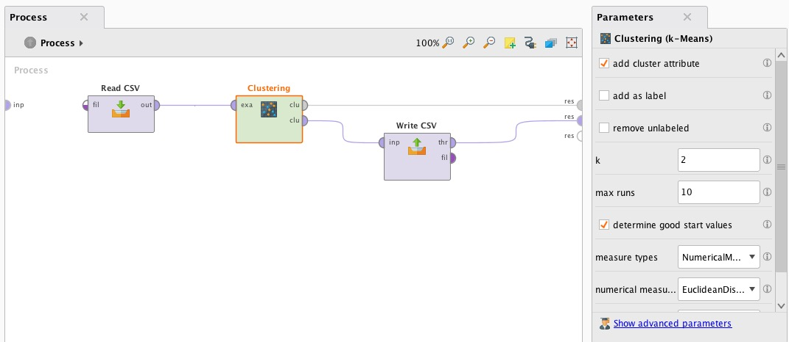
2. Cluster Students by PATH (k-means Clustering)
Algorithm: k-means clustering
Features: Similarity measure comparing set of student snapshots with each milestone
Output: k clusters grouping students according to their progression through the project

Slide 22
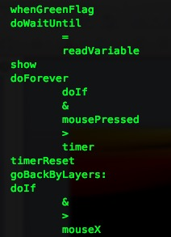
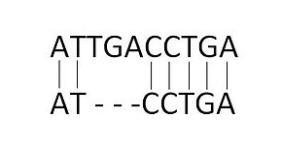
Similarity Metric: Needleman-Wunsch Algorithm
Used to compare and align segments of DNA
Using Scratch blocks in place of DNA nucleotides
Adapted code under GNU Public License for this purpose
Notes:
https://d1k5w7mbrh6vq5.cloudfront.net/images/cache/fd/69/37/fd6937f8d1e5fa87712cba62ed21f81b.JPG

Slide 23
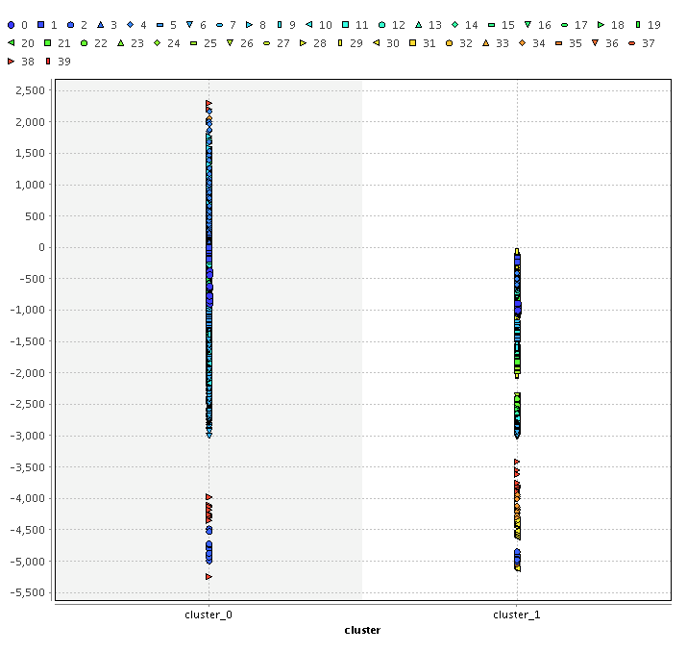
2. k-means Clustering: Similarity Metric Values by Cluster

Slide 24
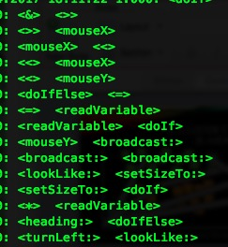
3. Generate Hints (sequential pattern mining)
Algorithm: Generalized Sequential Pattern (GSP) in RapidMiner
Input: Binomial features representing blocks in order in which they appear in complete, correct submissions
Output: Set of rules in which one block implies one or more other blocks

Slide 25
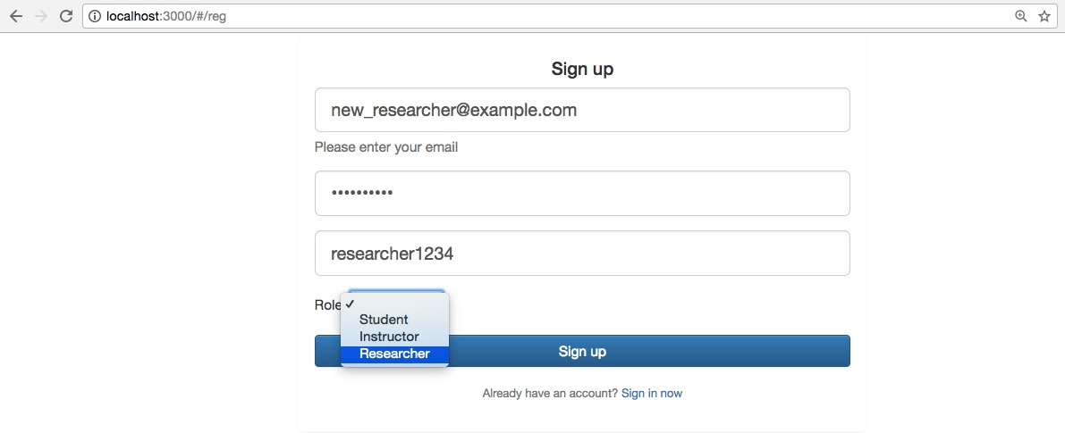
Dashboard integration: New User Registration

Slide 26
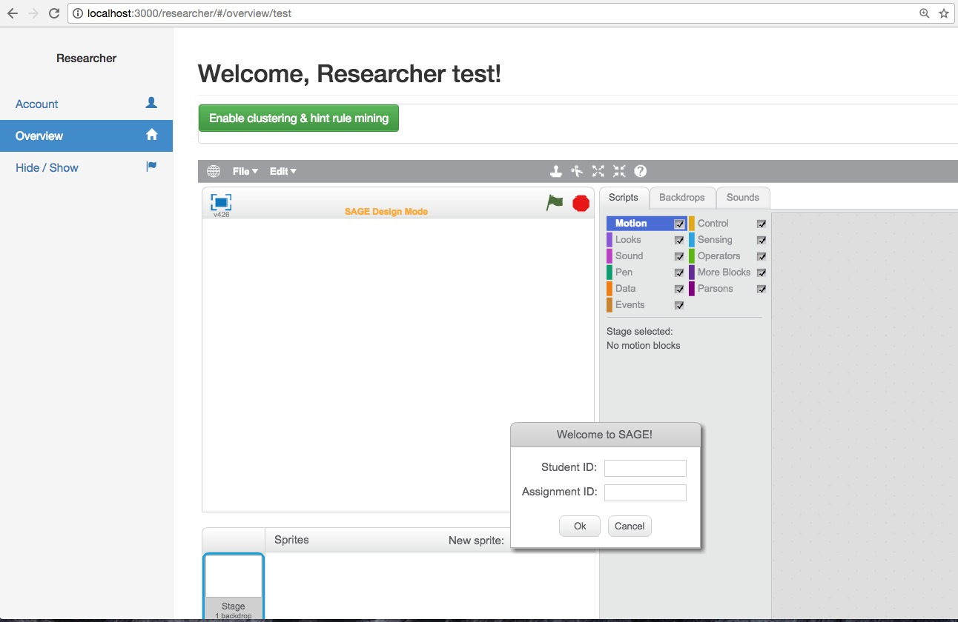
Dashboard integration: ML Disabled

Slide 27
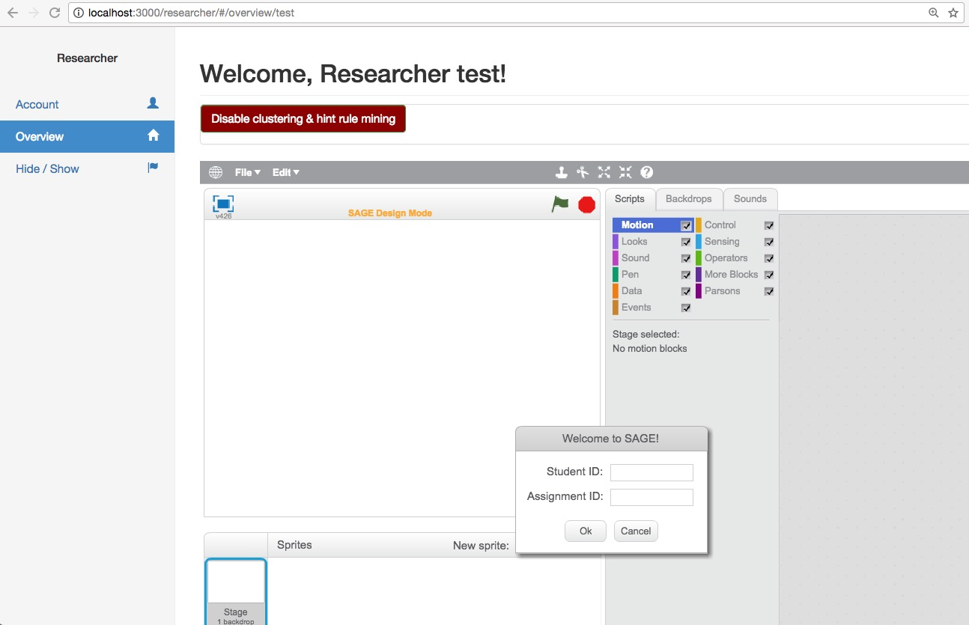
Dashboard integration: ML Enabled

Slide 28
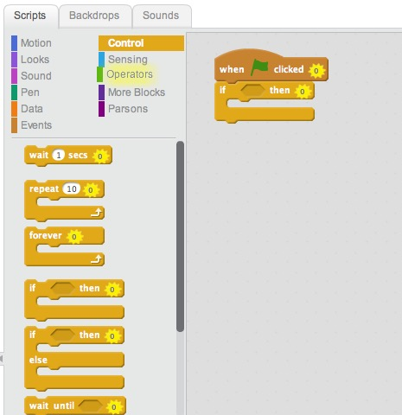

Scratch Editor UI modifications: Categories

Slide 29
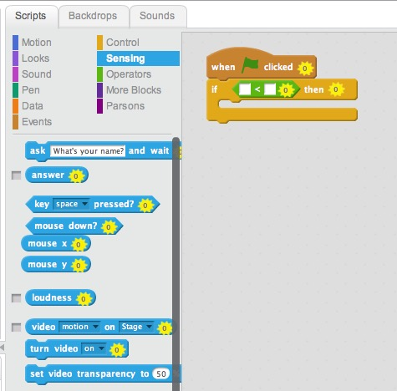
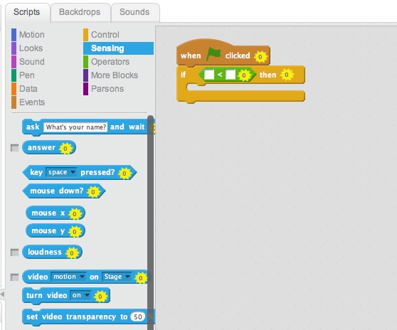
Scratch Editor UI modifications: Blocks

Slide 30
Outline
Motivation
Related Work
Project Planning
Implementation
Demos
Future Work

Slide 31
Demos
Sambhav’s data collection / feature extraction work
Allison’s demo of hinting in Scratch Editor in the Researcher Dashboard

Slide 32
Outline
Motivation
Related Work
Project Planning
Implementation
Demos
Future Work

Slide 33
Future Work: User Data Collection
The output CSV can be used in machine learning algorithms to classify student behavior
Further implementations of this project can be expanded to include parsing of mouse data

Slide 34
Future Work: Hinting System
Hinting improvements:
Personalizing hint frequency and granularity
Integrating data from Dashboard about student knowledge and ability
Adding support for on-demand hinting
Modeling student progress over multiple projects (i.e., courses/quests)
Obtaining real training data for machine learning algorithms from empirical studies with students

Slide 35
Thank you! Questions?

