Slide 1
CT Learning Platform
Plaban Mohanty (pm2878) Sajal Khandelwal (sk4226)
COMS 6901 Section 14

Slide 2
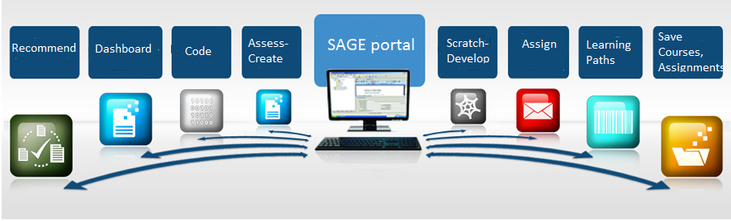
MOTIVATION

Slide 3


Related Work
GradeCraft¹ A gamified learning management system both for instructors and students.
Coursera An online platform offering Massive Online Open Courses (MOOCs).
Scratch
¹Holman, C., Fishman, B., Aguilar, S. 2013

Slide 4
Initial Goals
Build a one-stop platform for SAGE. All components - Dashboard, Scratch Editor, Visual Assessment Language etc. accessible under one platform leads to better engagement.
Add progression model through learning paths or quests
Better and centralised interactive site for all use cases
Provide recommendations for students

Slide 5
Existing Components
Scratch Editor: Flash based object implementing scratch for designing and playing assignments
Visual assessment Editor: Creation of assessments for these assignments
Scratch Assessment Server: Server for storing the assignments and assessments

Slide 6
Initial Work :
Setting up and testing out existing components
Getting access to existing mock data for the components
Checking connection and data schemas of different components
Analysis of the existing dashboard structure
Understanding and researching ways to make the dashboard more interactive

Slide 7
Integration

Slide 8
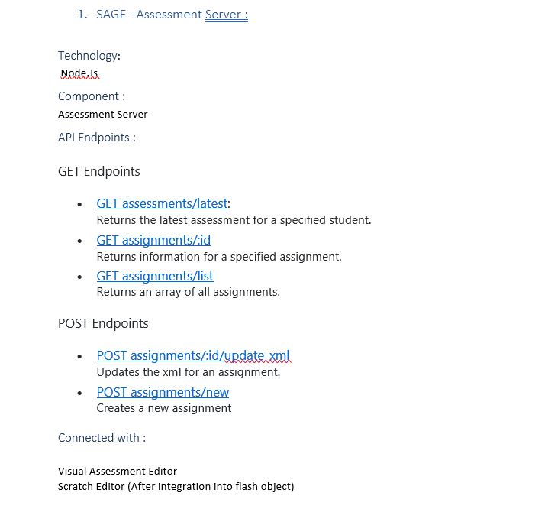
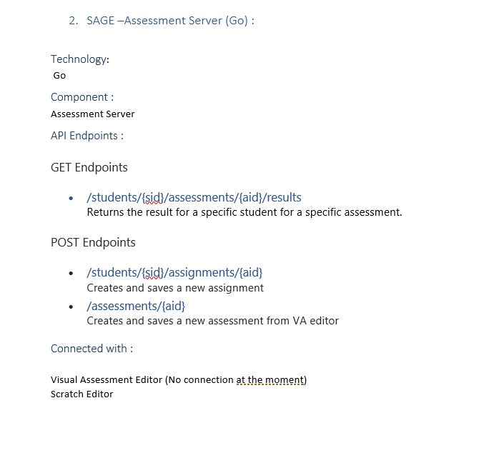
Documentation of the existing components
There was no available documentation detailing the connectivity ,role and schemas of the current components
For our dashboard integration plan, we tested out the various parts individually and analysed it to form a document that will be essential for our current project as well as future extensions
We documented the APIs exposed for the server , which component worked with which part and how the data was managed

Slide 9
Planning the control flow of SAGE Platform
Armed with the knowledge of the components and their proper connectivity , we established a control flow model for the entire SAGE platform
This model included the way data would be passed , in the required format, to the respective components and which component would handle which part of the entire process
We took into account all the current use cases and possible extensions to clearly divide the processes .

Slide 10
Building dashboard structure
Planning the required use cases
Deciding the UI
Building the model on top of existing dashboard structure
Creating required routes and views
Adding features and placeholders for other components
Integrating database models

Slide 11
Dashboard Implementations

Slide 12

Implementation Details:
Technology Used:
Server and backend : Node.Js
Frontend : AngularJS and Express
Database : MongoDB based online Mlab
Recommendations : Python on AWS Lambda
Online repo : https://github.com/cu-sage/sage-frontend

Slide 13
Instructor Dashboard
Use Cases :
Course Creation
Learning Path Creation
Assignment Creation
View all courses created
View statistics of courses created
In built Assessment creation with VAE

Slide 14
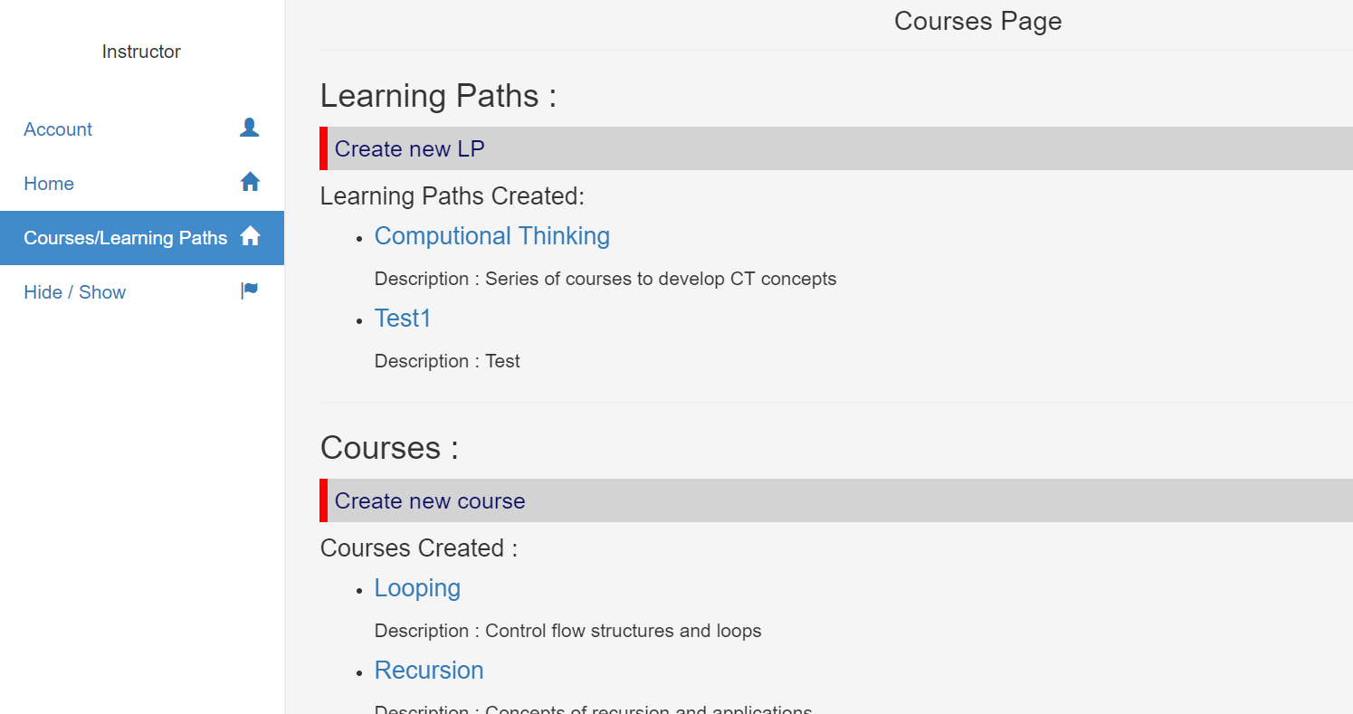
Instructor Dashboard

Slide 15
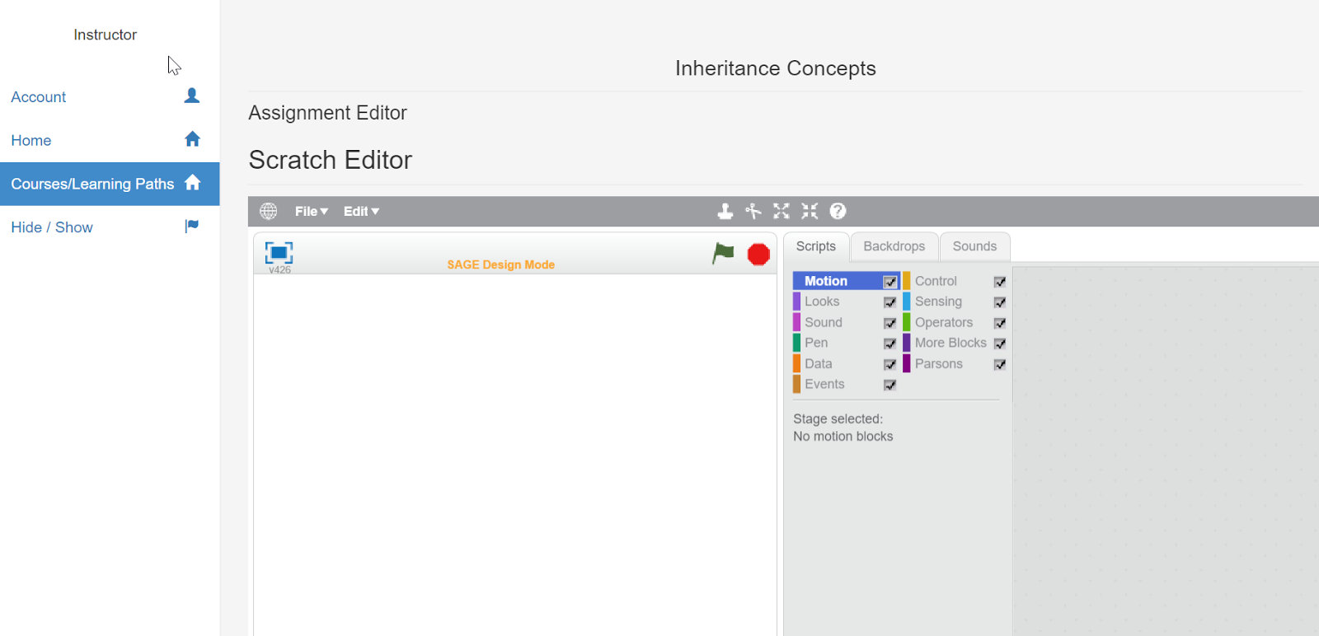
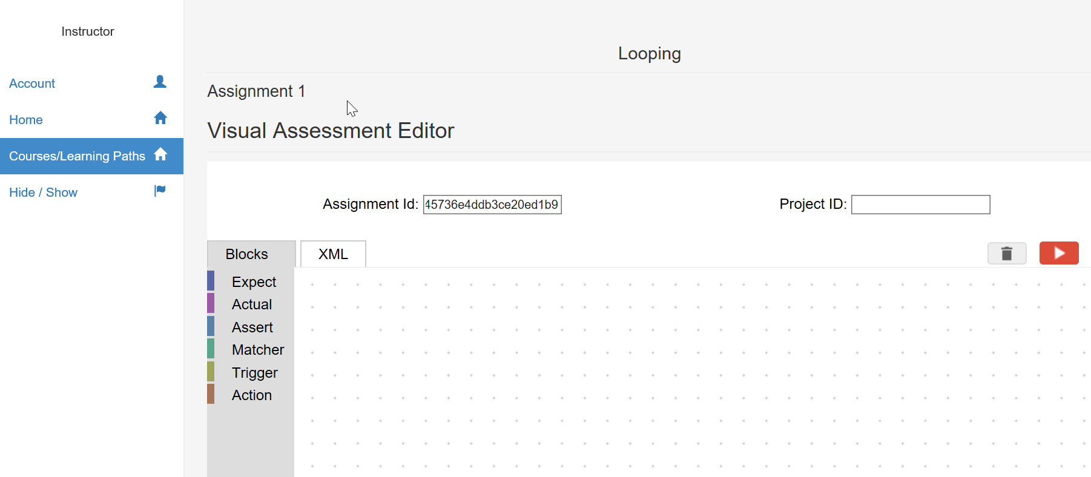
Instructor Dashboard Integrations with SAGE components:
Scratch Editor
VAE Editor

Slide 16
Student Dashboard
Use Cases : 1. Browse Recommended/Recent Courses
2. Course Enrollment
3. Access Tutorials and Course Information
4. Play Assignments and get assessed
5. View Statistics/Badges
6. Integration for scores and real-time feedback (Placeholders)

Slide 17
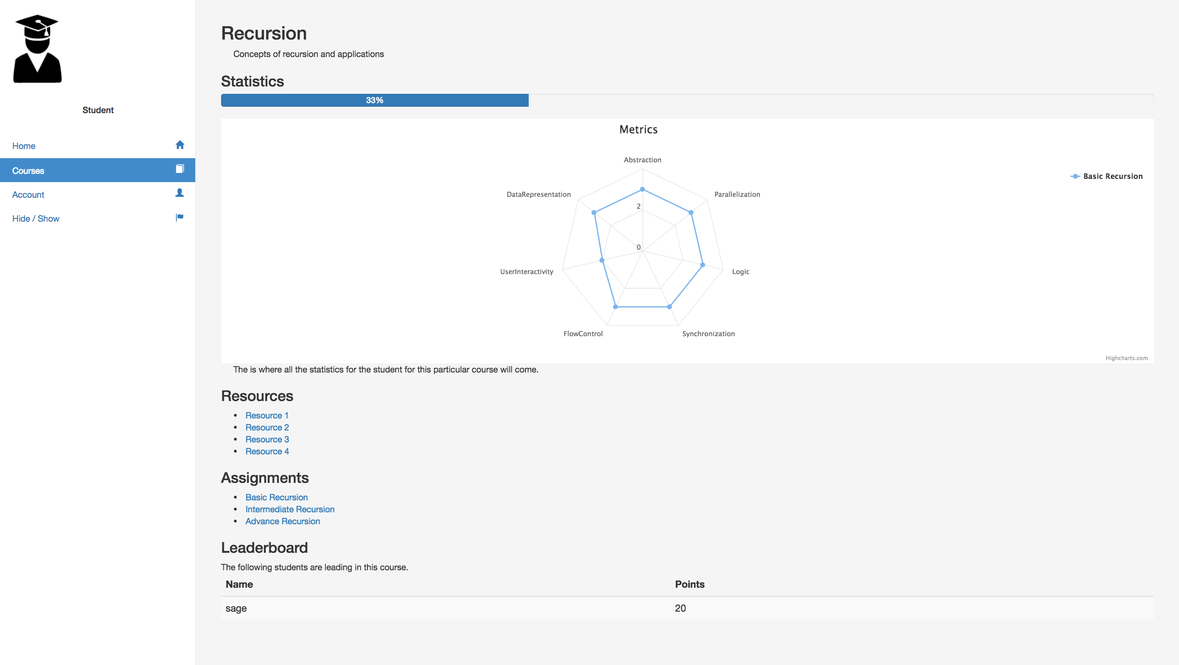
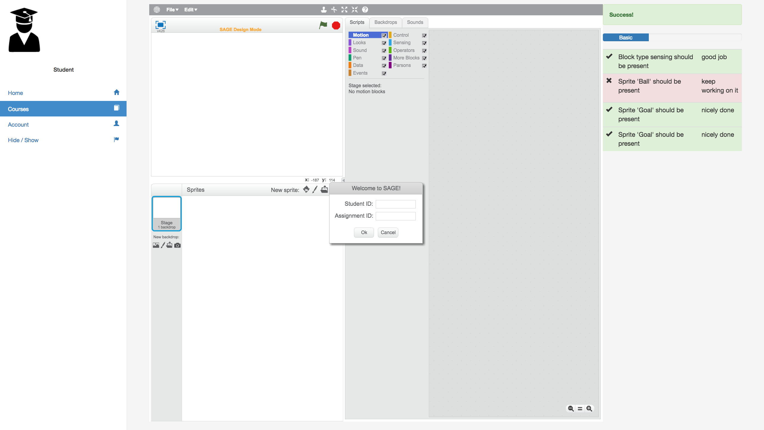
Student Dashboard

Slide 18
Learning Paths :
Progression model of education works quite effectively . Proven by online MOOCs like Coursera
Adds a gamified element of quests , where each course is a level in a quest that the young students need to cross to go further
Instructors can put together a series of multiple courses having similar CT concepts or subjects, either their own or created by others to form a learning path
The LP would essentially comprise of multiple courses leading up to a mastery in a particular concept or subject
Implementation :
Added as a functionality in Instructor Dashboard
After creation of a Learning Path , the instructor can separately specify its resources and description
Instructors can add courses by simply clicking on the course from the list of available courses
The added courses show up in the description of the LP and can be modified

Slide 19
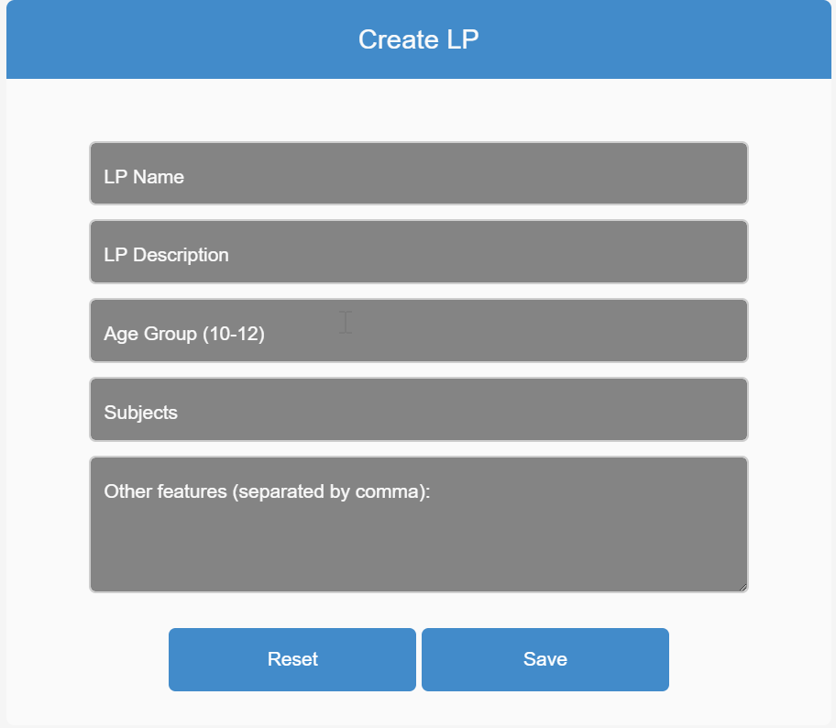
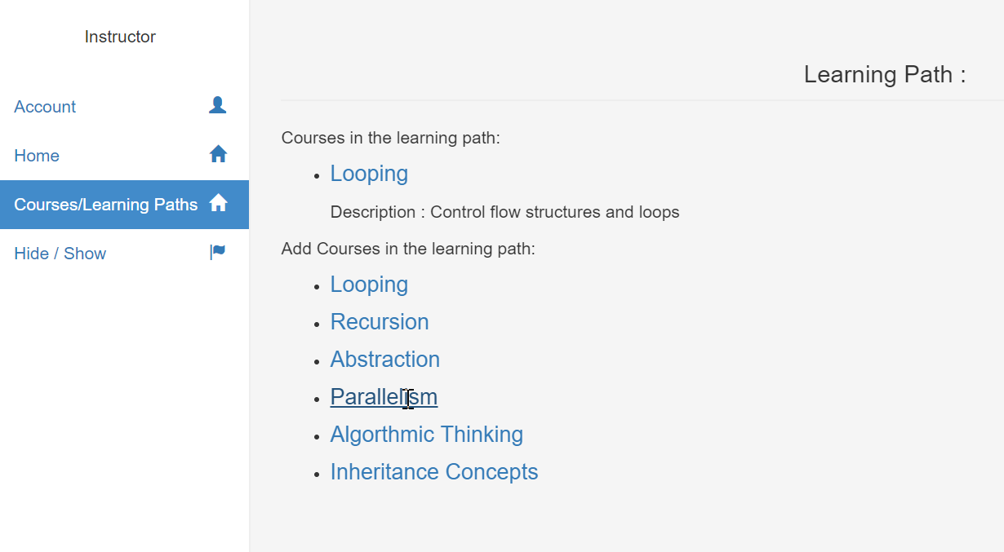
Learning Paths in Instructor Dashboard:

Slide 20
Recommendations :
Used course based similarity for collaborative filtering for recommendations ( Courses similar to the courses a student has taken)
Used user based similarity for collaborative filtering (What other students with similar preferences have taken)
Recommendations shown on the student’s dashboard
Adaptive algorithm that performs better as the data increases
Deployment :
Implemented in python
Deployed in AWS Lambda on a serverless platform so that it can be easily accessed from anywhere
Also have python script in place to run n local machine
Customizable algorithm that can be changed as per requirements

Slide 21
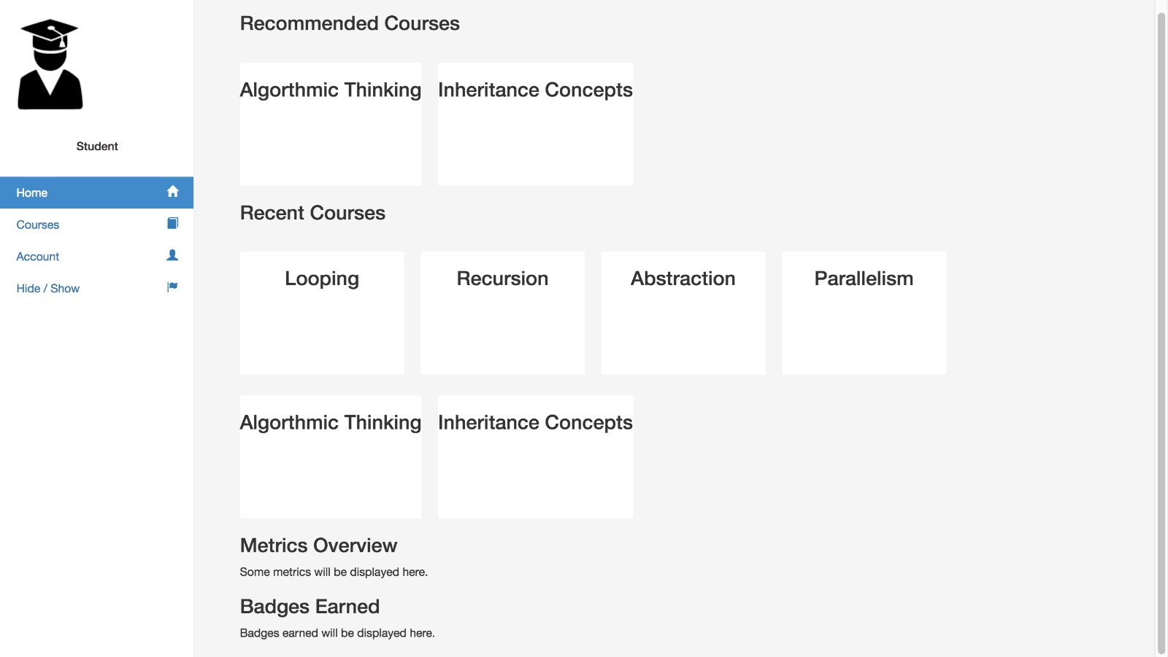
Recommendations on Student Dashboard:

Slide 22
Summary of Deliverables
1. Student Dashboard with complete interaction and all use cases
2. Instructor dashboard with Course creation and Assignment Creation
3. Advanced Graphs for statistics display
4. Recommendation engine for both user based and item based recommendations
5. Complete integration framework of the entire SAGE module
6. Comprehensive documentation for all separate modules
Scalable platform :
Placeholders for research dashboard integrations
Scope to include rating systems and badges
Could be easily scaled to include more functionalities without having to disrupt the current system.

Slide 23
Into the Future!

Slide 24
Improved Learning Paths
Create useful progression models with in built tutorials to start from instruction based and move to construction based courses and assignments
Present them in the form of quests and attach incentives or rewards/badges for their completion

Slide 25
Research Dashboard
Analyse the statistics , features and scores of students over different parameters of difficulty and CT concepts.
Useful in drawing fundamentally important results that could gamify the process and make it more useful.

Slide 26
Improved Recommendations
Currently only user based and course based recommendations. Could integrate features and CT concepts to provide more customized recommendations
With more data in place and with findings from research dashboard, we could use more efficient algorithms such as deep neural nets to adaptively learn a student’s learning style and provide feedback and recommendation based on that

Slide 27
That’s all folks!
Questions, anyone??

