Slide 1
COMS W3998 Midterm Progress Report: Enhancing Data Collection in Scratch Analyzer & Modeling Student Progress in SAGE
Sambhav Anand & Allison Sawyer
March 31, 2017

Slide 2
OUTLINE
Sambhav’s modifications to Scratch Analyzer to collect user behavioral data
Allison’s LinkingEdX side project
Allison’s machine learning progress and plans

Slide 3
Format
Input: a per-user path that contains individual time-stamped sb2 files
Output: a simple per-user csv file that contains the total number of times a block was moved by the user
A block move is a relative change in the tree structure of the JSON files associated with two consecutive time-stamped sb2 files

Slide 4
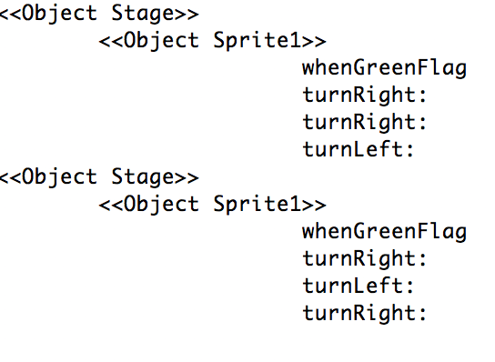
Using Scratch Extractor
Building on Scratch Analyzer’s ScratchExtractor class –
Builds a per-user Map storing a List of the relative structure of each time-stamped project
Snapshot of tree-hierarchy of different solutions to same problem

Slide 5
ReadMap
A list per user is taken in as a constructor
Relative order of each block is read and a per-block entry of the number of times a particular block is moved is added to the csv file
If a block is newly added/removed, its count is set as 0

Slide 6
Further Developments
Expand functionality to make it take in per-user, per-project time-stamped files rather than only a single project per user
Instead of relying on Scratch Extractor’s TreeMap as input, read directly from the JSON file associated with the sb2 file
Add other metrics to the csv file

Slide 7
Side Project: LinkingEdX
Matching MOOC learners with their LinkedIn profiles
Email discovery on Gravatar
Name comparison between LinkedIn and MOOC registration
Photo comparison between LinkedIn and Gravatar
Updated and simplified code for LinkedIn case
Demo…

Slide 8
SAGE: Machine Learning Approach (in Greater Detail)
Identify set of discrete, high-level project “milestones”
Algorithm: k-medioids clustering
Features: Bag-of-Words features from .se snapshots
Cluster students according to the paths they take through the milestones
Algorithm: k-means clustering
Features: Similarity measure comparing latest student snapshot with each milestone
Perform sequential pattern mining within clusters to see which step likely comes next (for hinting)
Algorithm: Generalized Sequential Pattern (GSP) in RapidMiner

Slide 9
1. Identify Milestones (k-medioids Clustering)
Length
Variation in Project Structure

Slide 10
2. Cluster Students by Path (k-means Clustering)
Length
Variation in Project Structure

Slide 11
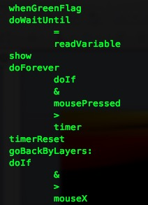
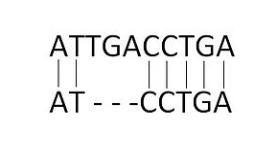
Similarity Metric: Needleman-Wunsch Algorithm
Used to compare and align segments of DNA
Using Scratch blocks and operators in place of DNA nucleotides
Adapted code under GNU Public License for this purpose
Demo…
Notes:
https://d1k5w7mbrh6vq5.cloudfront.net/images/cache/fd/69/37/fd6937f8d1e5fa87712cba62ed21f81b.JPG

Slide 12
Next Steps
Generating data
Implementing clustering
Once clustering is working, implementing sequential pattern mining to generate hints

Slide 13
QUESTIONS?

