Slide 1
CT Learning Platform
Plaban Mohanty (pm2878) Sajal Khandelwal (sk4226)
COMS 6901 Section 14

Slide 2
Midterm Progress Presentation

Slide 3
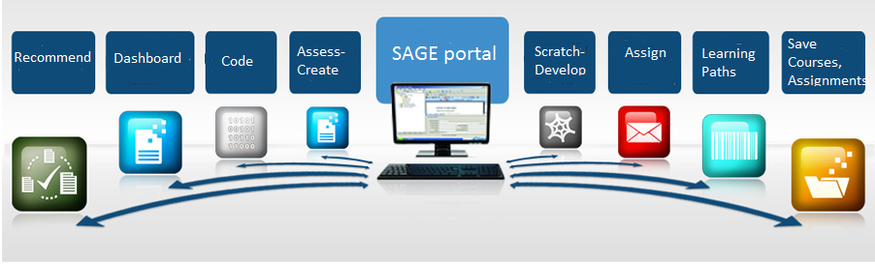
MOTIVATION

Slide 4
Initial Goals
Build a one-stop platform for SAGE. All components - Dashboard, Scratch Editor, Visual Assessment Language etc. accessible under one platform leads to better engagement.
Add progression model through learning paths or quests
Better and centralised interactive site for all use cases
Provide recommendations for students

Slide 5
Existing Components
Scratch Editor: Flash based object implementing scratch for designing and playing assignments
Visual assessment Editor: Creation of assessments for these assignments
Scratch Assessment Server: Server for storing the assignments and assessments

Slide 6
Initial Work :
Setting up and testing out existing components
Getting access to existing mock data for the components
Checking connection and data schemas of different components
Analysis of the existing dashboard structure
Understanding and researching ways to make the dashboard more interactive

Slide 7
Integration Plan

Slide 8
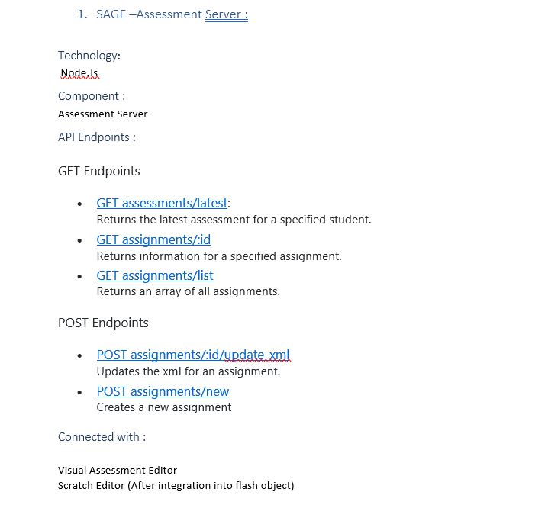
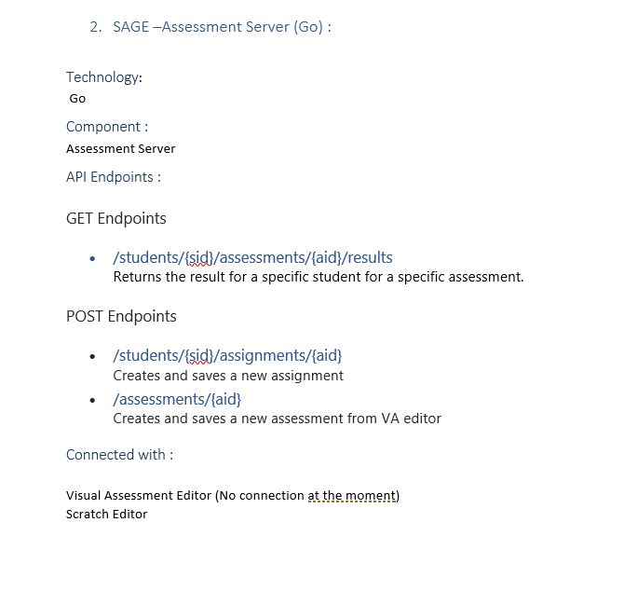
Documentation of the existing components
There was no available documentation detailing the connectivity ,role and schemas of the current components
For our dashboard integration plan, we tested out the various parts individually and analysed it to form a document that will be essential for our current project as well as future extensions
We documented the APIs exposed for the server , which component worked with which part and how the data was managed

Slide 9
Planning the control flow of SAGE Platform
Armed with the knowledge of the components and their proper connectivity , we established a control flow model for the entire SAGE platform
This model included the way data would be passed , in the required format, to the respective components and which component would handle which part of the entire process
We took into account all the current use cases and possible extensions to clearly divide the processes .

Slide 10
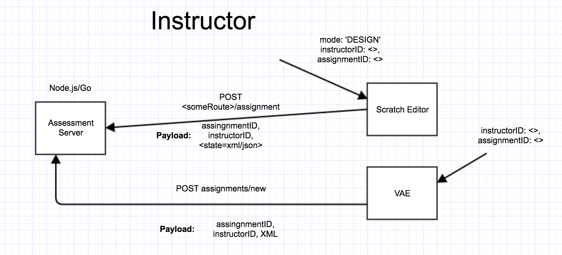
Control Flow Model Diagram for SAGE (1/2)

Slide 11
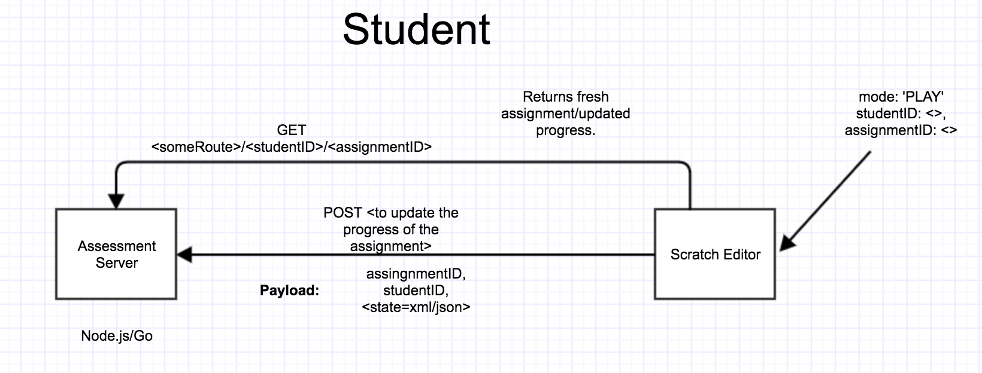
Control Flow Model Diagram for SAGE (2/2)

Slide 12
Building Dashboard Structure around the control flow
Formed use cases for the dashboard
Built database schemas for usage in dashboards
Built API endpoints for dashboard server
Formed dashboard views and added functionality for integration
Created integration endpoints for Scratch editor and VA editor.

Slide 13
Dashboard Implementations

Slide 14
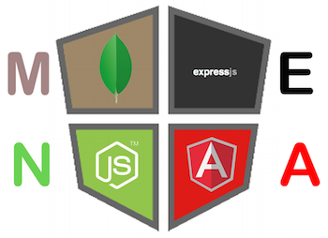
Implementation Details:
Technology Used:
Server and backend : Node.Js
Frontend : AngularJS and Express
Database : MongoDB based online Mlab
Online repo : https://github.com/cu-sage/sage-frontend

Slide 15
Instructor Dashboard
Use Cases :
Course Creation
Learning Path Creation
Assignment Creation
View all courses created
View statistics of courses created
Future integrations within dashboard :
Enhanced graphed and statistics
Design using existing courses
Searching courses and cloning them

Slide 16
Student Dashboard
Use Cases : 1. Browse Featured/Recent Course
2. Course Enrollment
3. Access Tutorials and Course Information
4. Play Assignments and get assessed
5. View Statistics/Badges
Future Integrations within dashboard :
Recommendations for courses
Learning Path Enrollments
Unified Search

Slide 17
Into the Future!
..The not so far future!

Slide 18
Recommendations...and more!
Present courses to students based on their currently enrolled courses and courses enrolled by students with similar preferences.
Highly useful when exposing SAGE to a global audience!

Slide 19
Research Dashboard
Analyse the statistics , features and scores of students over different parameters of difficulty and CT concepts.
Useful in drawing fundamentally important results that could gamify the process and make it more useful.

Slide 20
That’s all folks!
Questions, anyone??

