Slide 1
COMS W3998 Project Proposal: Student Affect Detection, Modeling, and Hinting in SAGE
Sambhav Anand & Allison Sawyer
February 10, 2017

Slide 2
OUTLINE
Motivation
Related Work
Proposal
Future Work

Slide 3
Motivation (Sambhav)
Type of thinking required for successful participation in society
Applicable not just in technology – humanities and social science applications as well
Recognize Pattern and Trends
Suite of programs aimed at making system designers educate the thinkers of tomorrow

Slide 4
Motivation (Allison)
Social
Inspiring connections among students
Helping teachers identify which students need most help
Addictive
Quality hints promote flow

Slide 5
Related Work (Sambhav)
Dr. Scratch: Web application – Analytical tool that evaluates scratch projects in a variety of computational areas
Data Mining for Education - Analyze Keystrokes, time, level etc.
K-12 Education – Updating the current Standardized-testing focused education system with a system that incorporates CT to continue the growth that led to Super-Power status
Notes:
Data Mining for Education - Ryan S.J.d. Baker, Carnegie Mellon University, Pittsburgh, Pennsylvania, USA

Slide 6
Related Work (1) (Allison)
“Modelling How Students Learn to Program” from Stanford University
Snapshots of student progress through assignment
Clusters of different student progressions
Predictive of midterm scores

Slide 7
Related Work (2) (Allison)
“A Framework for Capturing Distinguishing User Interaction Behaviors in Novel Interfaces” from University of British Columbia
K-means clustering on user behavior features
Association rule mining to identify behaviors that defined each cluster
Difference in learning between clusters

Slide 8
Related Work (3) (Allison)
DT Tutor
Probabilistic model of student reaction to different hints
Andes Physics Tutor
Granular mistake identification
Error-specific feedback

Slide 9
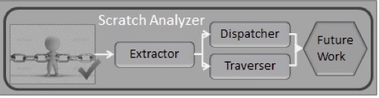
Proposal (1) (Sambhav)
The Scratch Analyzer has three components. Will build on the features of the current Analyzer implementation
Scratch Extractor
Scratch Dispatcher
Scratch Traverser

Slide 10
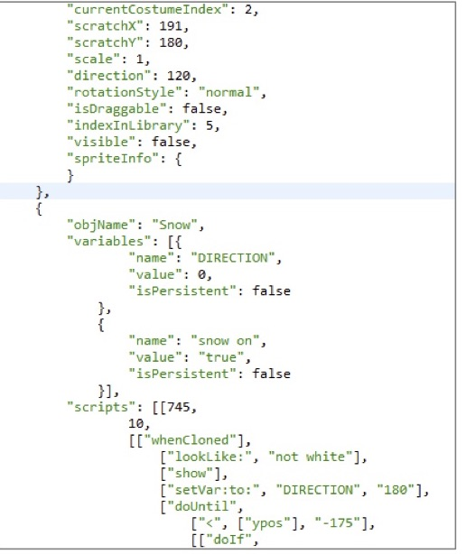
Scratch Extractor
Reads a rapid inflow of .sb2 files
Isolates required JSON snippet from other objects like sounds, audio etc.
Parses Block in order to construct memory tree representation for each project
Writes structure into human-readable format
Outputs in .se files

Slide 11
Scratch Dispatcher
Converts .se files into set of 3 CSV files as input sources for a variety of big data platforms
Flexible Output
String – Visualization programs
Numeric – Recommendation engines
Three straightforward steps
Per-user list of in-memory tree representations
Aggregates block counts for each user included in the input set
Serializes User ID, Block and count

Slide 12
Scratch Traverser
Maintains full block structure of .se files
Very powerful and versatile for anyone capable of programming in Java
Offers opportunity for analysts to find their own data points and compose their own means to find answers

Slide 13
Proposal (2) (Sambhav)
Collect mouse activity of student
Length of time since the student’s last action – devise a method to see if the action was a ‘real action’
Average number of times each block is moved
Average and SD of number of times the parameters of a block are changed
Keep a count of the number of times a block in space is moved back to the palette
Number of times a student uses a block not on the list of blocks that are required for the project
Notes:
Real action is something that is non trivial – a simple change in the text parameter of a block (could be a misspelling) would not count
The teacher/instructor will need to have an updated list of the blocks that he/she anticipates that the student would require for a particular project.

Slide 14
Proposal (Allison)
Detecting users’ emotional states through behavioral data
Black movements, latency, etc.
Real-time teacher notification
Modeling student progress and generating hints
K-means clustering to generate student model
Data from Scratch Extractor output
Sequential pattern mining algorithm to generate hints for which step to take next

Slide 15
Timeline
Milestone | Estimated completion date
Tune and apply k-means clustering algorithm to Scratch Extractor data | February 24, 2017
Develop experimental algorithms to detect frustration/guessing, and distractedness | March 10, 2017
Midterm report and presentation | March 31, 2017
Run sequential pattern mining algorithms on clusters | April 7, 2017
Automatically generate hints based on sequential pattern rules | April 28, 2017
Final report and presentation | May 5, 2017

Slide 16
Future work (Allison)
Multi-puzzle models (individual and group)
Hinting improvements
Changing hint frequency with student competence
More granular feedback
Empirical studies with students

Slide 17
QUESTIONS?

