Slide 1
CT Learning Platform
Plaban Mohanty Sajal Khandelwal
COMS 6901 Section 14

Slide 2
Motivation

Slide 3
Motivation
Build a one-stop platform for SAGE¹ All components - Dashboard, Scratch Editor, Visual Assessment Language etc. under one platform may lead to better engagement.
Opening the SAGE platform to the community.² Students should be able to learn from other recommended courses.
Add progression model through learning paths³
^{1.} Bender, J. (2015). Developing a Collaborative Game-Based Learning System to Infuse Computational Thinking within Grade 6-8 Curricula.
^{2.} Dillenbourg, Pierre.(1999) Collaborative Learning: Cognitive and Computational Approaches. Advances in Learning and Instruction Series.
^{3.} Seiter ,Linda Seiter and Foreman ,Brendan . Modeling the Learning Progressions of Computational Thinking of Primary Grade Students

Slide 4
Related Work
GradeCraft¹ A gamified learning management system both for instructors and students.
Coursera An online platform offering Massive Online Open Courses (MOOCs).
Existing SAGE Dashboard
¹Holman, C., Fishman, B., Aguilar, S. 2013

Slide 5
Proposal

Slide 6
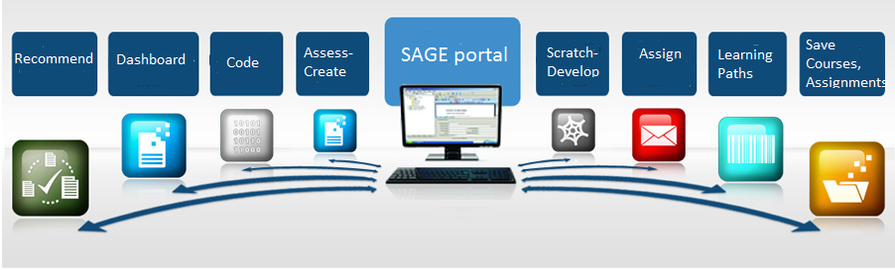

Online Integrated Platform
Common web-based platform to access all components of SAGE
Provides a web based affinity space for scratch player, analyser, user dashboards, recommendations and any future integrations
Ease of global access assists in building a community for games for computation thinking

Slide 7
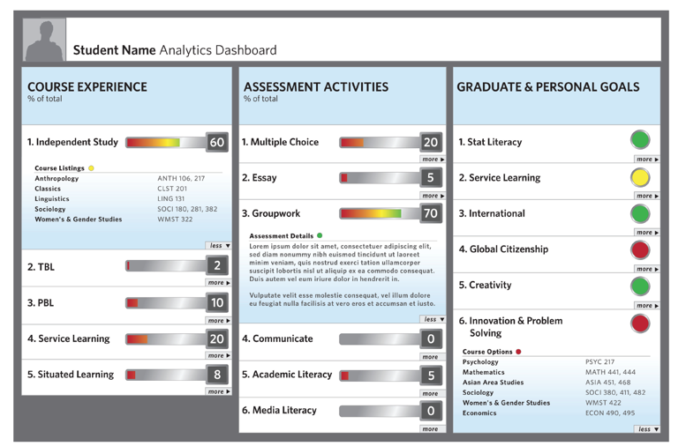
Student Dashboard
Displays current statistics of the student based on learning paths, courses and assignments
Rewards or gamified point based system to provide a sense of achievement and purpose
Course Pages - List of all courses enrolled in + portal to work on and play the assignments
Real time tracking of goals and CT concepts
Recommendations

Slide 8
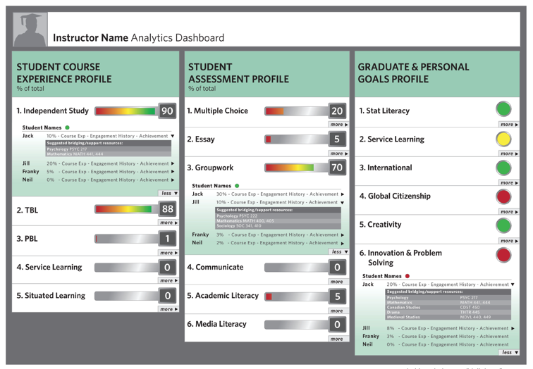
Teacher Dashboard
Displays current statistics of the students for all created courses and assignments with separate classification for own students and global students
Ability to track CT concepts and metrics of students
Course Creation- Create new courses by cloning an existing course and modifying it or by starting from scratch
Learning Paths - A guided way to create learning paths for students using available courses

Slide 9
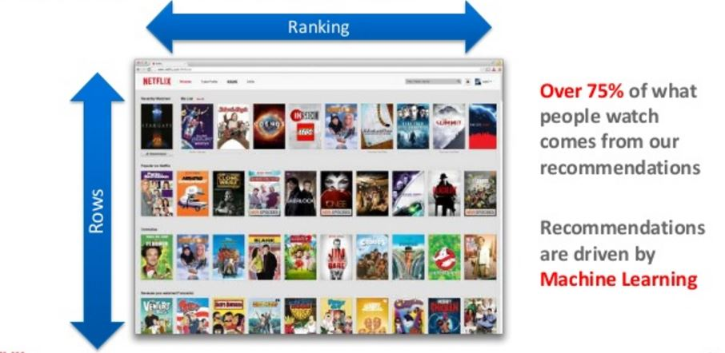
Recommendations
Create meaningful course recommendations for students .
Courses would be tagged with features - age group, subjects, difficulty level
Students would have attributes like user behavior, CT concepts learnt, concepts struggling in, comfort and interest levels
Using these, machine learning algorithms could use collaborative filtering and suggest courses that would be most beneficial

Slide 10
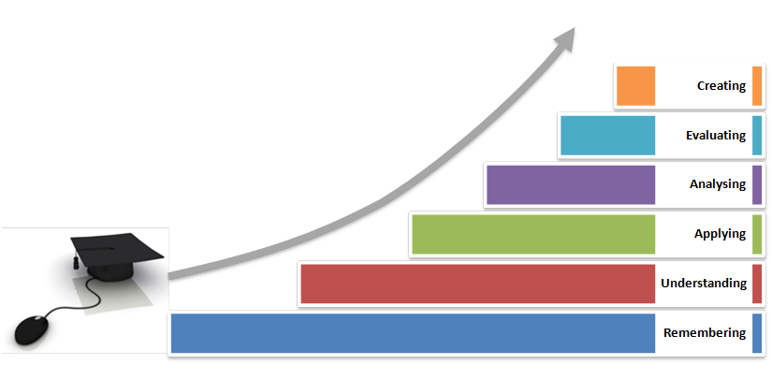
Learning Paths
Building of organized learning paths for better development of computational thinking concepts
Use learning progression models to build series of courses in succession to provide mastery over a subject or a CT concept.
Allow instructors to create customised learning paths for their students and share those across the world

Slide 11
Milestones and Timeline

Slide 12
Tasks | Milestones | Date
Building and integrating the dashboards | Building connectivity among the dashboards Embedding the assessment creators and players within the dashboards Establishing real time statistics gathering and visualisation | 28th February 13th March 25th March
Recommendations | Researching the features that would provide the best recommendations Implementing the algorithms and displaying the recommendations | 7th April 18th April
Learning Paths | Researching ways to produce guided learning paths Implementing creation and availability of learning paths in the platform | 21st April 28th April
Mid Term Project Progress Report |  | 25th March
Final Written Report and Presentation |  | 4th May

Slide 13
Future Work
Machine Learning algorithms could measure the learning trends of students and what affects the process of gameful thinking
Implement educational games following CT concepts in flash and other platforms apart from Scratch in this platform
Implement algorithms to extract useful features and data from the usage of the platform to be used in research for educational thinking

