Slide 1
Intelligent Tutoring System:
Outer Loop
By Harsimran Bath and Weiman Sun
Notes:
In this project, we have added intelligent capabilities to the outer loop of SAGE to automatically recommend games to students based on games other students have played. Furthermore, the recommender can also recommend games to the instructor that the students can play to progress in the cirriculum.

Slide 2
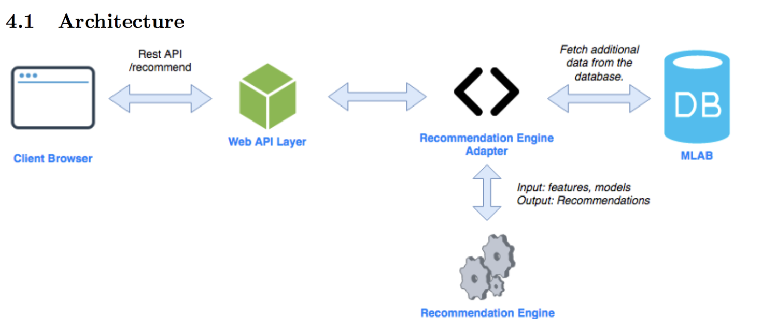
Architecture
Notes:
Recommendation Engine Adapter: layer of interaction between engine and rest of the system. Helps the overall system to response to the changes without requiring changes to the recommendation. If data models change, the adapter can update its requests without requiring any changes to the engine.

Slide 3
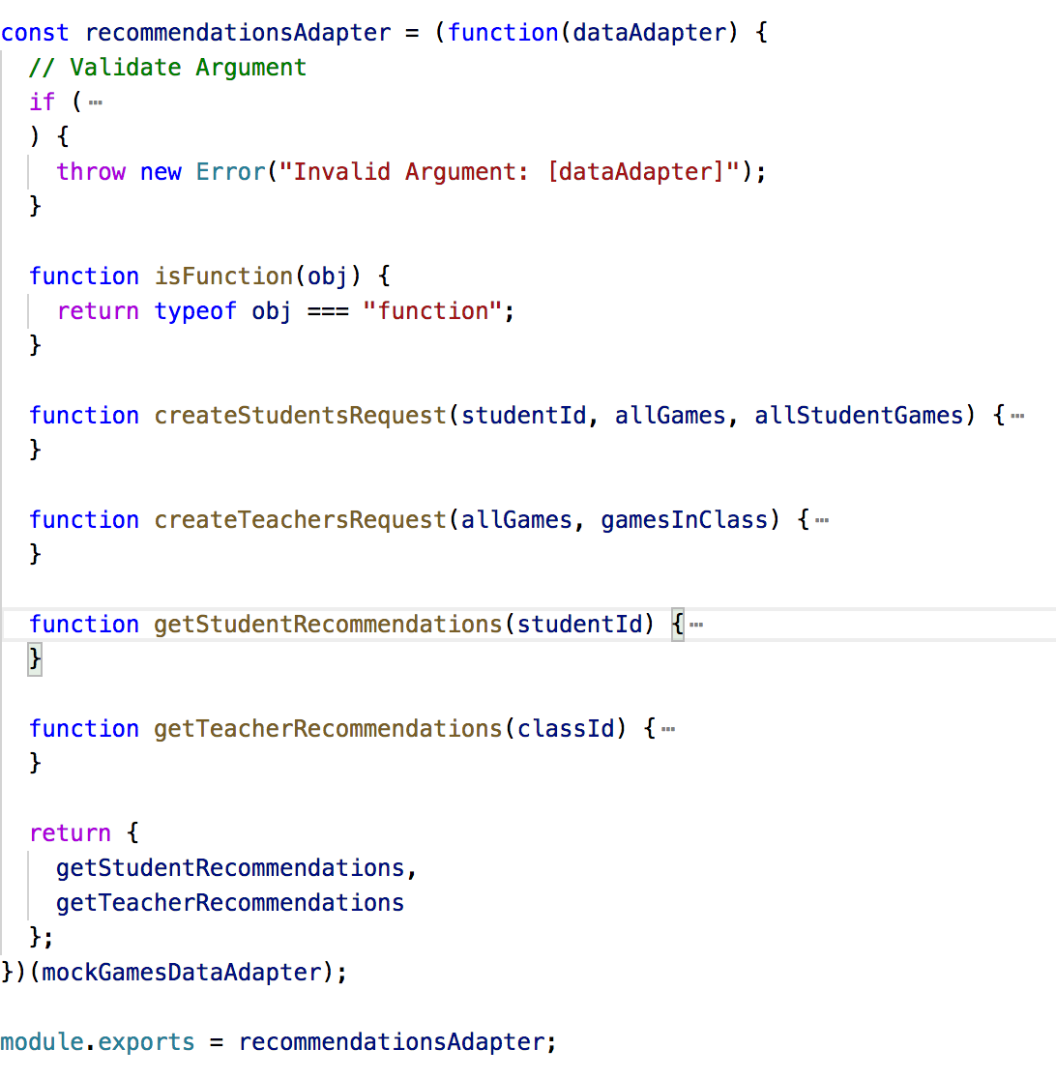
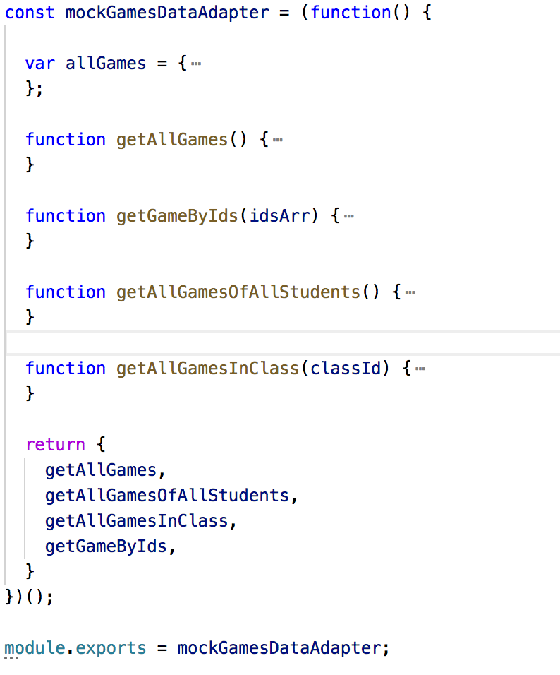
Adapter
Recommendations Adapter
Data Adapter

Slide 4


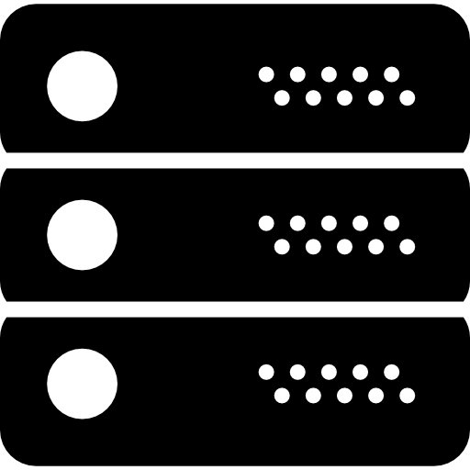






Student Recommendation
student
(id:1)
similar
students
game
candidates
similarity
score
(next games)
mastery of
ctConcepts
choose
mode
ranking
output
struggling
algorithm
(improve games)
Notes:
The system can recommend students additional unassigned games to complete. Suppose we want to recommend games for student 1, we first find the similar students of student 1. We then select the games that student 1 has not yet played from all the games of similar student to generate game candidates. At the same time, we compute the student 1’s mastery of each ctconcept. We then combine these two to compute the similarity score of each game in game candidates, this is called the next games. At this stage, we also apply the struggling algorithm to find the improve games. Then student 1 can chooses the mode to combine next games and improve games,. Finally, we ranks the result and output.

Slide 5
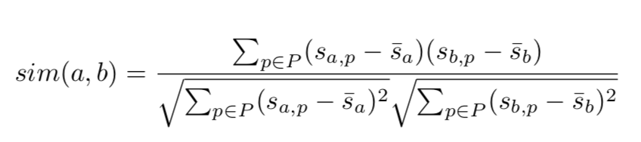
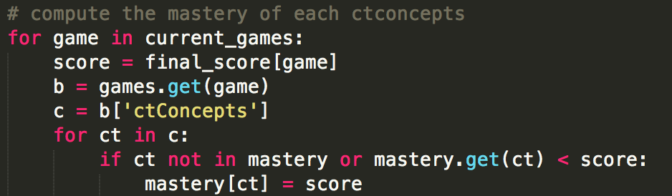
Student Recommendation
Find similar students
Collaborative filtering
Compute the mastery level of ctConcepts
Notes:
We employ the similarity formula in Collaborative filtering method to find the similar students. We define the mastery level of a ctConcept as the highest score this ctConcept ever got in the student’s history games.

Slide 6
Student Recommendation
Compute the similarity score of each game in game candidates
Table 1
ctConcepts | loop | condition | sequence | algorithms
mastery level | 1 | 2 | 3 | 1
Table 2
Table 3
mastery level | similarity score
<=1 | 0.33
<=2 | 0.66
other | 1
game candidates | ctConcepts | similarity score
game 1 | loop, condition | (0.33+0.66)/2
game 2 | loop, condition, sequence | (0.33+0.66+1)/3
game 3 | condition, sequence, algorithms | (0.66+1+0.33)/3
Notes:
The most important part of our recommendation engine is to compute the similarity score of each game in game candidates. So I will briefly go through the method from an example. Suppose we already computed the mastery level of each ctConcepts as shown in Table 1. Table 3 shows the mapping relationship between mastery level and similarity score. We can see from table 2, to compute the similarity score of a game candidate, we will average the score of all the ctConcepts involved in this game.

Slide 7
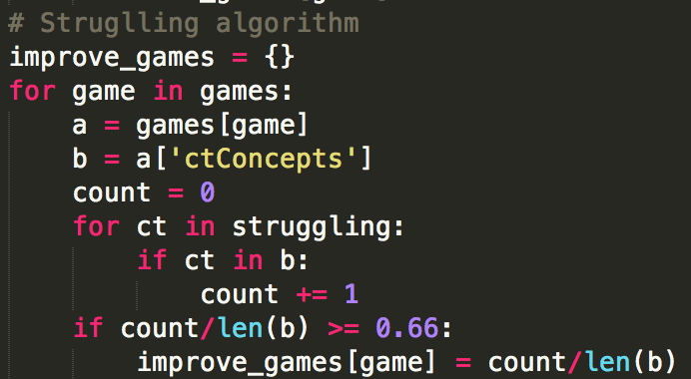
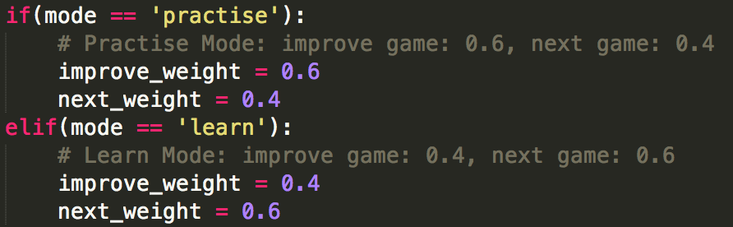
Student Recommendation
Struggling algorithm
choose mode
Notes:
Sometimes, the student may struggle in some games. So in this case, we proposed the struggling algorithm. This algorithm recommends games that contain similar ctConcepts with the sturggling one to student for practicing.
We also allow students to switch modes between practice mode and learn mode. In the practice mode, we will recommend more improve games and less next games to student to strengthen their weakness; in the learn mode, we will recommend more next games and less improve games to student to let them learn more new things.

Slide 8

Teacher Recommendation
similarity
score
(next games)
student
representative
performance
of classroom
mastery of
ctConcepts
choose
mode
ranking
output
struggling
algorithm
(improve games)
Notes:
The system can help the teacher to identify games to add to the quests. The basic idea of teacher recommendation engine is a bit similar with the student one, so we reuse some code of it. First, we need to find a student representative. Then we compute the performance of each game in the classroom, and compute the classroom mastery of each ctconcept at the mean time. Just like the student recommendation, we then compute the similarity score of each game candidate, and find the improve games using struggling algorithm. We also allow the teacher to switch mode between practice mode and learn mode. Finally, we rank the results and output it.

Slide 9
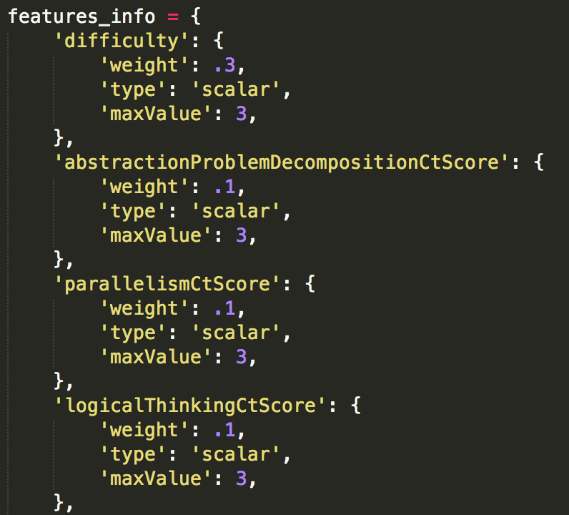
Teacher Recommendation
find student representative
compute performance of classroom
Notes:
The student representative can be seen as a student that has average learning ability among all students in the classroom. Compute performance of classroom is to compute performance of each game in the classroom. There are some features to evaluate the performance of games. So we will weight all the features together and generate a final performance score for each game. These features are kind of dynamic, which means the system manager can add or delete features, and change the weight of features.

Slide 10
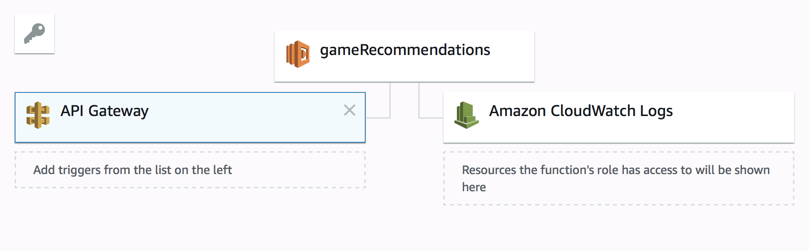
AWS Lambda Function
https://s94lk76f3b.execute-api.us-east-1.amazonaws.com/Dev/gameRecommendations

Slide 11
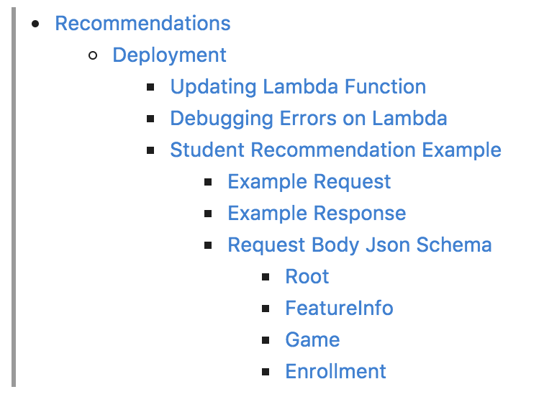
Lambda Documentation

Slide 12
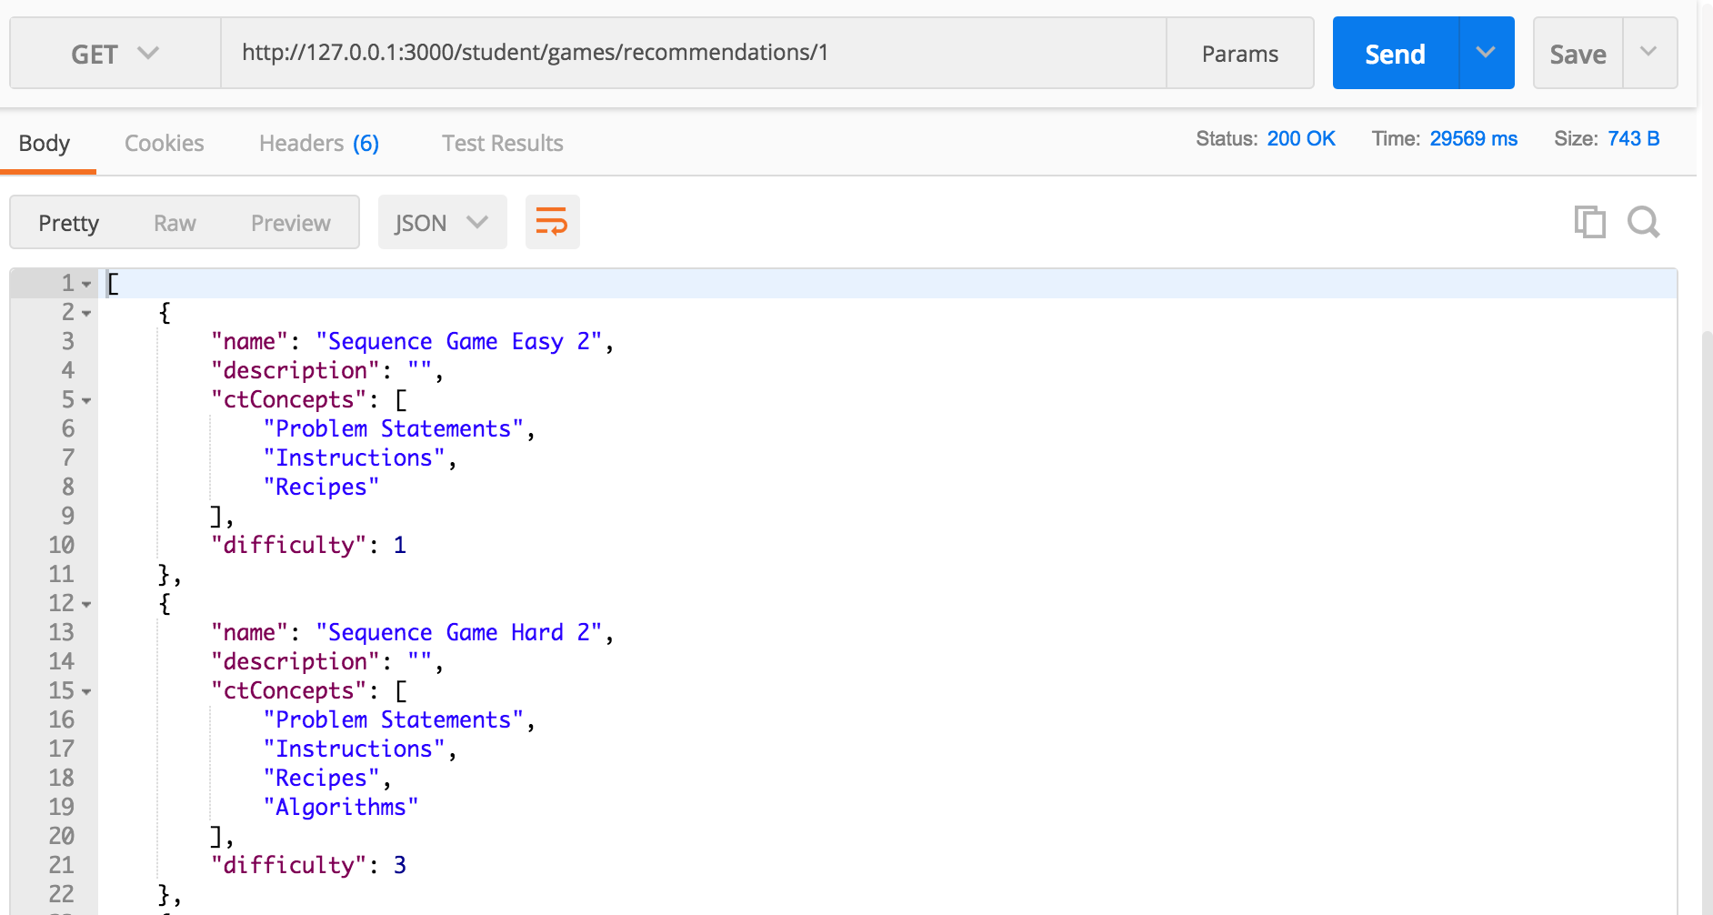
Sage API Endpoints
/students/games/recommendations/:sid
/instructors/:id/classes/games/recommend/:cid

Slide 13
Future Work
Affinity space
Real data models
Test harness and evaluation

