Slide 1
Parson’s Puzzle
Scoring System
By Haoxuan Huang, Zijie Shen

Slide 2
Primary Achievements
Mitigate Scoring System
Feedback for Separate Chunks
Meaningful Moves
Score Persistence

Slide 3
Mitigate Scoring System
Old Design
Only Manhattan distance

Slide 4
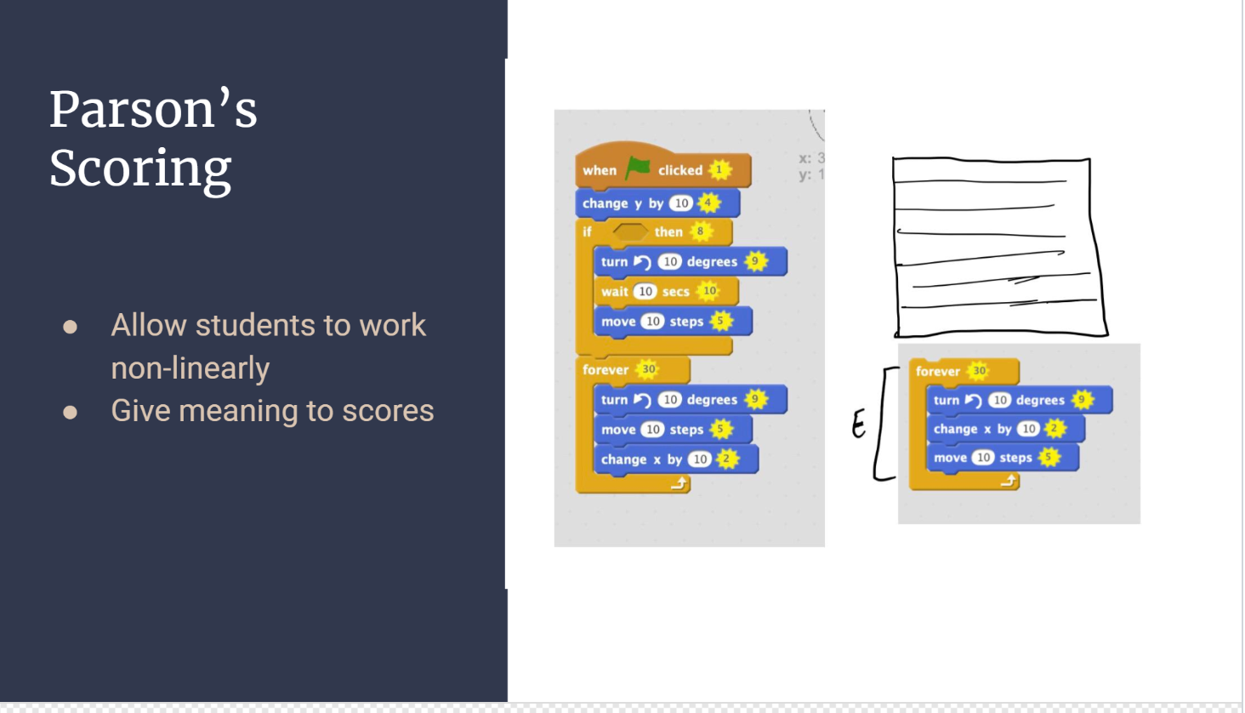

Slide 5
Mitigate Scoring System
Old Design
Only Manhattan distance
Our New Design
Longest common subsequences + Manhattan distance
Consecutive Matching Subsequences
And much simpler! Less code!

Slide 6
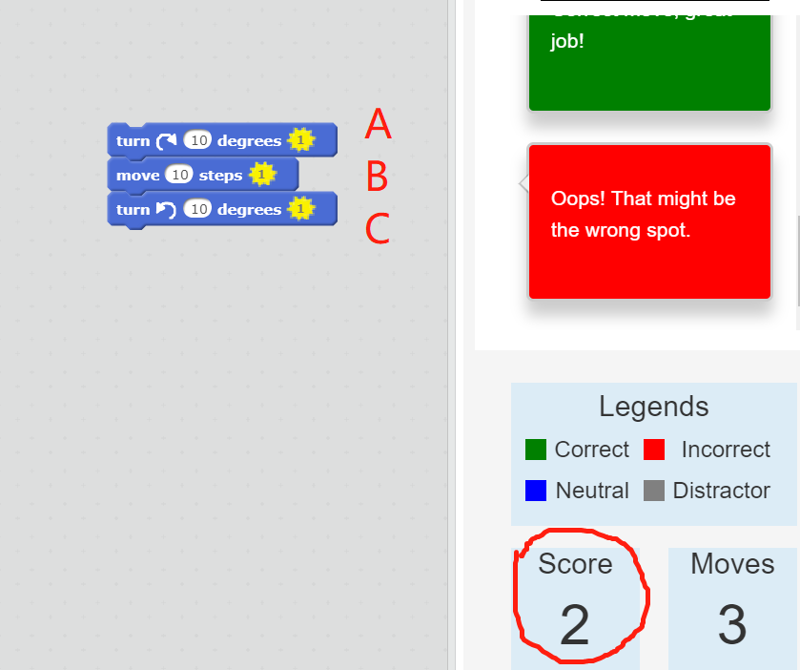
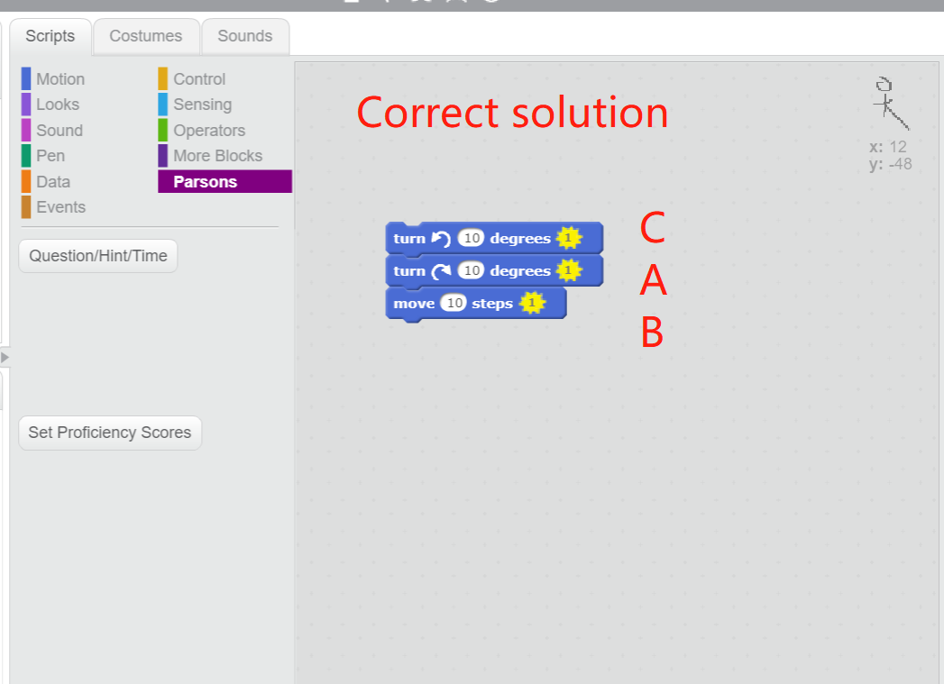
Correct solution
Student’s answer (wrong)
1
Score calculation:
“AB”: 1*2+1*2 -1 = 3
“C”: 1*1 -2 = -1
Total: 3 + (-1) = 2

Slide 7
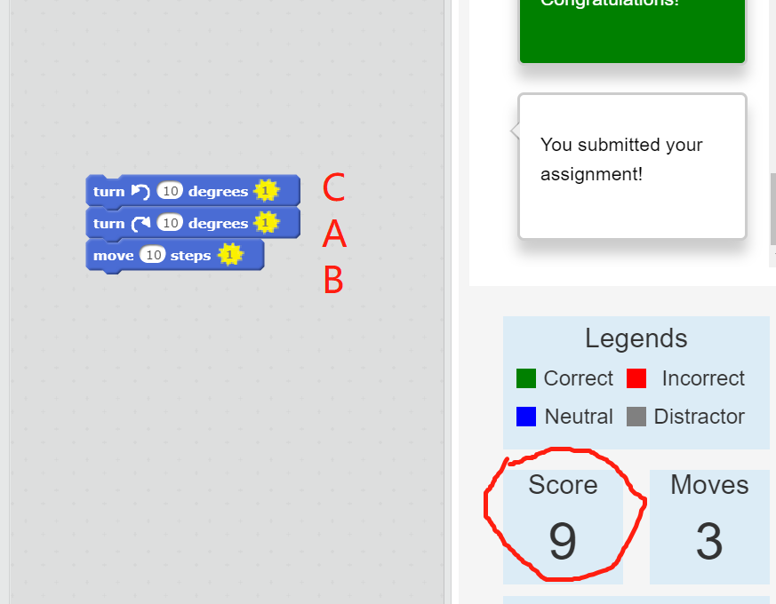
Correct solution
Student’s answer (correct)
Score calculation:
“CAB” = 1*3+1*3+1*3 = 9
Total = 9

Slide 8
Mitigate Scoring System
Old Design
Only Manhattan distance
Our New Design
Longest common subsequences + Manhattan distance
And much simpler! Less code!
Feedback for Separate Chunks

Slide 9
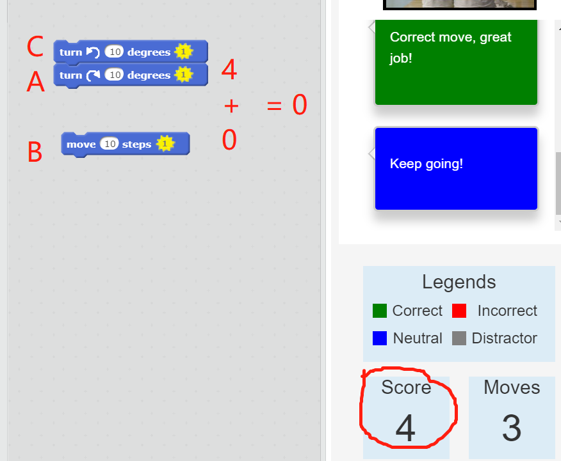
Feedback For Separate Chunks
Score calculation:
“CA”: 1*2+1*2 = 4
“B”: 1*1 - 2 = -1 => 0
Total: 4 + 0 = 0

Slide 10
Meaningful Moves
Drag a block from the palette to the panel
Connect existing sequences together
Disconnect a sequence into separate sequences
Prevent trial-and-error behavior
Indicate Distractions
Efficient Learning

Slide 11
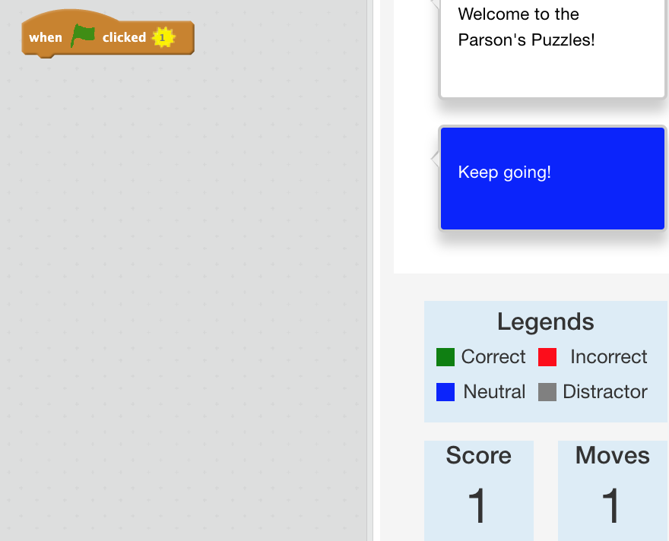
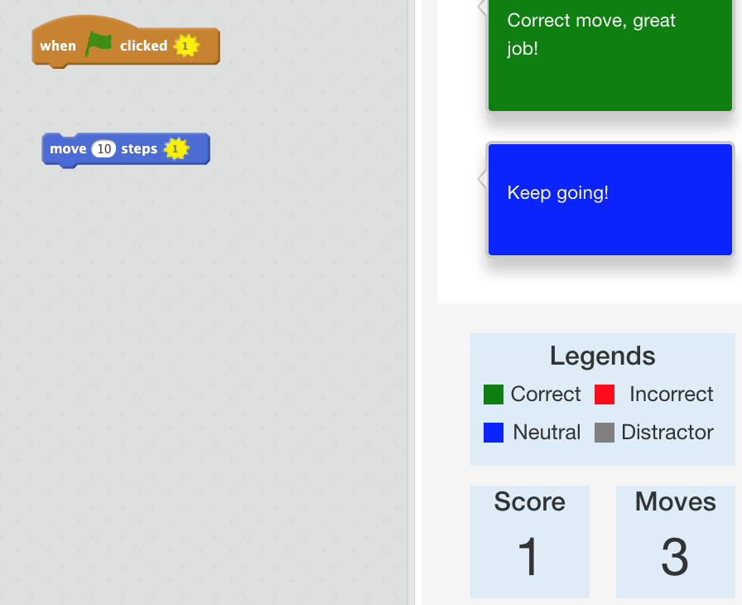
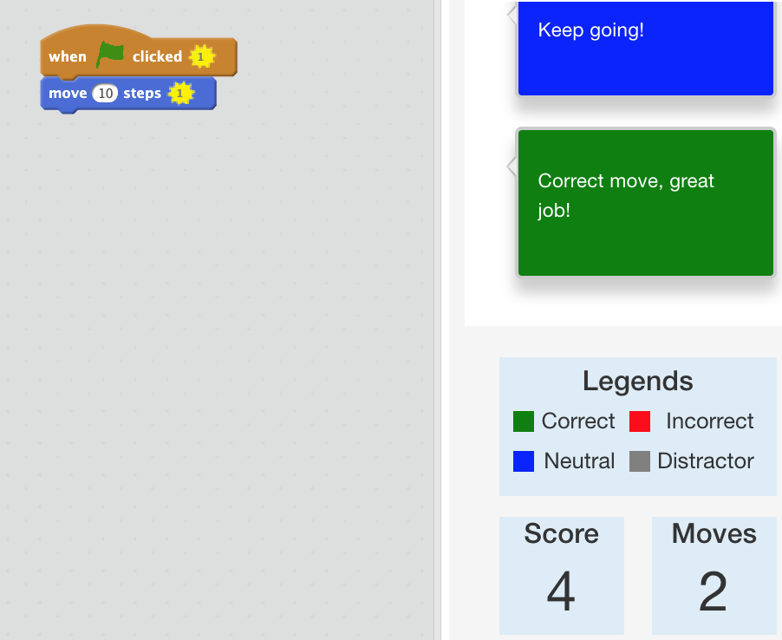

Slide 12
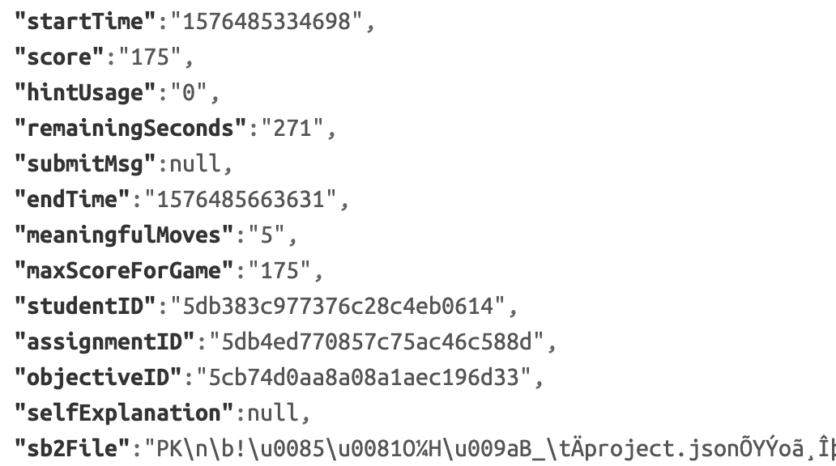
Score Persistence
Collection: studentsubmissions
Add meaningfulMoves, maxScoreForGame

Slide 13
Future Work

Slide 14
Scoring of Duplicate Blocks
Local Correctness of Separate Chunks
More Scenarios for Meaningful Moves

