Slide 1
Instructions
By Jen-An Lien and Yuval Schaal

Slide 2
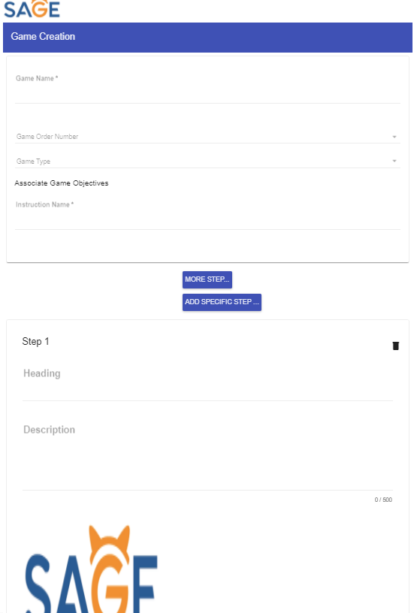
Create Instruction
Located in game creation
Can add multiple steps to an instruction
Each step allows a heading, description, and image

Slide 3
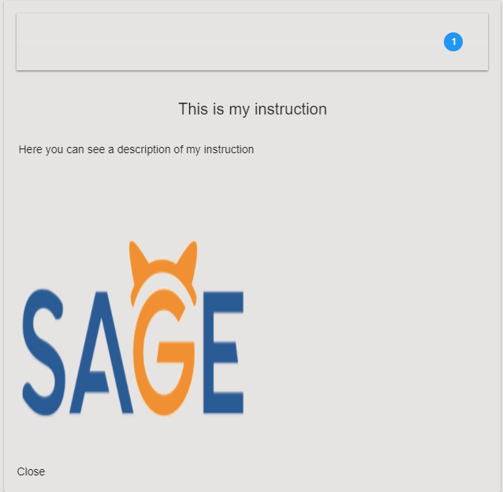
Preview Instruction
Notes:
j

Slide 4
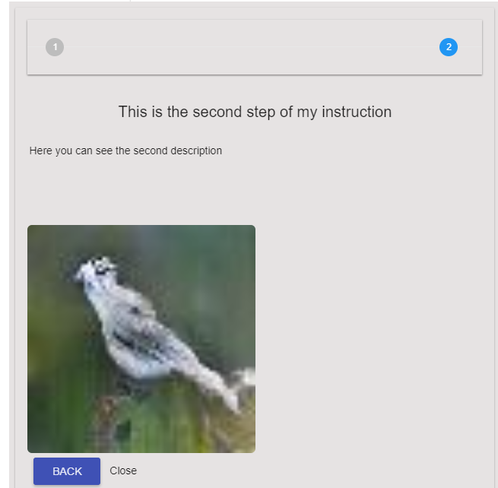
Adding Instruction Steps
Notes:
j

Slide 5
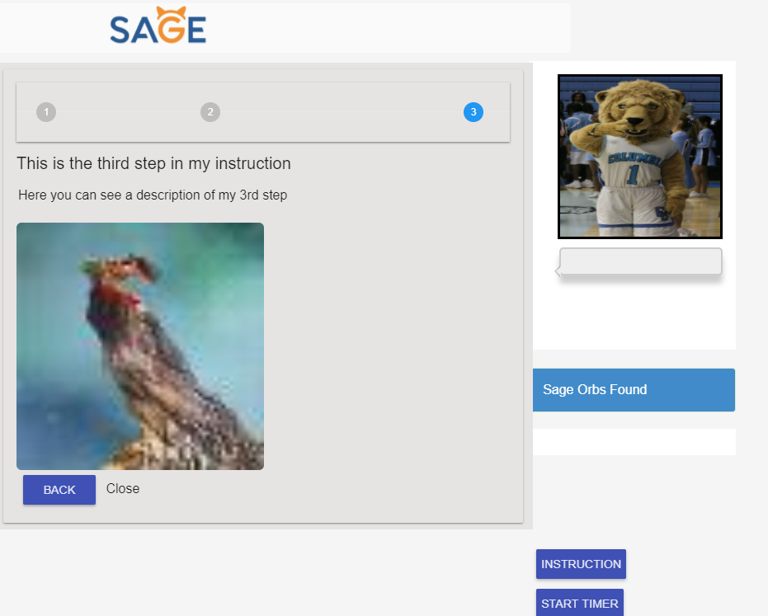
Student Side - Viewing Instruction
Notes:
j

Slide 6
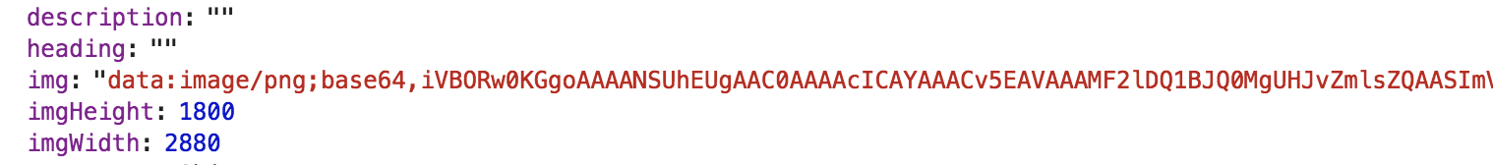
Adding Image to MongoDB
First time adding images to MongoDB in SAGE.
Converting to binary base64.
Sending to MongoDB as string.
Then for viewing we decode the base64 string to an image.
Notes:
j

Slide 7
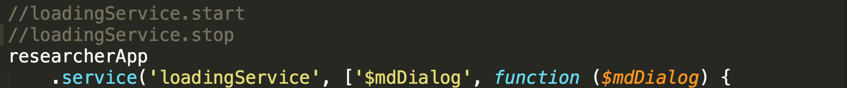
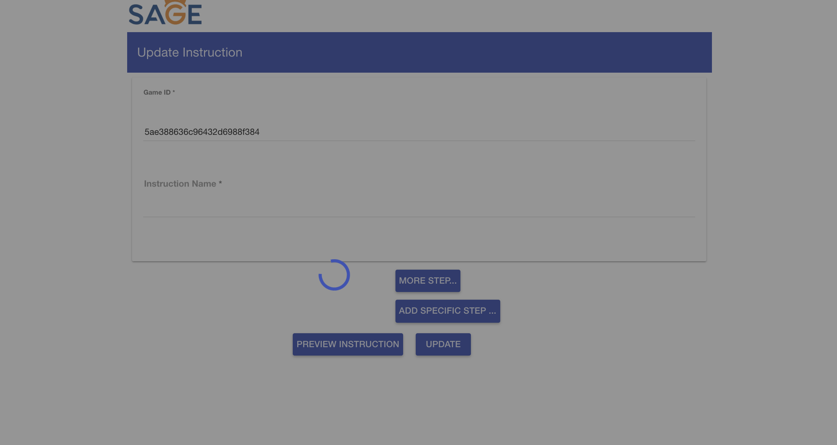
Loading Service
Notes:
j

Slide 8
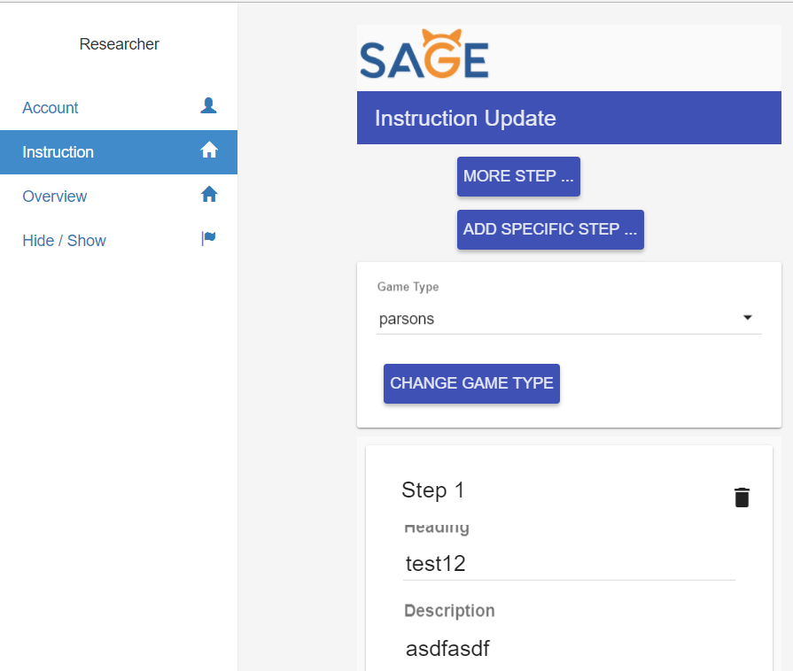
Researcher Side - Adding Instructor Side Instruction
Utilizing researcher space
For allowing instructors to be guided during the assignment creation process
Selection of either showing up on parson or cvg type games

Slide 9
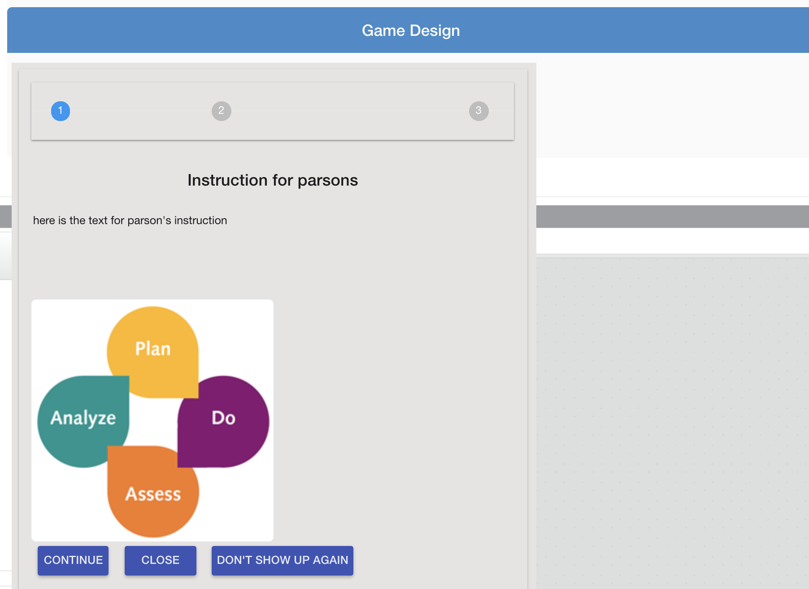
Instructor side - Viewing a Parson Instruction

Slide 10
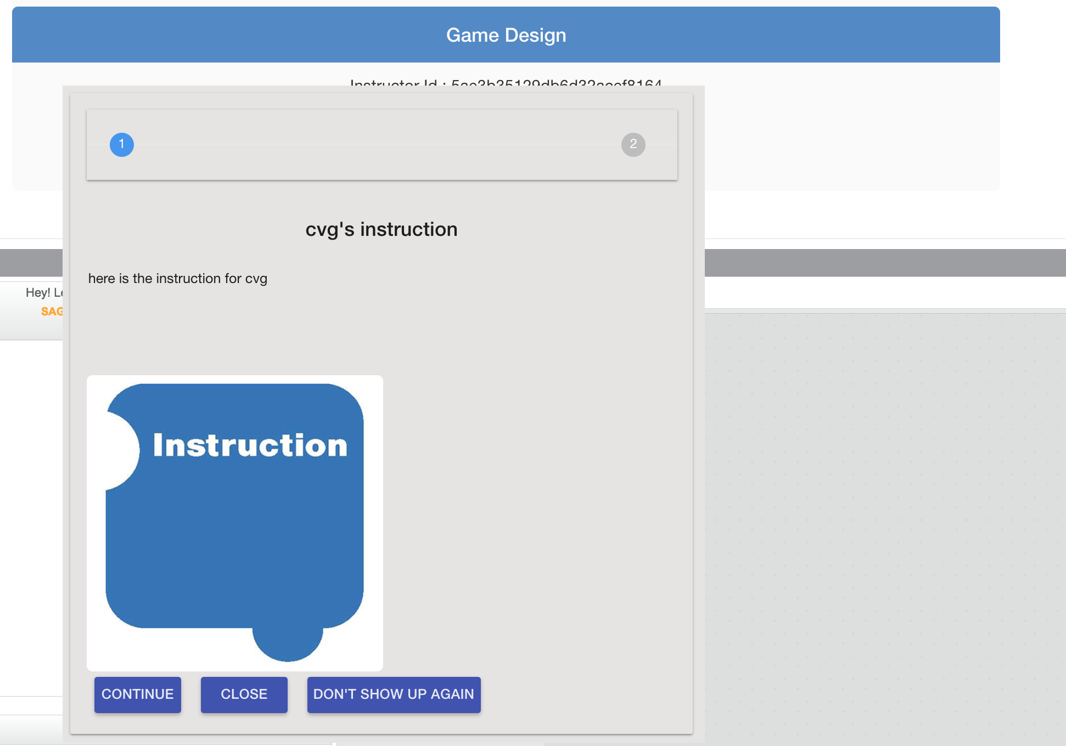
Instructor side - Viewing a CVG Instruction

Slide 11
Conclusions
Students can now be guided through games by instructors.
Instructors can now be guided in the assignment creation process by specified game type instructions.
We now store images (binary strings) in MongoDB.
Loading service can be used by other researchers in SAGE.

Slide 12
Demo

Slide 13
Thank You!
Questions?

