Slide 1
Intelligent Hinting and Affect Detection
Chengwei Bian and Mengqiao Zhang
Dec 15th, 2017

Slide 2
Outline
Motivation:
Improve hinting effectiveness
Focuses:
1. Behaviour detection
Generate mock data
Build ML models
2. Adjust hinting frequency

Slide 3
Sprint 1
Behavior detection
Behaviors
Stopper: stop when they cannot solve the problem
Mover: consistently try one thing after another without ever really seeming to be stuck
Extreme mover: tend to try new fixes with hardly any reflection or apparent convergence to a solution
Tinkerer: first write some code, then end up making many successive small edits to fix the program
Introduction to behavior types

Slide 4
Behaviors
Stopper: stop when they cannot solve the problem
Mover: consistently try one thing after another without ever really seeming to be stuck
Extreme mover: tend to try new fixes with hardly any reflection or apparent convergence to a solution
Tinkerer: first write some code, then end up making many successive small edits to fix the program
Perkins, et al. (1986)
Conditions of Learning in Novice Programmers

Slide 5
Sprint 1
Generate mock data
Start from complete .se files
Generate sequences of timestamped .se files for each kind of behavior
Make assumptions about probability of action interval and action type for each behavior

Slide 6
Demo

Slide 7
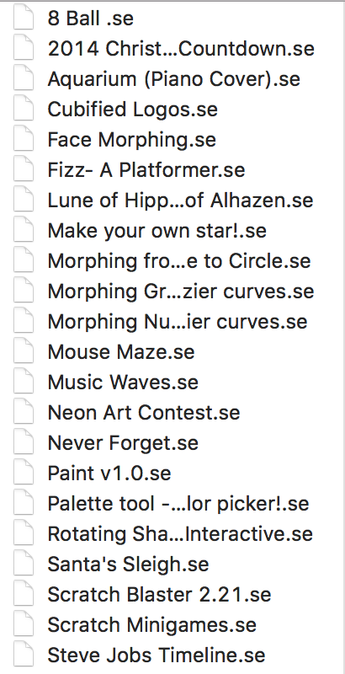
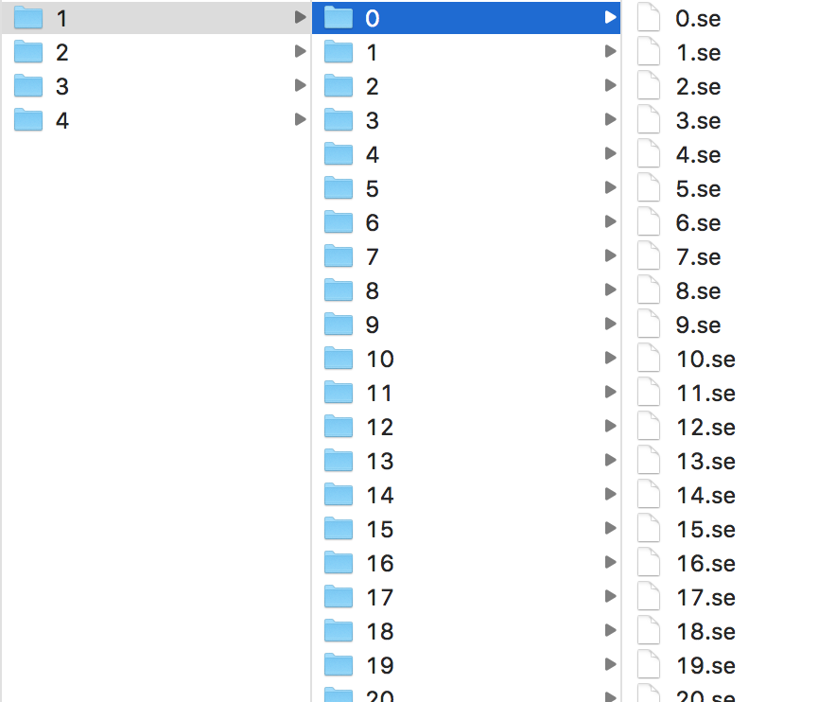
Complete .se files
Mock data
4 different behavior types
Different projects per type
A series of .se files per project

Slide 8
Feature Extraction
Create a java class Readfile to transfer these .se files into tree objects
Calculate and output the features from the tree objects to StatisticalAnalysis.csv
Read and analyze mock files

Slide 9
Feature Extraction
1. Time interval between two actions
2. Interval between two block removal actions
3. Number of actions taken in every 10s
4. Changes of each block in one project
Captured more features for behavior detection

Slide 10
Demo

Slide 11
Build models
Split mock data for training and testing
Reduce data dimensions via LDA
Trained data using Decision Tree, KNN, Logistic Regression, SVM models
Obtained model accuracy by cross validation
Trained ML models to classify behaviors

Slide 12
Demo

Slide 13
Results
Build models
Decision Tree: 83%
KNN: 82%
Logistic Regression: 82%
SVM: 81%
Split mock data for training and testing
Reduce data dimensions via LDA
Trained data using Decision Tree, KNN, Logistic Regression, SVM models
Obtained model accuracy by cross-validation

Slide 14
Results
Build models
Decision Tree: 83%
KNN: 82%
Logistic Regression: 82%
SVM: 81%
Split mock data for training and testing
Reduce data dimensions via LDA
Trained data using Decision Tree, KNN, Logistic Regression, SVM models
Obtained model accuracy by cross-validation

Slide 15
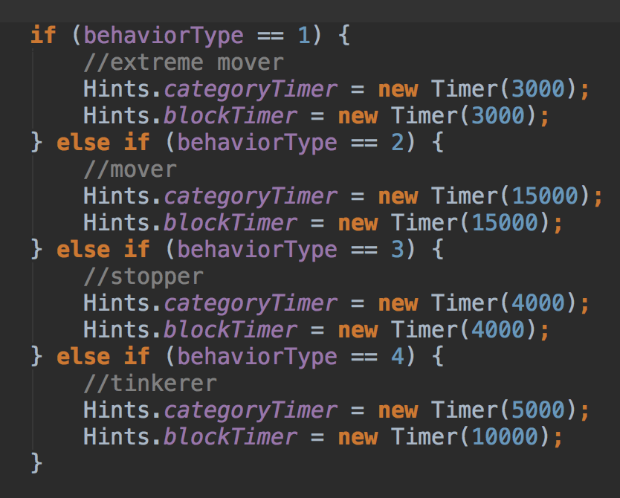
Adjust hinting frequency for different behaviors

Slide 16
Demo

Slide 17
In the future
Create on demand hinting function for users
Enable different hinting types to improve effectiveness
general text hints
category-level block hint
the specific hint

Slide 18
Thank you!

