Slide 1
COMS E 6910 Project Proposal:
Gameful Direct Instruction (Parson’s Puzzle)
Sudhanshu Mohan
October 1, 2017

Slide 2
Agenda
Introduction
Related Work
Proposals
Timeline
Future Work

Slide 3
Introduction
The motivations behind this project are to enhance Computational thinking and Parson’s Programming puzzles with visual progress for assessment in SAGE (Bender, 2015) and improve students’ understanding of computational thinking (Barr & Stephenson, 2011) concepts.
Computational Thinking - is a way of solving problems, designing systems, and understanding human behaviour that draws on concepts fundamental to computer science
Parson’s Programming

Slide 4
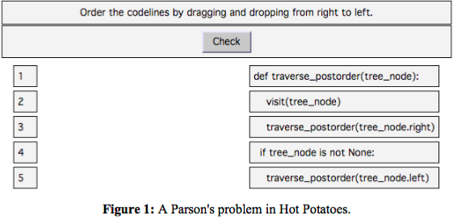
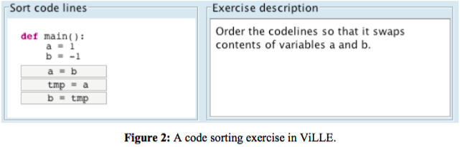
Related Work
Hot Potatoes
The original Parson’s problems (Parsons & Haden, 2006) were created using a generic drag-and- drop exercise framework called Hot Potatoes.
ViLLE (Rajala, Laakso, Kaila, & Salakoski, 2007)
Java application/applet which allow context to be created around the editable code. Distractors are not supported.

Slide 5
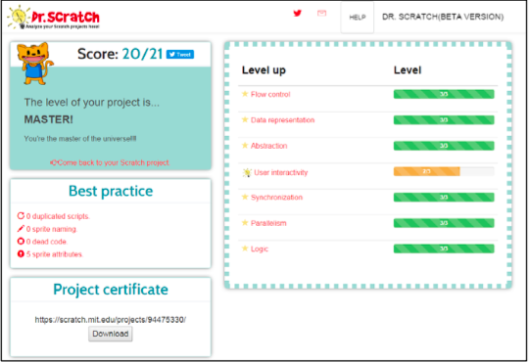
Related Work
CORT (Garner, 2007)
Used with Visual Basic programs so that students move lines from left to a part-complete solution on the right. Moving the lines is done by selecting a line and clicking arrow buttons to move it left or right. To get feedback, student can copy the code into Visual Basic interpreter and execute the code. CORT supports both distractors and context.
Dr. Scratch (Moreno-Leon, Robles, & Roman-Gonzalez, 2015)
A web application where Scratch project files can be uploaded for automated analysis. It serves as an analytical tool that evaluates Scratch projects in a variety of computational areas.

Slide 6
Proposals
Integrated Parson’s Puzzles
The teacher will be facilitated to create Parson’s puzzle and Constructionist video games
In Design mode, the puzzle should appear in the script pane for the teacher to make modifications
In Play mode, the puzzle should not appear in the script pane
The stage content and Constructionist video game will appear in any mode.
Student, Assessment & Video IDs via Query String
Presently, a modal section asks the ‘Student ID’ and ‘Assignment ID’
Scratch should identify the user as well as any assessment and video associated with the user
It could be implemented by passing the student, assessment and video ID information via Query String
Once implemented, the modal window asking the ID will be eliminated

Slide 7
Proposals
Parson’s Assessment Scores
SAGE should be able to calculate the maximum score for the puzzle
Prompt the teacher to enter two lower scores which will act as cut-offs
Cut-offs scores will be used by the teacher to differentiate performances between students by comparing their scores to the maximum scores
Help the system assign appropriately difficult in-Quest Constructionist Games
Parson’s Heads-Up Display
Display the student’s score in relation to the two cut-offs score and the maximum score
Help student to gauge his progress during the play

Slide 8
Proposals
Parson’s Self-Explanation
Students should explain their approach to solve a particular puzzle prior to the submission of the assignment
This will give an opportunity to students to reinforce learning by self-explanation
Comment box, in the present implementation, could be repurposed to implement the self-explanation feature.
Parson’s Submissions
Upon submission of the assignment, submission messages are displayed
Ability to the instructor to author these messages
Improve student experience so that they are motivated to play more

Slide 9
Timeline
S.No | Milestone | Completion Date
1 | Project Proposal | October 1, 2017
2 | SAGE Scratch Setup | October 12, 2017
3 | Integrated Parson's Puzzles | October 26, 2017
4 | Student, Assessment, & Video IDs via Query String | November 9, 2017
5 | Parson's Assessment Scores | November 9, 2017
6 | Parson's HUD | November 23, 2017
7 | Parson's Self-Explanations | November 23, 2017
8 | Parson's Submissions | December 7, 2017
9 | Final Presentation | December 15, 2017 (Tentative)

Slide 10
Future Work
Parson's Scoring
Present scoring scheme need to be revisited
Penalty of the incorrect move should depend on the block point value
Support multiple solutions to the puzzle
More points to the elegant solution
Differentiate use of distractors from the use of solution blocks placed in incorrect positions.
Parson's Score Persistence
Persist score for evaluation
Associate scores with the student and puzzle
Record puzzle start and end times
Persist usage of hints

Slide 11
Future Work
Parson's Coaching System
Design Coaching system using the information collected during gameplay
Custom messages to be presented during the puzzle
Preset configurations of coaching messages
Instructor can modify messages loaded via a preset configuration
Message to watch the video should pop up if student is struggling with the puzzle

Slide 12
Thank You!

