Slide 1
Assessment 4 – HTML CSS Design and Java Script
ITC293 Introduction to the Web
Rory Rock
Student ID – 11828802
Submission Date 7/6/2026

Slide 2
Preliminary design
Improve my work portfolio from A3 (assessment 3) for target audience of a potential employer.
Ensure that pages are responsive to smaller screen sizes such as mobile devices.
Add descriptive alt attributes to my images and merge print styles into my main css file using @ media in response to A3 feedback.
Clean up my Navbar, making logo smaller and responsive by removing absolute positioning and using grid.
Keep my colour pallet as it suited the site well.
Focus on form to ensure it meets all requirements and ensure validation goes above basic requirements as major marks awarded in this section, Eg. By making sure user can only enter text characters and not numbers in name fields.
Incorporate Java Script by at least meting basic requirements of form validation and attempt to utilise SCROLL Animations with Intersection Observer if I can understand and explain the concept.
I will host the site publicly on Github Pages as I have tested one other site and it works well and it’s free.

Slide 3

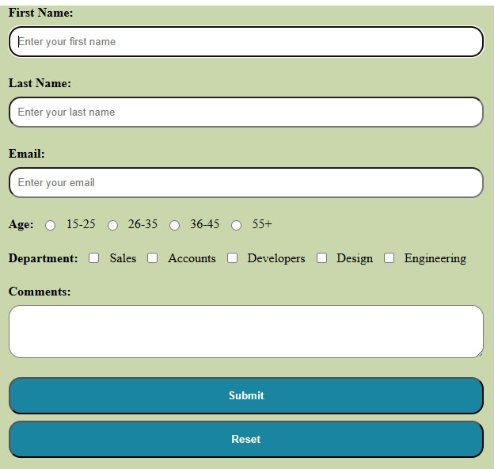
Mockup new Navbar style (see image above) that I have developed on a test site (note – pages, logos etc. not accurate for A4).
Incorporate button to navigate to Newsletter signup form included in nav to ensure it can not be overlooked and is prominent.
Much cleaner design than my A3 nav bar.
Use consistent grid layout as that will give a more uniform feel across pages and enable easier @media query to make pages responsive to mobile screen sizes.
Grid template 2 x 2 nav nav, lhs_column rhs_column, footer footer.
Design and test form in test page to ensure all functionality works then incorporate in A4 and style using css file. Mockup from my test site below.

Slide 4

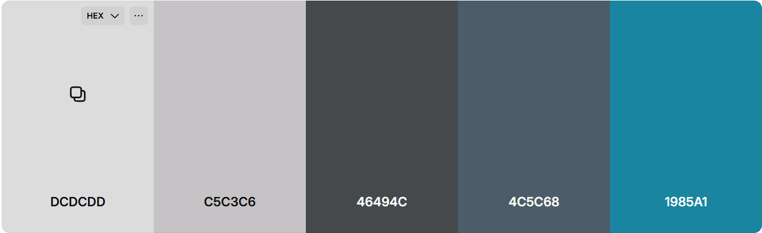
Interface design
Navigation Links/Buttons –
Sign Up button Colour #1985A1, box shadow, on hover change to #4C5C68 and transform scale
Page links to be text only (no background) , on hover give effect and change colour and retain the colour change to emphasise which page the user is on.
Typography –
font-family: Arial, sans-serif (if Arial unsupported by browser), keep consistent across entire html element.
Colour Scheme –
#DCDCDD background with black or near black text for readable contrast.
#1985A1 blue colour to include coloured elements
Logo Placement –
Logo and Favicon on every page
Print-Friendly Design –
Print View = Navbar removed, white background, and larger font.
Delete print.css from A3 and merge into style.css using @media print
HOME

Slide 5
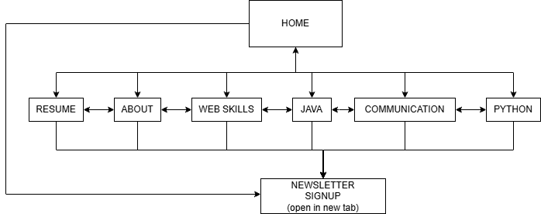
Navigation design
Navigation map (logical) below – ensuring all pages can be accessed from home (index.html) and that all pages can return to home.
Navbar to be uniform on all pages, link to stay coloured to emphasise the current page.
Newsletter sign up button will open newsletter.html page in new tab which will contain the form.

Slide 6
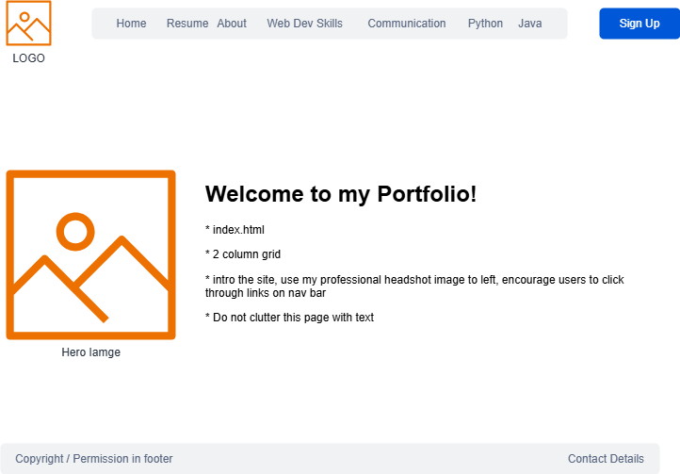
Storyboards - Home

Slide 7
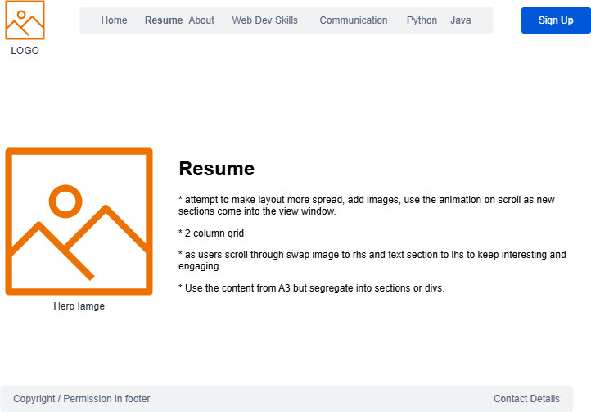
Storyboards - Resume

Slide 8
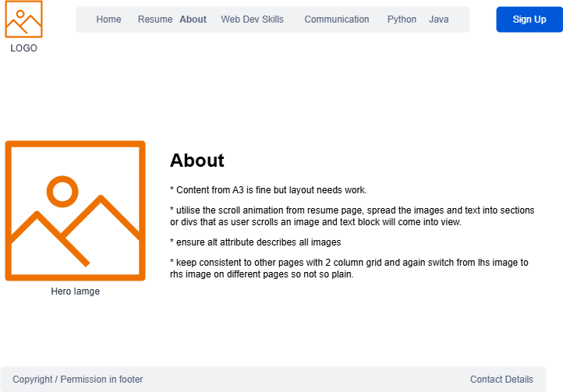
Storyboards - About

Slide 9

Storyboards – Various Skills Pages

Slide 10
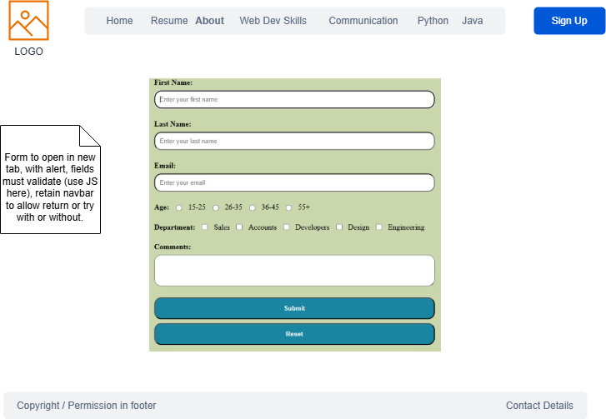
Storyboards – Signup Form

Slide 11
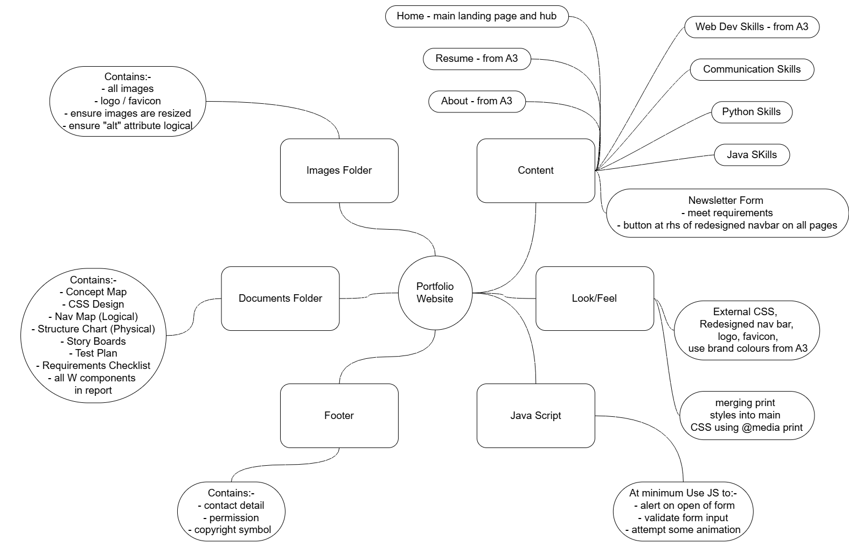
Organisation of Information – Concept Map

Slide 12
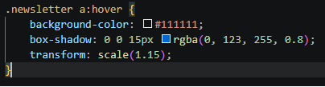
Usage of CSS
Contain all style css in external file as per A3 style.css
Utilise grid layout to give consistency across pages and enable easier page response for mobile screens using @media query.
Follow guidance from A3 feedback and merge my print.css file into the style.css using @media print query.
Use classes and selectors throughout html to give me ability to make css changes to related elements making code reuseable.
Provide many comments in css to avoid confusion when others inspect code or when change required. This enables me to understand the purpose of each css code block.
Emphasise newsletter sign up button with box shadow and transform scale.

Slide 13
HTML Form & JavaScript
Based off marking criteria the form & Java Script have the highest weighting for the professional dialogue so functionality, requirements met and understanding all vital here.
Add all necessary input elements; text box (first name), text box (last name), email (email), radio buttons (age), checkbox (department), text area, submit and reset buttons.
Ensure all criteria for field size met.
Add Java Script function for alert on page load
Add JavaScript function to validate the inputs of first name, and last name to ensure not blank and no numerical characters. Utilise a Regex pattern test here to catch all including a lack of entry.
Incorporate in validation function a condition to ensure that at least one checkbox is selected.
Style in css, the radio buttons and check boxes using fieldset html container with legend.
Using the post method to process the data on submit, I have utilised a third-party service https://formspree.io that, upon submit confirms successful submission and sends form data to my email address. I will validate with screenshot.

Slide 14
Code reusability and readability
External css used across project to separate the style from the content.
Plan to utilise class selectors for reusability of code across multiple pages to give consistent look and feel.
Build Java Script functions for reusability in various parts of website.
Add enough comments so that upon reflection both myself and other programmers understand the purpose of code blocks, particularly important in the css and Java Script files as they usually contain more complexity than the html elements.
Follow coding conventions, for example adding prologue to external Java Script file.

Slide 15
Validation of Form Fields
After much research on the best method for input validation on the Newsletter Signup Form I decided upon a function that incorporates a regex pattern matcher to verify that a name has been entered in first name, last name and that no numeric input was entered. Use if condition and, if pattern not matched throw an alert requesting correct input.
Test input control already has a required attribute, but it is not adequate to show my understanding of Java Script.
Within the same function use a for loop to iterate through all check box fields to ensure that at least one is selected. If no check box selected throw an alert to request correct input.
Email validation only basic here as required input control is adequate for the purpose, given more time I could create a function to validate a correct email address entered.
Ensure required fields are marked as such to the user to avoid unnecessary submissions.

Slide 16
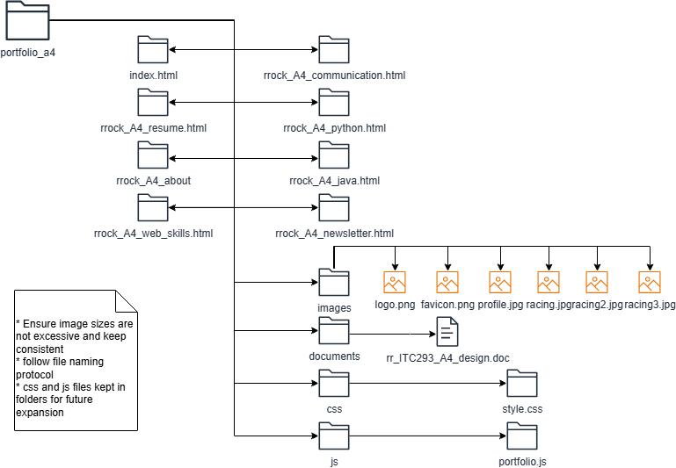
File sizes and naming

Slide 17
Reflection & Improvements
During the staged assessments I have found that the main improvements that I have learnt has come through careful planning prior to coding. As I have learnt new skills through subject tutorials, text reading, YouTube tutorials, and W3 school's website, those skills have then allowed me to plan better as those techniques and skills are how I wish to implement my plan.
From last assessment I have improved my nav bar and logo by making the whole section cleaner and changing the size of logo and reverting away from absolute positioning to enable responsive behaviour on smaller screens.
Utilising the grid layout on all pages improves consistency and spreads the text out allowing the user not to get bogged down reading large paragraphs.
As I learn more Java Script and use of the DOM I can see how powerful it can be in making the pages interactive and allowing manipulation of data input by user.
I now have a clear understanding of form creation and was surprised by the complexity of them.

Slide 18
Requirements Checklist
Requirement | Completed
Design fits screen resolution 1024 x 768 | ✓
Navigation Bar templated across all pages | ✓
Design contains theme and colour pallet | ✓
Consistent Fonts | ✓
Consistent image size and not excessive | ✓
No scroll bars | ✓
HTML5 implementation | ✓
HTML & CSS pass validation using W3C | ✓
DOCTYPE statement correct | ✓
Meta tags (home page) and a relevant page title on each page | ✓
At least six (6) pages on the website | ✓
At least four skills pages | ✓
HTML Form completed | ✓
Java Script used to validate form + alert on load | ✓

Slide 19
Requirements Checklist
Requirement | Completed
Site publicly hosted | ✓
Testing plan carried out | ✓
Addressed all Written (W) components in design document | ✓
At least 2 CSS type & 1 universal selector | ✓
Preparation for Professional Dialogue | ✓

Slide 20
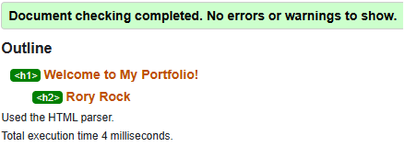
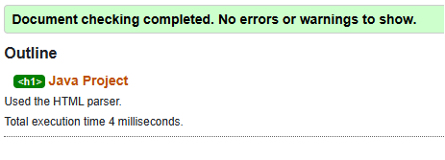
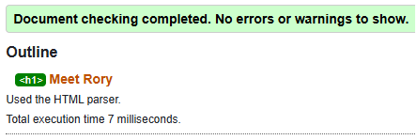
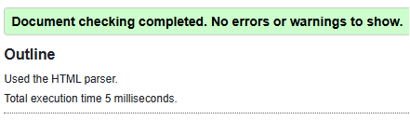
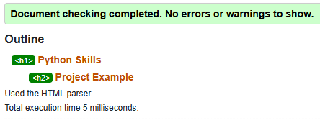
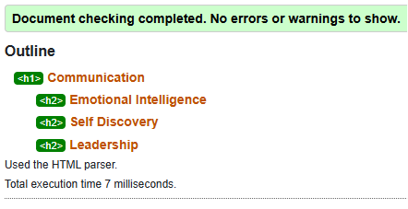
W3C HTML Validations

Slide 21
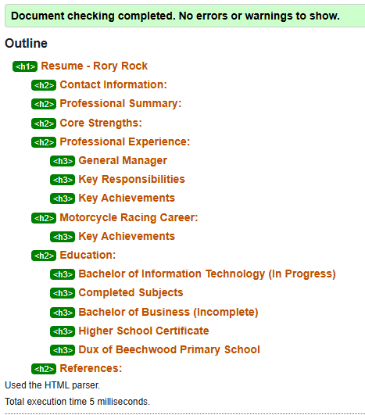
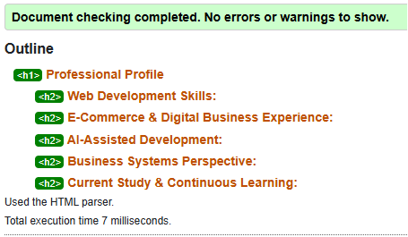
W3C HTML Validations

Slide 22
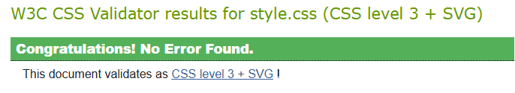
W3C CSS Validations

Slide 23
Testing
Requirement | Test Method | Anticipated Result
Form opens in new tab with alert | Click link from all pages | Newsletter form page opens in new tab and alert “welcome msg” works.
Form data submits using POST method | Submit a test form response | Screenshot received email to show data submitted successfully.
“Required Data” instructions on form fields | Visual inspection of form and test submission with fields missing. | Form should not submit with any “required” field blank.
Form input controls as per guidelines | Attempt to enter too many characters, test button functionality. | Field size should limit character entry. Buttons should function as expected.
Form should not submit with blank names | Attempt input with first, last, or both names null. | Alert should pop up if invalid input.
URL of page functions | Open page and test all links on remote device. | Page should function on public browser with no access to local files.

Slide 24
Testing
Requirement | Test Method | Anticipated Result
Requirement | Test Method | Anticipated Result
External CSS | Review HTML Code | No trace of inline/internal css.
NavBar uniform across pages and all links work | Page by page review | NavBar presents the same on each page.
Print Layout | Print and compare | No NavBar, background colour/image removed and larger font.
Logo/Favicon | Browser Tab & page comparison | Favicon on each tab, Logo on each page.
Validation | W3C validator | Ensure no errors.
Phone, Email links | Click Links | Ensure successful.
Page nav links | Click Links | Ensure no dead links & home accessible from each page.
Browser compatibility | Test in Chrome, Edge | Ensure page displays.

