Slide 1
Taconic transfer overview

Slide 2
What are we supposed to get?

Slide 3
Directory listing: Directory List and Print
No admin account needed
Can get a lot of file info: date/time of creation, date/time of modification, file size

Slide 4
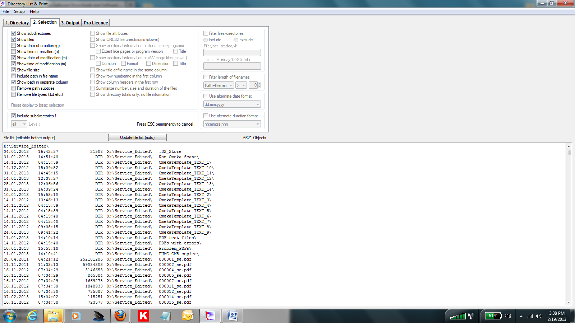
Directory print out

Slide 5
Never trust Excel

Slide 6
Ideal transfer mechanisms:
Disc image (logical/physical) or rsync

Slide 7
DENIED

Slide 8
No:
connection to JP Morgan via outside server, connection to server via laptop-> USB, no upload/download from Dropbox (or like services), save on CD/DVD

Slide 9
only email

Slide 10
Zip + MD5summer

Slide 11
MD5summer: ensure no change to the file

Slide 12
Zip: packages directories, reduce likelihood of MAC changes

Slide 13
Transfer instructions should be specific as possible.

Slide 14
And repeated as much as possible.

Slide 15
Received 20+ emails with transfer materials while traveling.

Slide 16
Checksums didn’t match.
There were alterations in directory structure (files deleted) and the checksums were not run recursively.

Slide 17
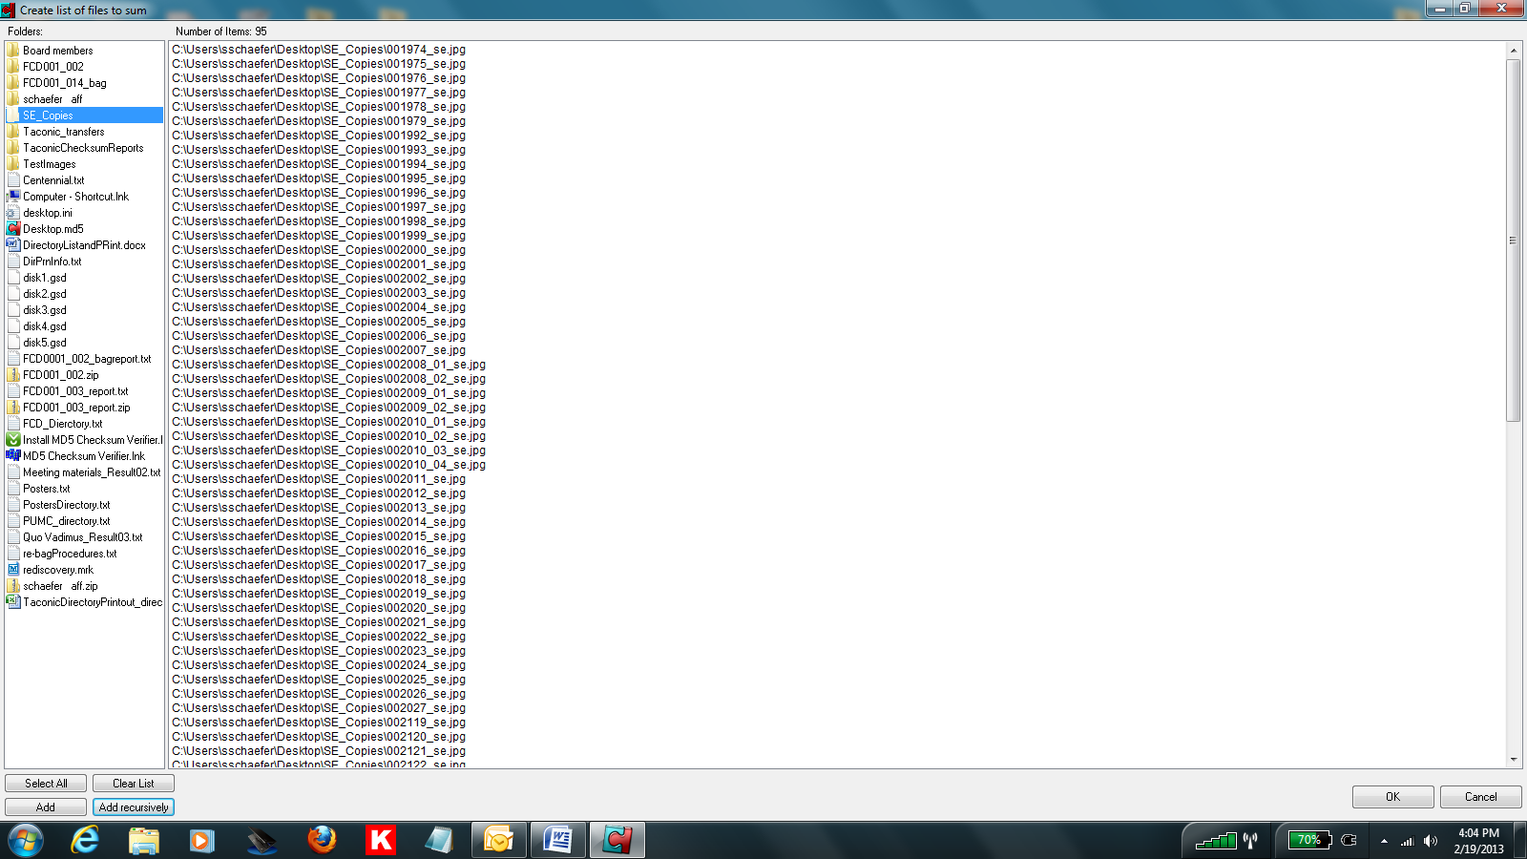

Slide 18
Large files (>10MB or so)
didn’t make it through the email system.

Slide 19
Gsplit: Splits the zip files into specified chunks. Re-organizes them on the other end of the transfer.

Slide 20
Download site blocked by JPMorgan internet filter.

Slide 21


Slide 22
Lessons

Slide 23
Transfer should be discussed as early as possible.

Slide 24
Agreements should include agree-upon transfer methods and requirements.

Slide 25
We’ll need to quickly assess and deploy tools (software) to deal with issues as they arise.

Slide 26
We’ll need to provide guidance on how to use these tools, and be aware of the common mistakes made when using them.

Slide 27
Documentation:
checksum validation reports, emails, Transfer Document, directory listing

Slide 28
Needs:
Designated server space. Virus check.

