Slide 1
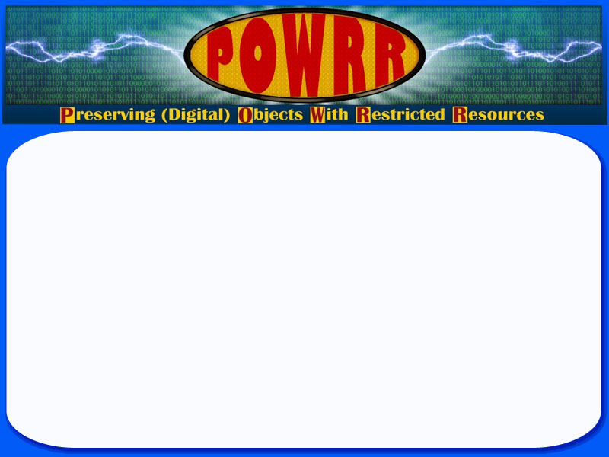






Aaisha Haykal, Chicago State University
Patrice-Andre Prud’homme, Illinois State University
Sponsored By:

Slide 2
Project Overview
IMLS National Leadership Grant
Audience
Medium and smaller sized institutions
Goal
Investigate, evaluate, and, at its close, recommend scalable, sustainable digital preservation solutions for libraries with smaller amounts of data and/or fewer resources
Deliverables
ToolGrid
Workshops during dissemination phase
Case Studies
Webinars

Slide 3
Tool Grid
Resources for various steps in a digital preservation program
Sources
tool websites,
contacting the tool developers directly,
discussion boards,
and some direct tool testing
OAIS Reference Model
http://digitalpowrr.niu.edu/tool-grid/
Connection with Paul Wheatley and Comptr

Slide 4
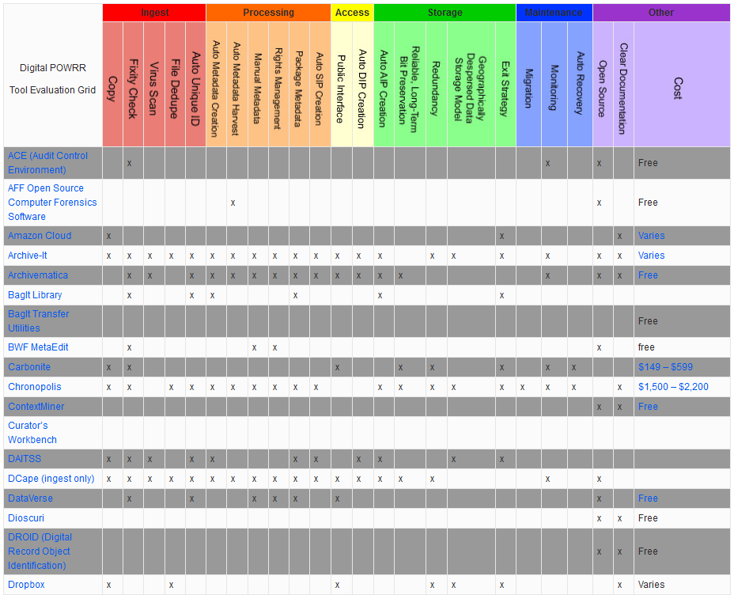

Slide 5
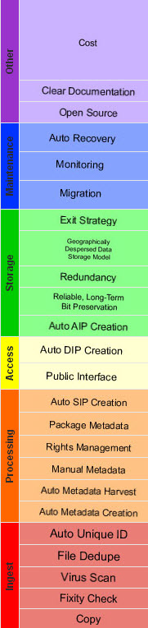
Archivematica
Curator’s
Workbench
MetaArchive
Internet
Archive
DuraCloud
varies
free
free
low
free

Slide 6
System testing is just beginning
Comprehensive testing
Rubric for testing outcomes

Slide 7
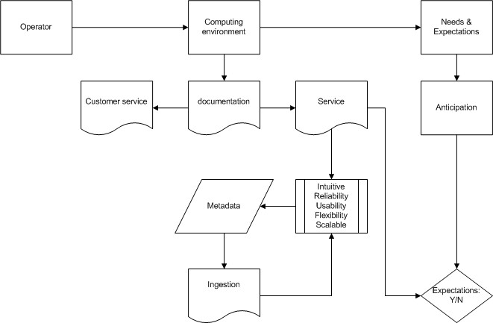
The five tools: Evaluation framework
Notes:
NIU will be tackling a high-level evaluation:
tool descrip;
syst reqts;
cost;
robustness & user community (the latter relates somehow to documentation from the general eval);
Exist strat;
Viability (release, update, implementation/clients)
Doc (clarity, etc. (ditto to documentation from the general eval))

Slide 8
Digital POWRR Timeline: Dissemination
Tool selection and installation
Tool Testing
Dissemination Phase
Findings
Target audience
Risk management
Manageable steps that show incremental progress
Implementing success rather than just planning for it
Presentations, conferences, etc.
White paper due December 2014
Notes:
Test data grouping: Sept ‘12 – July ‘13
System testing: July ‘13 – Feb. ‘14
Dissemination: May ‘14 – Dec. ‘14

Slide 9
Thank you very much
Website
http://digitalpowrr.niu.edu/
Wiki
http://powrr-wiki.lib.niu.edu/index.php/Main_Page
Aaisha Haykal
ahaykal@csu.edu
Patrice-Andre Prud’homme
ppprudh@ilstu.edu

