Slide 1
ENGI 301 Colorful Music Box Proposal
9/25/23
Callum Flemister
Parts Sheet Design Block Maker
Helpful Link For PocketBeagle

Slide 2
Background Information
What is being proposed?
A music box that uses color inputs to product corresponding sounds
Links to existing projects / libraries
Colorful Tunes
IR Breakbeam Candy Dispenser with Zelda Music
connect 4 game project
What improvements / additions over existing project
able to sense more than two colors
Continuous color sensing and sound production
customizable color blocks
Reason for my project
I started this idea as an addition to my Engi 210 midterm which was to make a wooden mimic of record player.
I want to experiment building devices that incorporate electronics and this project incorporates light value reading, producing coordinated sounds, a motor(s), and some kind of auto sensing/activator.

Slide 3
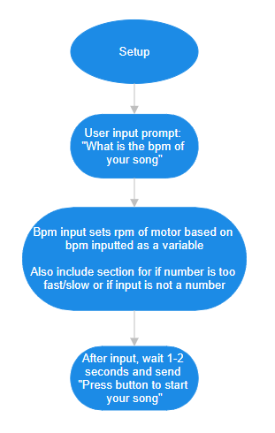
System Block Diagram, V1
Set Up
Notes:
Components (Label interfaces / pins)
In
On switch
Color Sensing x 2+
Timed Sensor
Out
Moter
Color Wheel
Speaker to play notes x 1+ (?)
—----------------------------------------
Code that takes in a color input and produces a corresponding sound
How to time when the color sensor reads role
Leaning towards external activation (like taking a pic)
Magnets/ magnetic field sensor
press a button/ force pressure
as role rotatites, it has spot that are conductive to complete a circuit, activating the sensor

Slide 4
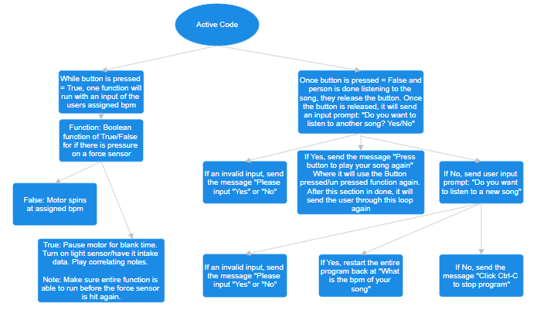
System Block Diagram, V1
Active Code
Notes:
Components (Label interfaces / pins)
In
On switch
Color Sensing x 2+
Timed Sensor
Out
Moter
Color Wheel
Speaker to play notes x 1+ (?)
—----------------------------------------
Code that takes in a color input and produces a corresponding sound
How to time when the color sensor reads role
Leaning towards external activation (like taking a pic)
Magnets/ magnetic field sensor
press a button/ force pressure
as role rotatites, it has spot that are conductive to complete a circuit, activating the sensor

Slide 5
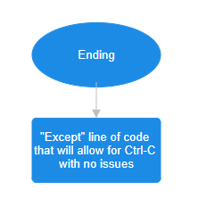
System Block Diagram, V1
Ending
Notes:
Components (Label interfaces / pins)
In
On switch
Color Sensing x 2+
Timed Sensor
Out
Moter
Color Wheel
Speaker to play notes x 1+ (?)
—----------------------------------------
Code that takes in a color input and produces a corresponding sound
How to time when the color sensor reads role
Leaning towards external activation (like taking a pic)
Magnets/ magnetic field sensor
press a button/ force pressure
as role rotatites, it has spot that are conductive to complete a circuit, activating the sensor

Slide 6
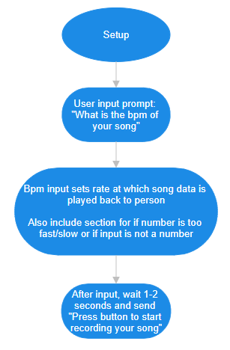
System Block Diagram, V2
Set Up
Notes:
Components (Label interfaces / pins)
In
On switch
Color Sensing x 2+
Timed Sensor
Out
Moter
Color Wheel
Speaker to play notes x 1+ (?)
—----------------------------------------
Code that takes in a color input and produces a corresponding sound
How to time when the color sensor reads role
Leaning towards external activation (like taking a pic)
Magnets/ magnetic field sensor
press a button/ force pressure
as role rotatites, it has spot that are conductive to complete a circuit, activating the sensor

Slide 7
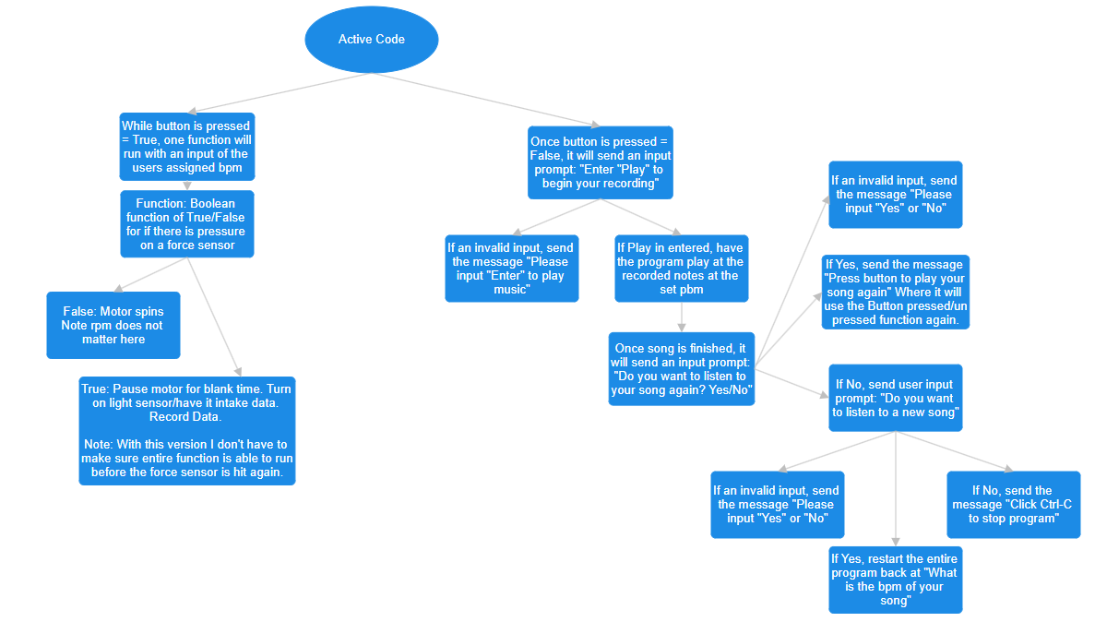
System Block Diagram, V2
Active Code
Notes:
Components (Label interfaces / pins)
In
On switch
Color Sensing x 2+
Timed Sensor
Out
Moter
Color Wheel
Speaker to play notes x 1+ (?)
—----------------------------------------
Code that takes in a color input and produces a corresponding sound
How to time when the color sensor reads role
Leaning towards external activation (like taking a pic)
Magnets/ magnetic field sensor
press a button/ force pressure
as role rotatites, it has spot that are conductive to complete a circuit, activating the sensor

Slide 8
System Block Diagram, V2
Ending
Notes:
Components (Label interfaces / pins)
In
On switch
Color Sensing x 2+
Timed Sensor
Out
Moter
Color Wheel
Speaker to play notes x 1+ (?)
—----------------------------------------
Code that takes in a color input and produces a corresponding sound
How to time when the color sensor reads role
Leaning towards external activation (like taking a pic)
Magnets/ magnetic field sensor
press a button/ force pressure
as role rotatites, it has spot that are conductive to complete a circuit, activating the sensor

Slide 9
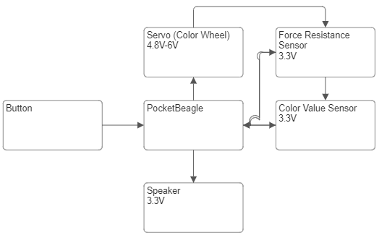
Power Block Diagram
Create a Power Block Diagram
Label voltages / currents of components

Slide 10
Components / Budget
Component | Need to Buy | Cost
Button | No(Parts Kit) | In parts kit
Tube for colors | No | 0
Force Resistance Sensor | No | 0
TF-LIGHTING WS2812B | Yes | $17.99
HiLetgo TCS-34725 | Yes | $14.00
Continuous Motor | Yes | $5.40
Adafruit BH1750 | Yes | $18.00
Speaker | Yes | $16.98
Total | 5 | $72.37

Slide 11
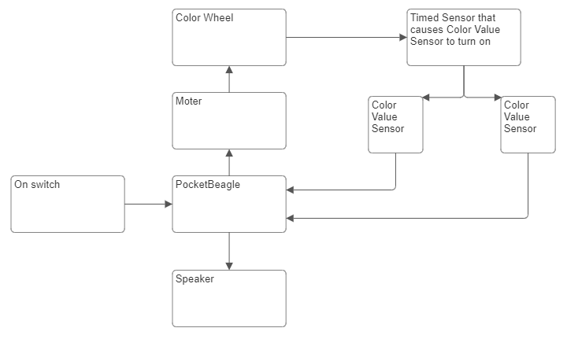
Appendix

Slide 12
Component Selection (Remove slide for submission)
All components must be from either: Amazon, Adafruit, Sparkfun, Digi-Key, or Mouser
Select no more than two (2) components that are not on approved component spreadsheet
See Canvas 🡪 Files 🡪 assignments 🡪 ENGI301_project_01_parts_list.xlsx
All components needed for the project should be listed on Slide 5
All components should have links to the website where they can be purchased
Please trim URLs for links to Amazon
All components together should not cost more than $75
If you have a special request, we can discuss in the project meeting

