Slide 1


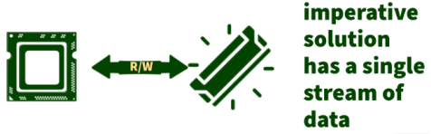
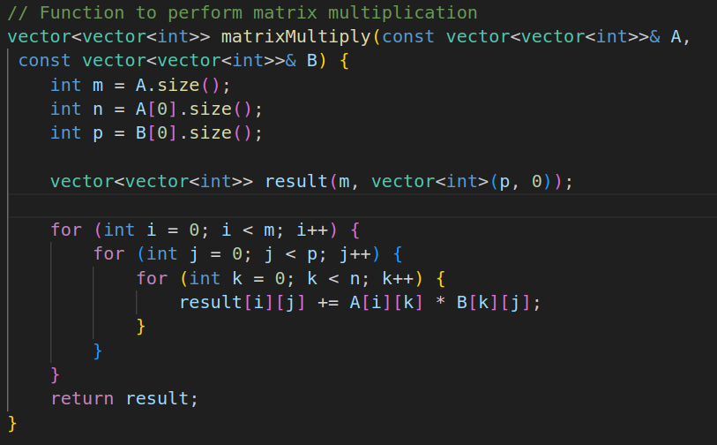
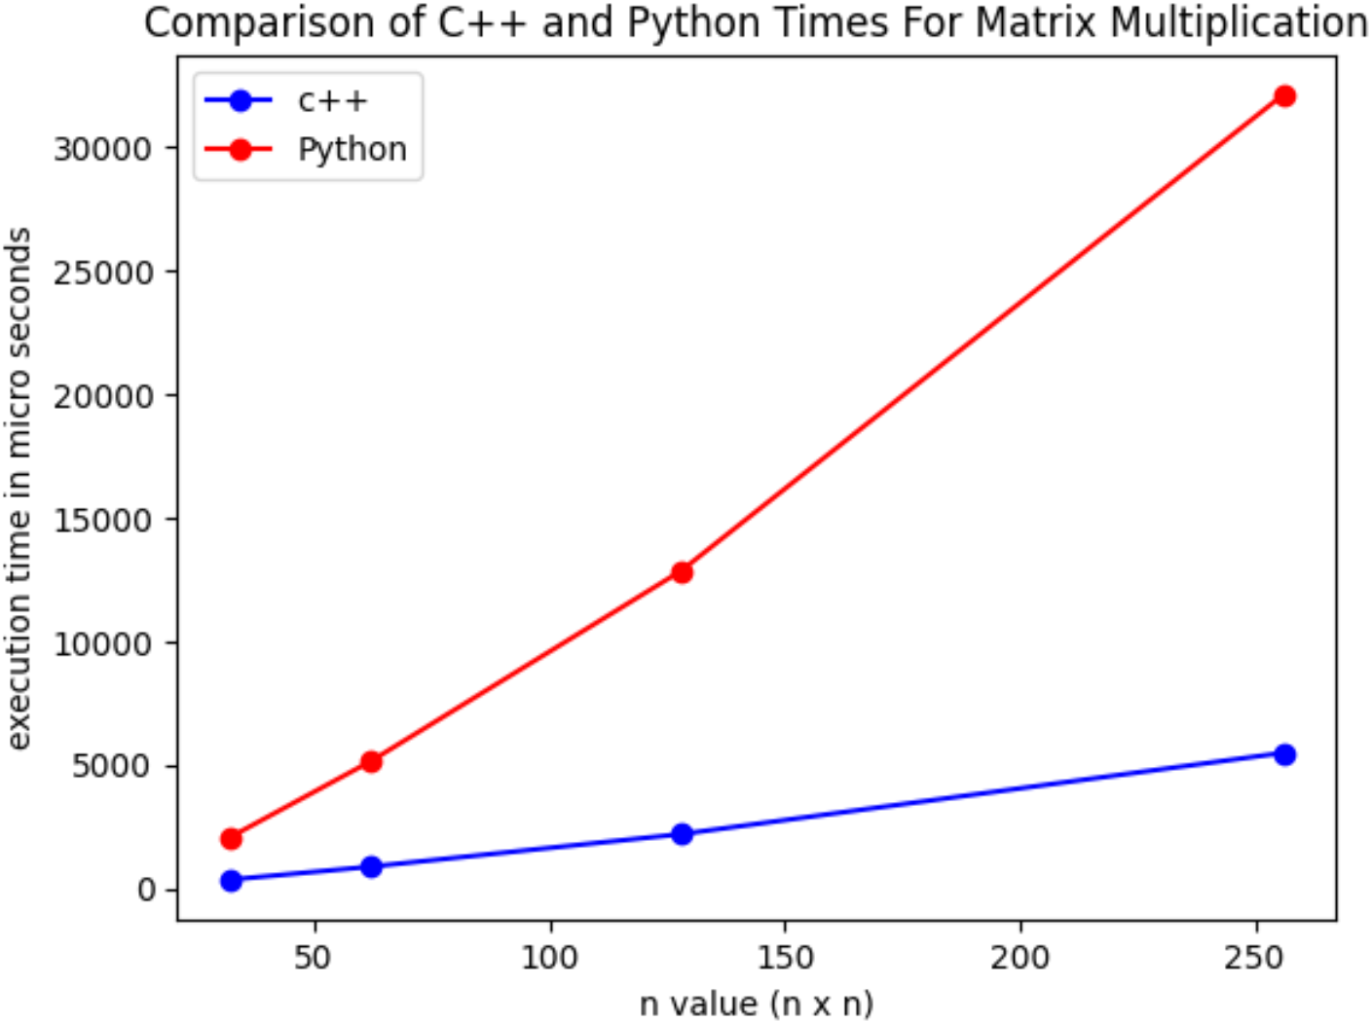
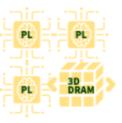
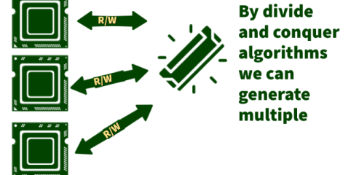
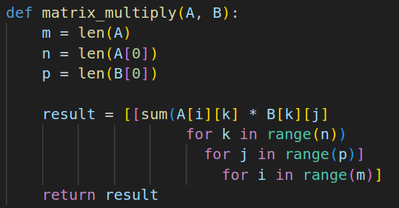
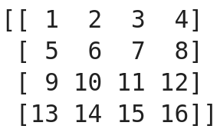
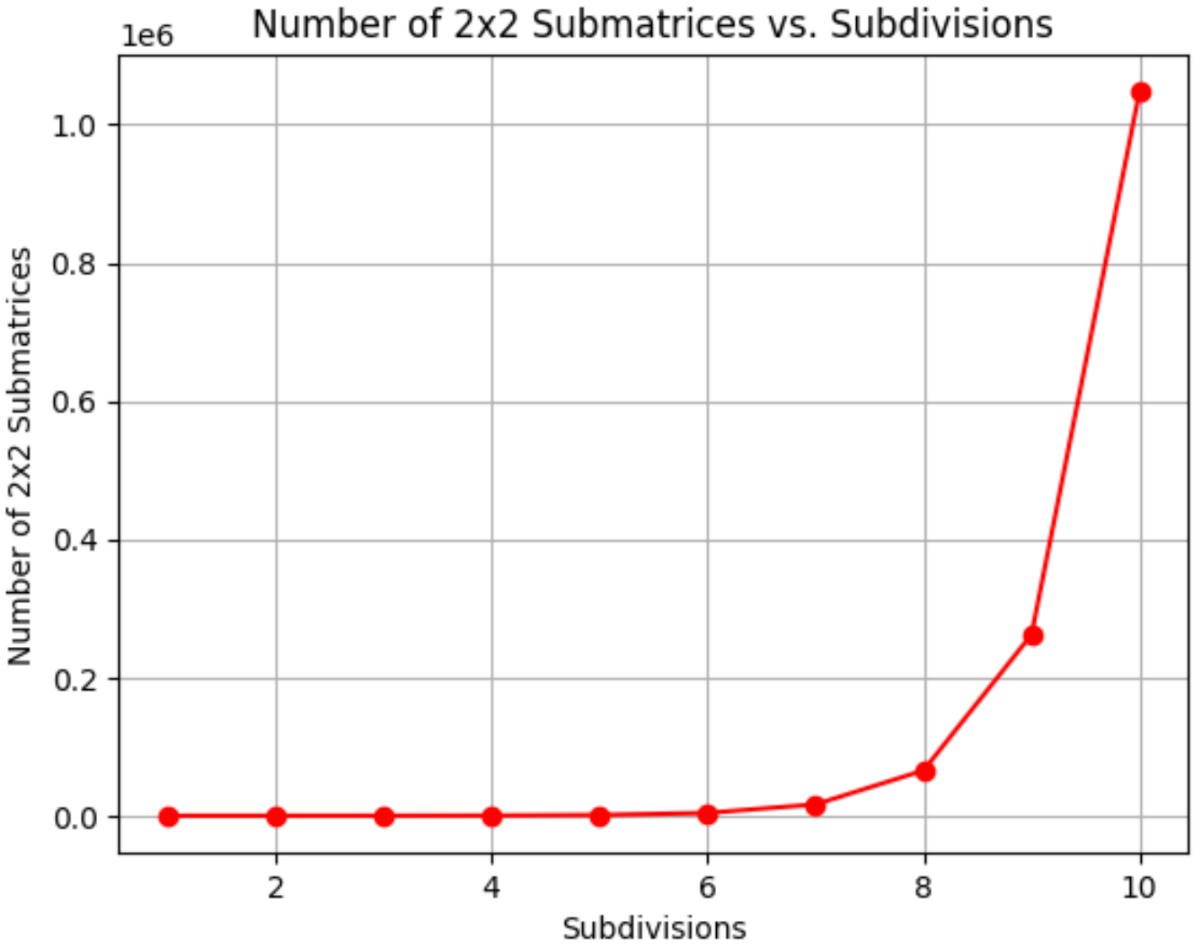
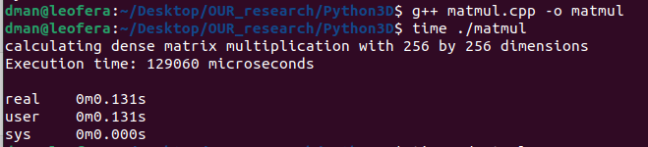
Pythons Distributed Computing Capabilities Enhanced by Shared 3D Memory
Daniel Jolin, UNC Charlotte
Ron Sass PhD, College of Engineering
Introduction
Python vs C++
Results
Modern CPUs are comprised of many parallel computing elements called “cores”
Soon Very Large Scale Integrated Circuits (VLSI) chips will have tens of thousands of cores coupled with 3D vertically stacked memory.
Most programs written in popular programming languages like C++, java and Python are single threaded thus only utilizing one core.
Traditional programming techniques used to achieve parallelism are designed for parallelizing within a single process and thus fail to scale to 10,000 concurrent processes.
C++
A single core version of C++ is much faster than a single core version of Python at the cost of human readability.
Conclusions
Caption for your photo
Python
Although the C++ code is inherently faster, it is consistently ~6 times faster than Python for any value of n.
Although C++ is faster than Python we can make up for it by distributing the work load to multiple threads.
With 3D memory we can get the parallelism with Python for “free”
With divide and conquer algorithms we can quickly create an enormous amount of data streams
We would need 6 parallel threads to match the performance of C++.
Divide and Conquer
Objectives
Collected Data
We can achieve a degree of parallelism with just 1 subdivision.
README.md
Although Python is written with single threaded programming in mind, we would like to exploit the memory bandwidth afforded by the 3D memory to automatically map many tasks to parallel cores.
Execution time comparison: Matrix multiplication
n | 32 | 64 | 128 | 256
C++ | (μs) 320 319 343 414 | (μs) 2,516 2,158 3,080 2,058 | (μs) 16,690 17,240 16,180 17,250 | (μs) 129,000 131,100 130,200 129,100
Python | (μs) 2,040 2,040 2,040 2,100 | (μs) 17,250 15,780 15,840 15,500 | (μs) 119,300 122,400 126,200 124,900 | (μs) 985,400 994,700 992,500 971,800
Our goals this summer were modest.
Get comfortable with popular version control system git.
explore the software/hardware structures of 3D stacking DRAM.
Learn what it means to write “pythonic” code
I am pleased to share that we have not only achieved the intended goal but have also gone above and beyond the initial objectives.
For example:
In dense matrix multiplication, the imperative solution has a single stream of data.
However, by utilizing Divide and Conquer algorithms, we can open multiple data streams.
Code Samples
Python vs C++ time to execute dense matrix multiple for n by n matrix.
In fact, with a matrix large enough for 10 subdivisions, we can achieve an enormous degree of parallelism
https://github.com/RocketDan11/OUR-summer-reasearch.git
Timing was implemented in software.
Note: Mean execution time used in graph

