Slide 1

Your calendar should be full.
MARKETING AND TECHNOLOGY FOR HOME SERVICES
Every call, form submission and estimate request gets a response in under 60 seconds and is booked directly onto your calendar.
rocketllamalabs.com · © 2026 Rocket Llama Labs LLC
Notes:
Open with the promise: a full calendar. We are a Phoenix marketing and technology company built for HVAC, plumbing, electrical, roofing and every home service trade. Every lead answered in under 60 seconds, every marketing dollar tracked to a completed, paid job. You own the leads, the data and the results.

Slide 2



Built for the trades. Powered by experience. Driven by results.
ABOUT ROCKET LLAMA LABS
A marketing and technology company that helps home service businesses build stronger operations, attract more customers, and achieve sustainable growth.
Real experience
Connected systems
Built for the trades
Solutions rooted in work we’ve already done, challenges we’ve already addressed, and systems we’ve already implemented.
Marketing, technology, and business execution brought together, instead of disconnected campaigns and software.
HVAC, plumbing, electrical, roofing, garage doors, pest control, landscaping, painting, and every trade that serves homeowners.
Notes:
Rocket Llama Labs is a marketing and technology company dedicated to helping home service businesses build stronger operations, attract more customers, and achieve sustainable growth. We specialize in the industries that keep homes running. Real experience, connected systems, built for the trades.

Slide 3
More than a marketing agency
OUR APPROACH
We are a complete growth and technology partner.
Successful businesses need more than individual marketing campaigns, disconnected software, or strategies that look good on paper. They need integrated systems that work together.
WHAT WE DO FOR YOU
Design
Build
Implement
Manage
Grow
We don’t make recommendations and leave you to figure out the execution. We run the systems that help you operate and grow.
Notes:
We are more than a marketing agency; we are a complete growth and technology partner. We don’t simply make recommendations and leave businesses to figure out the execution. We design, build, implement, manage, and continuously improve the systems that help home service companies operate and grow.

Slide 4



Home service companies have unique demands
WHY IT MATTERS
Every missed call
Every inefficient process
Every customer interaction
can mean a lost opportunity.
can affect profitability.
decides a one-time job or a relationship that lasts for years.
We don’t just build marketing. We build the systems behind better businesses.
Real experience. Connected systems. Built for the trades.
Notes:
Every missed call can mean a lost opportunity. Every inefficient process can affect profitability. And every customer interaction can determine whether a business earns a one-time job or a relationship that lasts for years. Our mission is to bring marketing, technology, and business execution together into one coordinated approach.

Slide 5
Three ways good companies lose jobs
THE PROBLEM
You buy your leads, answer them late, and can’t be found where people look now.
1 in 5
62% vs 28%
45%
Your odds on a shared lead
Close rate, fast vs average
Now ask an AI for a local pro
A Yelp or Angi lead is sold to four other contractors, and you pay whether you win it or not.
Answer inside two minutes and 62% of leads convert. The average company answers in 42 minutes and converts 28%.
Up from 6% a year earlier. Most contractor websites have nothing an AI can read.
Top Three Web Design, 2026 · owner’s field results
ServiceTitan, 2025 · Hatch, 2026
Elev8 Operations roundup, 2026
Notes:
Most home services marketing sells one tactic at a time: a lead list, an SEO package, an ad budget. Companies lose jobs in the gaps between them. Shared leads: one in five odds. Speed: 62% close inside two minutes against 28% at the 42-minute average; only 12% of contractors respond inside five minutes. AI: 45% of people now ask an AI for a local pro, up from 6% a year earlier.

Slide 6
Most agencies sell you one tactic. We run the whole thing.
THE FULL SYSTEM
Website
Search and AI search
Reviews
Funnels
Phones
CRM
Built as one system and run by one marketing and technology team for home service contractors.
Ads
Ownership
Notes:
Eight pieces, one system: website, search and AI search, reviews, funnels, phones, CRM, ads, and ownership. One team runs all of it, so nothing falls in the gaps between vendors.

Slide 7




One system, from the first search to the booked job
WHAT WE RUN FOR YOU
Get found
Get the call
Answer and book
Keep it running
Where homeowners look first.
Ads that run in your name, on your card.
Every lead answered, every job on the calendar.
A team on the other end of the line.
Google search and Maps
AI search results
Google Business Profile
A website you own
Google Ads
Local Services Ads
Facebook and Instagram
YouTube and email
AI voice attendant
AI calendar booking
CRM with AI built in
Call tracking
Monthly jobs report
Review requests
Website updates
Technical support
Notes:
Walk left to right. Get found: Google search, Maps, AI search (ChatGPT, Gemini, Perplexity), Google Business Profile, a website you own with free hosting. Get the call: Google Ads, Local Services Ads, Meta, YouTube, email. Answer and book: phone system, AI voice attendant, AI calendar booking, CRM. Keep it running: support, monthly report of booked jobs by source, review requests after every job, website updates.

Slide 8
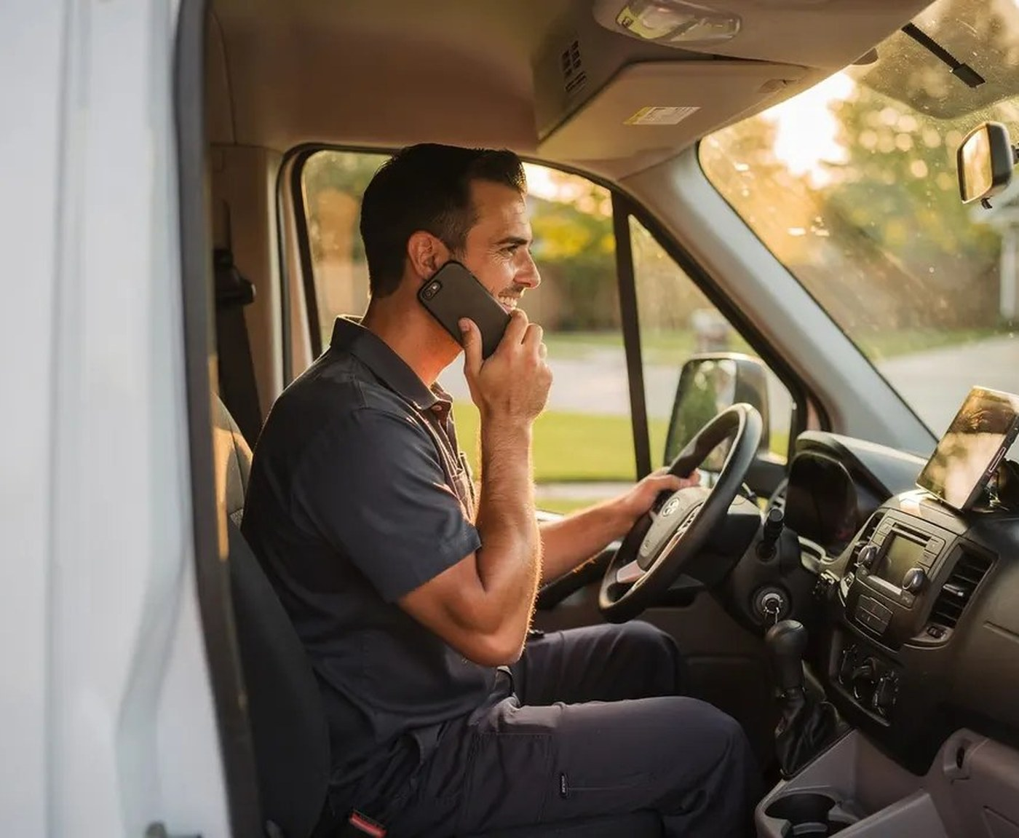
Never miss a call again
ANSWER AND BOOK
1
A lead comes in
A call, a form submission or an estimate request.
2
A reply in under 60 seconds
A text and an email, written in your voice.
3
The system calls you first
Even while you’re at a job site.
4
If you can’t answer, AI steps in
It captures the details, qualifies the lead and books the appointment on your calendar.
Notes:
When a new lead comes in they get a text and email in under 60 seconds, written in your voice, even while you are on a job. The system calls you first. If you cannot answer, AI captures the details, qualifies the lead and books the appointment directly on your calendar. After hours it books, it does not go to voicemail.

Slide 9


Show up where homeowners look first
GET FOUND
When they search Google, check Google Maps or ask ChatGPT who to call, your business shows up.
A website you own
Built for search engines and AI, with pages per service and per city. Hosted free.
Your Google Business Profile
Fully built out and posted weekly, with a review request after every job.
Google
Google Maps
ChatGPT
Ads in your name
Google, Local Services and Meta ads on your accounts and your card.
Notes:
Homeowners look in three places now: Google search, Google Maps, and AI assistants. We cover all three with a website you own that carries structured data an AI can read, a Google Business Profile that is worked every week, and ads that run in your name on your accounts.

Slide 10
We report booked jobs and what they were worth
TRACKED TO THE JOB
No chasing clicks or digging through dashboards. Every call and form is tracked in a CRM you own.
$2 : $1
<60s
1 per source
100% yours
Our floor: two dollars back for every dollar spent, or we work free.
Every new lead gets a text and an email in your voice.
Tracked phone numbers, so we know which ad made it ring.
The site, the data, the numbers and the ad accounts.
Notes:
We do not report clicks. On the first of every month you get booked jobs by source and what they were worth. Our floor is two dollars back for every dollar spent or we work free. One tracked number per source tells us which ad made the phone ring, and that dashboard sets next month’s budget.

Slide 11

Never locked in
OWNERSHIP
Exclusive leads
Everything in your name
Eight pieces. One system. All yours.
From your own site and ads. Never sold to four other contractors.
The site, the data, the phone numbers and the ad accounts.
Take it with you
Free hosting
Export your data, port your numbers, take the code.
For the life of the site.
Budget you control
A clean handover
Month to month. Never a contract.
Up in busy months, down in slow ones. Your card, our management.
If you leave, we help the next provider get set up.
Notes:
Everything is in your name: the website, the CRM data, the phone numbers and the ad accounts. It is month to month, never a contract. If you ever leave, you export your data, port your numbers, take the code, and we help the next provider get set up. Every lead comes from your own site and ads, so it is yours alone.

Slide 12
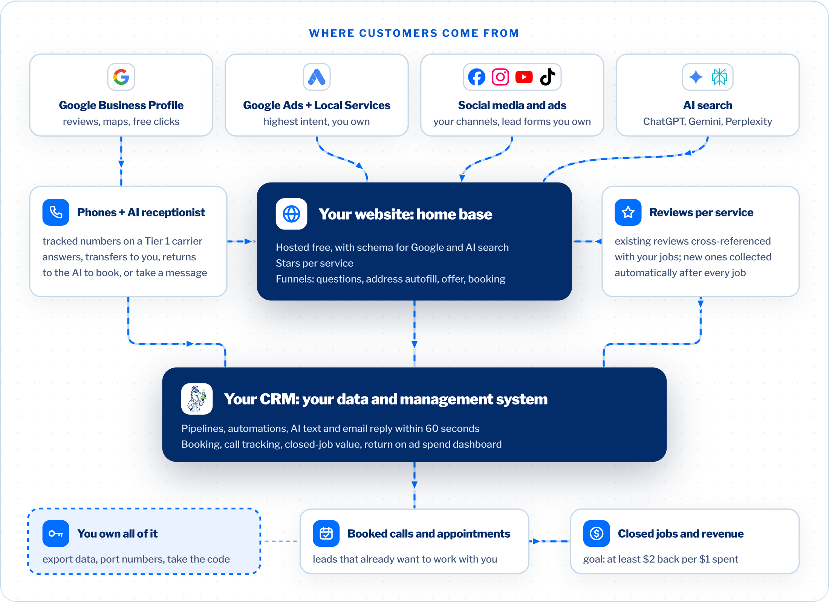
Everything points to a website you own and lands in a CRM you own.
HOW IT CONNECTS
Traffic from Google, Meta, and your reviews feeds a site built for search and AI search. The site and the phones feed your CRM. The CRM books the job and records what it was worth.

Slide 13
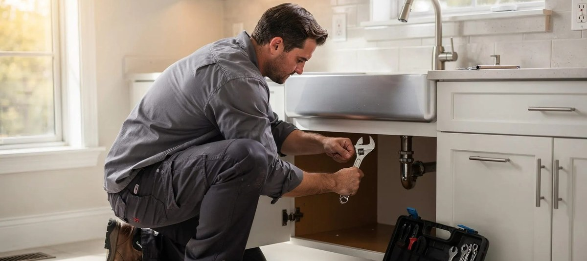
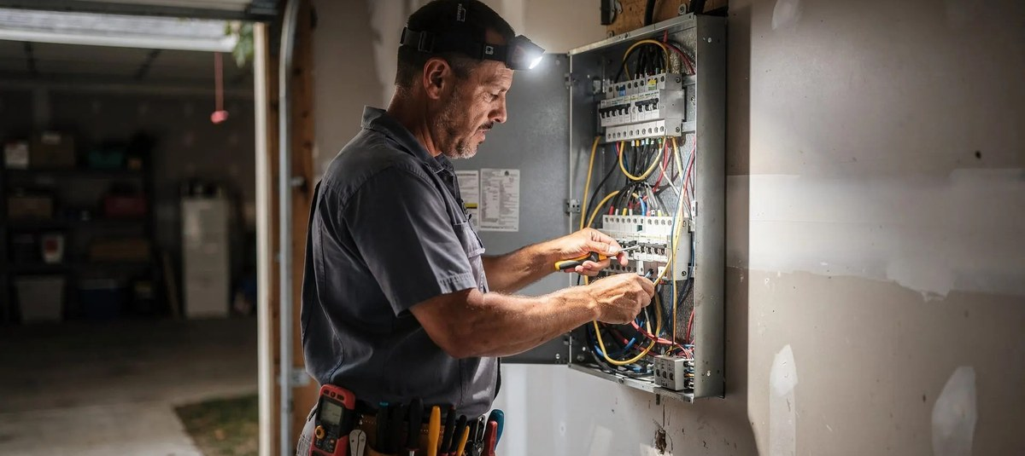

Every trade that goes to a customer’s home
INDUSTRIES
HVAC
Plumbing
Electrical
Roofing
Garage door
Pest control
Landscaping
Painting
Window and pressure washing
Handyman
Mobile mechanic
Windows and doors
Solar
Flooring
Remodeling
If you send a truck to a house
Notes:
If you send a truck to a house, this is built for you. We start in your service area and expand city by city. HVAC, plumbing, electrical and roofing are the core, and the same system runs for garage doors, pest control, landscaping, painting, solar, flooring, remodeling and more.

Slide 14
Three people, one system
WHO WE ARE
23+
20+
$50M+
years leading sales teams and client strategy
years building businesses that get found online
generated through inbound marketing
Branson Cobb
Brian Greenberg
Madison Schantz
Chief Executive Officer
Chief Strategy Officer
Chief Marketing Officer
Runs the business and every client relationship.
Sets the strategy and the marketing playbook for every client.
Designs the brand, the website, and the AI-powered tools each client runs on.
Notes:
Branson, our CEO, runs the business and every client relationship; he spent more than 23 years leading sales teams, business development and client strategy for some of the country’s largest healthcare organizations. Brian, our Chief Strategy Officer, has spent more than twenty years building businesses that get found online, including a fully digital insurance agency that generated $50M+ through inbound marketing. Madison designs the brand, the website and the AI-powered tools. A small team with modern AI tools delivers what used to take an agency floor.

Slide 15
Getting started is simple
HOW IT WORKS
1
2
3
4
Schedule a call
We quote your plan
We build and run everything
Your phone starts ringing
It takes about a minute to book. The call opens with a free audit of how you show up online.
Your vision and what you have now, plus our suggestions, expertise and technology.
Website, phones, CRM, ads and reviews, all in your name.
On the first of every month: booked jobs by source and what they were worth.
Notes:
Four steps. Book a call, which takes about a minute. We quote a plan built on what you already have. We build and run everything in your name. Then the monthly report shows booked jobs by source, what they were worth, and what we changed. Keeping the phone ringing and the calendar full is our job.

Slide 16

Never miss a call again.
NEXT STEPS
Questions
Notes:
Two ways forward. Schedule a call: it takes about a minute to book and opens with a free live audit of your Google profile, reviews, website and how your phone gets answered, side by side with the top company in your trade. Or run the instant audit: four questions, a score out of 100.

