Slide 1
Optoelectronically innervated soft prosthetic hand via stretchable optical waveguides
by Huichan Zhao, Kevin O’Brien, Shuo Li, and Robert F. Shepherd
Sci. Robotics
Volume 1(1):eaai7529
December 6, 2016
Copyright © 2016, American Association for the Advancement of Science

Slide 2
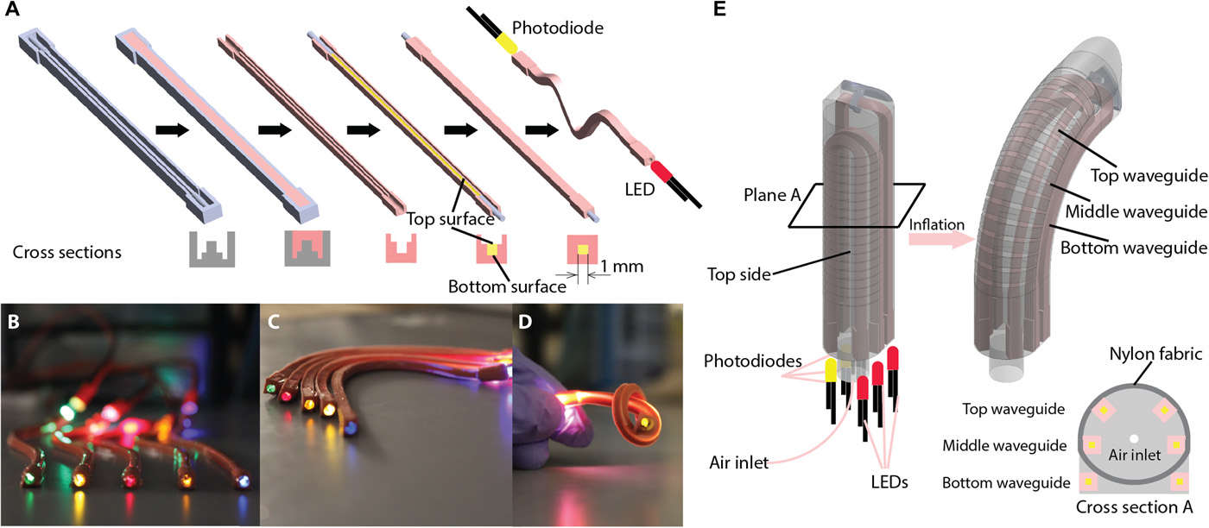
Stretchable waveguide fabrication and structure of the optoelectronically innervated soft finger.
Huichan Zhao et al. Sci. Robotics 2016;1:eaai7529
Copyright © 2016, American Association for the Advancement of Science
Notes:
Stretchable waveguide fabrication and structure of the optoelectronically innervated soft finger. (A) Steps for fabricating a waveguide and the corresponding cross section for each step; (B) fabricated waveguides with LEDs of assorted colors inserted from one end in a sinuous shape; (C) waveguides in a curved shape; (D) waveguide in a knot; (E) schematic of a soft innervated finger in both unpowered (left) and powered (right) states and its cross section (bottom right corner).

Slide 3
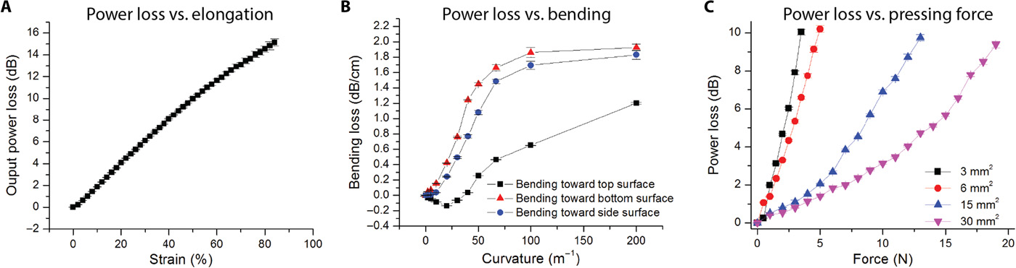
Characterization of the waveguide sensor in different deformation modes.
Huichan Zhao et al. Sci. Robotics 2016;1:eaai7529
Copyright © 2016, American Association for the Advancement of Science
Notes:
Characterization of the waveguide sensor in different deformation modes. Characterization for (A) pure elongation, (B) pure bending, and (C) pure pressing. (Error bars indicate SEs from 20 cyclic tests of one waveguide sample).

Slide 4
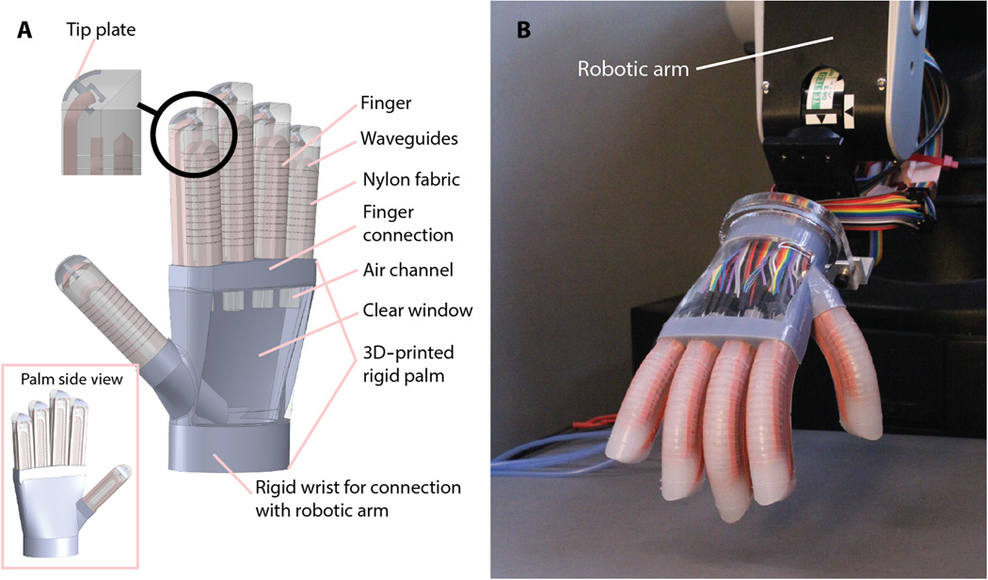
Innervated prosthetic hand.
Huichan Zhao et al. Sci. Robotics 2016;1:eaai7529
Copyright © 2016, American Association for the Advancement of Science
Notes:
Innervated prosthetic hand. (A) Schematic of hand structure and components; (B) image of the fabricated hand mounted on a robotic arm with each finger actuated at ΔP = 100 kPa.

Slide 5
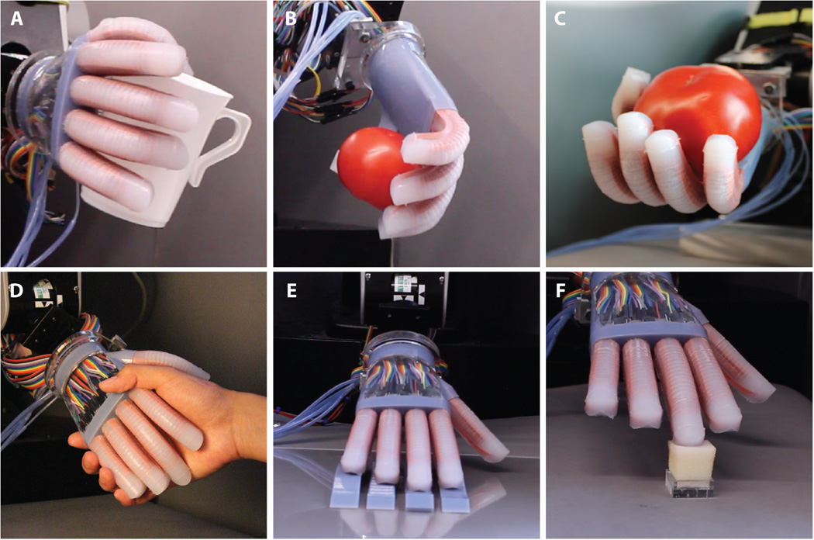
Capabilities of the hand.
Huichan Zhao et al. Sci. Robotics 2016;1:eaai7529
Copyright © 2016, American Association for the Advancement of Science
Notes:
Capabilities of the hand. (A) Holding a coffee mug; (B and C) grasping a tomato with the palm facing down (B) and the palm facing up (C); (D) shaking a human hand; (E) lateral scanning over surfaces to detect roughness and shape; and (F) probing the softness of a soft sponge using the middle finger.

Slide 6
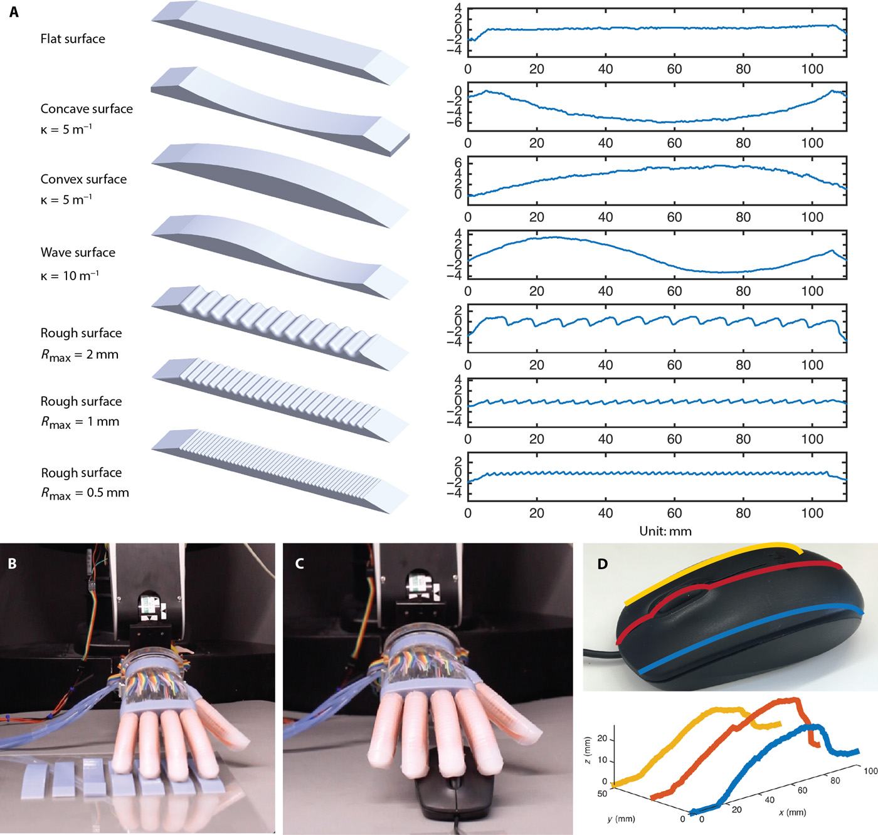
Shape and texture detection.
Huichan Zhao et al. Sci. Robotics 2016;1:eaai7529
Copyright © 2016, American Association for the Advancement of Science
Notes:
Shape and texture detection. (A) Seven surfaces of different shape and roughness (left) and the reconstructed surfaces by the hand (right); (B) image of the lateral scanning for (A) using the bottom waveguide of each digit; (C) lateral scanning of a computer mouse; (D) mouse and the reconstructed shape.

Slide 7
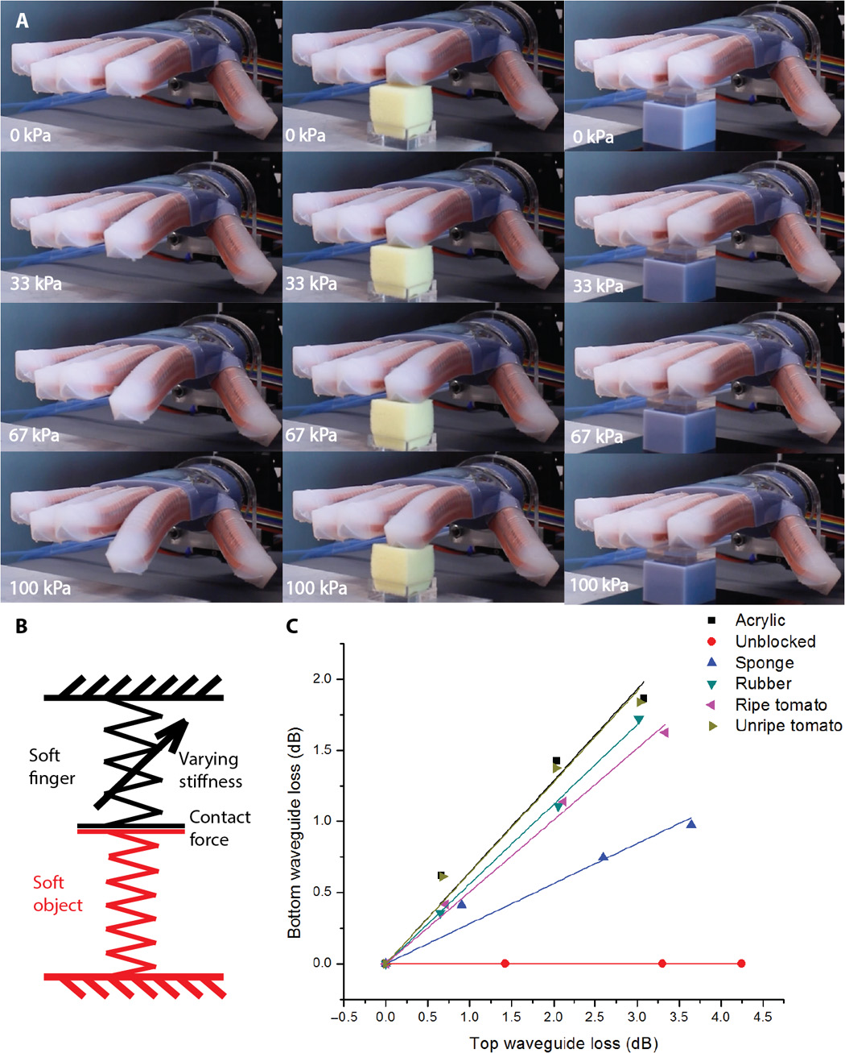
Softness detection.
Huichan Zhao et al. Sci. Robotics 2016;1:eaai7529
Copyright © 2016, American Association for the Advancement of Science
Notes:
Softness detection. (A) States of the softness detection at different air pressures for unblocked (left), sponge (middle), and acrylic (right); (B) model of softness detection; (C) force-curvature curves for different objects detected from the bottom and top waveguides of the index.

Slide 8
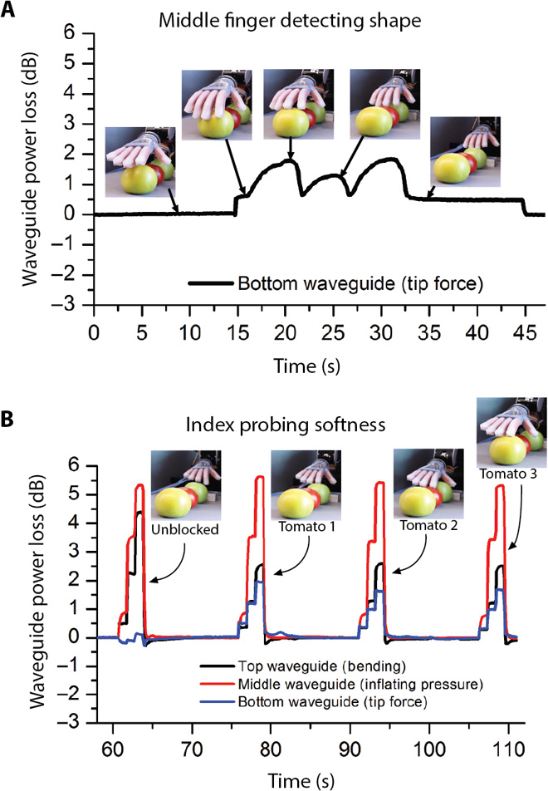
Waveguide power loss during shape detection and probing softness.
Huichan Zhao et al. Sci. Robotics 2016;1:eaai7529
Copyright © 2016, American Association for the Advancement of Science
Notes:
Waveguide power loss during shape detection and probing softness. (A) Process of middle finger detecting the shape using its bottom waveguide: actuate fingers, scan above tomatoes, de-actuate fingers. (B) Process of index finger probing the softness using three waveguides: press unblocked, press tomato 1 (unripe), press tomato 2 (ripe), and press tomato 3 (unripe).

