Slide 1


This is pretty strange how it worked out this way.
Even if you are not religious, you should read this.
CLICK AT YOUR LEISURE

Slide 2

Q: What is the shortest chapter in the Bible?
A: Psalm 117

Slide 3
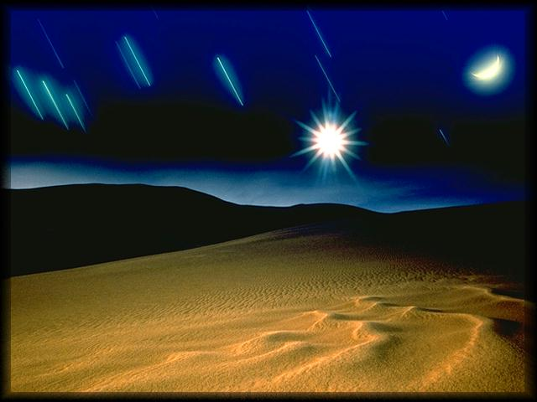
Q: What is the longest chapter in the Bible?
A: Psalm 119

Slide 4

Q: Which chapter is in the centre of the Bible?
A: Psalm 118

Slide 5
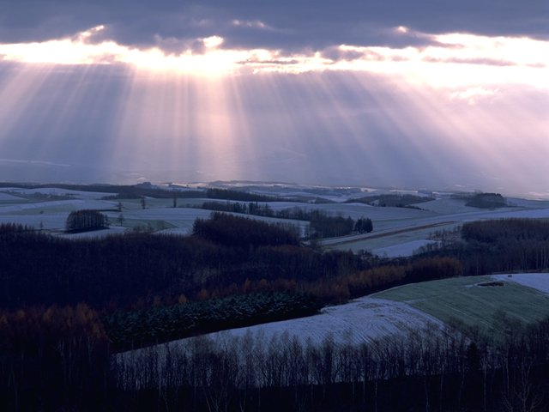
Facts: There are 594 chapters before Psalms 118.
There are 594 chapters after Psalms 118.
Add these numbers up and you get 1188.
Q: What is the centre verse in the Bible?
A: Psalm 118:8

Slide 6

Does this verse say something significant
about God's perfect will for our lives?
The next time someone says they would like to find
God's perfect will for their lives and that they want to
be in the centre of His will, just send them to the
centre of His Word!

Slide 7

Psalms 118:8 (NKJV)
"It is better to trust in the LORD than to put confidence in man."
Now isn't that odd how this worked out… or was God in the centre of it?
Before sending this, I said a prayer for you.
Have you got a minute — 60 seconds for God?
All you do is simply say a small prayer for the person who sent you this to you.

Slide 8
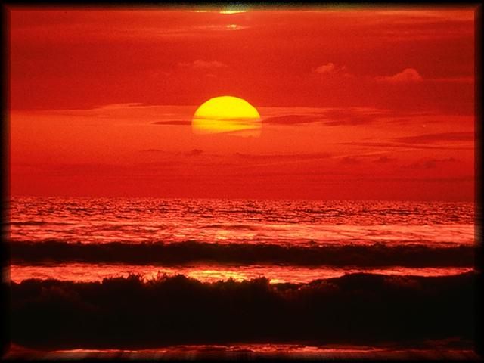
"Father God, bless my friend in whatever
it is that you know
he or she may be needing this day!
May their life be full of your peace,
prosperity, and power as they seek to have a
closer relationship with You.
Amen."

Slide 9
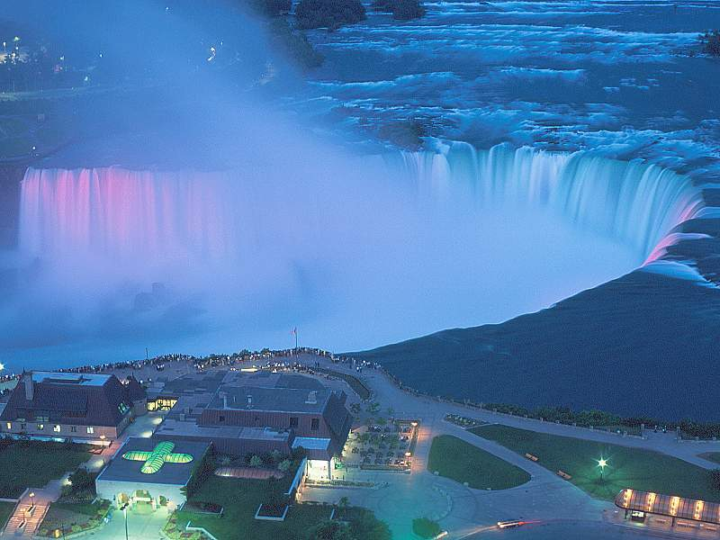
Then send it on to 10 other people.
Within hours, 10 people have prayed
for you, and you caused many people
pray to God for other people.
Then sit back and watch the power of God
at work in your life
for doing the thing that
you know He loves.

Slide 10

When things get tough, always remember...
faith doesn't get you around trouble,
it gets you through it !
"When you relinquish the desire to control your future,
you obtain happiness."

Slide 11

May God bless you!

Slide 12


