Slide 1

GOD

Slide 2

Have you ever felt the desire to do something special for someone you love?

Slide 3

THAT’S GOD
who is speaking to you.

Slide 4

Have you ever felt the sadness and the loneliness of someone who approaches and stands beside you?

Slide 5

THAT’S GOD
who has chosen you.

Slide 6

Have you ever thought of someone who is very dear to you and have not seen for a long time, and suddenly that person unexpectedly appears.

Slide 7

THAT’S GOD
For there is nothing that ever happens by chance!

Slide 8
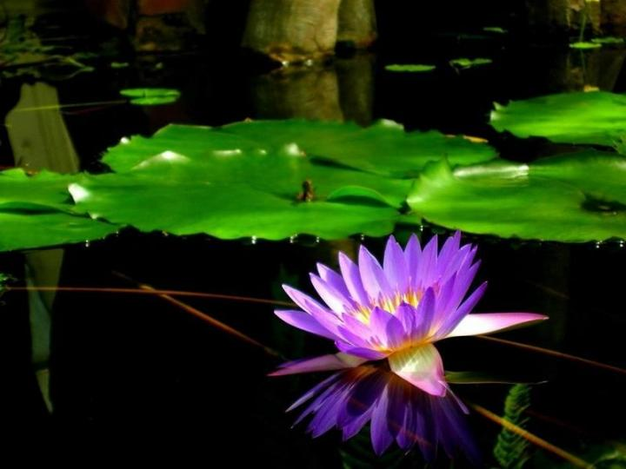
Have you ever received something marvellous for which you did not ask?

Slide 9
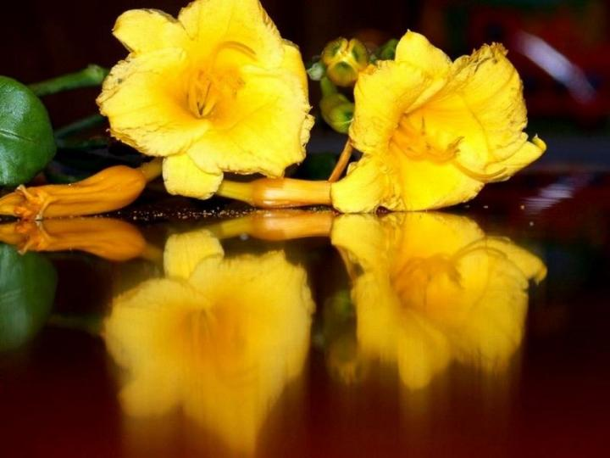
THAT’S GOD
who knows all the secrets which you keep well hidden in your heart.

Slide 10
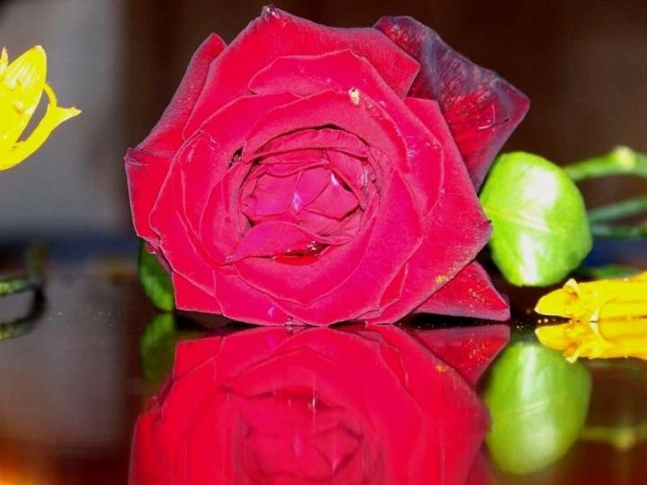
Have you ever found yourself in a difficult situation for which there seemed to be no apparent solution, and then ‘in the twinkling of an eye’ the answer became as clear as daylight?

Slide 11
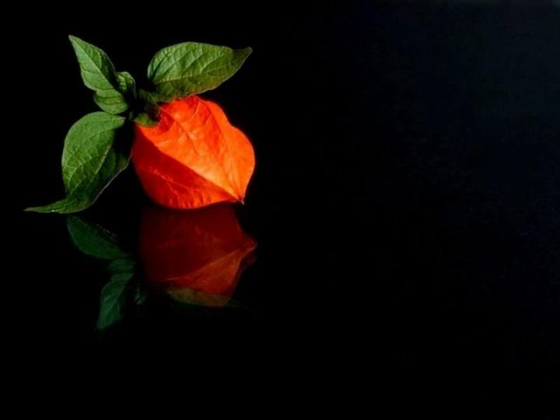
THAT’S GOD
who unceasingly takes our problems into his hands and helps us solve them.

Slide 12
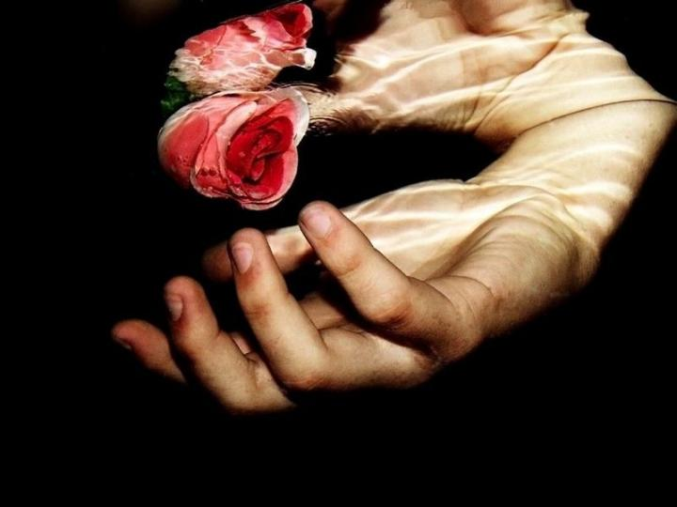
Have you ever felt an immense sadness in your soul, and then suddenly, as if your inner self was infused with love, an inexplicable sense of peace enveloped your entire being?

Slide 13

THAT’S GOD
who consoles you in his arms and gives you peace.

Slide 14
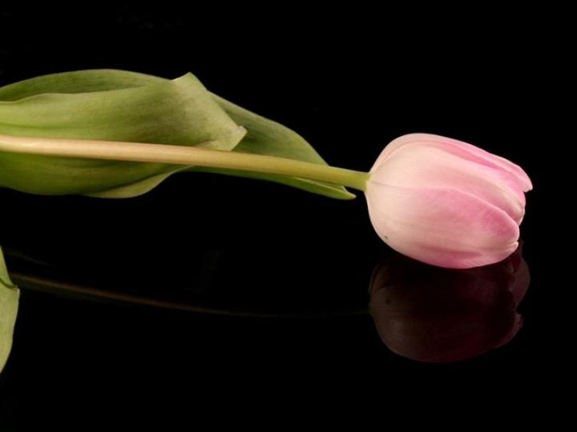
Have you ever felt tired of life to the point of wanting to die, and then suddenly you were able to find the courage and the resolve to continue your journey full of vigour and hope?

Slide 15

THAT’S GOD
He is always there beside you, lovingly accompanying you every step of the way on your life’s journey.

Slide 16

Everything goes better when
GOD TAKES THE LEAD!

Slide 17

Do you think that this message was sent to you by chance?

Slide 18

THAT’S GOD
who touched my heart.

Slide 19
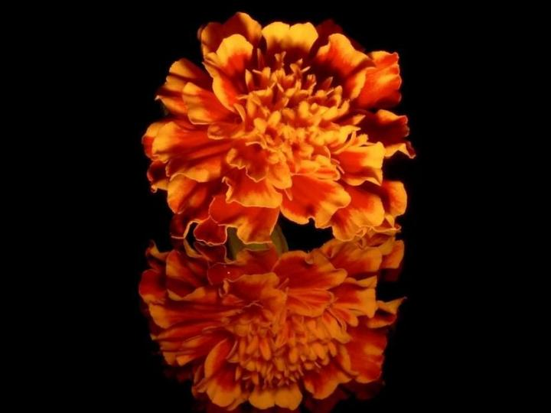
He inspired me to think of you not because you are my friend, but on account of the fact that you are of infinite value in HIS eyes and in mine.

Slide 20

Let God touch your heart so that you’ll feel moved to share this message with all your friends.

Slide 21

Send this message to all your loved ones, friends and acquaintances…

Slide 22
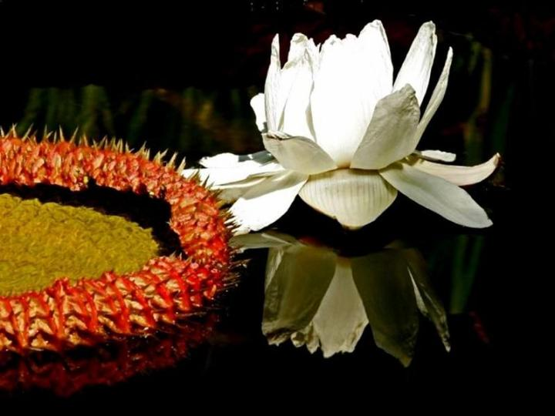
…because we all need to know that GOD IS ALWAYS WITH US!

Slide 23

Let us share with everyone the
GREAT LOVE GOD HAS FOR US.

Slide 24
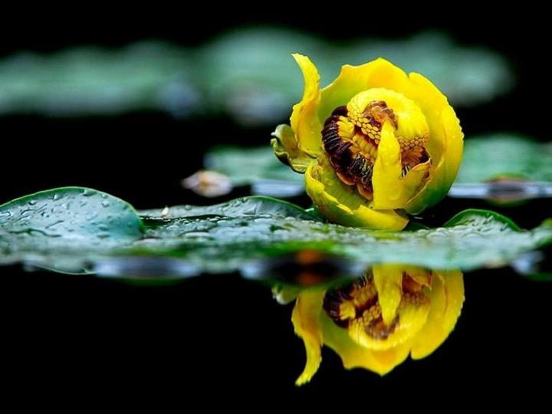
Glory to God

Slide 25
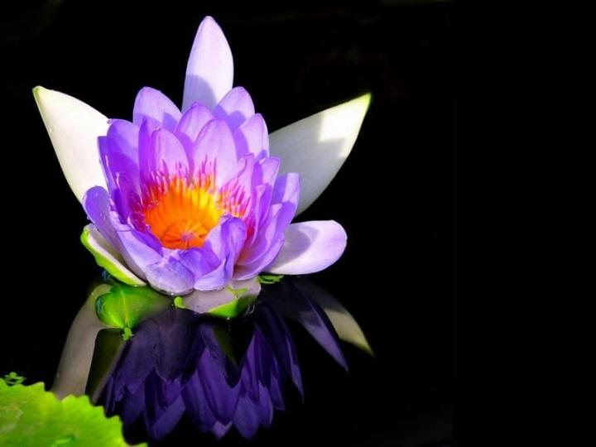
Thank you my dear God.
God’s Blessings
to one and all!

