Slide 1
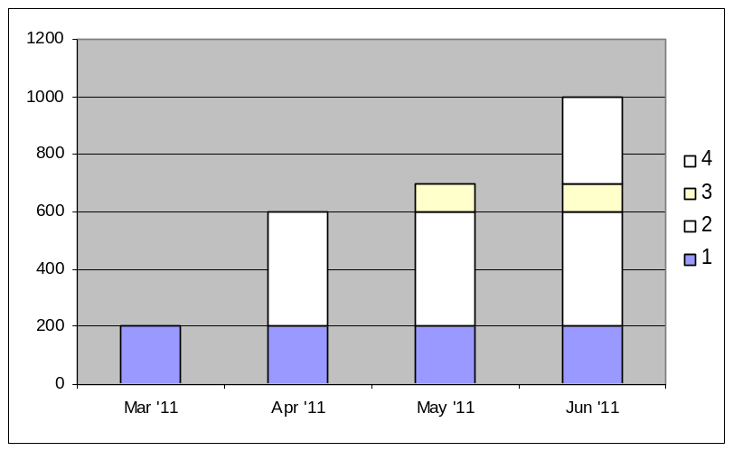
Front Line Leaders
Creating Capacity Update
Hours to Save Goal:
Project Status Information
100 managers x 8 hours = 800 hours
Meetings Savings to Date
Mgr Hrs | Non-Mgr Hrs | Optional Hrs | Total
250 | 150 | 50 | 450
Hours Saved to Date:
200 hours
Starting Email deployment in March
Time Savings Projects (% Complete)
  Required Reading (100%)
  Meetings ‘Spring Cleaning’ (25%)
  Email (0%)
  Training (0%)
Planned Savings Status
Legend
Solid = Realized Savings
Hashed = Planned Savings
Goal
Data Current as of: 30 Jan 2011

