Slide 1

BELTS OF NORTH AMERICA
-SUNBELT-

Slide 2
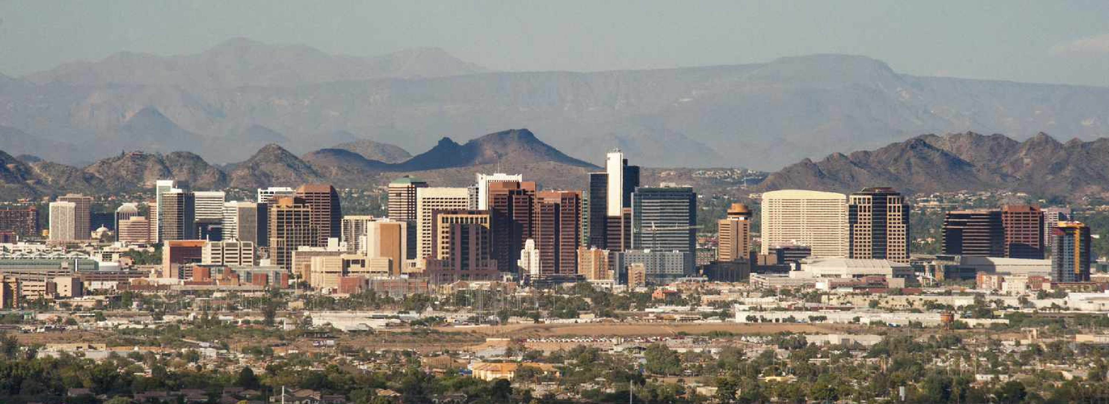


Table of content's
Why is it called sunbelt?
Population
Geography
Economy
History
Voting behavior

Slide 3


Why is it called Sunbelt?
characterized by sunny, warm climate
hotest belt
desert/semi-desert landscape
"sun spots" such as Texas and california temperatures as high as 52°C

Slide 4


Geographic
south of america
south of the 38 degree latitude for instance: Silicon valley, florida little inhabited in rural aeras

Slide 5
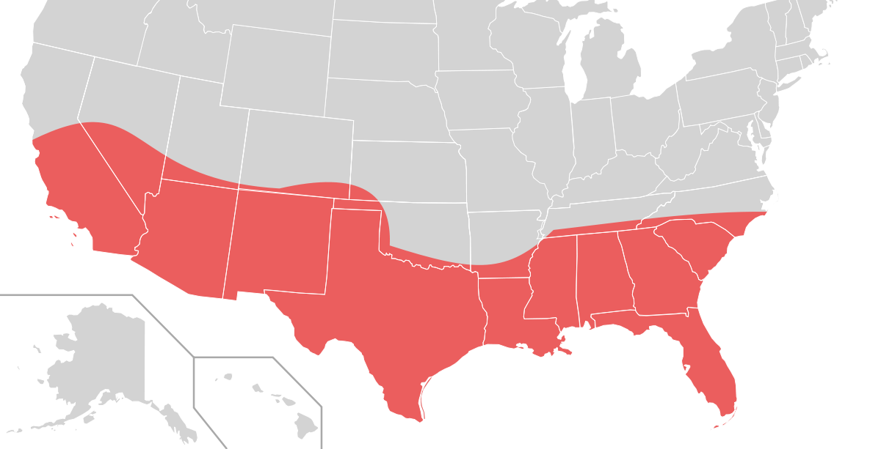
Map

Slide 6


History
The term "Sun Belt" is said to have been coined in 1969 by writer Kevin Phillips
continously becoming more popular grew via migration in the 1970s
problems in the 1980s and 1990s such as lowest per capita income in the US

Slide 7



Population
Sun Belt now holds about 50% of the national population
Sun Belt has seen a surge in population growth for decades
Between 1970 and 1990, the South grew in population by 36 percent and the West by 51 percent

Slide 8

Religion
mainly christians and more conservative religions
high attendance to church

Slide 9
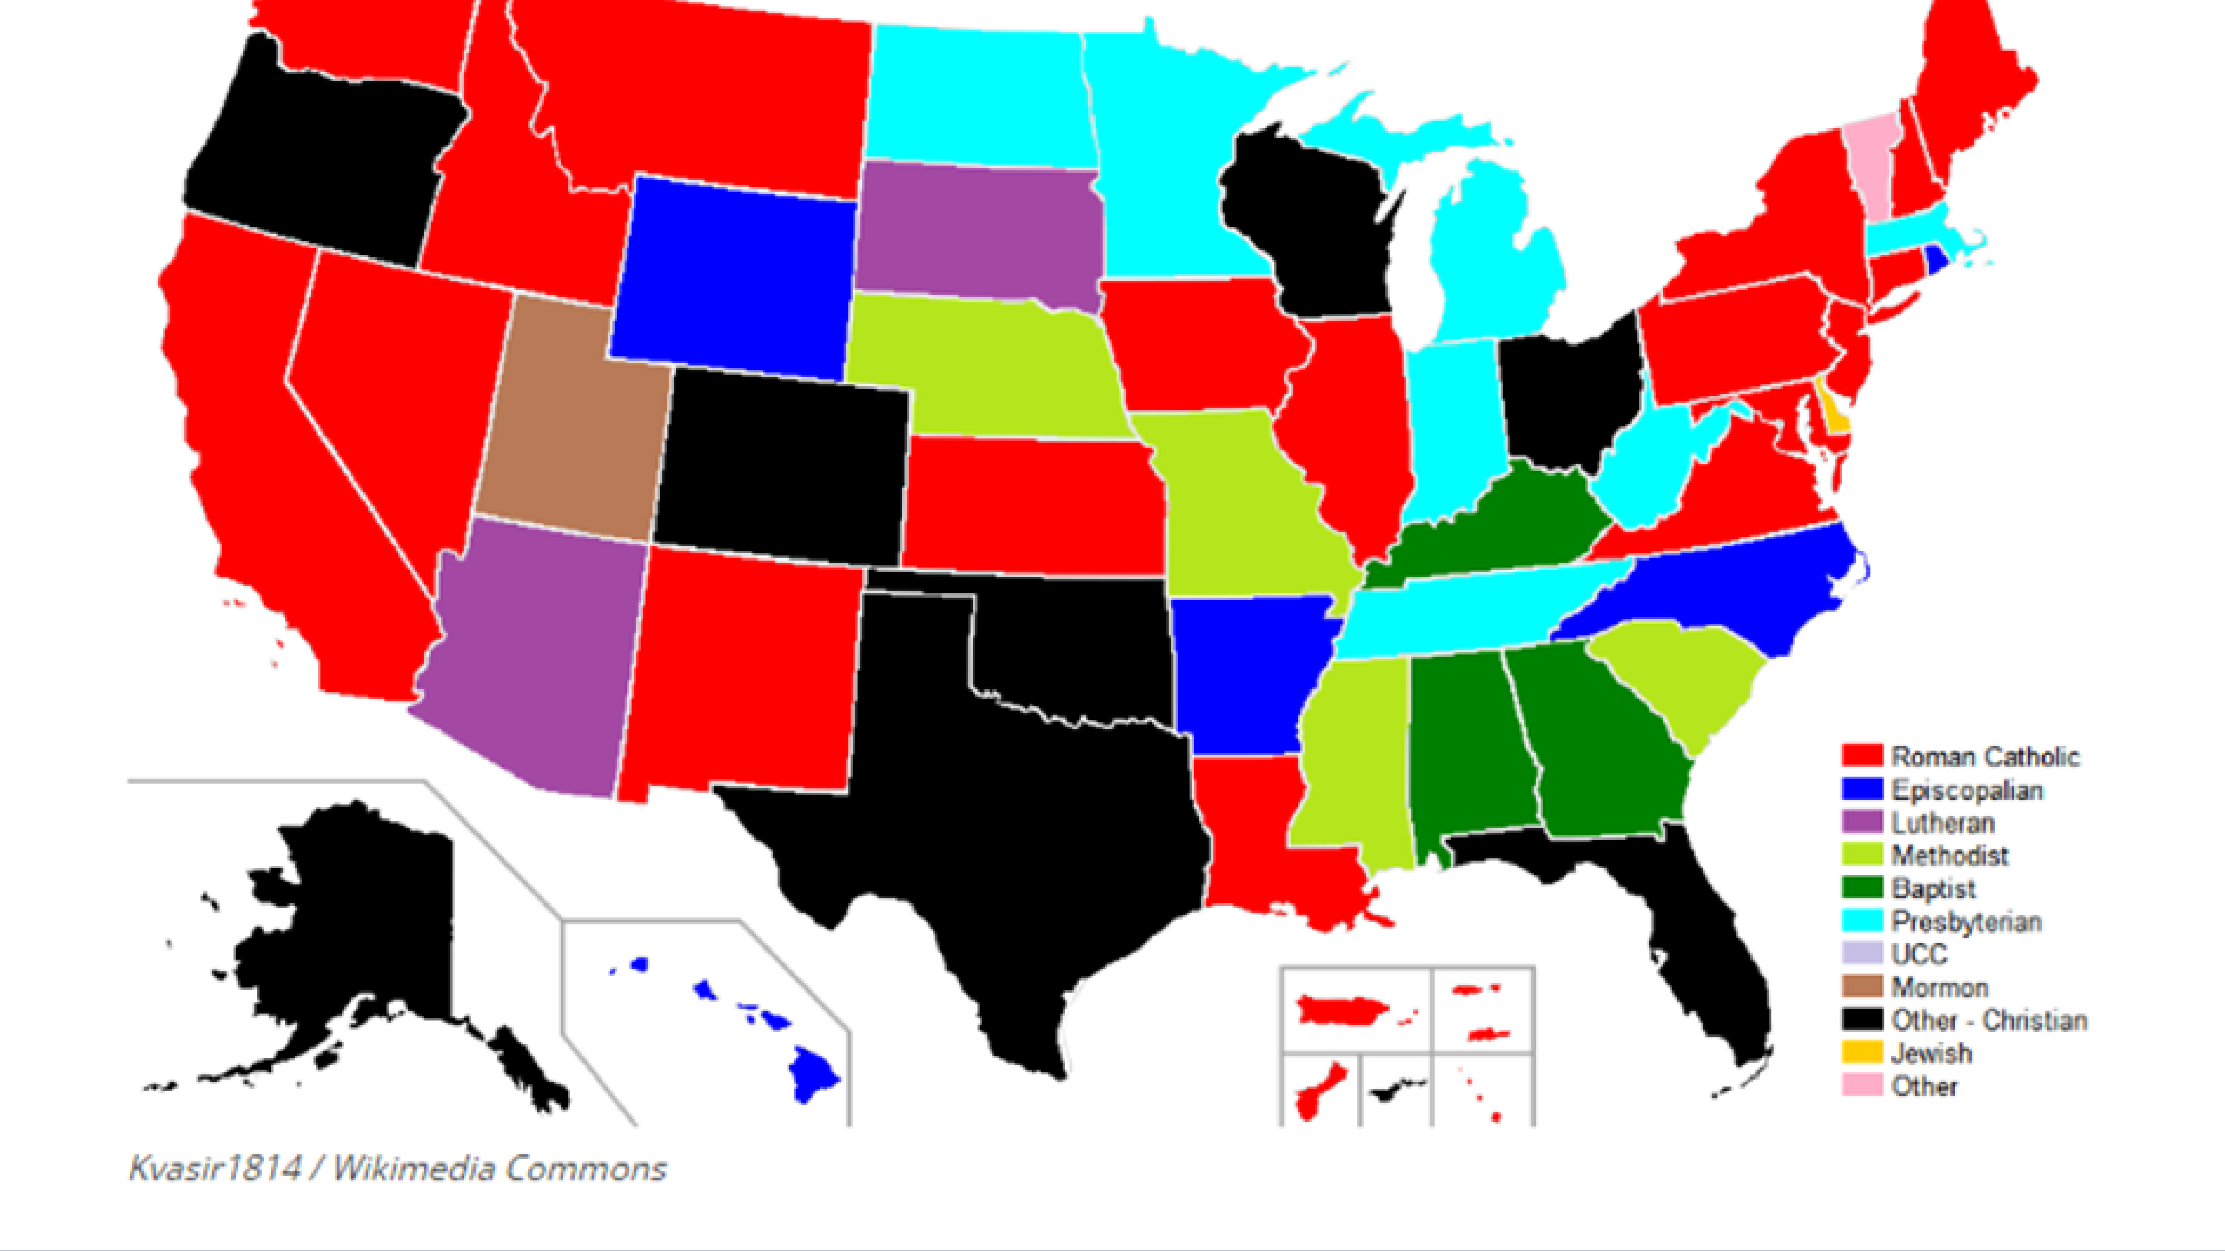

Slide 10
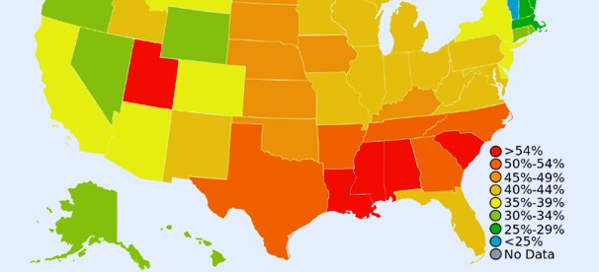
Weekly church attendance, by state

Slide 11
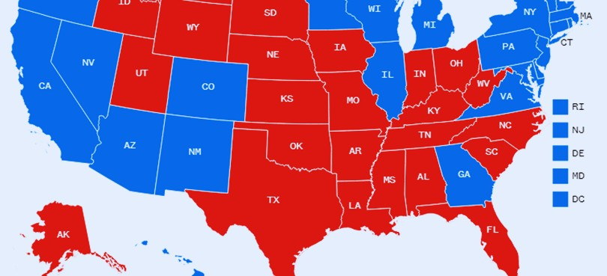
Voting behavior
Most Sunbelt states are pro republicans
Due to the industrial tribe in these areas (petrol and food industry)
split from west to east cost

Slide 12
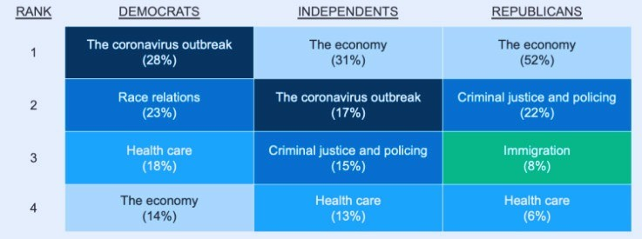

Slide 13


Economy
Outpaced the rest of the nation in terms of aggregate economic growth in last decades
Industries such as aerospace, defense, and oil boomed in the Sun Belt
the region is cheaper and there are fewer labor unions
six cities mainly drive the economy

