Slide 1
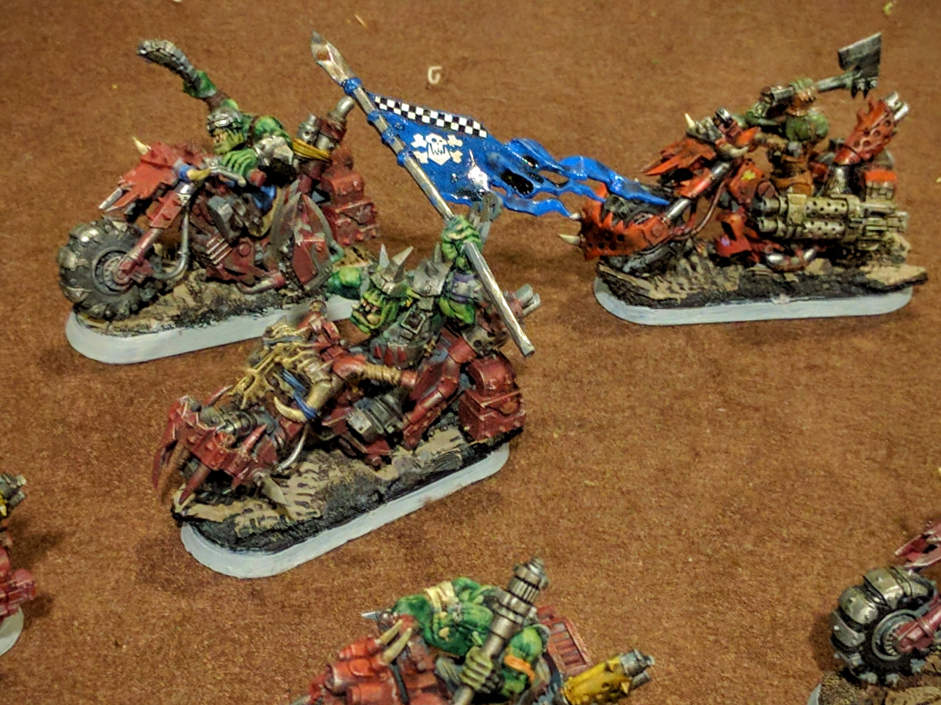
40k Trios

Slide 2
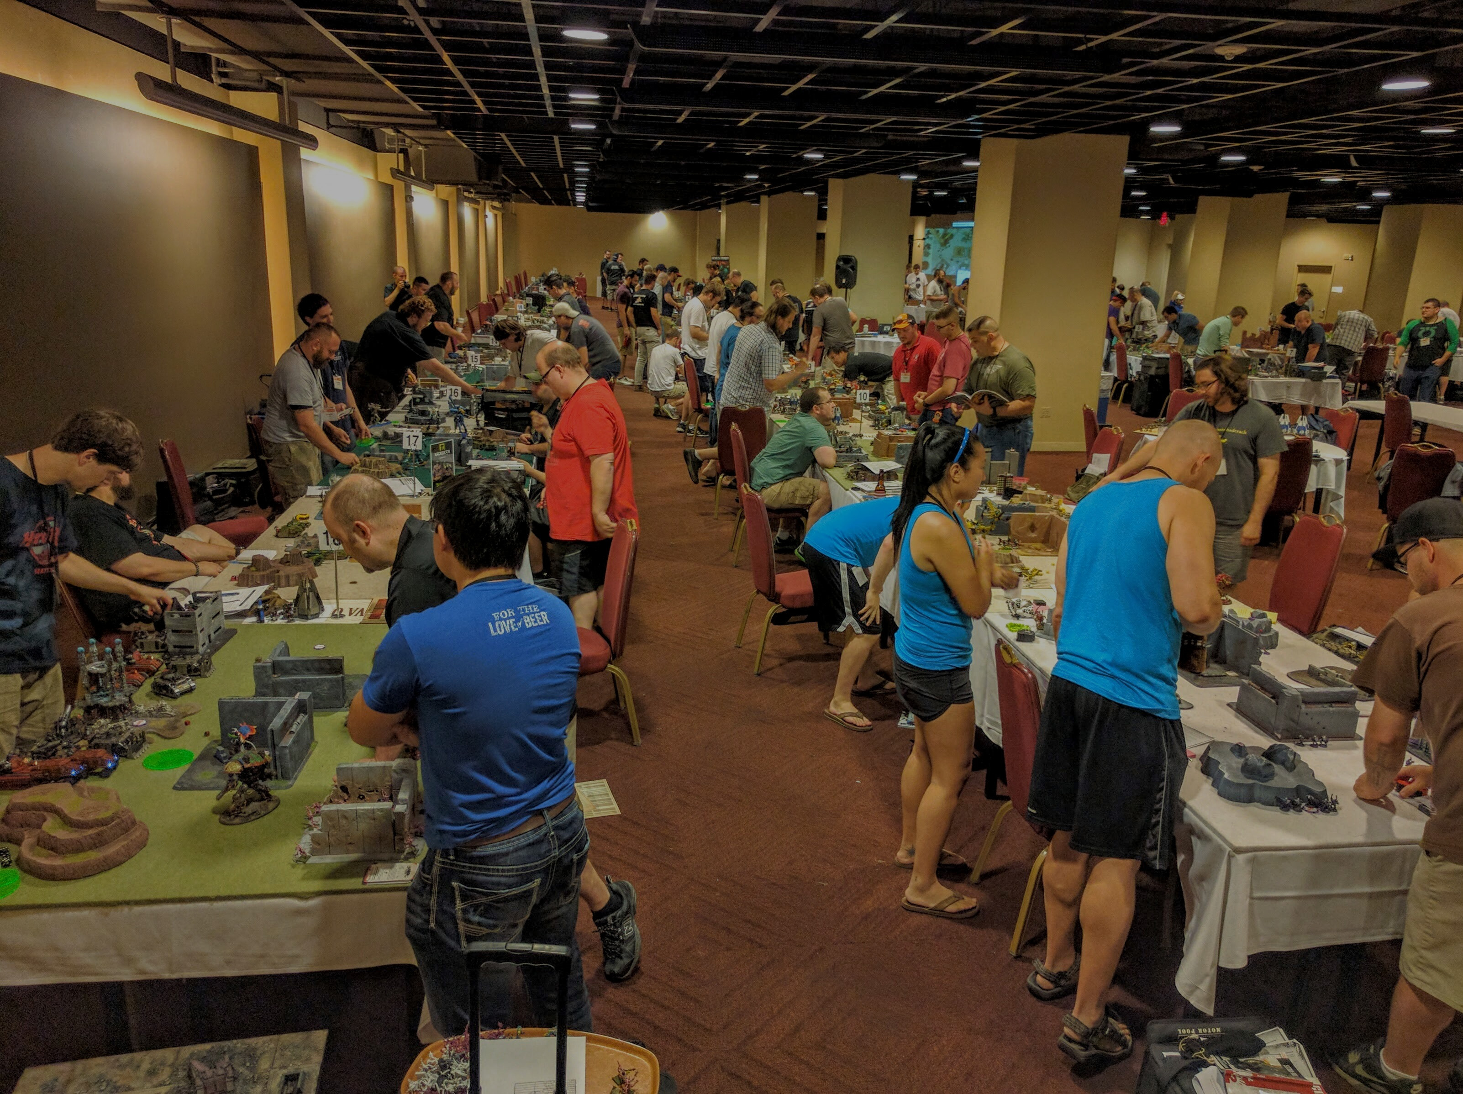
40k Trios Highlights
Doubled previous participation record
  18 teams, 54 players
New Warmaster achievements individual prize
Did not delay 40k Narrative: ULTIMATE VICTORY!

Slide 3
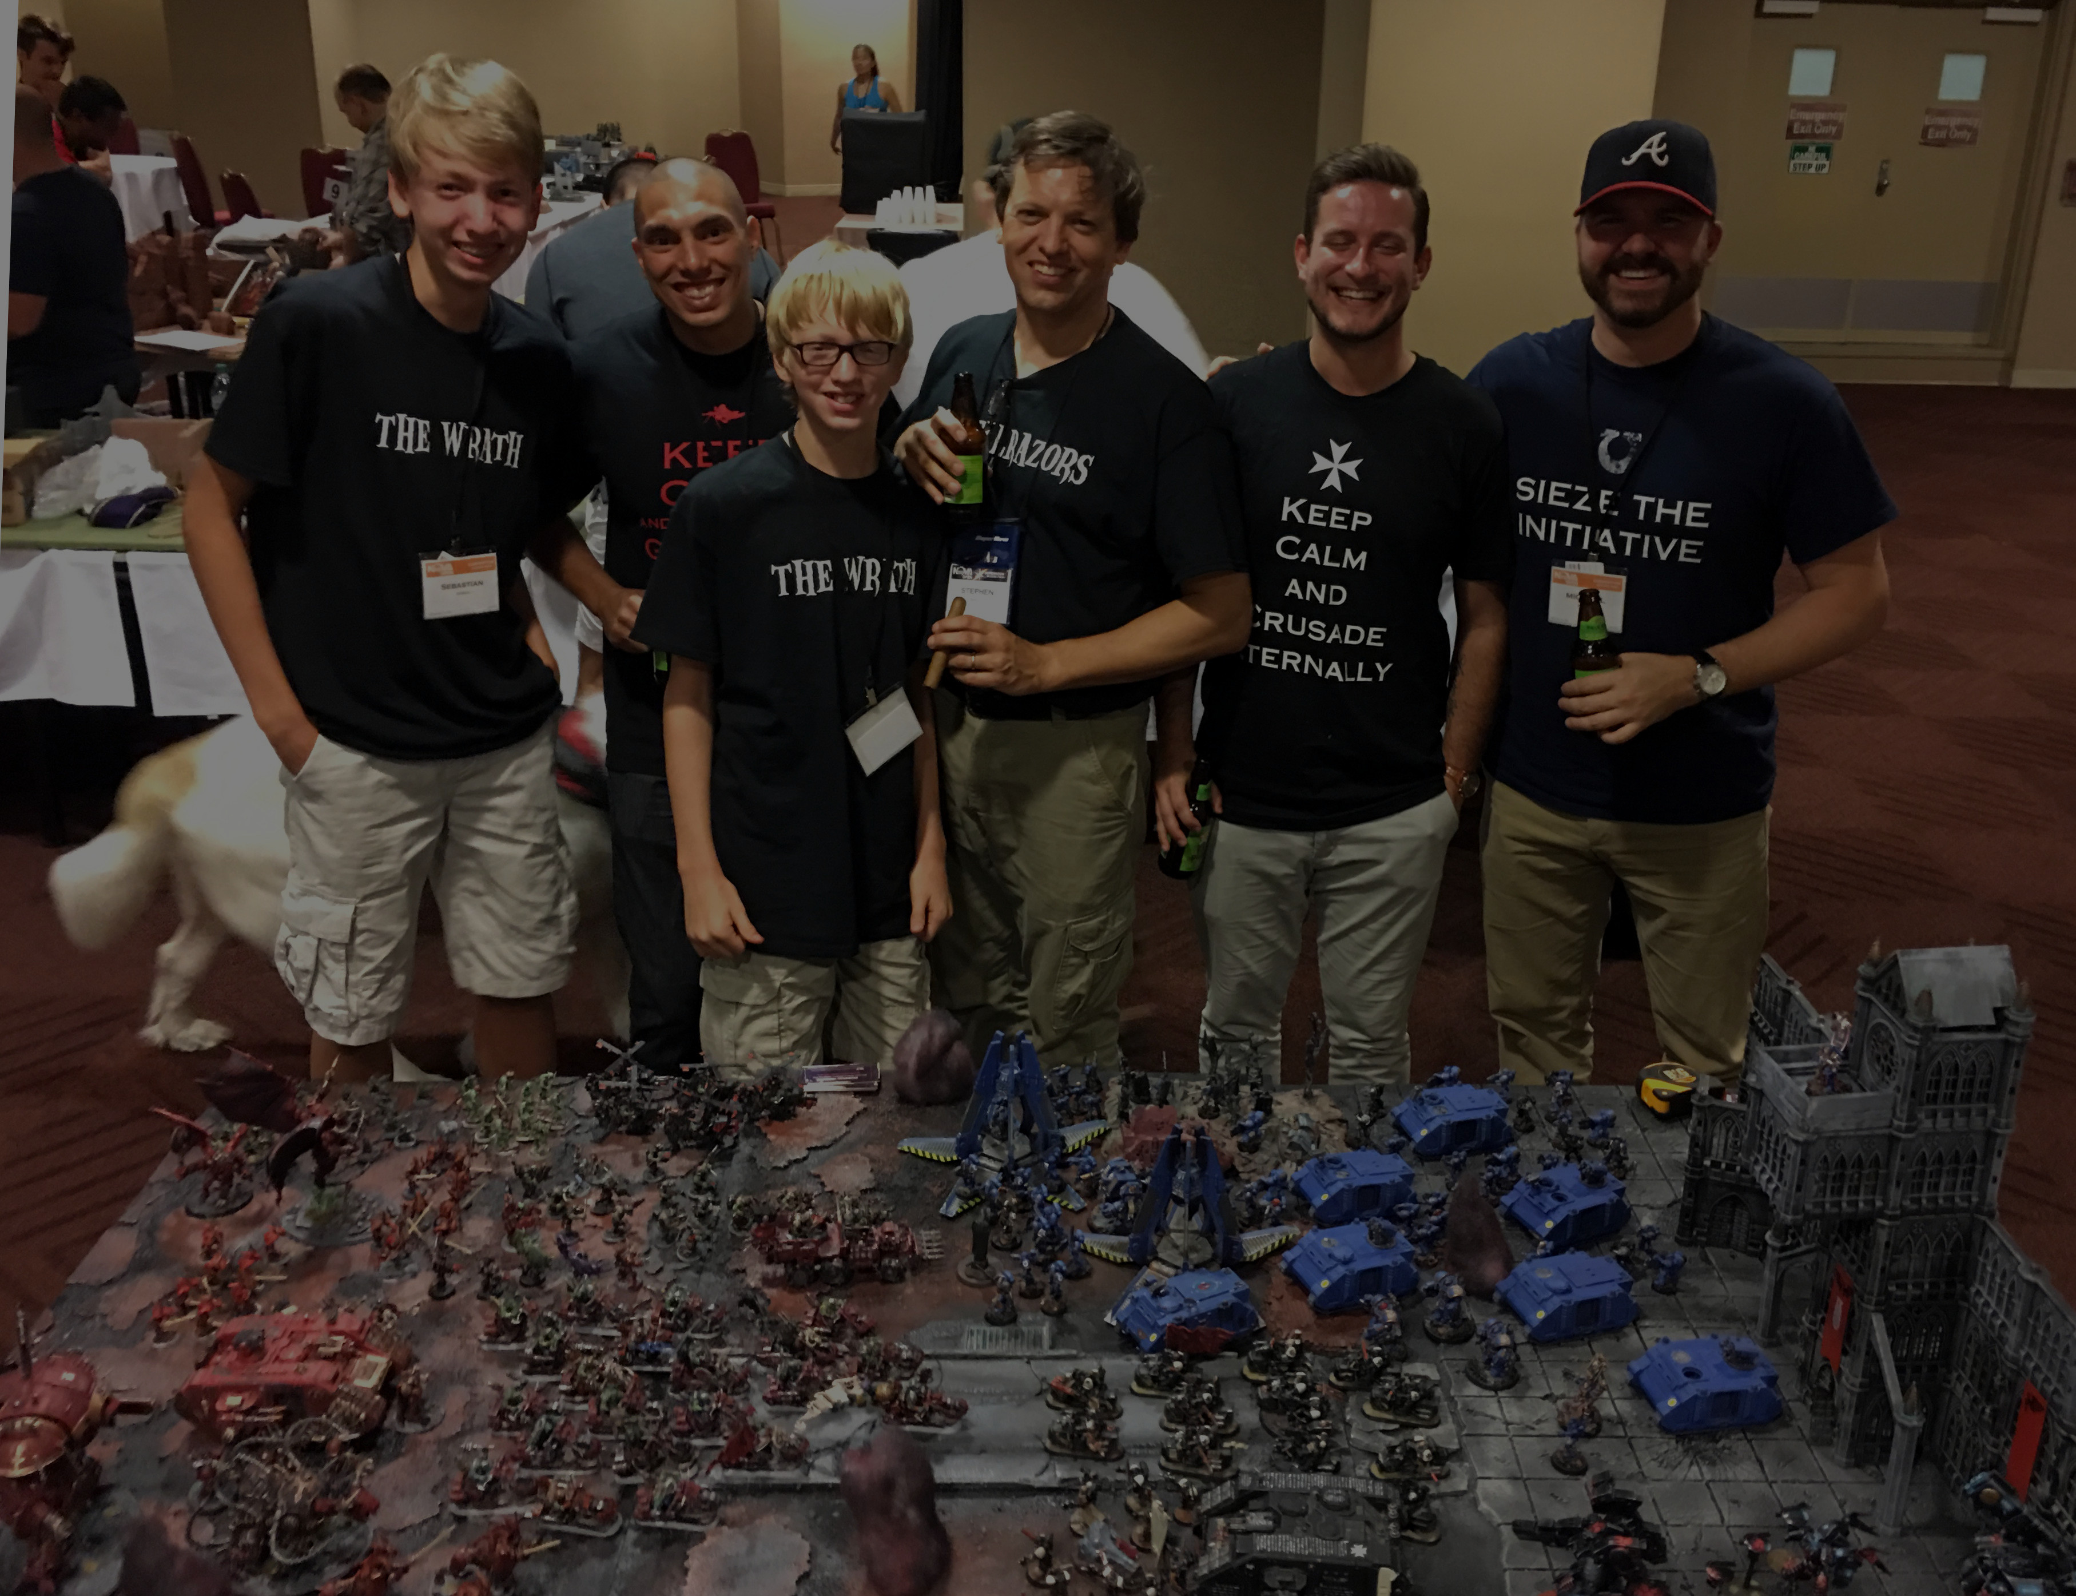
40k Trios Winners
Renaissance Trios: Team Determined
  Chris Bimbo, Steven Pampreen, Jhason Hardy
Strategists: Team Gallant
  Paul Bowman, Jessica Bowman, Dave Penfold
Artists: Team Judicious
Storytellers: Teams Bellicose and Heinous
  Clemente Berrios, Trevor Alen, Michael Hayes
  Stephen Duall, Sebastion Duall, Alex Duall
Warmaster: Jhason Hardy, Team Determined

Slide 4
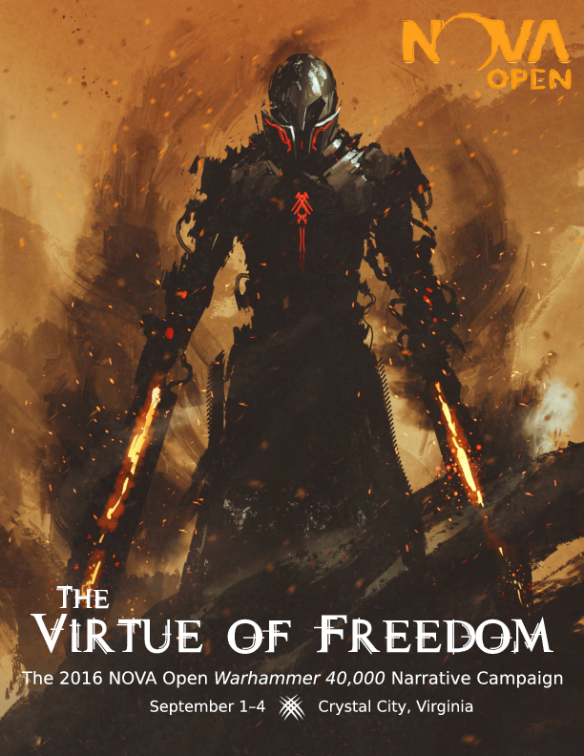

Slide 5
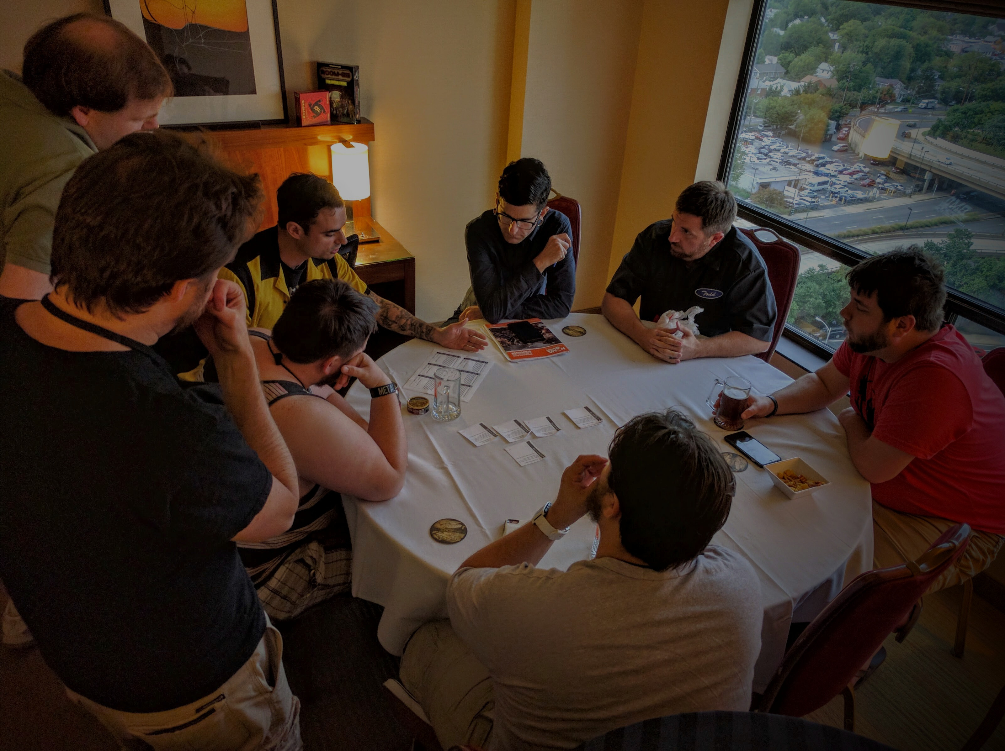
40k Narrative Highlights
All new storyful missions
  Shuttles crashing, convoys ambushed, etc
All new Fame & Infamy mechanic
  Saving or slaughtering civilians
All new Recon Squads skirmish track
  Warlords sending squads on critical missions
Next year: Much more flexibility to drop in & out
  Dayfighter missions & a la carte, like Recon Squads

Slide 6
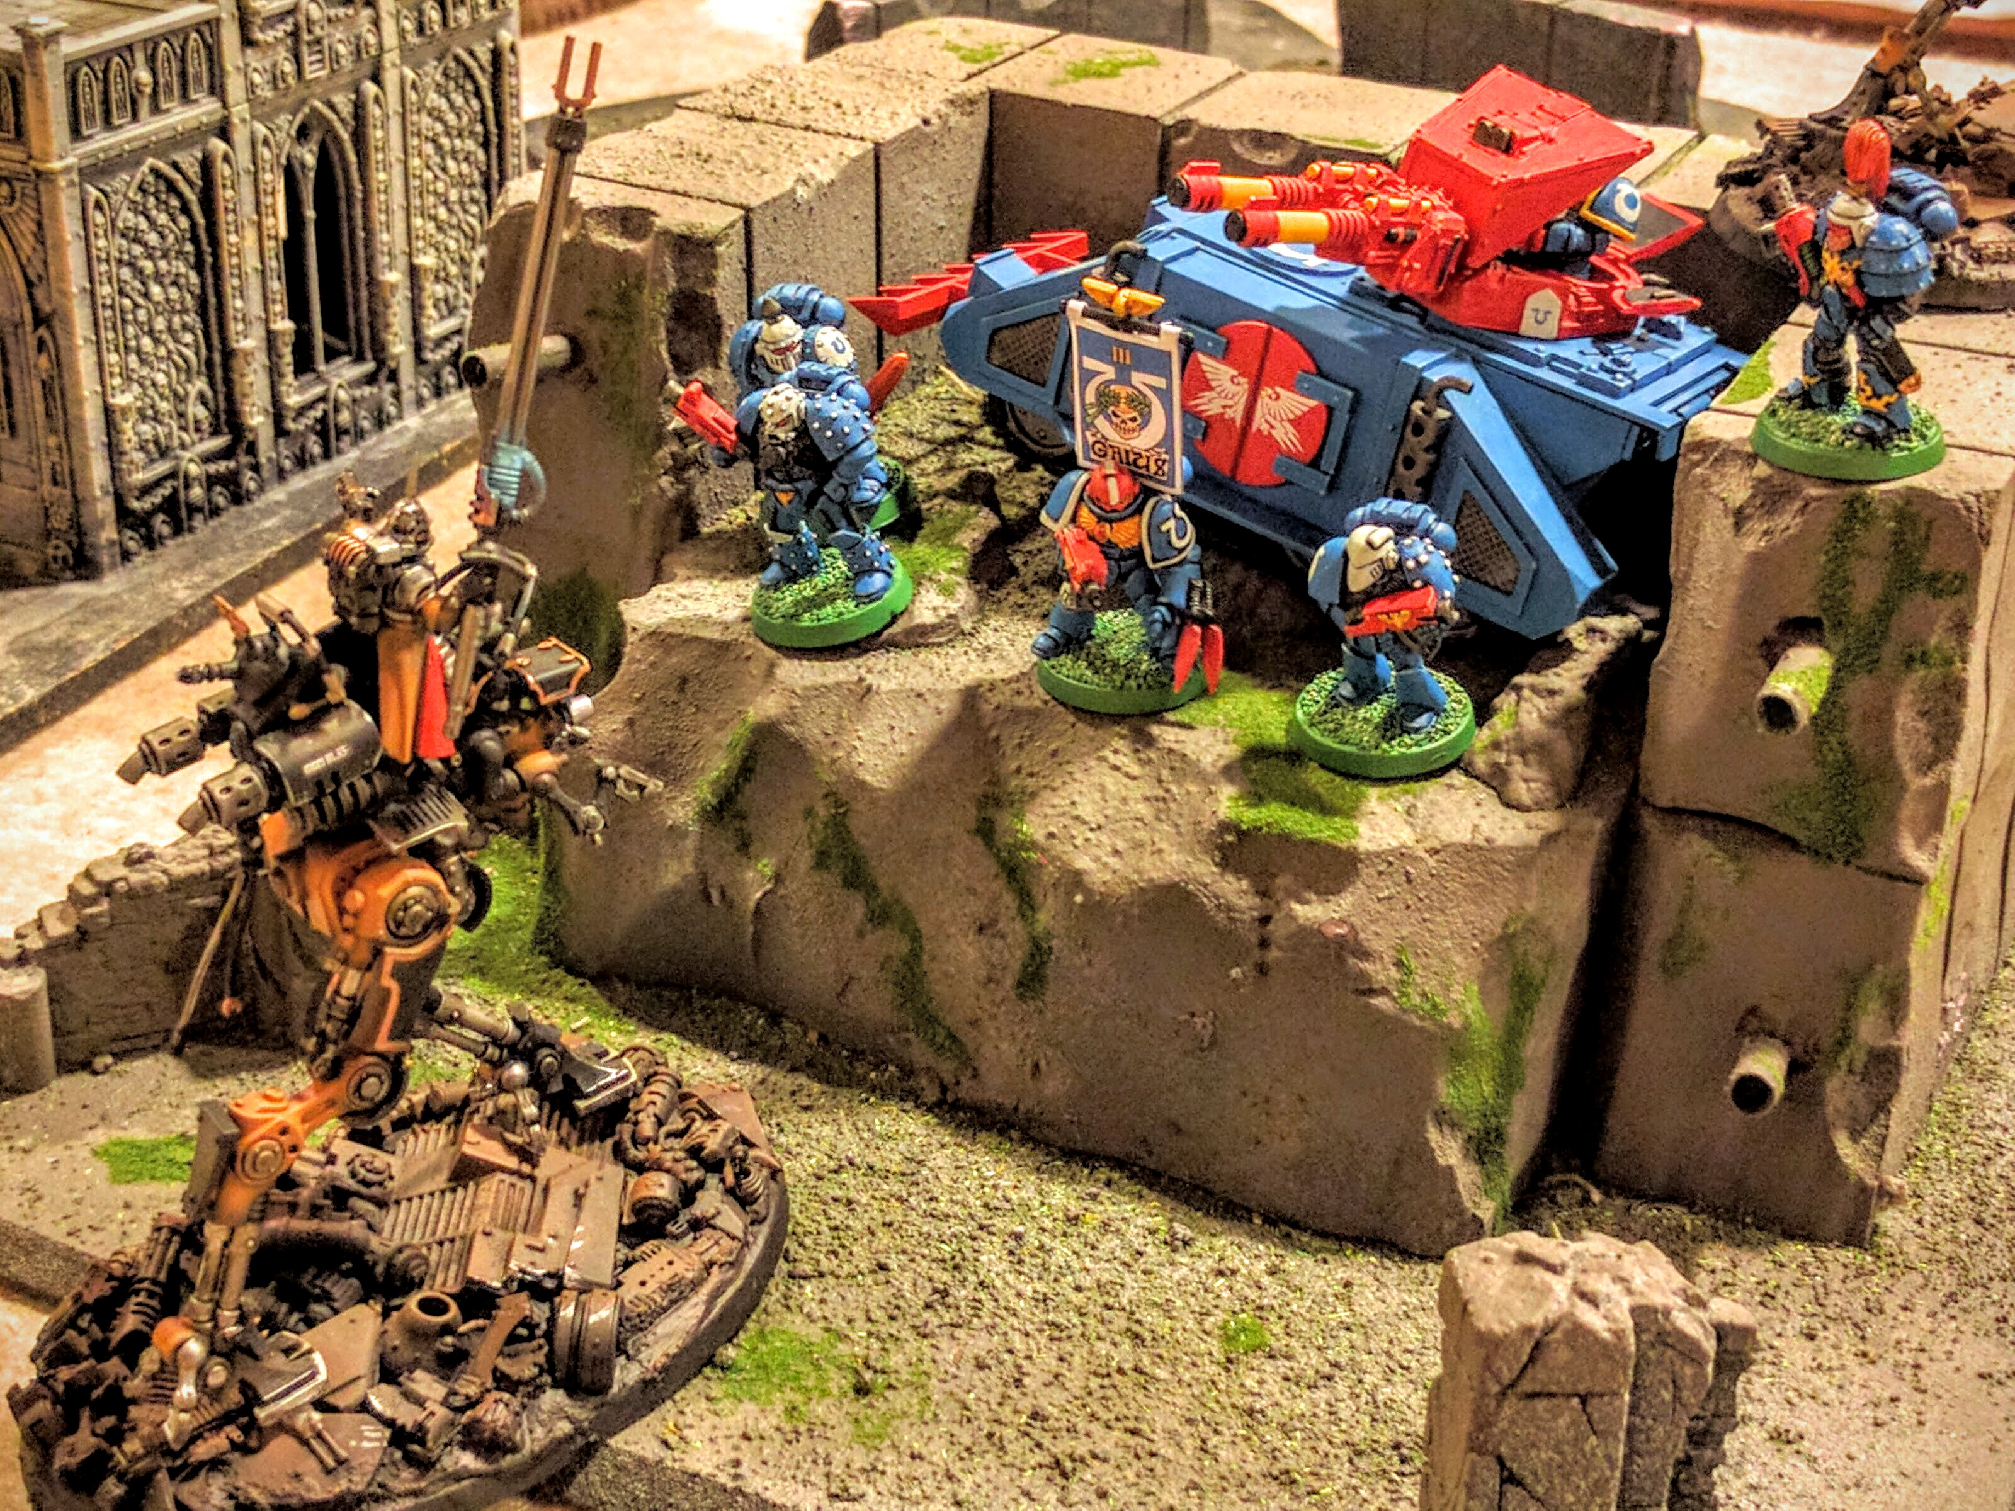
40k Narrative Outcome

Slide 7
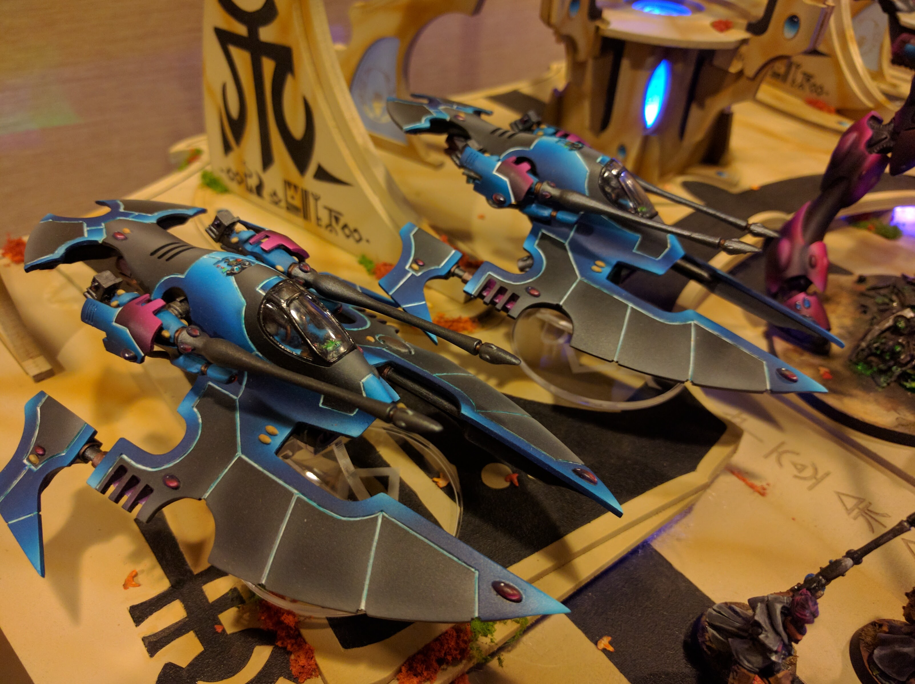
40k Narrative Winners
Craftsmanship
Fame & Infamy
Paragon of the Virtue & Hero of the Free
Subjugator of the Worlds

