Slide 1
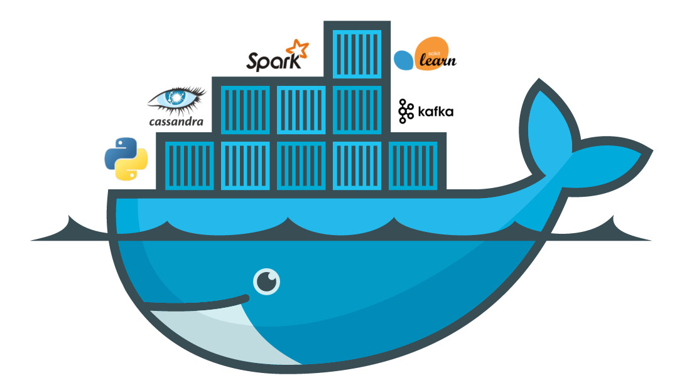
What is Docker?

Slide 2

AGENDA
INTRODUCTION to Docker
Understanding Docker
Use cases for Docker
Let’s do it together now.
Q&A

Slide 3
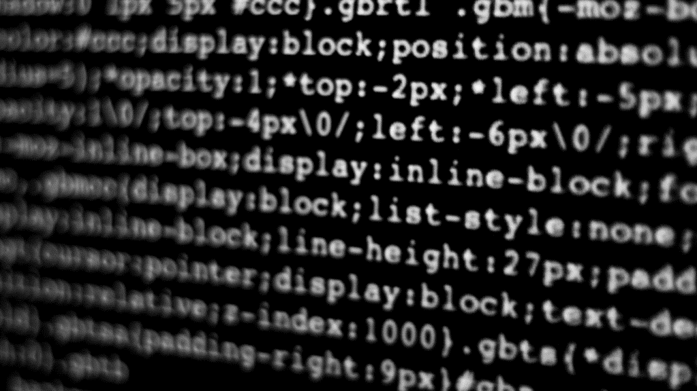
THE POWER OF
DOCKER

Slide 4
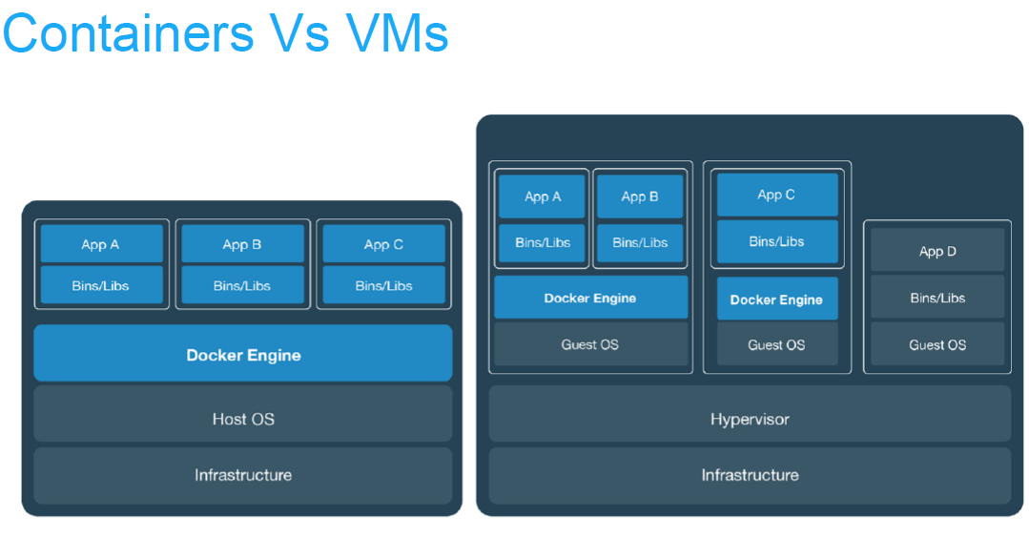
What is Docker?
Docker is the ability to run multiple
applications on the same hardware
in a virtualized environment without
over saturating your hardware resources
Docker containers are ethereal.
Docker containers scale to your usage.
Docker allows you to run applications that are OS specific in non OS specific environments.

Slide 5
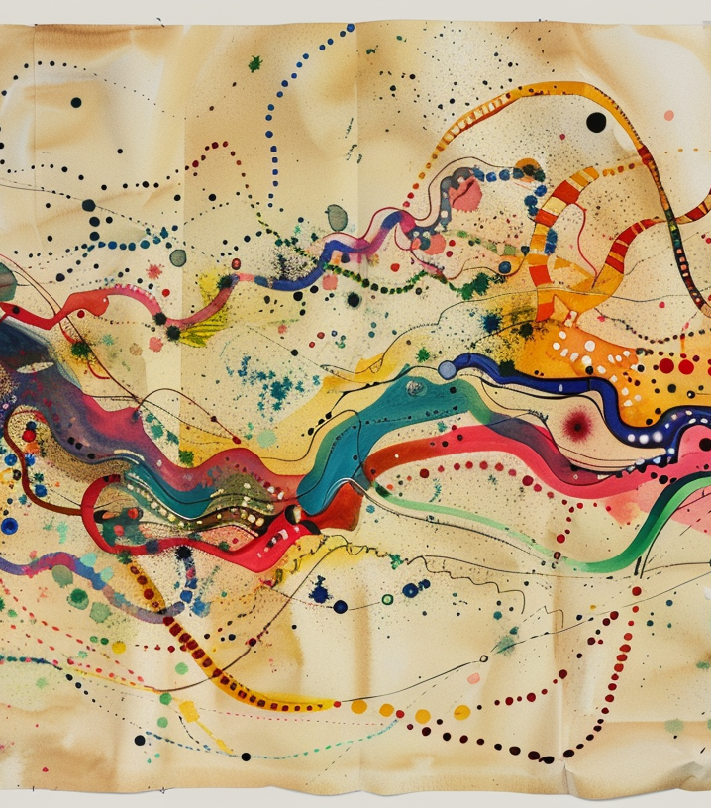
Why do I care about Docker?
What’s in it for me?

Slide 6
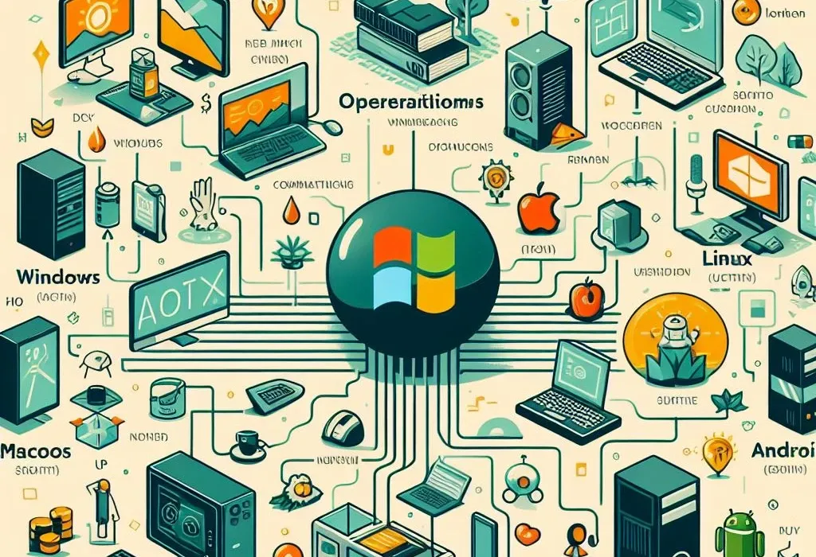
Docker Uses cases for Makers
All this hardware, and I have to install an OS?
IoT and Home Automation projects.
3D printer farm management.
Shared resourcing for Astrophotography with PixInsight or Siril
Telescope control automation without exposing hardware.
Astronomy simulations.
Collaborative Data collection, processing, and monitoring.

Slide 7

Docker Container Uses Continued
  Web Hosting Solutions – Wiki for exploratory note taking or project note taking
  Network management solutions
  SMB Controllers (more projects, less hardware)
  Hardware vs Software – Remotely mange your hardware without having it directly connected.
  Public Accessibility with CloudFlare Zero Trust env
  LLM for local AI
  Data management and Graphing
  OS trials – Wanna try a new Linux OS?
  Project doesn’t support your OS?
  Your project uses software that IS an OS?
  Collaborate on projects together an host a single source of truth for updates from each other.
  Dispose of projects you’ve abandoned and free up space.
  Flexibility to try more things with lower risk
  Faster deployments and uses

Slide 8
Docker Images.
What are Docker images?
Docker images are precompiled operating system images that have the applications installed at the OS level as a service or daemon.
It’s not magic.
It’s not a black box.

Slide 9
Let’s Deploy something with Docker!
  Deploying Ollama (LLM AI) with Docker!
  Prereqs:
  Have docker desktop installed.
  Navigate to the official Ollama site for instructions.
  https://ollama.com/blog/ollama-is-now-available-as-an-official-docker-image
  Follow instructions to pass GPU to Ollama docker image. (Where applicable.)
Seek feedback
Reflect on performance
Explore new techniques
Set personal goals
Iterate and adapt

Slide 10

THANK YOU
Q/A Time.

