Slide 1
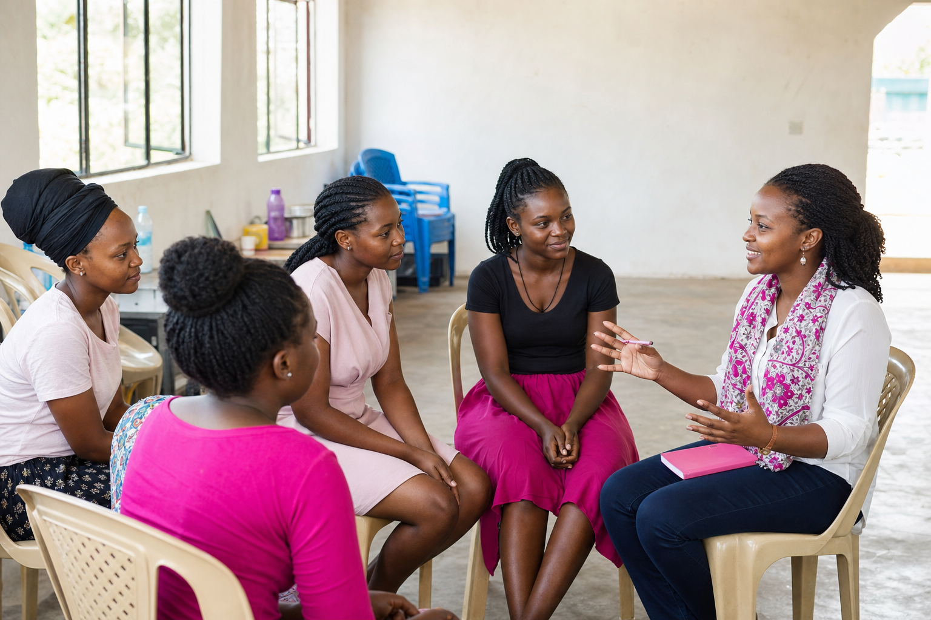

SisterCares
ORGANISATION PITCH · 2026
No girl or woman should face pain, stigma or a difficult question alone.
SisterCares joins private digital support with practical community action for mental wellbeing and menstrual dignity.
LISTEN
SUPPORT
EQUIP
REFER
Uganda · built to grow with trusted local partners

Slide 2

SisterCares
THE CHALLENGE
THE CHALLENGE
The need is larger than an app.
A private digital channel matters, but many people also face limited phone access, stigma, material poverty and weak referral pathways.
1
Silence and stigma
2
Unequal access
Mental distress, harassment and menstrual questions may feel unsafe to discuss.
Some girls do not own a phone or can use one only during school holidays.
3
Material barriers
4
Broken handoffs
Pads, accurate information and safe disposal are not always available.
A referral is not enough if nobody checks whether support was reached.
Source: WHO, Mental health of adolescents (2025)
Source: UNICEF, Menstrual hygiene
02
Notes:
Sources: WHO Mental health of adolescents, 1 September 2025; UNICEF Menstrual hygiene. The need statement combines published context with SisterCares' intended community discovery; it does not claim measured local prevalence.

Slide 3
SisterCares
OUR MODEL
OUR MODEL
One trusted organisation, several ways to ask for help.
People can enter through the channel available to them and still reach information, a trained human, practical support or referral.
SisterCare app
1
SisterCare app
SisterBoxes
Community conversations
Menstrual dignity
1
2
3
4
Private conversation, cycle context and verified counsellor support for eligible users.
Private conversation, cycle context and verified counsellor support for eligible users.
Locked question boxes let students ask anonymously without needing a phone.
Facilitated mental-health and menstrual-health sessions answer real concerns without shame.
Pads, first-period guidance and SisterCares disposal bins make support practical.
Every channel should lead to a clear answer, practical support or a completed referral.
03

Slide 4
SisterCares
ACCESS WITHOUT A PHONE
ACCESS WITHOUT A PHONE
A question can still reach help.
The offline pathway is designed for schools and communities where personal phone access cannot be assumed.
1
Ask anonymously
2
Review safely
3
Respond
4
Refer and follow up
→
→
→
Write a question and place it in a locked SisterBox.
A trained, authorised focal person groups questions and escalates safety concerns.
A facilitated session answers common questions without identifying the writer.
Private concerns move to an agreed safeguarding or clinical pathway.
Safeguarding boundary
The adult app pilot does not automatically extend to minors. School programmes require consent rules, trained staff, referral partners and incident ownership before launch.
04

Slide 5
SisterCares
PROGRAMME PORTFOLIO
PROGRAMME PORTFOLIO
Support the whole person, not one isolated symptom.
Mental wellbeing and menstrual dignity are linked in the organisation, while each programme keeps a clear purpose and accountable owner.
1
Mental wellbeing
2
Menstrual dignity
Listening spaces, stigma reduction, coping education, safeguarding and completed referrals.
Pads, first-period guidance, myth correction and practical self-care information.
3
Safe environments
4
Digital continuity
Anonymous question boxes and maintained disposal bins in partner sites.
Eligible users continue privately through the app and verified counsellor network.
05

Slide 6
SisterCares
PEOPLE AND PARTNERS
PEOPLE AND PARTNERS
Local trust is how the model reaches people safely.
SisterCares provides the system and accountability; established partners provide context, access and specialist support.
1
School-aged girls
2
Young women and adults
3
Schools and universities
Safeguarded offline programmes, menstrual dignity and anonymous questions.
App access, community conversations and verified counsellor support.
Sites, focal persons, student services and safeguarding structures.
4
NGOs and clinics
5
CSR and funders
6
Local leadership
Specialist referrals, supervision, community access and evidence.
Pads, bins, pilot funding, evaluation and responsible scale.
Permission, cultural context, accountability and community trust.
06

Slide 7
SisterCares
IMPACT
IMPACT
Measure whether support helped, not how busy we looked.
Registrations, sessions and pad counts are useful operations data. They are not the final proof of impact.
01
A difficult question was answered
02
The person felt heard
The person received a clear response through the app, a SisterBox or a facilitated session.
Private feedback shows whether the interaction respected and helped her.
03
A referral was completed
04
Menstrual barriers reduced
Serious cases have an owner and follow-up, rather than only a phone number.
Participants report better knowledge, product access and safe disposal at the site.
Pilot targets will be agreed with partners before delivery; no impact figures are claimed yet.
07

Slide 8
SisterCares
SUSTAINABILITY
SUSTAINABILITY
Blend earned income with mission-aligned support.
No single revenue source should decide who deserves help.
1
Premium app
2
Institutional programmes
3
Grants and CSR
4
In-kind partners
Paid AI and counsellor access for users who can afford it.
Universities, NGOs and schools fund agreed support packages.
Fund early pilots, pad access, bins, safeguarding and evaluation.
Clinicians, manufacturers and venues reduce delivery cost.
No advertising · no sale of private data · transparent sponsored access
08

Slide 9
SisterCares
THE FUTURE
THE FUTURE
Build the evidence, then make the model easier to repeat.
The organisation grows site by site, keeping local referral ownership and safeguarding ahead of visibility.
YEAR 1
YEAR 2
YEAR 3
Prove three sites
Deepen locally
Prepare to replicate
Co-design and run the integrated model. Measure trust, referral completion, menstrual dignity and true delivery cost.
Target ten partner sites across two districts, with trained focal people and dependable clinic and safeguarding partners.
Publish the model, improve procurement and create a district-ready toolkit without weakening local accountability.
Decision rule
Pause any service whose people, safeguarding, supplies or referral capacity cannot meet its promise.
09

Slide 10
SisterCares
FUNDING ASK
FUNDING ASK
US$40,000 for a 12-month, three-site integrated pilot.
Grant and CSR funding will test the complete organisation model: private support, mental-health programming, menstrual dignity, safe facilities and completed referrals.
Community programme delivery
25%
$10,000
THE ASK
Pads and menstrual education
25%
$10,000
US$40,000
SisterBoxes, bins and installation
15%
$6,000
12 months · 3 pilot sites
Safeguarding and referral support
15%
$6,000
Restricted to delivery, dignity supplies, safeguarding and evidence milestones.
Measurement and learning
10%
$4,000
Governance, communication and contingency
10%
$4,000
Partners can also contribute pads, bins, venues or clinical time.
Funds unlock: 3 equipped sites · anonymous questions · pad access · safeguarded support · measured referrals
Local procurement will be rebudgeted at the prevailing official exchange rate before disbursement.
kamwangaraheem2050@gmail.com · +256 704 057 370 · sister-care.vercel.app
10
Notes:
Planning conversion uses the Bank of Uganda's published exchange-rate context. Final local procurement budget should use the prevailing official rate at disbursement: https://bou.or.ug/interest_rates_exchange_rates

Slide 11
SisterCares
THE TEAM
THE TEAM
Three builders turning private questions into practical support.
The organisation starts with a working application and grows through responsible community partnerships.
KR
Kamwanga Raheem
KA
Kisakye Abigail
KI
Kaboggoza Ivan
Product and engineering
Founding team
Founding team
What we need now
US$40,000 · 3 pilot sites · clinical, pad, bin and safeguarding partners
kamwangaraheem2050@gmail.com
+256 704 057 370
sister-care.vercel.app
11

