Slide 1


Slide 2

Sprout
Bärn Häckt 2023
Joel Robles
Chiara Stampfli
Cédric Zwahlen

Slide 3
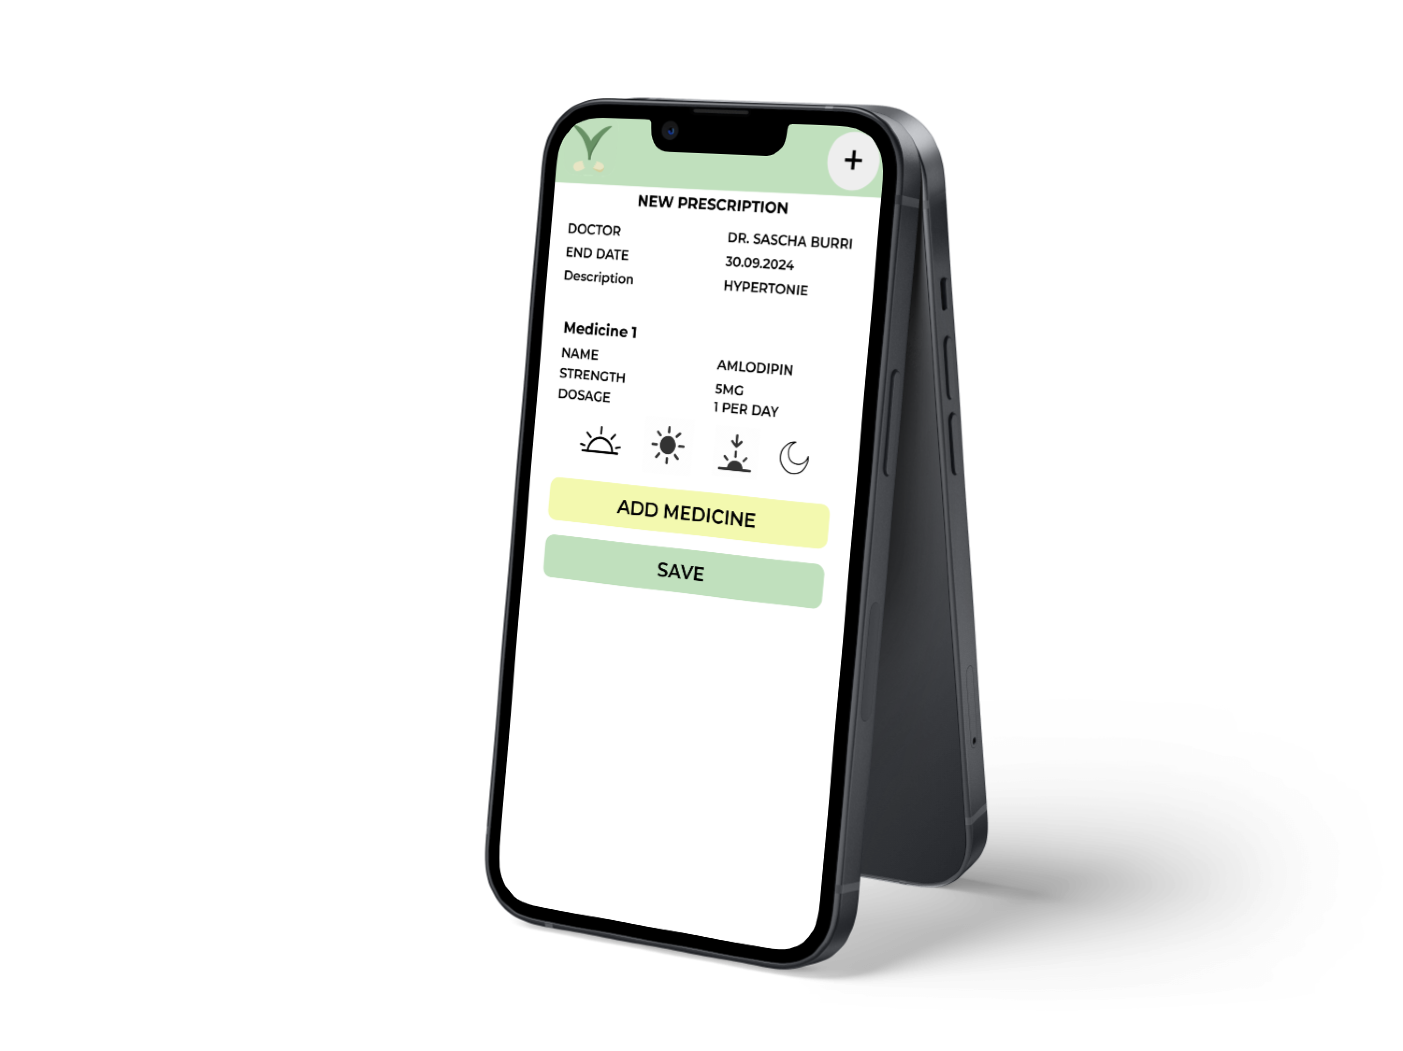
ADD YOUR PRESCRIPTIONS

Slide 4
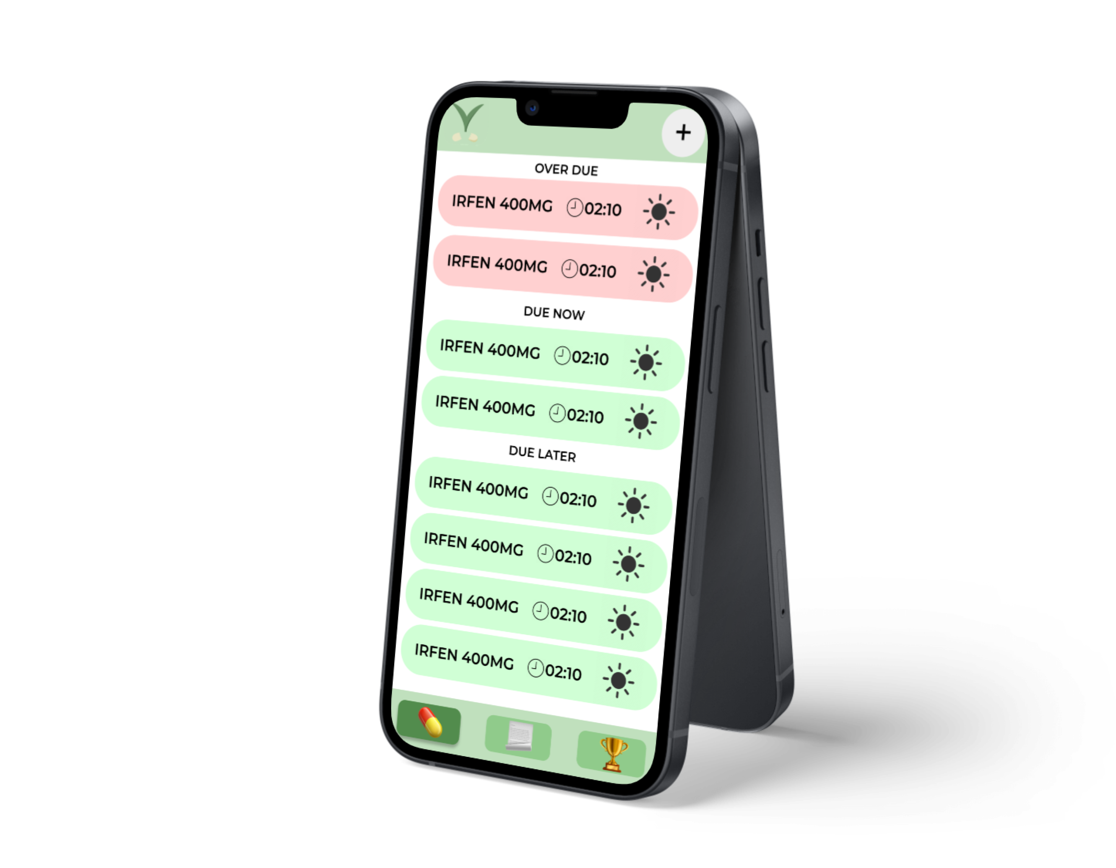
QUICK OVERVIEW

Slide 5
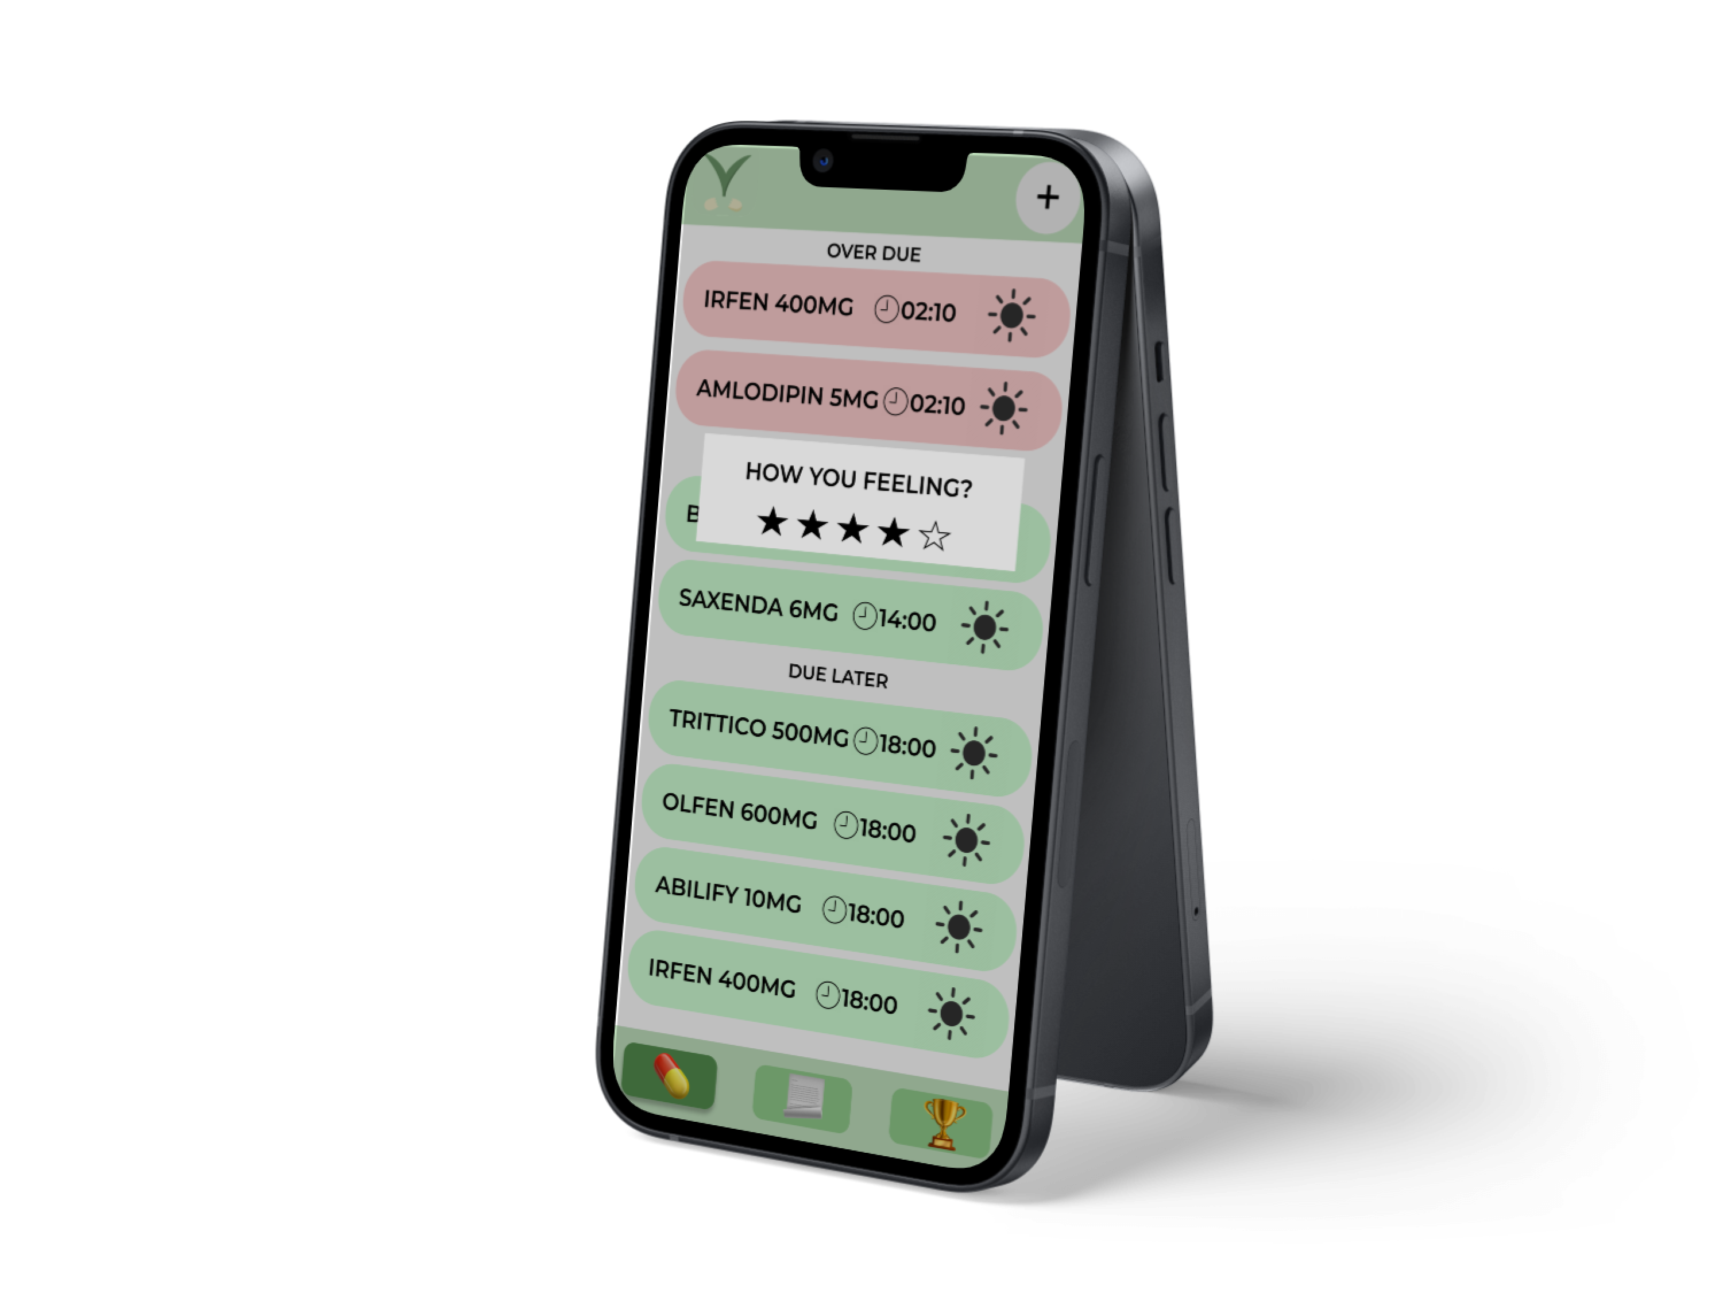
RATE YOURSELF

