Slide 1

BBS Signature Scheme From Theory to Implementation
Joël Gabriel Robles Gasser
&
Miguel Angel Schweizer

Slide 2
Task
Implement the Identity Foundation BBS Signature Scheme Draft Pseudocode into Java code

Slide 3
Example

Slide 4
Why is BBS so fancy?
Decentralized Identity
Verifiable Credentials
Selective Disclosure
Linked Secrets
Unlinkable Proofs
Proof of Posession

Slide 5
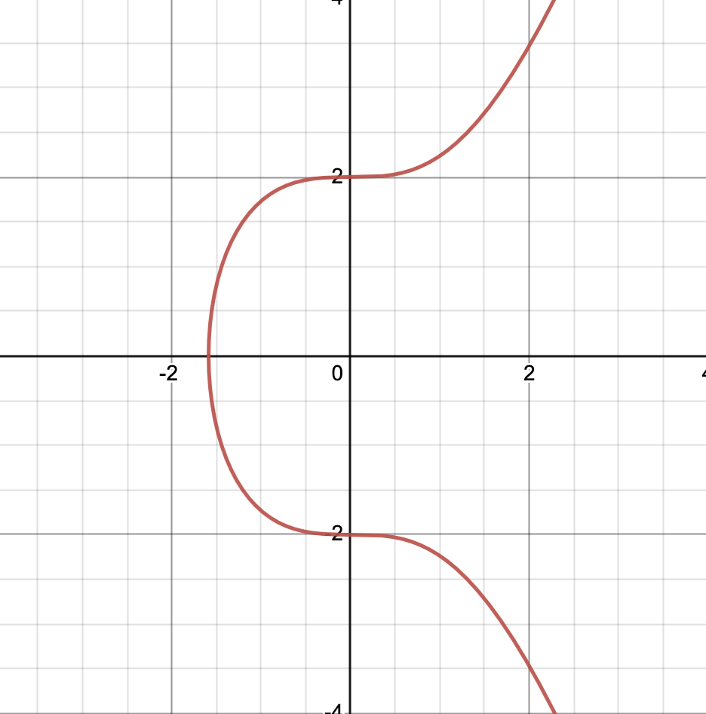
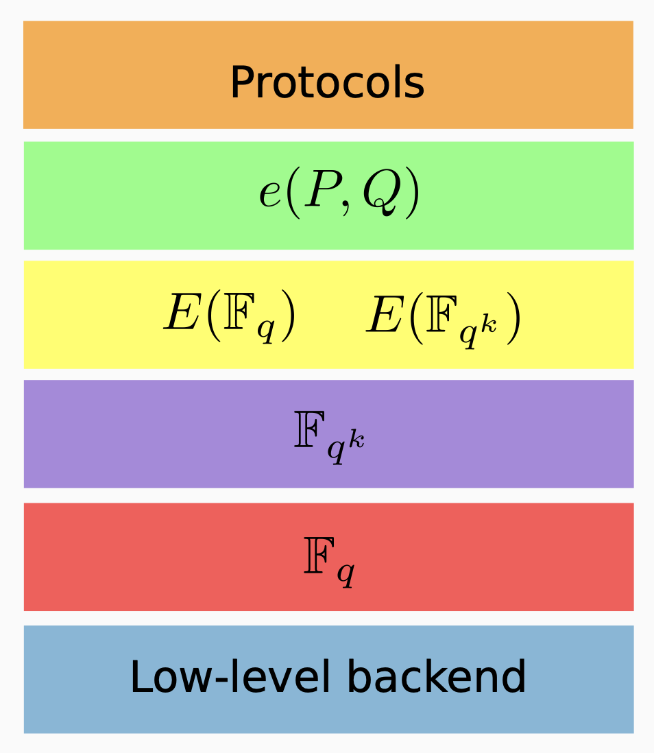
BLS12-381

Slide 6
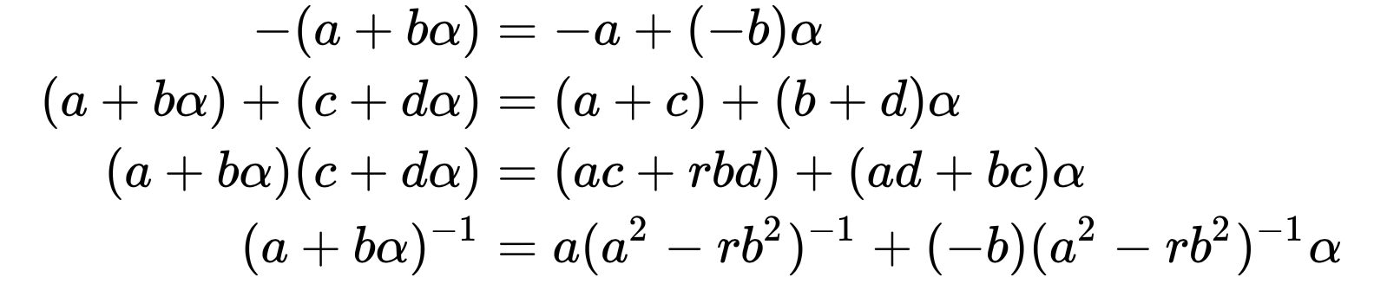
Polynomials

Slide 7
Pairings

Slide 8
The Recipe
Identity Foundation BBS Signature Scheme Draft

Slide 9
Implementation

Slide 10
Encountered Problems
Difficult Research
High Mathematics
Constant change of the Draft
A lot of mistakes in the Draft

Slide 11
Is the goal achieved?
YES!
Working Java code for the next step -> Bachelor-Thesis

Slide 12
Questions

Slide 13
Thank you for listening!

