Slide 1

BBS Signature Scheme
From Theory to Implementation
Joël Gabriel Robles Gasser & Miguel Angel Schweizer
Presentation Project 2 BTI3041
Notes:
https://www.zdnet.com/a/img/resize/54a8df488b3da3a9d0956a6a90a167da17372df9/2023/10/04/5fcc0bbf-b43e-4c1a-a58e-916cd9ddb63d/gettyimages-913017298.jpg?auto=webp&width=1280

Slide 2
Tasks
Understanding :
Elliptic curves
Pairings
Why BBS?
Implement the IETF BBS Signature Scheme Draft Pseudocode into Java code

Slide 3
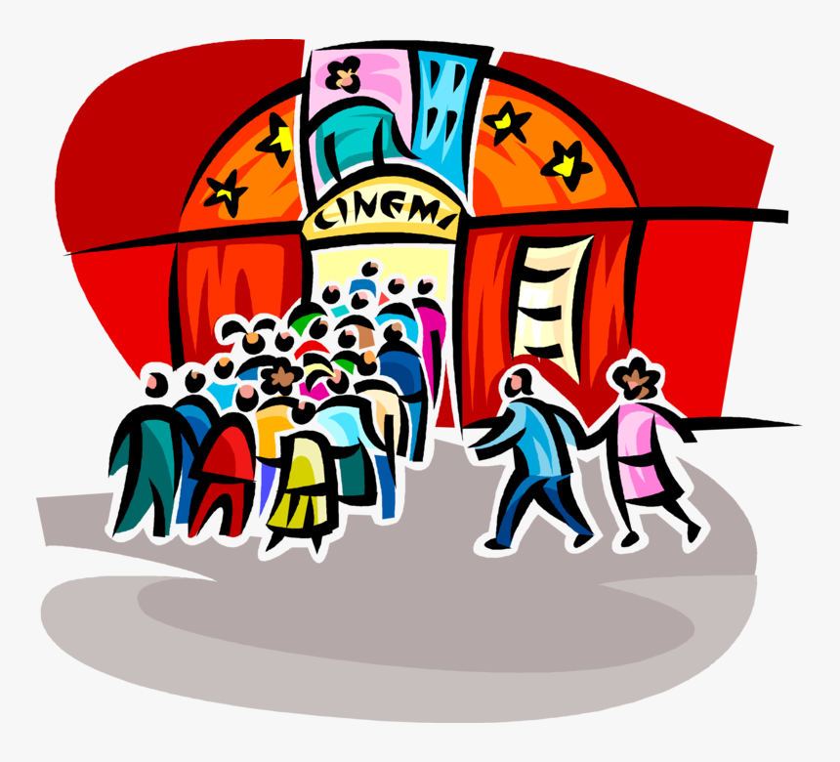
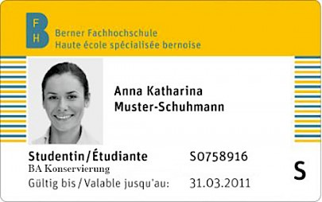
Example
BFH Card -> Verified if valid when purchasing something
Notes:
BFH-Card: https://mmbe.ch/wspx/site/assets/files/1600/bfh-card_kur.405x0-is.jpg
Cinema: https://www.kindpng.com/picc/m/346-3466294_vector-illustration-of-cinema-movie-theatre-or-theater.png

Slide 4
Why is BBS so fancy?
Verifiable Credentials
Selective Disclosure
Proof of Posession
Unlinkable Proofs
Notes:
Public key and secret key

Slide 5
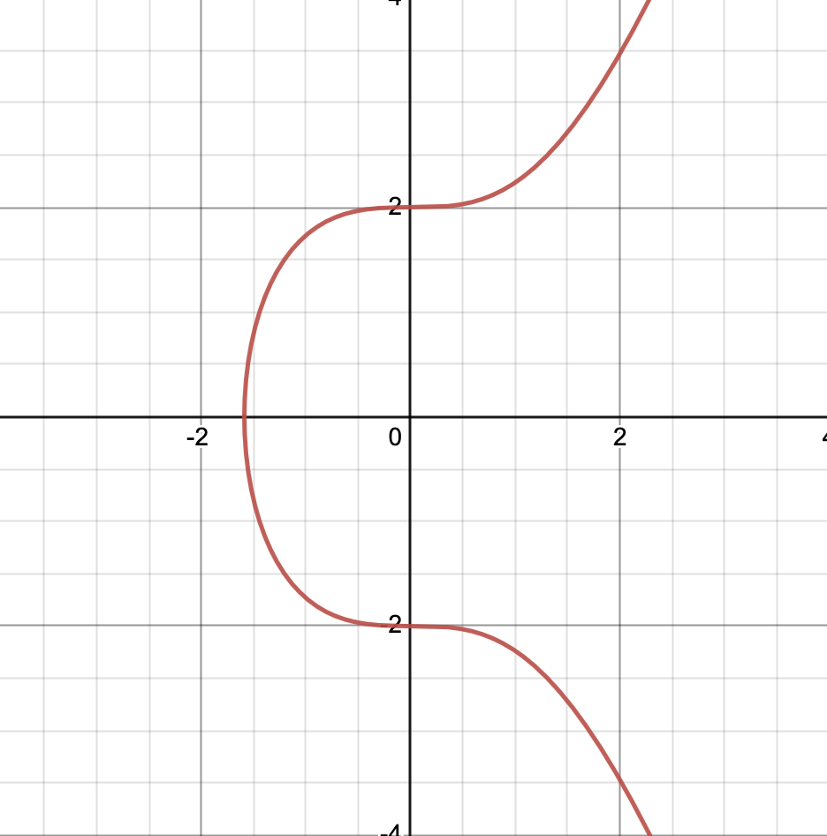
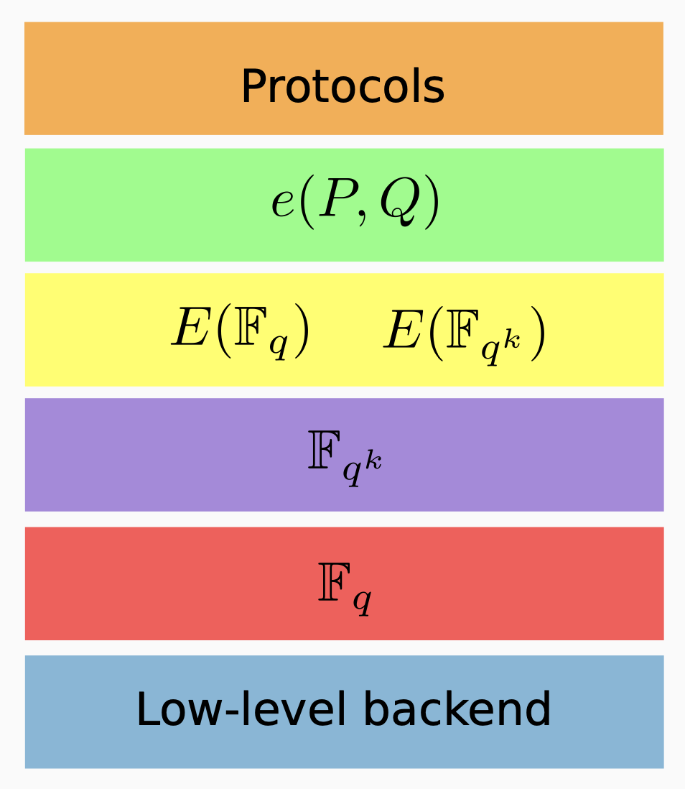
BLS12-381
Notes:
2017 Sean Bowe
Pairing-firenldy curve -> efficient for Digital signatures
Baretto, Lynn and Scott
12 -> embedding degree , 381 bits size of the field mod q

Slide 6
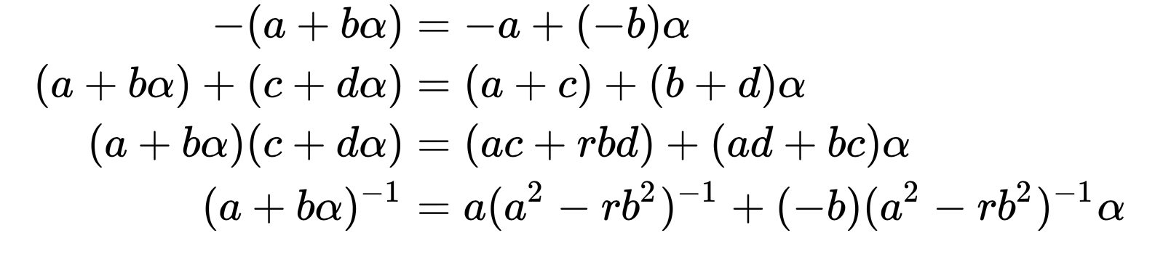
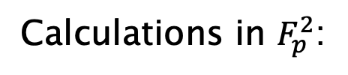
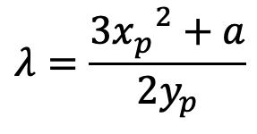


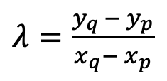
Calculations
Slope:
$λ=\frac{y_{q }− y_{p}}{x_{q}− x_{p}}$
Point addition:
$$x_{r}= λ^{2}−x_{p}−x_{q}$$
$$y_{r}=λ\left(x_{p}−x_{q}\right)−y_{p}$$
$$λ=\frac{{3x_{p}}^{2}+a}{{2y}_{p}}$$
Point doubling:
Calculations in $F_{p}^{2}$:
Notes:
Rechenregeln für polynome -> BLS12-381 Kurve in G_2 wurde dies gebraucht
G_2 punkte werden mit polynomen von G_1 Werte für x und y beschrieben
Eine kleine Herausforderung

Slide 7
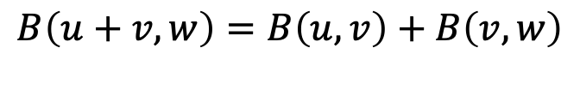
Pairings
e(P,Q)
Bilinearity
Weil pairing
Tate pairing
Ate pairing
$$B\left(u+v,w\right)=B\left(u,v\right)+B\left(v,w\right)$$
$$B\left(au,v\right)=aB\left(u,v\right) \& B\left(u,bv\right)=bB(u,v)$$

Slide 8

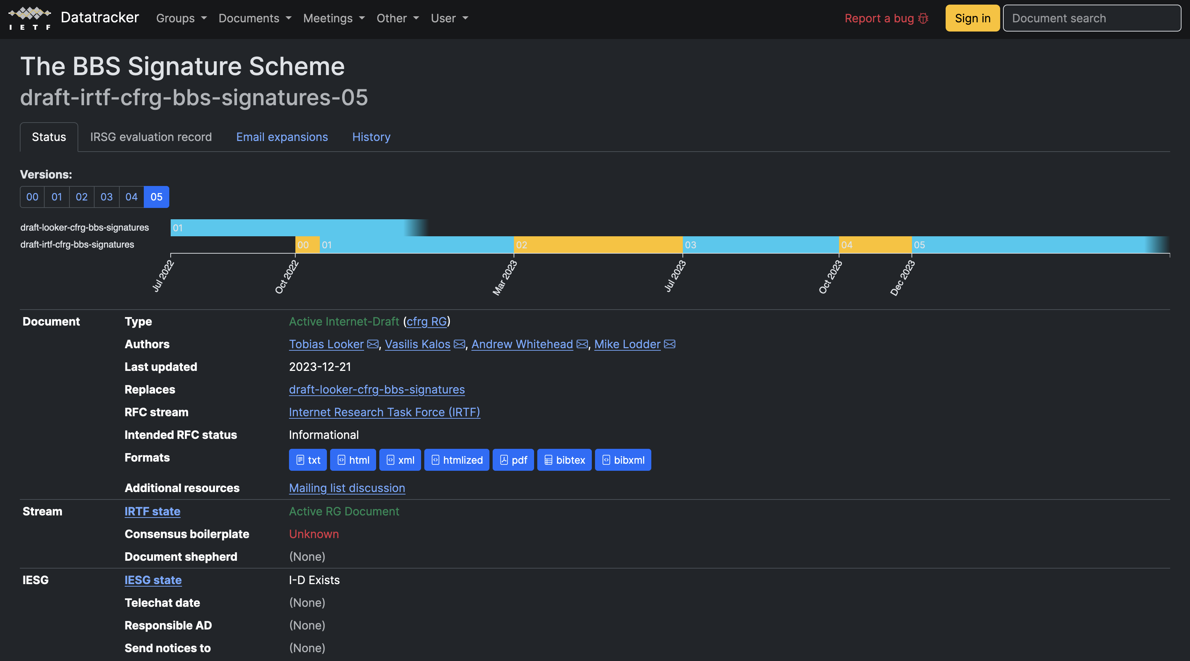
The Recipe
IETF BBS Signature Scheme Draft
Notes:
IETF-Logo:https://thenew.org/app/uploads/2021/05/ietf-logo.original.png

Slide 9
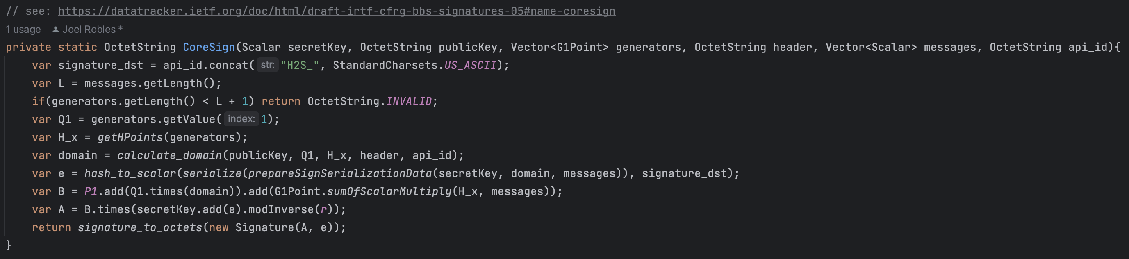
Implementation
Java
MCL library
Problems with ARM
New library from supervisor Rolf Haenni

Slide 10

Encountered Problems
Difficult Research
Advanced Mathematics
Constant change of the draft
Some mistakes in the draft
MCL library
Test Vectors
Notes:
Problem: https://cdn-icons-png.flaticon.com/512/7910/7910705.png
War schwierig Informationen zu finden für gewisse Themenbereiche

Slide 11
Is the goal achieved?
Implemented Java code:
YES!
Understanding:
YES!
Working Java code for the next step -> Bachelor-Thesis
Notes:
Goals for Understanding and main task

Slide 12

Questions
Notes:
https://www.slideteam.net/media/catalog/product/cache/1280x720/q/u/question_ppt_powerpoint_presentation_file_pictures_Slide01.jpg

Slide 13
Thank you for listening!

