Slide 1

BBS Signature Scheme
From Theory to Implementation
Presentation Project 2 BTI3041
Notes:
https://www.zdnet.com/a/img/resize/54a8df488b3da3a9d0956a6a90a167da17372df9/2023/10/04/5fcc0bbf-b43e-4c1a-a58e-916cd9ddb63d/gettyimages-913017298.jpg?auto=webp&width=1280

Slide 2
Taks
Implement the Identity Foundation BBS Signature Scheme Draft Pseudocode into Java code
Understanding :
Elliptic curves
Pairings
Why BBS?

Slide 3

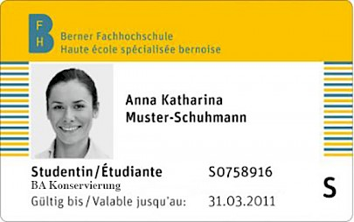
Example
BFH Card -> Verified if valid when purchasing something
Notes:
BFH-Card: https://mmbe.ch/wspx/site/assets/files/1600/bfh-card_kur.405x0-is.jpg
Cinema: https://www.kindpng.com/picc/m/346-3466294_vector-illustration-of-cinema-movie-theatre-or-theater.png

Slide 4
Why is BBS so fancy?
Verifiable Credentials
Selective Disclosure
Proof of Posession
Unlinkable Proofs

Slide 5
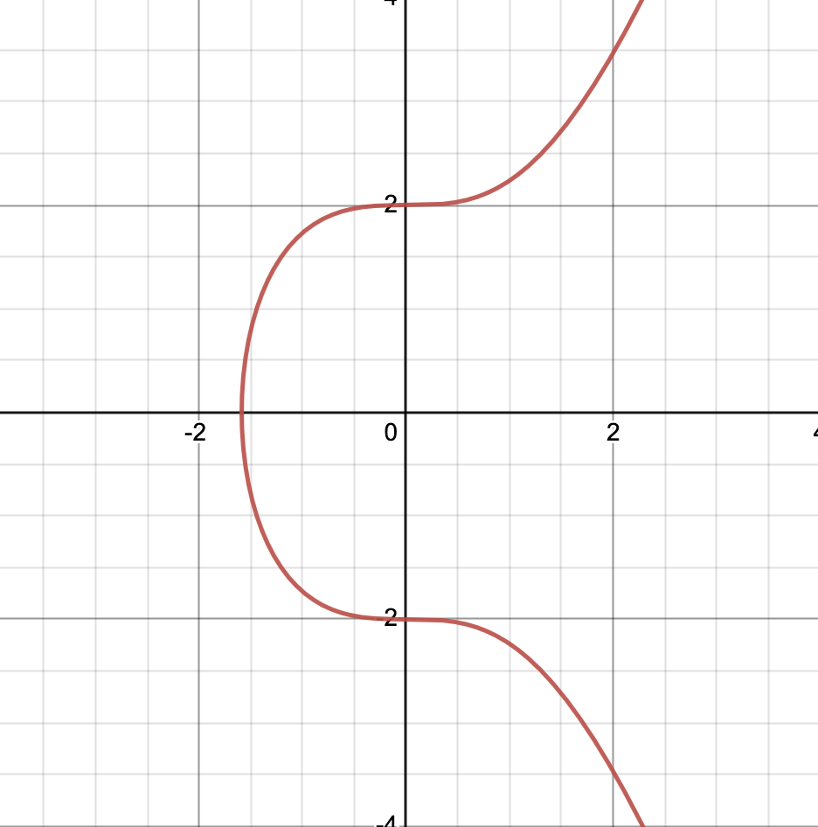
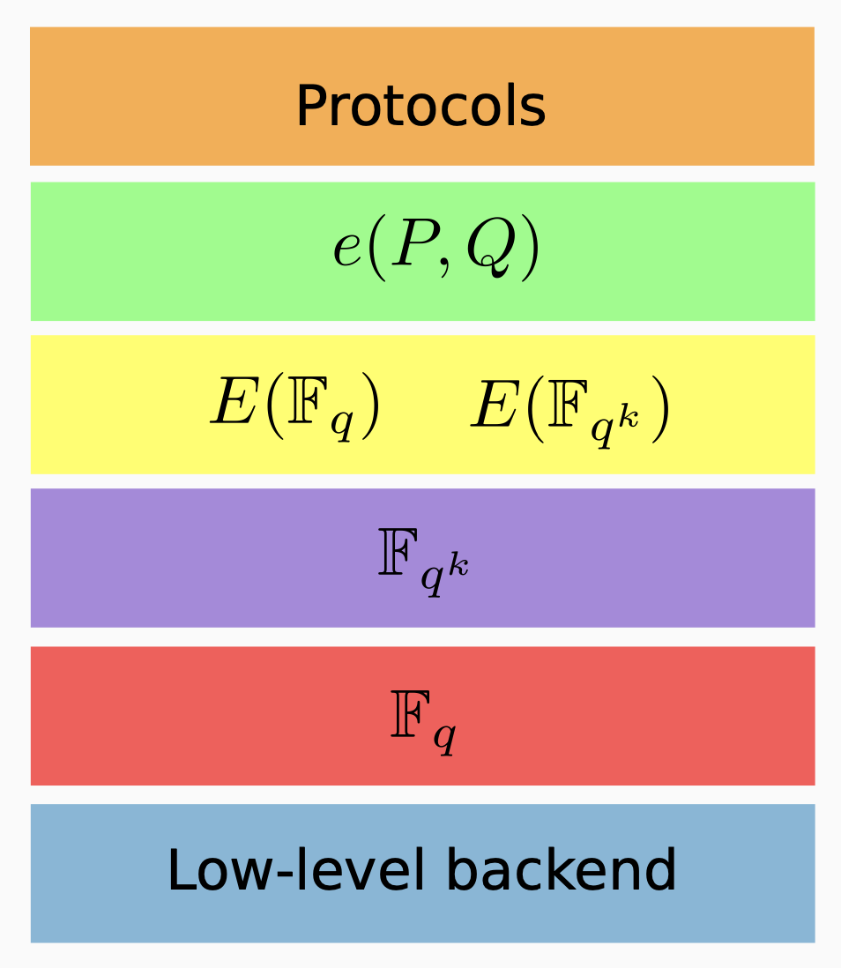
BLS12-381

Slide 6
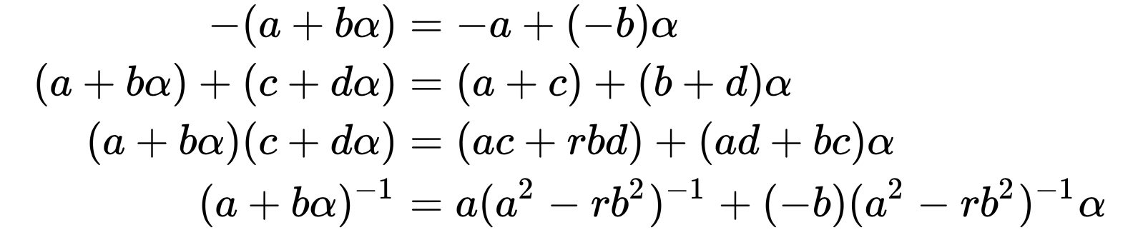
Polynomials

Slide 7
Pairings
e(P,Q)
Bilinearity
Miller’s algorithm
Tate pairing
Weil pairing

Slide 8

The Recipe
IETF BBS Signature Scheme Draft
Notes:
IETF-Logo:https://thenew.org/app/uploads/2021/05/ietf-logo.original.png

Slide 9
Implementation

Slide 10

Encountered Problems
Difficult Research
Advanced Mathematics
Constant change of the draft
A lot of mistakes in the draft
MCL library
Test Vectors
Notes:
Problem: https://cdn-icons-png.flaticon.com/512/7910/7910705.png

Slide 11
Is the goal achieved?
YES!
Working Java code for the next step -> Bachelor-Thesis

Slide 12

Questions
Notes:
https://www.slideteam.net/media/catalog/product/cache/1280x720/q/u/question_ppt_powerpoint_presentation_file_pictures_Slide01.jpg

Slide 13
Thank you for listening!

