Slide 1

BBS Basics
Joel Robles & Miguel Schweizer
19.10.2023
Project 2
BFH TI

Slide 2
BBS or BBS+?
BBS was first introduced in 2004 by Boneh, Boyen, and Shacham
Cast as standalone in 2004 by Camenisch and Lysyanskaya
In 2006 BBS+ was introduced, which was provably secure Is in the process of standartization
In 2023 Tessaro and Zhu showed that BBS is secure, BBS+ is 💀

Slide 3
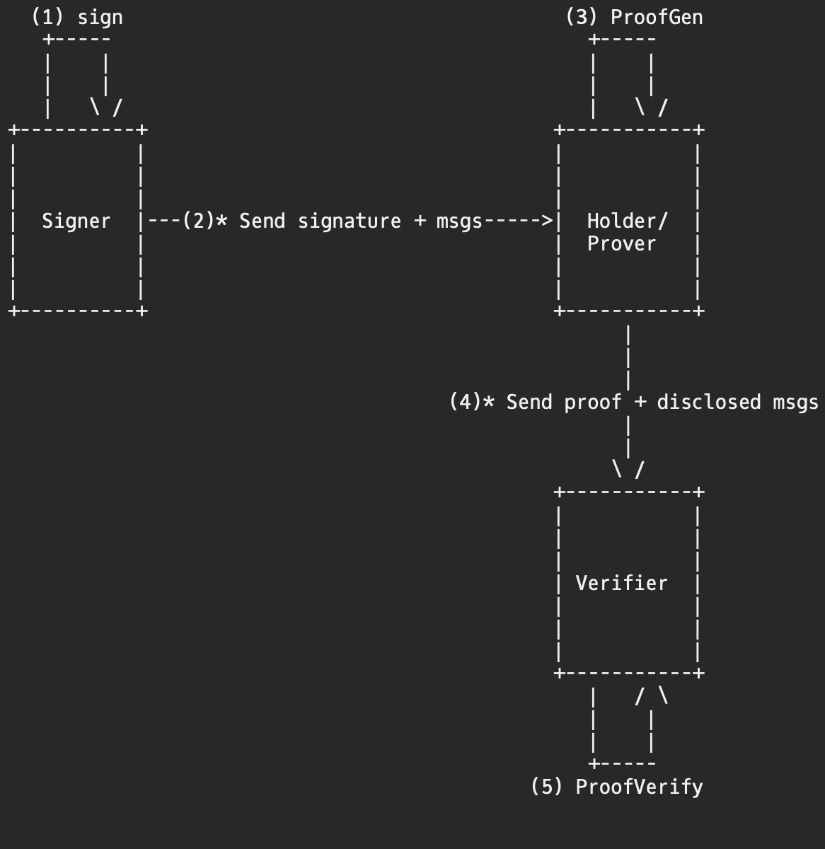
Issuer

Slide 4
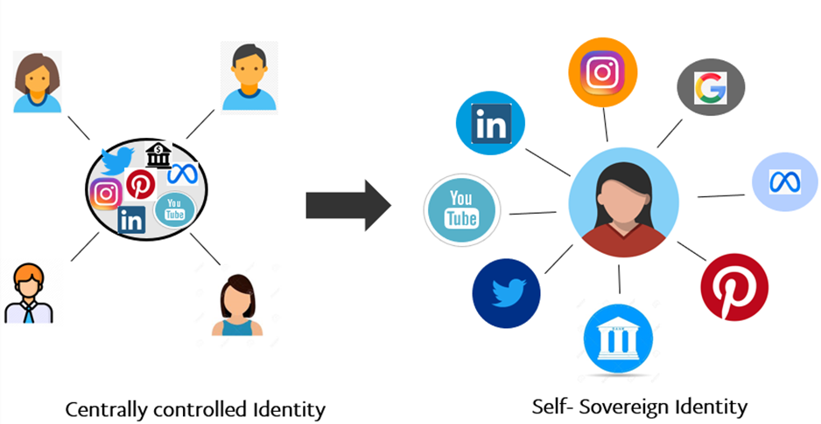
Self-Soverign Identity (SSI)
SSI is a model
Manages digital Identities
Individuals or coorperations have complete ownership

Slide 5
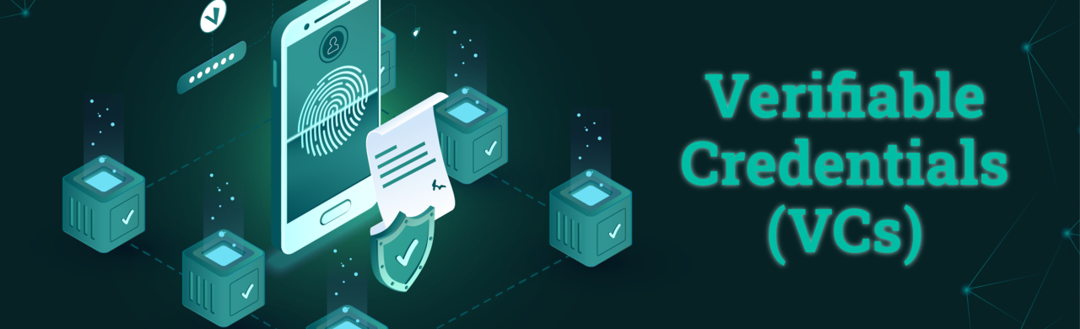
W3C standard
Digital cryptographically verifiable credentials
Stored on digital devices

Slide 6
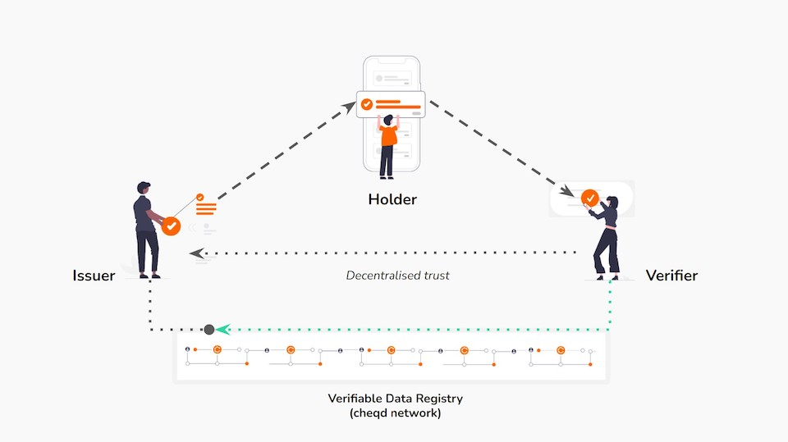
Trust Triangle

Slide 7
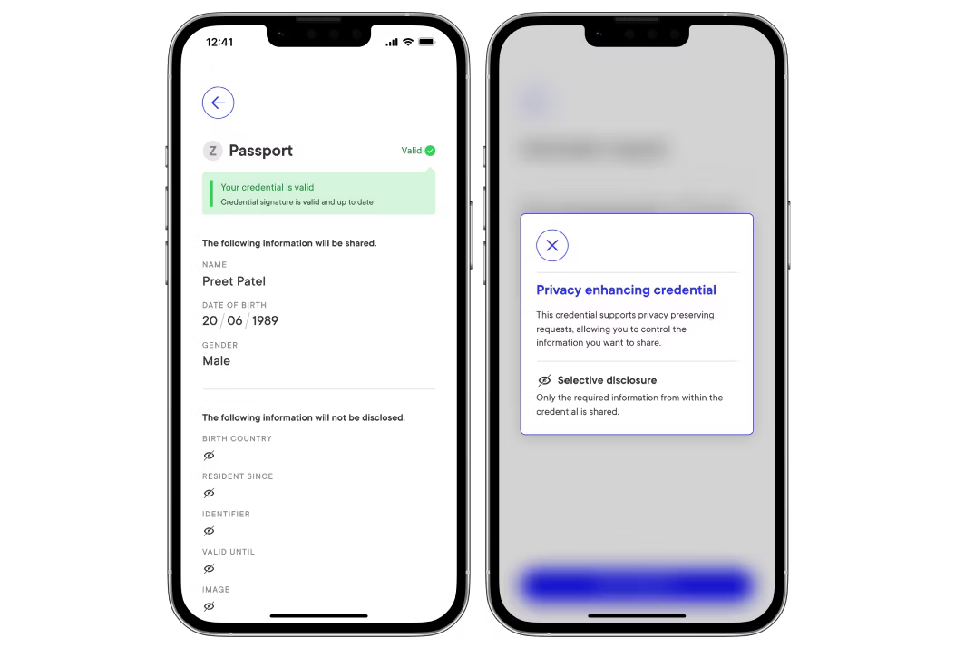
Selective Disclosure
Holder chooses what to disclose
Disclosing messages reveals no information about undisclosed messages

Slide 8
Unlikable proofs
Generated proofs cannot be linked
Verifier cannot determine signature
Proofs guarantee the integrity and authenticity

Slide 9
Zero-knowledge Proof (ZKP)
Lower version of proof-of-knowledge
Attributes: - completeness - soundness - zero-knowledge

Slide 10
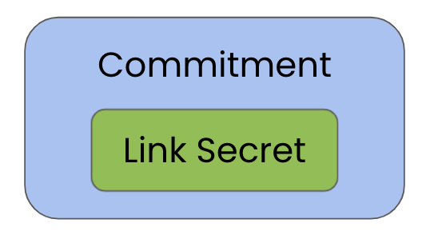
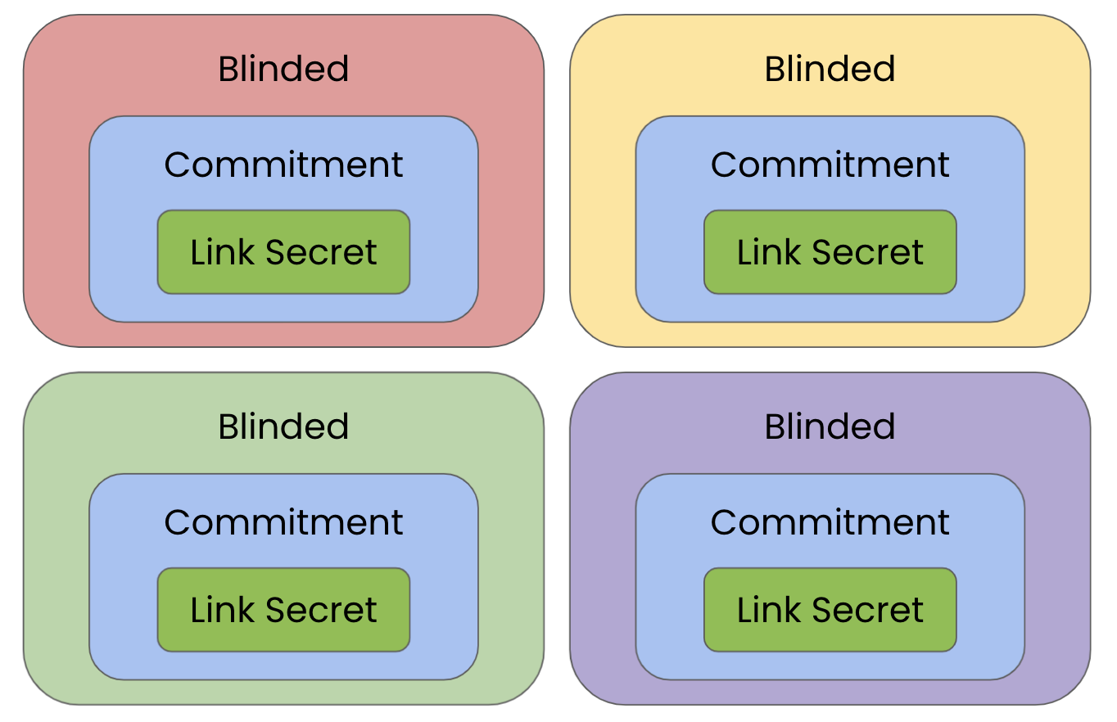
Link Secrets
Is a random number
Wrapped with a commitment
Can be blinded

Slide 11
Link Secrets in BBS
Proofs possesion
Can be used to link VCs

