Slide 1

Pairing Based Cryptography
Presentation Project 2
by
Joel Robles

Slide 2
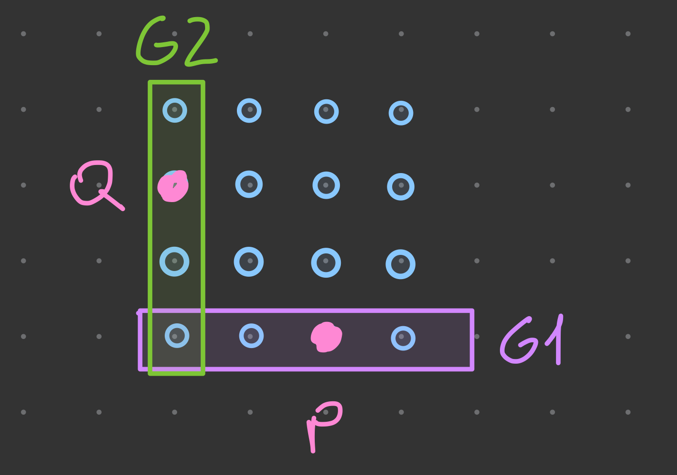

What is a pairing?
$$G_{1}{ x G}_{2} → G_{T}$$

Slide 3

What is a pairing?
$$G_{1}{ x G}_{2} → G_{T}$$
$$e(G_{1}{,G}_{2})$$

Slide 4
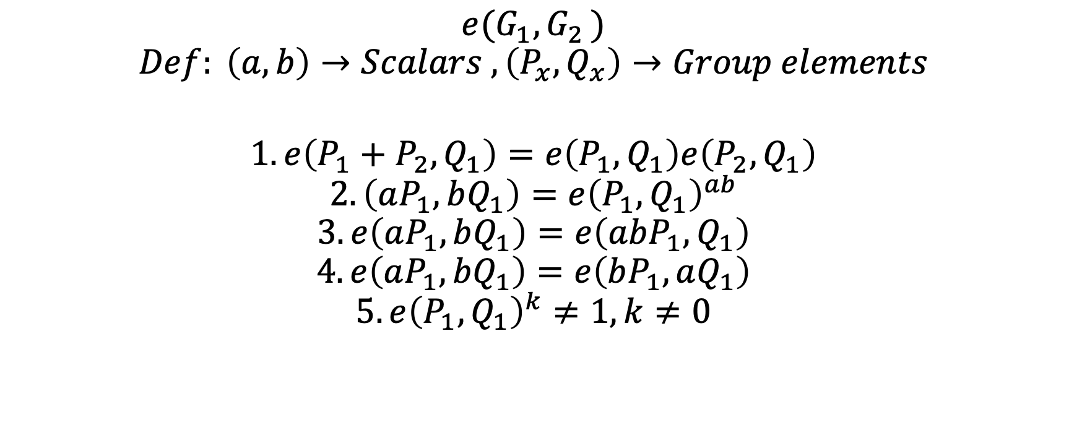
Characteristics: Bilinearity
$$e(G_{1}{,G}_{2})$$
$$Def: \left(a,b\right)→Scalars , \left(P_{x},Q_{x}\right)→Group elements$$
$$1. e\left(P_{1}+P_{2},Q_{1}\right)=e\left(P_{1},Q_{1}\right)e\left(P_{2},Q_{1}\right)$$
$$2. \left(aP_{1},bQ_{1}\right)=e{\left(P_{1},Q_{1}\right)}^{ab}$$
$$3. e\left(aP_{1},bQ_{1}\right)=e\left(abP_{1},Q_{1}\right)$$
$$4. e\left(aP_{1},bQ_{1}\right)=e\left(bP_{1},aQ_{1}\right)$$
$$5. e{\left(P_{1},Q_{1}\right)}^{k}≠1, k≠0$$

Slide 5
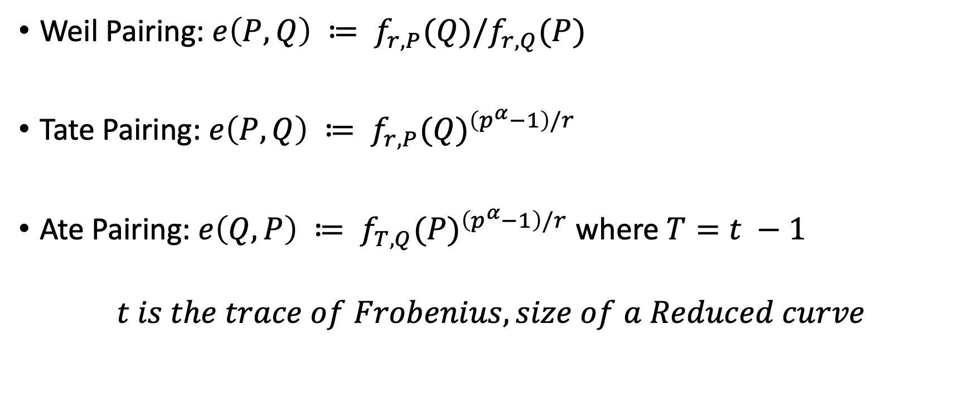
Different Pairings
Weil Pairing: $e\left(P,Q\right) ≔ f_{r,P}(Q)/f_{r,Q}(P)$
Tate Pairing: $e\left(P,Q\right) ≔ f_{r,P}(Q)^{\left(p^{α}−1\right)/r}$
Ate Pairing: $e\left(Q,P\right) ≔ f_{T, Q}(P)^{\left(p^{α}−1\right)/r}$ where $T=t −1$
$$t is the trace of Frobenius, size of a Reduced curve$$

Slide 6
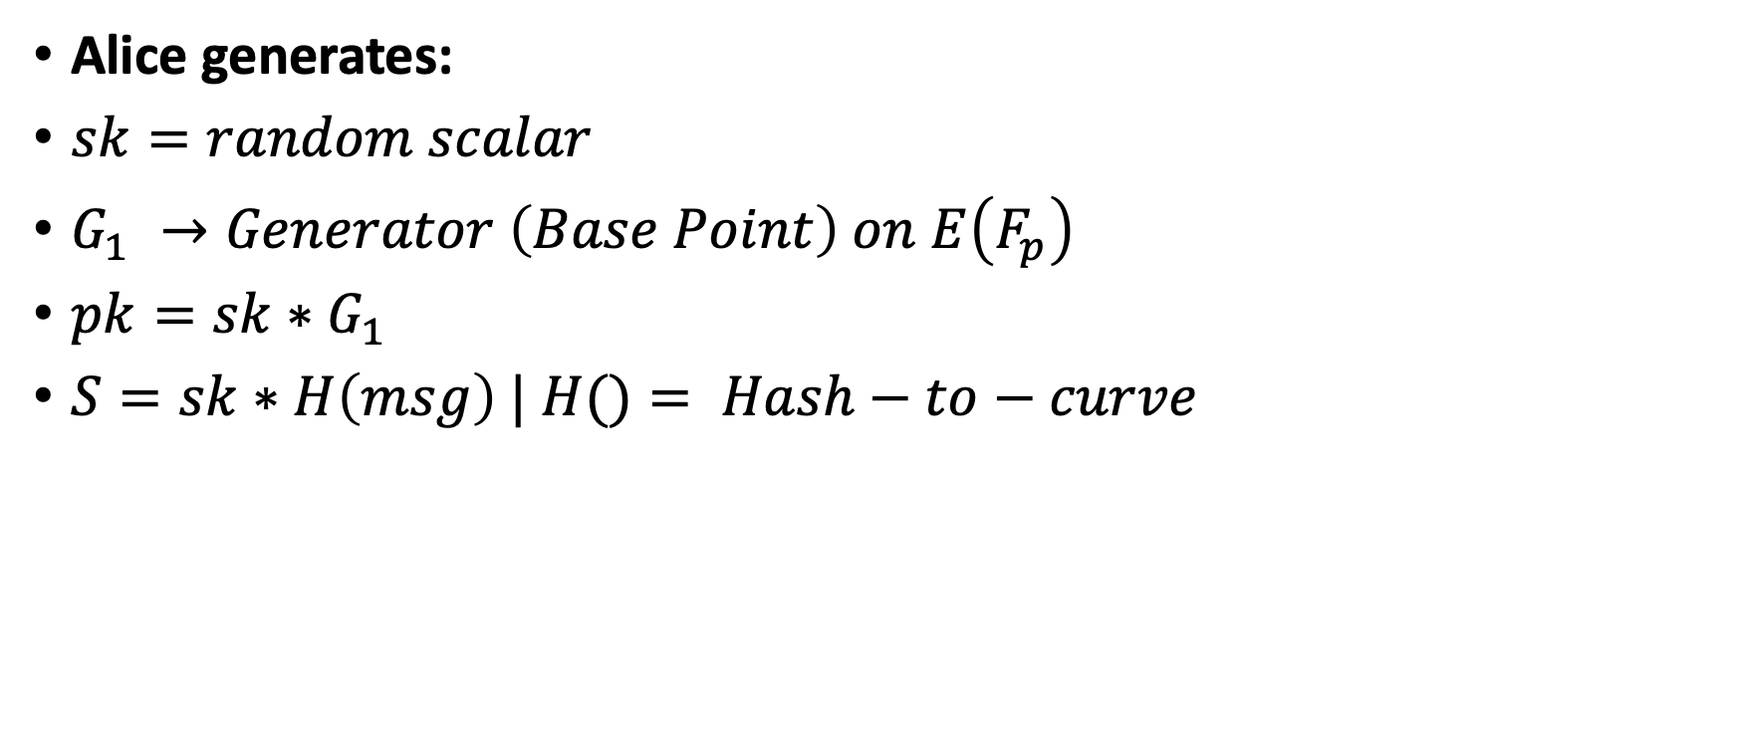
Applications: BLS Signatures
Alice generates:
$sk=random scalar$
$G_{1} →Generator \left(Base Point\right) on E\left(F_{p}\right)$
$pk=sk∗G_{1}$
$S=sk∗H\left(msg\right) | H()= Hash−to−curve$

Slide 7

Applications: BLS Signatures (Prove)
Alice sends $G_{1},S,msg$ to Bob
$e\left(G_{1},S\right)=e\left(pk, H\left(msg\right)\right)$
$e\left(G_{1},S\right)=e\left(G_{1}, sk∗H(msg)\right)=e\left({sk∗ G}_{1}, H(msg)\right)$
$e\left({sk∗ G}_{1}, H(msg)\right)=e\left(pk, H\left(msg\right)\right)$ = $e\left(pk, H\left(msg\right)\right)$

Slide 8
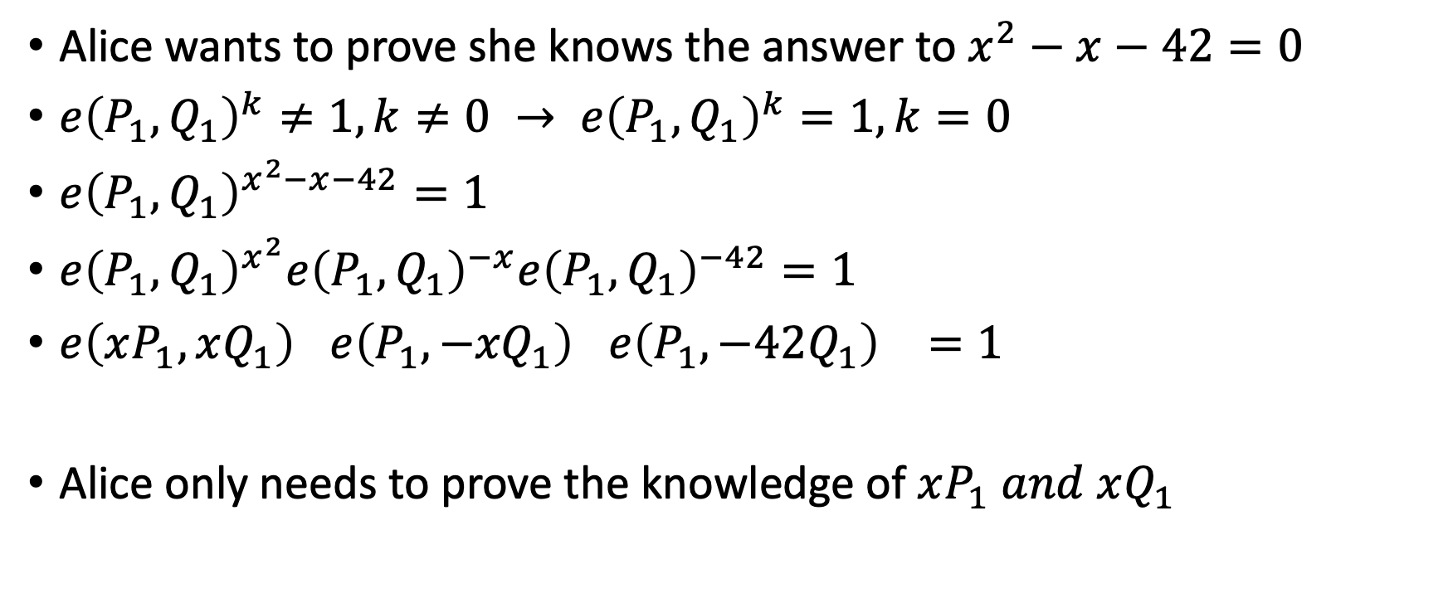
Applications: Zero-Knowledge-Proof
Alice wants to prove she knows the answer to $x^{2}−x−42=0$
$e{\left(P_{1},Q_{1}\right)}^{k}≠1, k≠0 → e{\left(P_{1},Q_{1}\right)}^{k}=1, k=0$
$e{\left(P_{1},Q_{1}\right)}^{x^{2}−x−42}=1$
$e{\left(P_{1},Q_{1}\right)}^{x^{2}}e{\left(P_{1},Q_{1}\right)}^{−x}e{\left(P_{1},Q_{1}\right)}^{−42}=1$
$e{\left(xP_{1},xQ_{1}\right)}^{}e{\left(P_{1},{−xQ}_{1}\right)}^{}e{\left(P_{1},−42Q_{1}\right)}^{}=1$
Alice only needs to prove the knowledge of $xP_{1} and xQ_{1}$

