Slide 1

BLS12-381 Curve
Presentation Project 2
by
Miguel Angel Schweizer

Slide 2
History
Pairing-fiendly elliptic curve
Designed by Sean Bowe in 2017
Zcash protocol update

Slide 3
Naming
Family of curves from Baretto, Lynn and Scott (BLS)
12 = embedding degree
381 = size in bits of base field modulus q

Slide 4
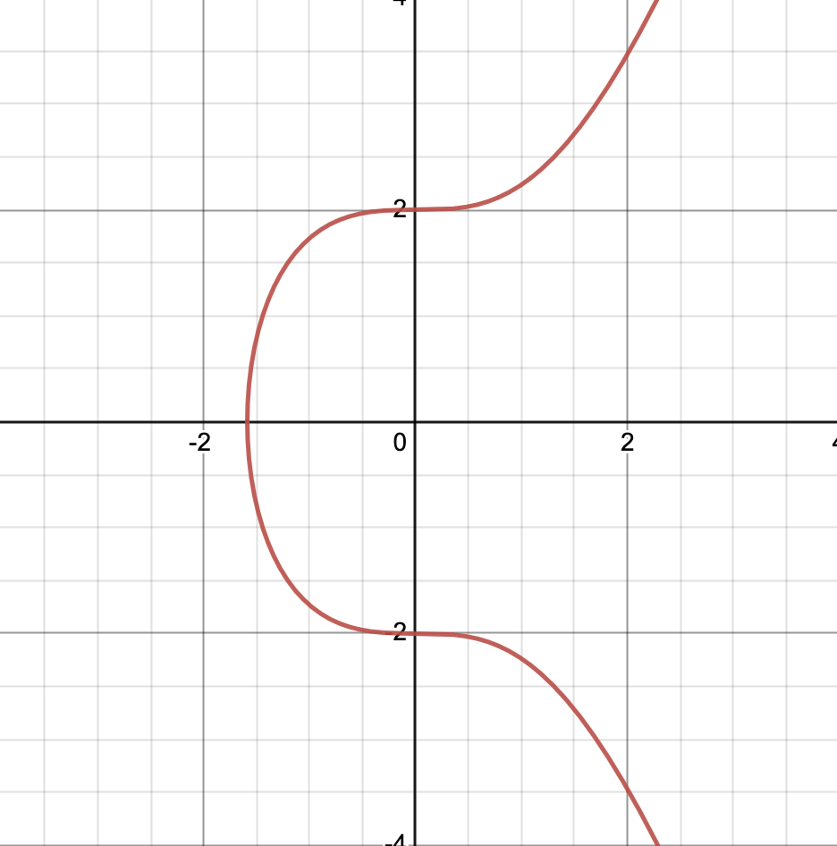
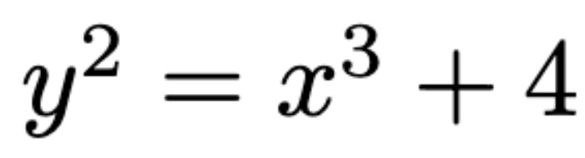
Curve Equation

Slide 5
Groups – G₁
Cyclic group
Group order r
Generated with base point BP=(x,y)
Field F_{p}
G₁ defined over E: y²=x³+4

Slide 6
Groups – G₂
Cyclic group
Subgroup order r
Generated with base point BP’=(x’,y’)
Field F_{p}²
G2 defined over E’: y2=x3+4(1+i)

Slide 7
Groups – G_{T}
Subgroup of multiplicative group F_{p}¹²
Group order r

Slide 8
Parameters
IETF draft suggestions
Security level
Subgroup size r
Field modulus q^{k}
Embedding degree k
Cofactor h

Slide 9
Embedding degree
k = 12
Smallest positive integer so that r devides (q^{k} -1)
Impact on security and efficiency

Slide 10
Cofactor
Relevant for mapping the hashed messages
Used for finding generators of G₁ and G₂

Slide 11
Secret and public keys
sk = secret key
pk = public key
sk selected randomly between 1 ... (r-1)
pk = [sk]g₁

Slide 12
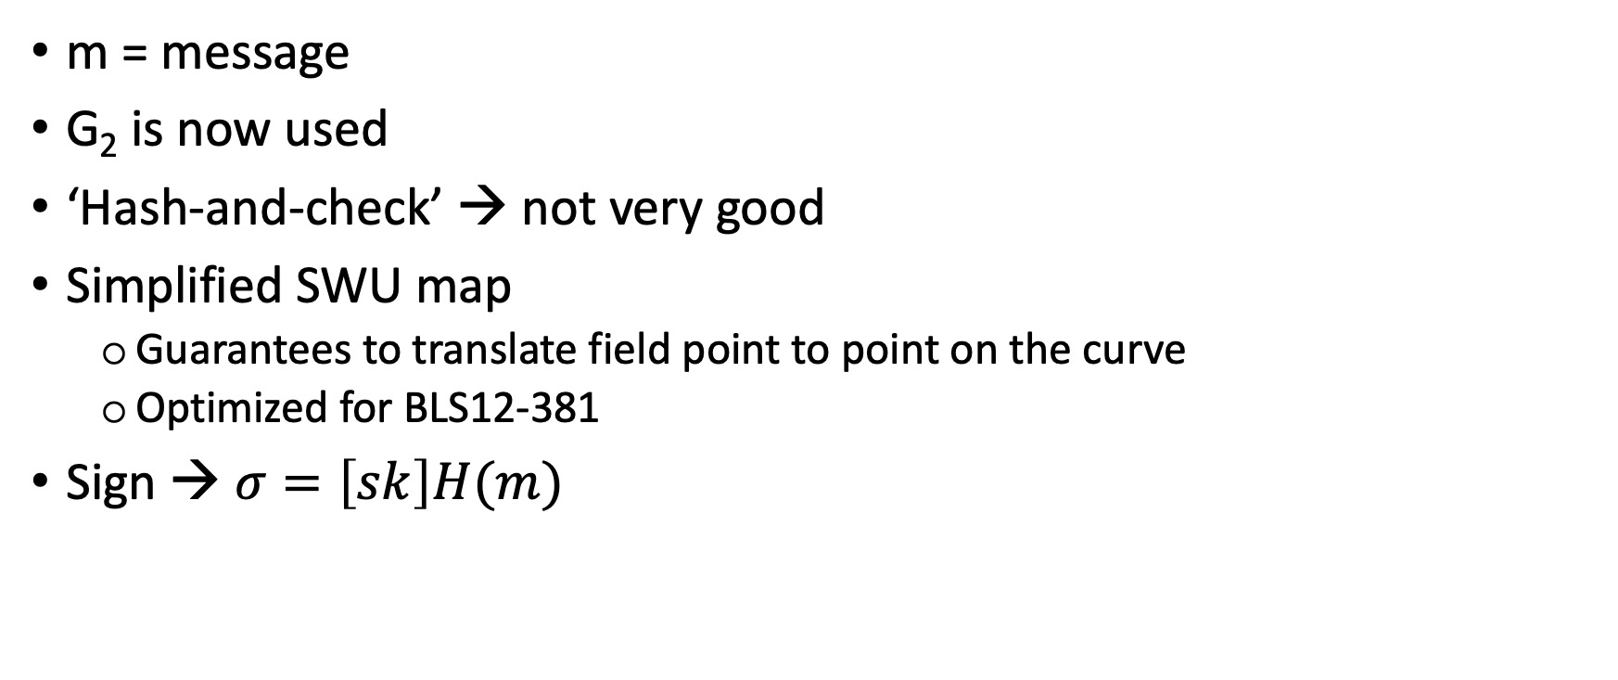
Signing
m = message
G₂ is now used
‘Hash-and-check’ → not very good
Simplified SWU map
Guarantees to translate field point to point on the curve
Optimized for BLS12-381
Sign → $σ=\left[sk\right]H(m)$

Slide 13
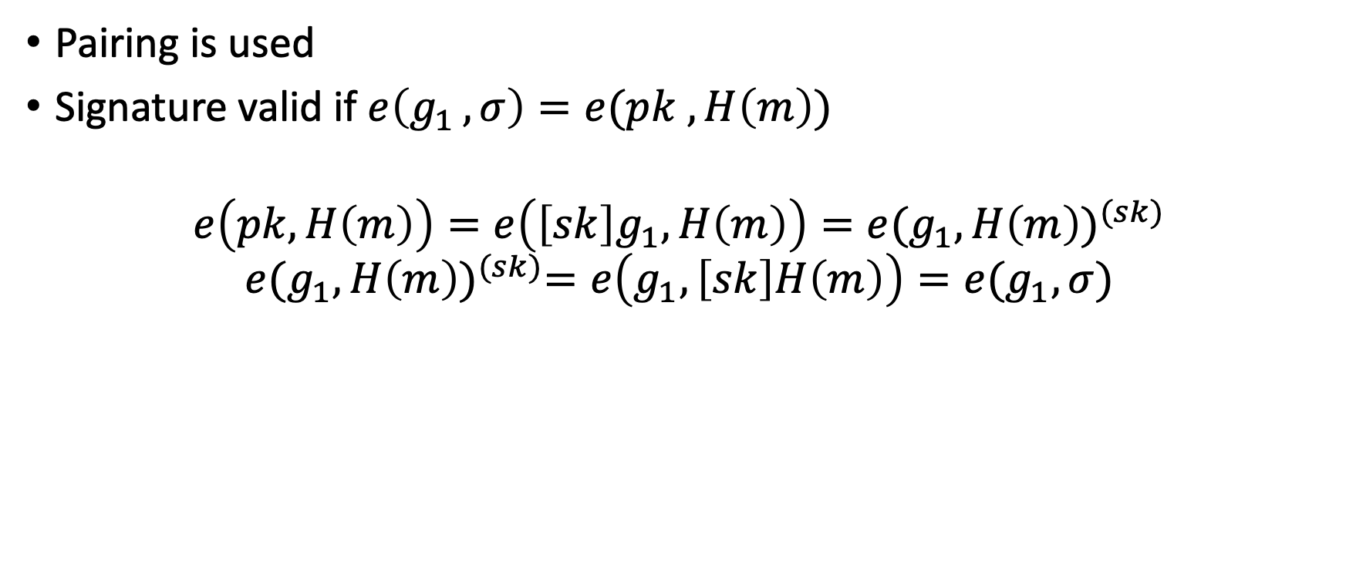
Verification
Pairing is used
Signature valid if $e\left(g_{1 }, σ\right)=e(pk , H\left(m\right))$
$$e\left(pk,H\left(m\right)\right)=e\left(\left[sk\right]g_{1},H\left(m\right)\right)=e{(g_{1},H\left(m\right))}^{(sk)}$$
$$e{(g_{1},H\left(m\right))}^{(sk)}=e\left(g_{1},\left[sk\right]H\left(m\right)\right)=e(g_{1},σ)$$

