Slide 1


ECU Application Manager - EcuAppM
August 2023

Slide 2
Agenda
Objective
EcuAppM Introduction
  Architecture
  State machine overview
  Group containers
  Group container State Transitions
  Group container properties
  Component Containers
  Component Locality
EcuAppM Configurator
  Configuration description XML file
Model-In-Loop simulation Results
Q & A

Slide 3
Objective
Design a generic manager component responsible for bringing up the applications in an ECU and manages the complete life cycle of an application components. The component shall be reusable across the programs and platforms.
EcuAppM
TIME TO MARKET
VIP ONLY
VIP + GIP
VIP LESS
QUALITY
SCALABILITY
REUSABILITY

Slide 4
EcuAppM - Introduction
The name “EcuAppM” refers “Ecu Application manager”. A generic manager which manages the sequence of prerequisite functionalities required to run the applications in an ECU. This component manages life cycle of an ECU application starting from powerup sequence, activating application components and performing shutdown activities. This manager is independent of underlying hardware and the type of the application it is managing.
Supported Functionalities
      Validation of the Wakeup’s
      Triggers powerup and power down sequences
      Triggers NVM read all sequences
      Responsible for spawning Power manager and system control applications
      Activation and deactivation of application components
      Backing up the application data.
      Supports partial wakeup strategies

Slide 5
EcuAppM – Architecture
  Below figures shows where the “EcuAppM” located in Autosar Architecture
Application Layer
Runtime Environment
System Services
Memory services
Communication
services
Diagnostic services
Complex
drivers
I/O HW
abstraction
layer
EcuM
BswM
Hardware abstraction layer
ComM
WdgM
EcuAppM
MCAL abstraction layer
I/O drivers
Microcontroller

Slide 6
EcuAppM – Architecture Block Diagram
EcuAppM_Cfg
Power up/Down Request
Power
EcuMExt
Wakeup Source
Groups Container’s
EcuAppM
EcuAppMExt
CDD's
Activation/Deactivation Command
SWC's
Callouts
Sleep Manager
Application sleep Status
IoHwAbs
NVM Read All request
NVM

Slide 7
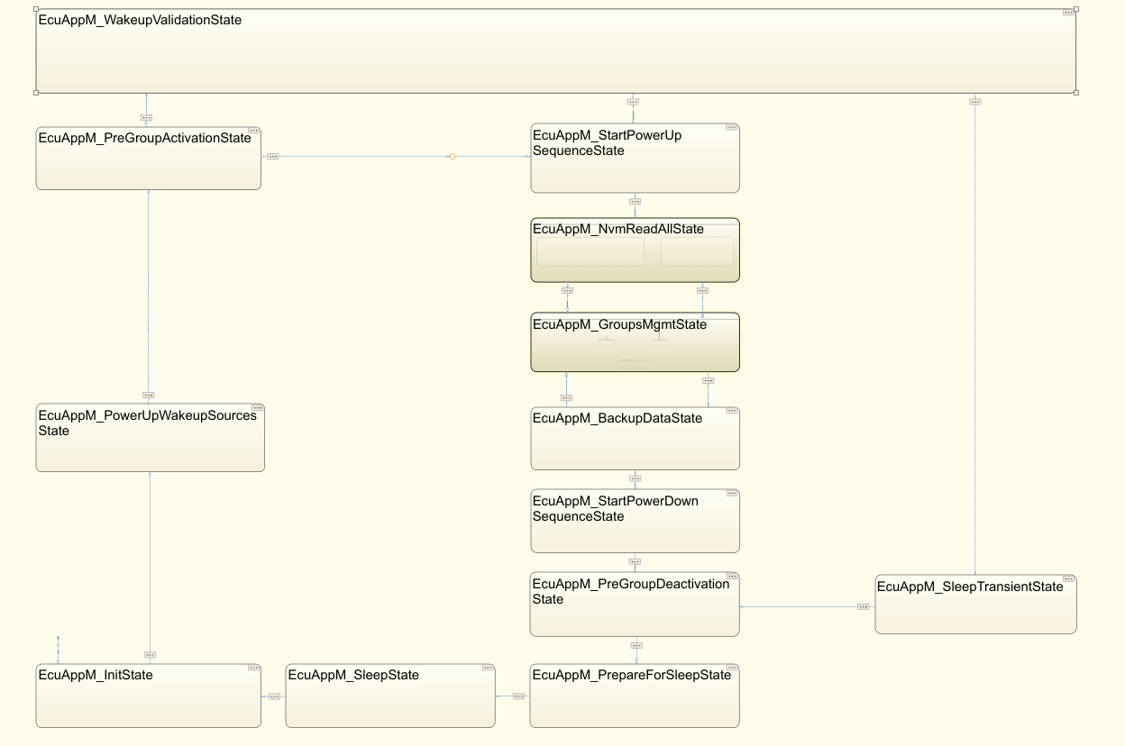
EcuAppM – State Machine

Slide 8
EcuAppM - Group Containers
EcuAppM manages life cycle of components using “Group Containers”. Each Group container can further contain multiple component Containers. A Component refers to an either SWC’s or CDD’s or any application entity.
A component container will have a data objects and/or methods required to manage the respective component.
EcuAppM offers great degree of flexibility in configuring the behavior of “Group containers”. This makes it possible to use this component across programs and can be scalable for future needs.
Groups Container
Group#0
Group#1
Group#2
Group#3
components
components
components
components

Slide 9
EcuAppM - Group Container State Transitions
Each Group Container will follow below Group life cycle state transitions. A Group will transition to new state after all the components under the group transitioned to the commanded state.
eGroup_StateInactive
eGroup_StateInit
eGroup_StateActivation
eGroup_StateActive
eGroup_StateDeactivation

Slide 10
EcuAppM – Group Container Properties
Group#0 and Group#1 are special groups called pre-groups.
Group#0 container will be activated before powering switched supplies and it’s meant for activating “Power manager” related components.
Group#1 container will be activated in parallel to NVM read all and it's meant for activating “system control”
related components like SleepWakeup Manager, ComMExt etc. Those components which controls Network and
application sleep status.
From Group#2 onwards they are normal groups they can be used for life cycle management of CDD’s, SWC’s etc.
  Following are the currently supported list of Group properties
    Wakeup source mask
    Activation type
    Deactivation type
    Fail safe mechanism
  Wakeup source mask
  Except pre-groups, all the other groups can be subscribed for configured wakeup sources for which particular
  group/groups will be activated.
  This type of configuration allows for efficient partial wakeup strategies like RTC wakeups and MEET
  mode implementations.

Slide 11
EcuAppM – Group Container Properties
  Typical configuration looks like below
Groups Container
PreGroup#0
PreGroup#1
Group#2
Group#6
Group#7(RTC)
Group#8(MEET)
components
components
components
components
components
components
Power Group
System control
Group
Application Groups
MEET Group
RTC Group

Slide 12
EcuAppM – Group Container Properties
  Activation Type
  A group “Activation Type” can be configured as “ASYNCHRONUS” or “SYNCHRONUS”.
  ASYNCHRONUS type groups will be activated in parallel example Group#2, Group#3 etc. will be activated
  simultaneously.
  SYNCHRONUS groups will be activated in sequential manner example after Group#2 activation confirmation
  Group#3 will be activated.
ASYNCHRONUS
Deactivation
Active
Activation
Init
Inactive
Group#0
Group#1
Group#2
Group#3
Group#4
Group#5

Slide 13
EcuAppM – Group Container Properties
SYNCHRONUS
Deactivation
Active
Activation
Init
Inactive
Group#0
Group#1
Group#2
Group#3
Group#4
Group#5
  Deactivation Type
  A group “Deactivation Type” can be configured as “SHUTDOWN” or “KEEP ALIVE”.
  A group will be allowed to deactivate only when its configured as “SHUTDOWN”. A KEEP ALIVE
  group will never be deactivated.
  Failsafe Mechanism
  A maximum failsafe timer can be configured to ensure that a particular group will be activated within
  that time after this time a “Failsafe action callout” will be triggered. Users can take action based on
  program’s requirement.

Slide 14
EcuAppM – Component Container
Component Container contains a data member to hold the status, Life cycle API method, status notify API method.
EcuAppM just uses “Life cycle API” to manage life cycle of the components and reads the component status
from status notification API if configured.
Activation of a component is independent of its activation library and location
EcuAppM can manage the life cycle of GIP components. Life cycle API needs to be configured with RTE write calls which can trigger UCL messages and status notify API’s can be configured with RTE read calls which reads the stats received from UCL messages.
Group and Component container’s linked list
Group Container
Component Container List
Component Container
No of Components
Reference to Component#1 container
Component Status
Reference to Component container list
Reference to Component#2 container
Life cycle Manager API
Status notify API
Reference to Component#N container

Slide 15
EcuAppM – Component Locality
A Component can register to any group irrespective of its location
Group Container
VIP
components
GIP

Slide 16



EcuAppM – Configurator
VcoreConfigurator tool will be developed to configure the EcuAppM module. The specification of VcoreConfigurator tool is out of the scope of this presentation.
GUI
Interface
Code
Generator
USER
EcuAppM_Cfg
<.h/.c>
VcoreConfigurator
Currently the XML to Code generator is developed to auto generate the configuration files.

Slide 17
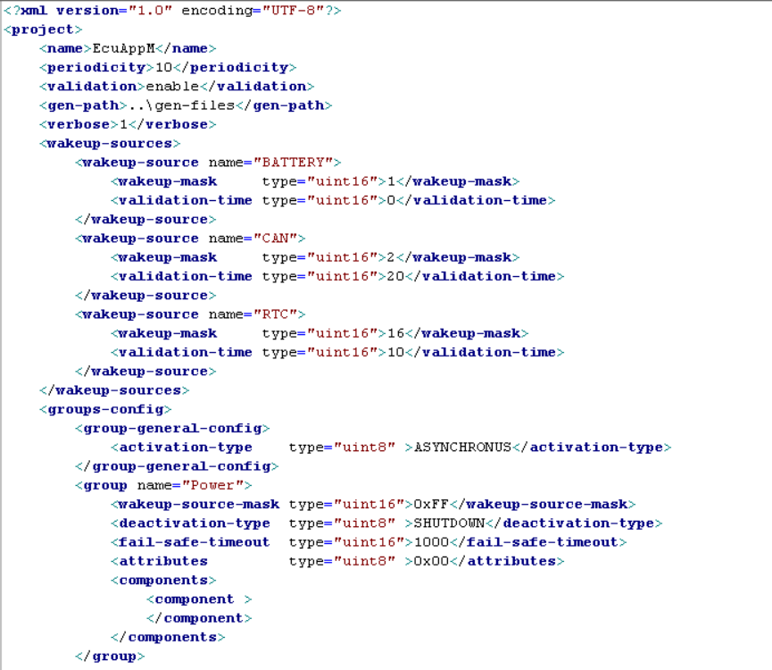
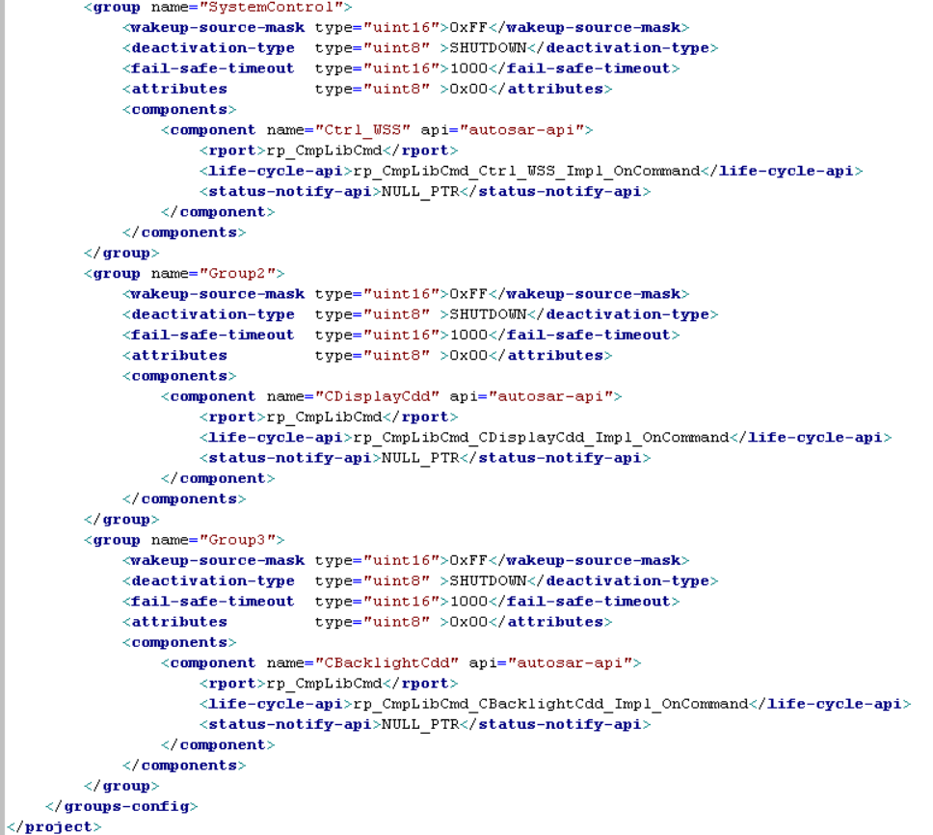
EcuAppM – Configurator
Configuration description file

Slide 18
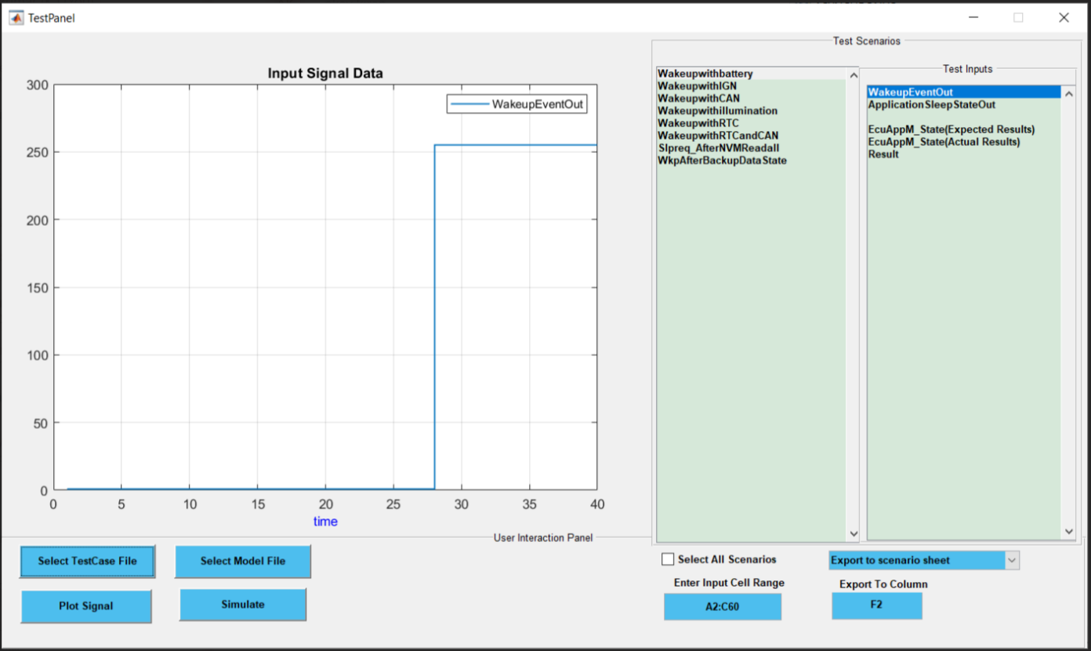
EcuAppM – Model-In-Loop Simulation
EcuAppM state machine designed in Simulink and Stateflow. The model simulated using test vectors.
Please find below test vectors and results.
Test Results

Slide 19
EcuAppM
Q & A

