Slide 1
NvM Configuration
ReadMe

Slide 2
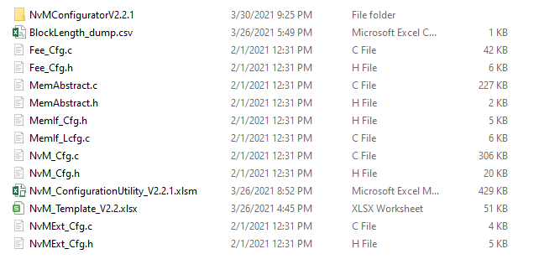
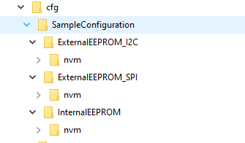
Integrating NvM to new program
For integrating NvM to new base, you have to take Sample Configuration which has some sample block and element.
Steps:-
  Go to turing.bsw.nvmmgr -> NvM -> cfg -> SampleConfiguration.
  Next open the folder respective to your program. For Eg: If your program has Internal EEPROM, open InternalEEPROM folder.
  Copy the nvm folder and paste it in Bsw-Gen -> bsw folder in your program.

Slide 3
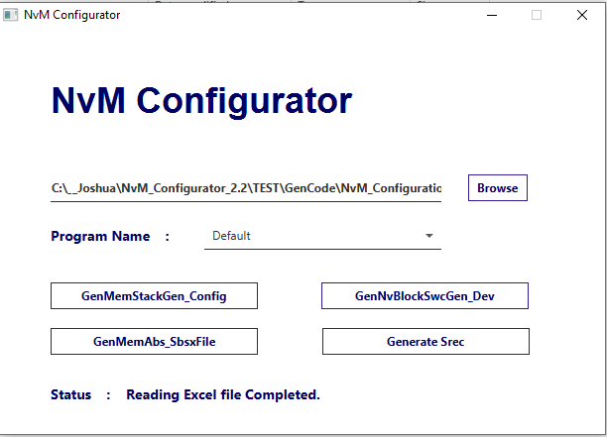
NvM Configurator User Guide
Open the NvMConfiguratorVx.x.x.jar in nvm -> NvMConfiguratorVx.x.x-> bin folder.
Click “Browse” button and select the NvM_ConfigurationUtility_V.x.x.xlsm excel file from nvm folder.
Once the excel file imported properly you will see the Status as Reading Excel file Completed.

Slide 4
Generating Arxml Files
To Generate Developer arxml, click GenNvBlockSwcGen_Dev button.
Once it got generated successfully you will see the successful pop up message.
To generate Configurator arxml, click GenMemStackGen_Config button.
Once it got generated successfully you will see the successful pop up message.
Both arxml files will be generated in nvm -> NvMConfiguratorVx.x.x -> out -> arxml folder.

Slide 5
Generating Sbsx file
To generate MemAbs Sbsx file, Select your program name if available. If it was not available select Default.
Then click GenMemAbs_SbsxFile button.
Once it got generated successfully you will see the successful pop up message.
Output sbsx files will be generated in nvm -> NvMConfiguratorVx.x.x -> out -> sbsx folder.

Slide 6
Generating Work Flash Images.
To Generate work flash images, Select your program name if available.
Click Generate Srec Button.
Then go to nvm -> NvMConfiguratorVx.x.x-> bin folder. and run Srecgen.bat from command prompt.
This will generate work flash image in nvm -> NvMConfiguratorVx.x.x -> out -> srec folder.

Slide 7
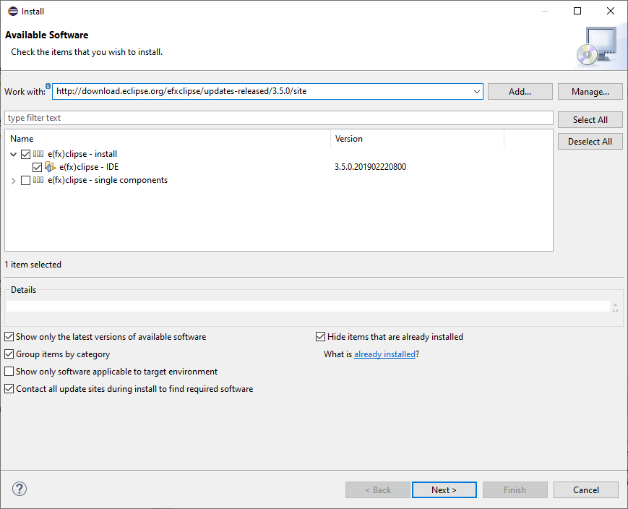
Accessing Tool’s Code Base
This NvMConfigurator source code will be found in "2: turing_bsw_tools_0.0.1"
In order to run the code, you may need eclipse and “e(fx)clipse -IDE” pulgin installed in it
Go to Help -> Install New Software. Copy this link in work with (http://download.eclipse.org/efxclipse/updates-released/3.5.0/site).

