Slide 1
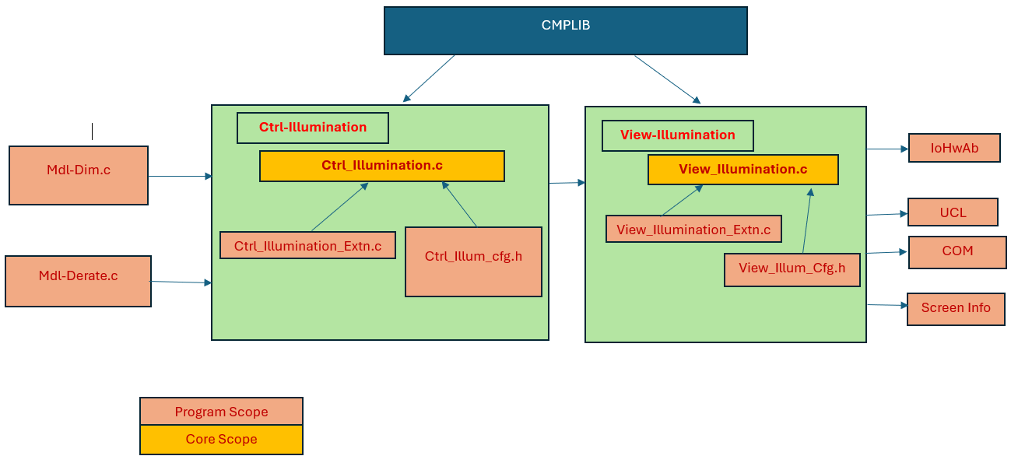
Core-Illumination

Slide 2
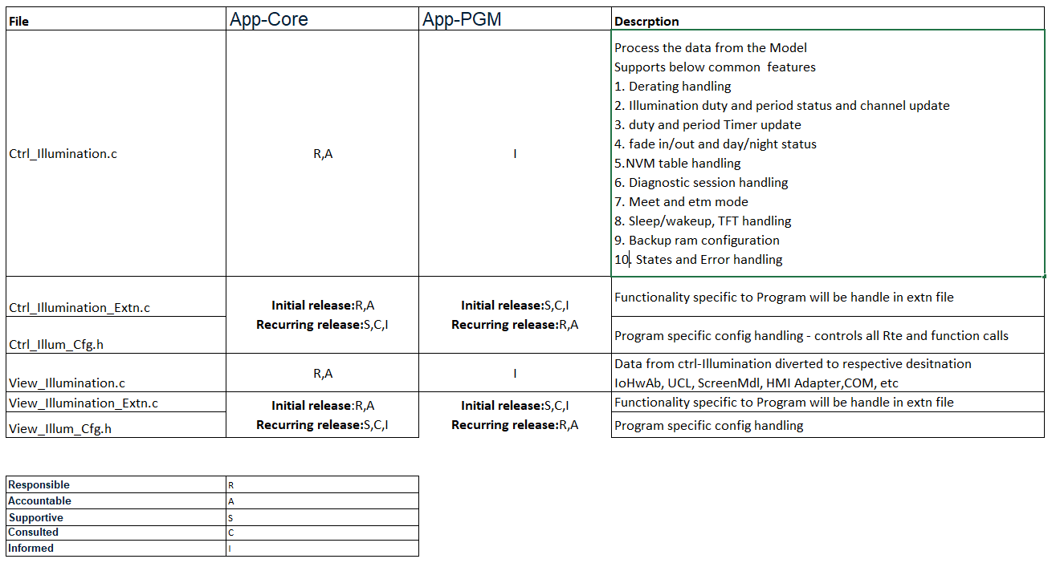
RASIC

Slide 3
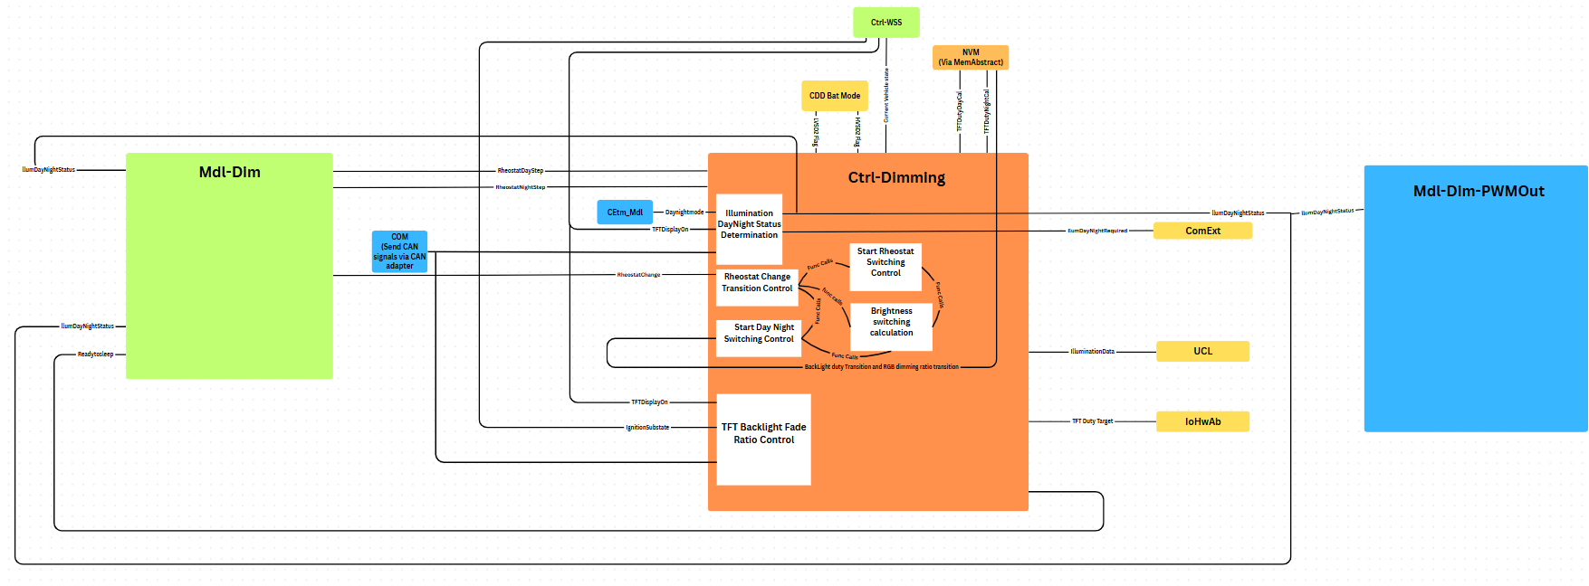
ILLUMINATION CONTROL – TOYOTA BASE

