Slide 1

Visteon Graphics Development Tool
Team, VTSC India
Version 1.0

Slide 2

Overview
GDT was developed initially to support the Yukawa platform.
GDT has grown over the years and currently supports following platforms
  Yukawa 1.0
    RGB565
    ARG4444
  Kepler Spectrum and Rainbow
    RGB888, RGB565
    ARGB8888, ARGB4444, ARGB1555
    A8, A4
    PAL8, PAL4, PAL1
    APAL8
  OpenVG Yukawa 2.0/Kepler Rainbow
    Up to RGB888
    Vector import via SVG file
  Monochrome (Platform Independent)
    1BPP
    2BPP
    4BPP
Page <number>

Slide 3
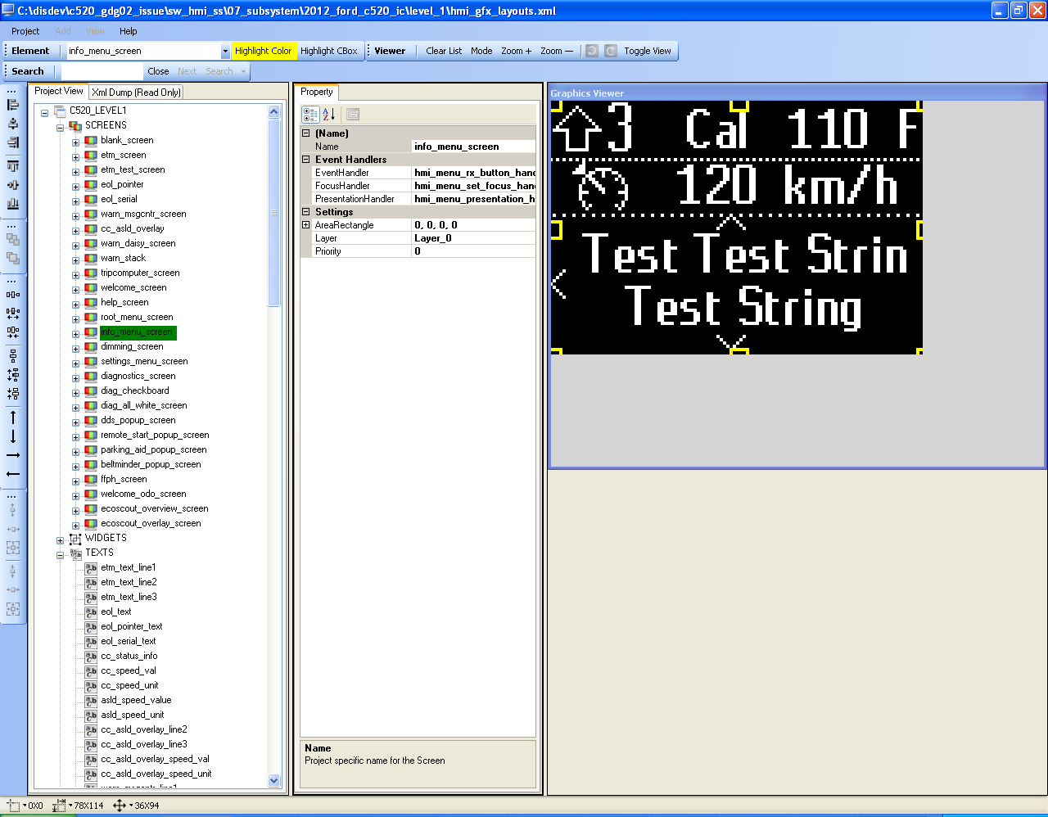
GUI
Project menu
New
Open
Save
Project Settings
Generate Code
Close
Viewer Shows the selected elements appearance. You will get the same appearance and placement in the target
Project Tree View
Arranges elements into
Screens
Widgets
Texts
Images
Fillscreens
Fonts
Property Grid View
Shows the relevant properties of a selected element
Page <number>

Slide 4
GUI
Context Based Tools
Alignment
Arrange build order
Adjust XY location
Adjust Fill Area
Global Tools
Tools available always
Status Bar
Shows XY location, HW
Page <number>

Slide 5
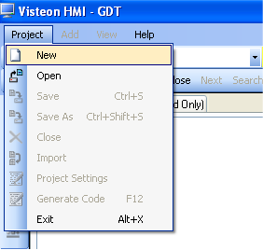
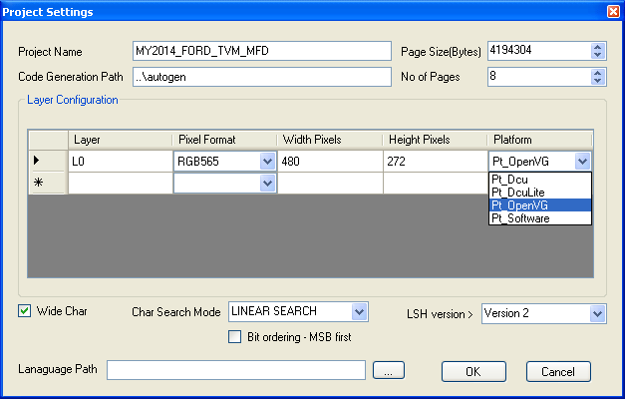
Creating a Project
Step 1 – Select Project->New
Step 2 – GDT opens the New Project Settings Dialog as below
Page <number>

Slide 6
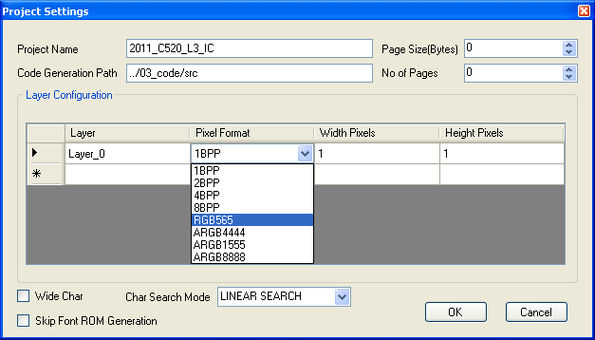
Creating a Project – Project Settings
Enter the project name (follow macro naming conventions)
Specify Code generation path
- You can specify a relative path with respect to the GDT project file
In cases where the amount of graphics data is huge, you can split the graphics data in to multiple files. Here page means file
Specify the width and height of the display (Please note that if you don’t configure this you will not see anything in GDT viewer)
Choose the pixel format of the frame buffer (depends on your target LCD/TFT and hardware)
Page <number>

Slide 7
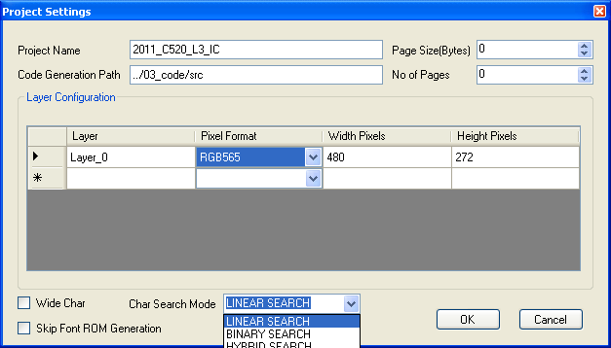
Creating a Project – Project Settings
Tick if you want to skip the font rom file generation.
When there are more char to be generated (Chinese), the generation wil be slower. So you can tick this so that font generation can be skipped. Generally fonts needs to be generated only once or when ever we make any changes
Tick if you require wide char support (>256 chars)
Page <number>

Slide 8
Creating a Project – Project Settings
Select how the graphics library needs to search char.
- When there are limited char (e.g. only ASCII) or if there are no gaps in char codes it makes sense to go for linear search
Page <number>

Slide 9
Creating a Project – Project Settings
- When there are more number of char (e.g. chinese) or if there are gaps in char codes, linear search will be time consuming. So it makes sense to go for binary search
Page <number>

Slide 10
Creating a Project – Project Settings
Click OK after finishing with the settings
- Hybrid search options allows the graphics library to dynamically decide whether to do a linear search or binary depending on how many split ranges are available in a given font.
Page <number>

Slide 11
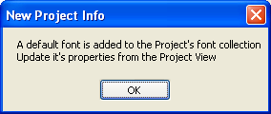
Creating a Project – Create & Save
GDT shows the following message
  In an empty project there won’t be any fonts. So when you add text elements, it may cause issues. So GDT adds a default font to make it easier. You can modify or delete this default font at any time. You can safely click OK to this message
Now the next thing to do is to save the project
  Click Project->Save or Project->Save As to bring up the save dialog. Choose the path and enter a file name for the project and click “Save” button
Page <number>

Slide 12
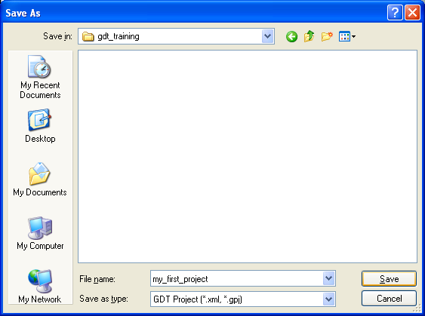
Creating a Project – Create & Save
Page <number>

Slide 13
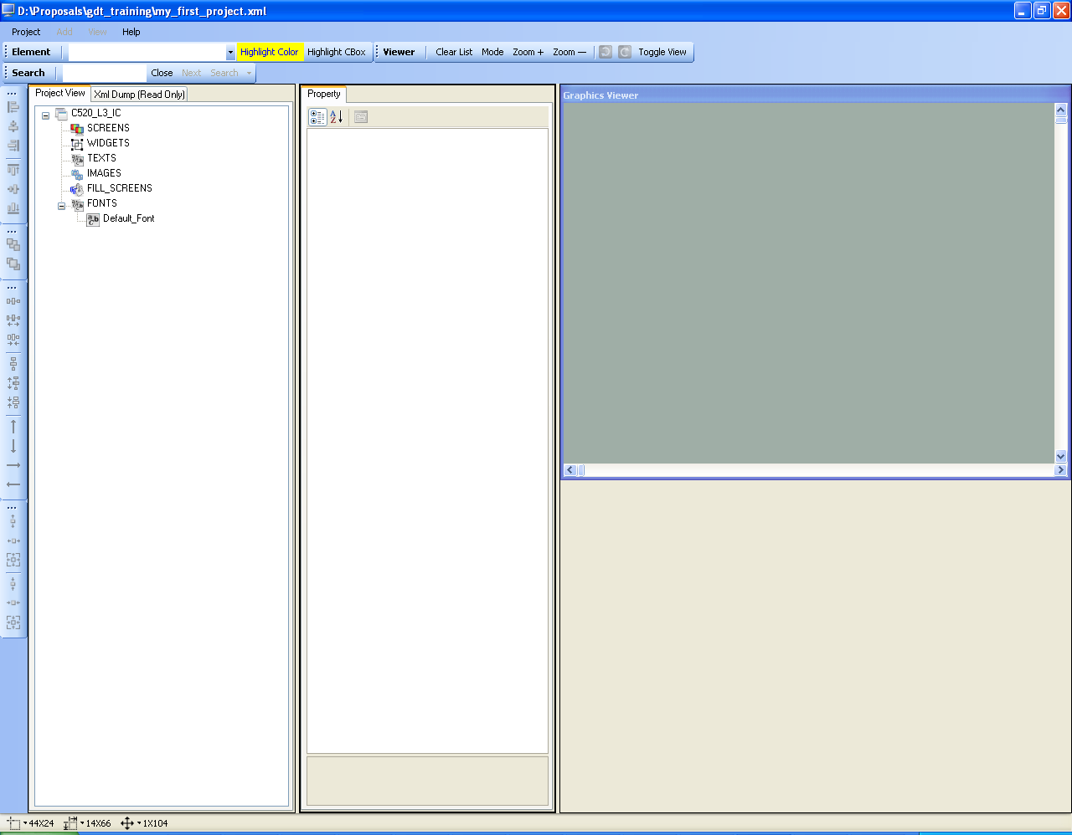
Creating Project
Now the GDT shows the new project view that we have just created. From this point onwards we can start adding elements to implement the graphics requirements
Page <number>

Slide 14
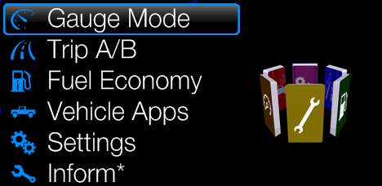
Basic Elements
Consider the below example layout. We can split this in to individual elements
  A black background fill screen
  6 lines of texts
  6 small icons, 1 large icon and menu focus bar images.
Splitting a layout in to elements provides us with the following benefits
  Low memory requirement
  Easy to animate or update individual elements
  Reuse elements
A black background fill screen
menu focus bar image
6 lines of texts
1 large icon
6 small icons
Page <number>

Slide 15
Basic Elements
GDT works on the same priciple of creating a graphics layout with the help of few basic elements
Basic elements supported by GDT are
  Text (display static or dynamic text information)
  Image (display static or dynamic images)
  Fillscreen (fill a rectangular area with a specified color or image)
Following slides will provide more information about the basic element support in GDT
Page <number>

Slide 16
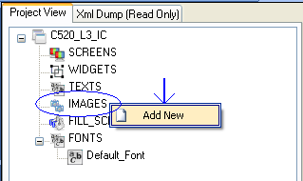
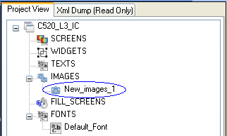
Creating Basic Elements
Basic elements can be created in the following way
  On the project treeview, locate the basic element container and right click.
  For example if you need to create an image element, right click on IMAGES container
  This will open a context menu
  Click on the “Add New” menu item
  This will add a new image element
You can do the above operation on TEXTS and FILL_SCREENS containers to create the corresponding basic elements
Page <number>

Slide 17
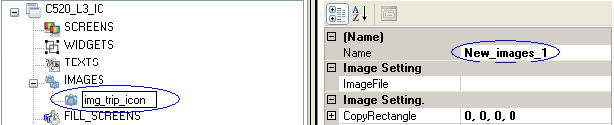
Configuring the Element
A basic element will be created with an auto generated name. You will need to rename it with a meaningful name based on what you are designing or what the element represents. For example if the text element is to display odometer then it will be ideal to name it as txt_odometer
Two ways to rename an element,
  Double click the element and edit the name
  Click the element to select it and in the property window “Name” enter the new name.
Once an element is created, it will be created with default properties.
You will need to configure it according to your needs
We will see the properties available for each of the basic elements next
Page <number>

Slide 18
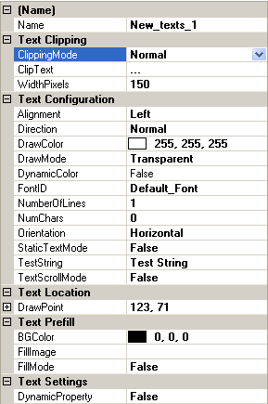

Text Element
A text element can be used for displaying static or dynamic text information on the display such as
  Odometer or Radio Frequency
Name field of the element – This will be later used in your presentation code to interact with this element
Specifies how much width shall be allocated in pixels. Text will not be displayed if this is specified as “0”
Control box highlight indicates area occupied by the given text
In the viewer the dotted highlight indicates the allocated width (e.g. 150px)
Page <number>

Slide 19
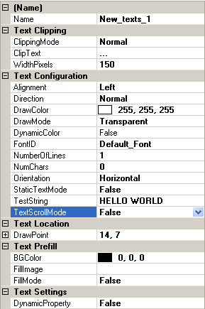

Text Element
Text Clipping property specifies how the text is clipped to fit in to a the configured WidthPixels
Clipping mode can be set to Normal or Text Fit or Append
If the given String exceeds the available width Clipping is performed
Page <number>

Slide 20
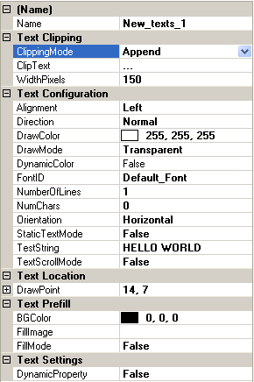

Text Element
If the given String exceeds the available width characters are stripped until the string can be fitted in to the available width along with a ClipText
Page <number>

Slide 21








Text Element
Specify num of char for the text
Used for determining RAM buffer allocation
Leaving it at 0 may cause no text display in target
Static Text Mode = False means text buffer is in
RAM and can be changed during run time.
Static Text Mode = True means text buffer is in
ROM and cannot be changed during run time.
XY location for the text element
Background is transparent
Background is BGColor
DrawColor&BGColor reversed
Page <number>

Slide 22
Text Element
Another important property of a text element is which font and setting needs to be used to display it.
In all our cases, customer will be providing us with the font files and its height requirements.
In order to assign a font to a text element we must first create a font element.
Follow the basic element creation technique on FONTS container and a new font will get added.
Not click on the new font element created to modify its properties
Assume a case where the requirement is to use Times New Roman with a height of 24 pixels
Page <number>

Slide 23
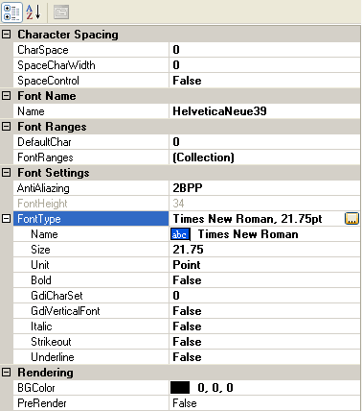
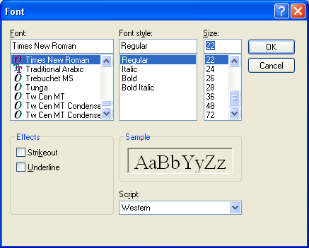
Configuring Font Element
Click on the font browse button to open the font selection dialog
Change the Size (point) property until the required FontHeight (Pixel) is achieved
Choose the font and click OK
Page <number>

Slide 24
Configuring Font Element
Enter a meaningful name
Choose the Antialiazing option
1BPP, 2BPP, 4BPP or 8BPP
(support depends on platform)
Page <number>

Slide 25
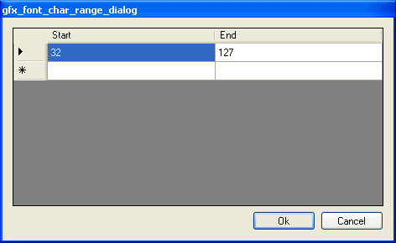
Configuring Font Element
Next step is to specify what character ranges needs to be supported by this font element
Click on the (Collection) to open the range dialog
You can configure a default character to be used by the target font rendering engine incase unsupported character is given for display
Page <number>

Slide 26

Text Element
You can now see that the newly added font elements is added in the pulldown list of the text elements FontID property.
You can choose this from the pulldown list and the text will now display in the choosen font.
One thing to remember is that you don’t need to create a font element for every text element. You can reuse the font element for text elements as long as the font configuration (font name, size and character ranges) doesn’t changes.
Page <number>

Slide 27
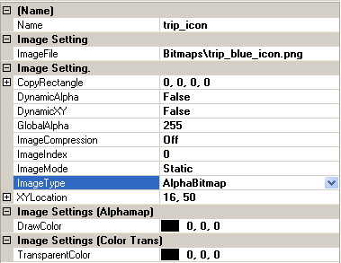
Image Element
Choose the image file to be displayed. You click on the browse button to open the file browse dialog
Note that if the image file resides in the same or a child directory where the design xml is placed, then imageFile path is taken as a relative path automatically. So make sure you keep the file in same folder or child folders
.png, .bmp and .svg files are supported
If the image needs to be cropped you can specify a crop rectangle area here
If the image needs to be moved dynamically during run time say True
If the image needs to be stored with RLE compression choose it here
Page <number>

Slide 28
Image Element
Choose the type of the image.
Yukawa - Bitmap, AlphaMap, AlphaBitmap or Color Transparent Bitmap
Specify the XY location
Specify the Draw color incase of the ImageType = AlphaMap
Specify the transparent color incase of
ImageType = Color Transparent Bitmap
Page <number>

Slide 29
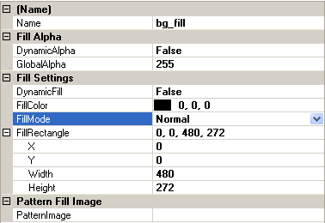
Fill Screen Element
Fill screen elements can be used for two purpose
  Fill a rectangular area with color
  Fill a rectangular area with a given image (called as pattern fill or tiling)
If the fill area needs to be modified during run time Choose True here
Choose the fill color for the Normal Fill rectangle
Choose the fill mode
- Normal
Horizontal pattern
Vertical pattern
Choose the fill image incase of pattern fill
Choose the fill rectangle
Page <number>

Slide 30
Realizing the Sample Screen
A black background fill screen
menu focus bar image
6 lines of texts
1 large icon
6 small icons
Page <number>

Slide 31
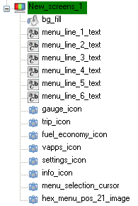
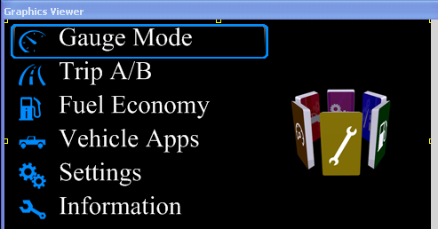
Realizing the Sample Screen
Our first example image can be constructed by using the basic elements as below
A black background fill screen
6 lines of texts
6 small icons
menu focus bar image
1 large icon
Page <number>

Slide 32
Group Elements
Inorder to provide more functionality in terms of easy visual representation, reuse GDT provides group elements
  Widgets
  Dynamic Widgets
  Dynamic Images
  Screens
Widgets are a collection of
  Basic elements
  Dynamic widgets
  Widget
  Dynamic Images
Dynamic Widget is a collection of Widgets and you can select one of them during run time. This allows switching between different contents
Dynamic Image is a collection of Static or Dynamic Images and you can select one of them during run time. This allows switching between different images at run time
Page <number>

Slide 33
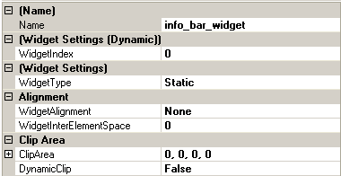
Widgets
Incase of dynamic widget indicates the selected widget (you can click on the child widgets and this index will automatically updated)
Indicate the widget type
- static
- dynamic
For a static widget if the content needs to be aligned (Left, Right, Centre) use this option
For a static widget if the content needs to be clipped to a rectangle use this. You can also change the clip region in run time to achieve animation effects
You can drag and drop elements
In to widget after you create a
widget
Page <number>

Slide 34
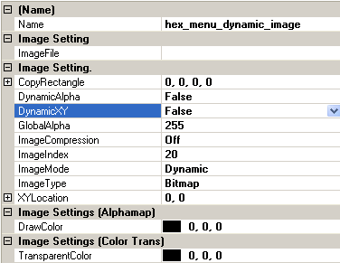
Dynamic Image
Indicates the selected image (you can click on the child image and this index will automatically updated)
By default the child elements of a dynamic image are displayed at the programmed location of the child image
If the DynamicXY property of a dynamic image is set to True the above behaviour will be changed. The child images will not get displayed at the XY location of its parent dynamic image. Also you can change the XY location during RUN time
Page <number>

Slide 35
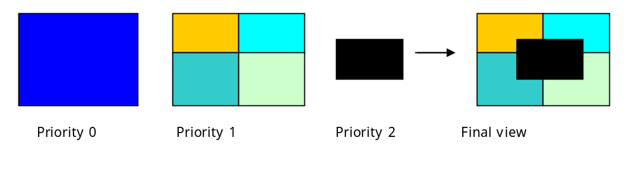
Screens
Screens are the highest level of group elements which can contain all the basic elements, Widgets (Dynamic and Static) and Dynamic Images.
Screen cannot contain another screen
Screen represents one layout
Screen has mainly two properties
  Layer : says which hardware layer the layout needs to be built
  Priority : says in a layer which priority order the layout needs to be placed or simply specifies the building order. So a screen with priority 0 will be built first and priority 1 screen will be built on top of priority 0
Page <number>

Slide 36
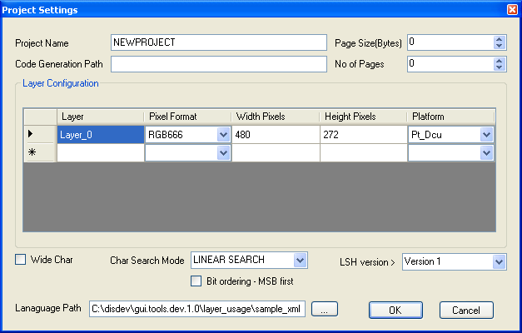
Language Support
A language file could be configured in project settings
The language xls sheet needs to be saved as a Unicode text file and set is input to GDT
Page <number>

Slide 37
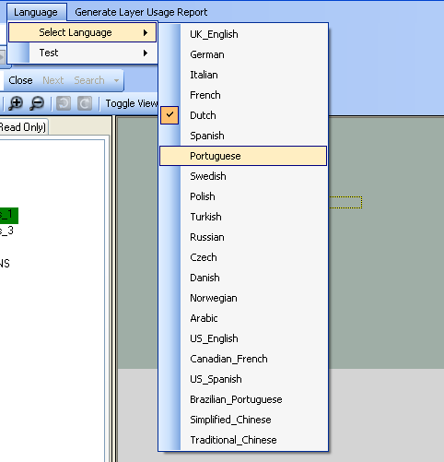
Language Support …
Language File is parsed and language menu is added in GDT
Current display language for text can be selected
Also a test can be initiated to find out whether any text clipping will occur based on current configuration
Test could be run for a single language or all the languages
Test will be run for all possible values possible for a text based on its configuration and checks whether any clipping will occur or not
Page <number>

Slide 38
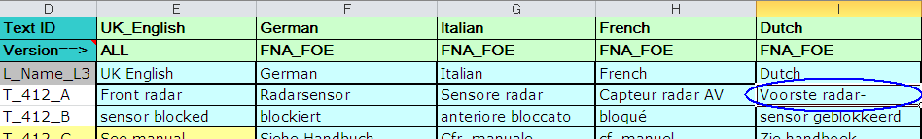
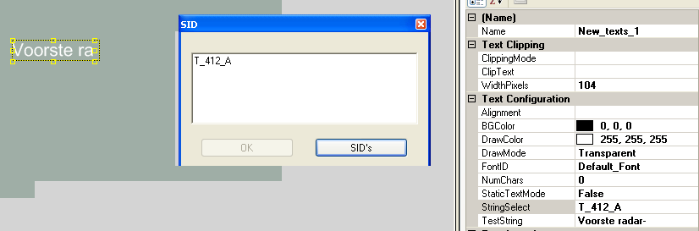
Using SID’s in Text
Click on the StringSelect Property of the text to Open the SID editor
Type in the SID or click SID’s button to open the SID list
Page <number>

Slide 39
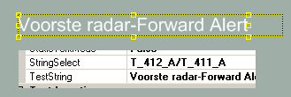
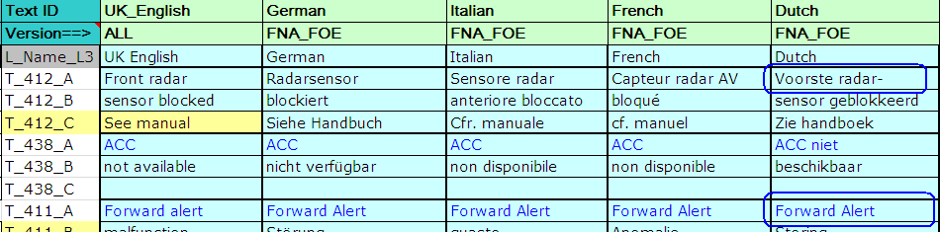
Using SID’s in Text
If the text box needs to display a combination of multiple SIDs, then enter them as a ‘/’ separated list
Page <number>

Slide 40
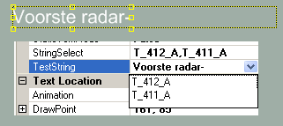
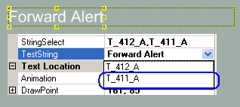

Using SID’s in Text
If the SIDs to be displayed as one at a time use a ‘,’ separated list
Then click on the TextString property to open up a dropdown menu to choose the SID that you wanted to get displayed
Numeric values and Static String also can be specified
Following are the supported types
  SID
  Static String - enter in single quotes
  Dynamic String – enter Y for every character e.g. for length of 4 use YYYY
  Numeric Value – enter as XX.XX, use Z to hide leading zero
    XX.XX -> 00.00 to 99.99
    ZX.XX -> 0.00 to 99.99
Page <number>

Slide 41
Rotation feature
TFT originally in the Landscape orientation
Frame buffer memory can be visualized as starting from 0,0 till 320,0 and then repeats similarly till 320,240
(0,0)
(320,0)
240
pixels
DISPLAY PANEL
(0,240)
(320,240)
320
pixels
Page <number>

Slide 42
Rotation feature
If TFT placed in the Portrait orientation in the hardware
320
pixels
240
pixels
Page <number>

Slide 43
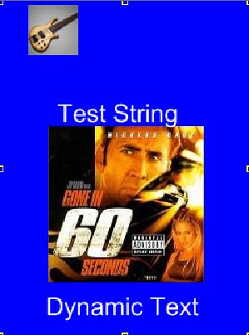
Rotation feature
GDT always scans the screen info and generates the data in the order to be written in the framebuffer
Normally DMA is used to transfer the graphics content from Flash to framebuffer
Now with the orientation change DMA cannot be used since the destination address in the framebuffer is not sequential
This leads to redundant load on the CPU to transfer the content into framebuffer
So the idea was to make the change in the code generation of GDT itself
Clockwise rotation-The pixel data is read from the top right corner of the element in the vertical direction
Anti-clockwise rotation-The pixel data is read from the bottom left corner of the element in the vertical direction
Page <number>

Slide 44
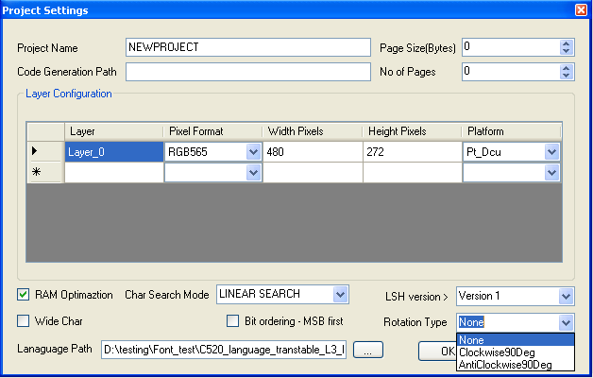
Rotation feature
Have a look at rotation settings
Page <number>

Slide 45
Rotation feature
Text Rendering:
Text consists of characters which are taken from the font library. So each character can be visualized as a bitmap again
Font generation is not modified so the text rendering is not done through DMA right now.
The change is done in the graphics driver with the pixel data in character copied to the frame buffer
The next pixel is rendered after decrementing the frame buffer in case of clockwise rotation and incrementing the frame buffer by the WIDTH of the display in case of anticlockwise rotation
Text clipping, start offset , end offset to be taken care while modifiying the framebuffer
Page <number>

Slide 46
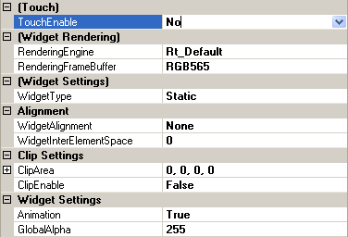
Widget element Enhancements
TouchEnable – When set to Yes, the widget area is assumed to be an active area and mouse events are passed to application.
Widget Rendering – This option is available if the widget is used in a Kepler target. Default setting is RT_Default which will make the run time to build the widgets in RAM using eDMA. User can override this to either Rt_OpenVG or Rt_Software and also set the buffer pixel format (RGB565, ARGB4444 or ARGB8888) to be used.
Alignment – Set the alignment option if the elements inside widget needs to be aligned. For center and Right alignment, the first element inside the widget will decide the available width/height for performing the alignment
Clip – Set the clipping rectangle. If animation is enabled, the rectangle size can be changed during run time. All child elements are clipped to the set area.
Dynamic buffer allocation to the extend needed by the child element is not available in the next planned release. This will be added in next release to save memory in usecases like a pointer needs to be rotated.
Page <number>

Slide 47

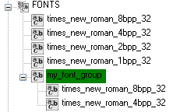
Font Element Enhancements
Support to create a Font Group
  Font group is a collection of Fonts similar to a dynamic image
  User can set the font to be selected at run time
  A text can be configured with a font group
  Based on the user selection, the text gets rendered with choosen font
  Allows the user to display a text in multiple fonts one at a time
How to use
  Right click on FONTS container
  Select the New Font Group menu item
  A new font group element is added
  Now drag and drop the fonts in to the newly created group
Page <number>

Slide 48
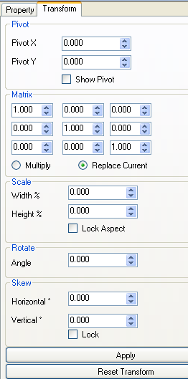
OpenVG property Tab
In order to set OpenVG transformation proeprties a tab is added.
Tab will be visible only for OpenVg elements
Tab provides editing for
  Pivot point for transformations
  Transformation matrix
Currently only keyboard based editing only is supported for OpenVG transformations
Page <number>

Slide 49
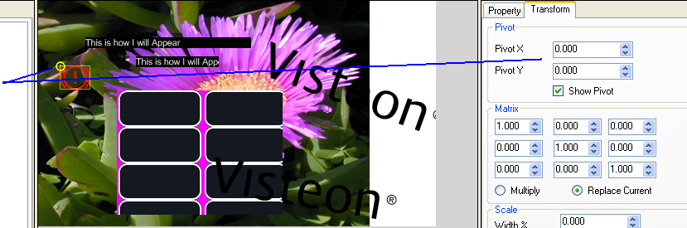
Setting the Pivot
Pivot handling for base elements are entered as an offset from its top left corner
  Default pivot is 0, 0 on element creation
Pivot handling for group elements are entered as an absolute XY location
  Default pivot is 0, 0 for a group element on creation, which is absolute 0, 0
In order to set the pivot
  Enable the Show Pivot check box and drag the pivot point shown as an yellow circle using mouse.
  Or enter the values directly in the Pivot X/Y text box and click the Apply button
Page <number>
Notes:
Visual editing for Pivot is supported only for image elements in this version of the tool

Slide 50
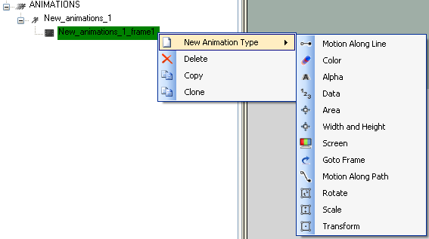
Animation support in GDT
Following animation support is added
  Motion along Line or Path
  Color
  Alpha
  Data
  Area
  Width/Height
  Screen
  GoTo Frame with conditioncheck
  OpenVG Transformations
Page <number>

Slide 51
Animations – Usage Overview
How to use
  Rightclick and create an animation under ANIMATIONS container
  Right click and add a new frame
  Under the frame right click and add any supported animations
  Drag and Drop GDT elements in to animations (Please under stand animations supported by each GDT element type before dragging, if an unsupported element type is dragged and dropped, then it will not animate)
  Perform the required configurations for animations
When an animation is played
  Animation starts with first frame
  All animations inside a frame is executed in parallel
  Once a frame is completed, execution shifts to the next frame
  Once all frames are completed, animation is stopped
Page <number>
Notes:
There are unused properties still displayed in the current version of the tool

Slide 52

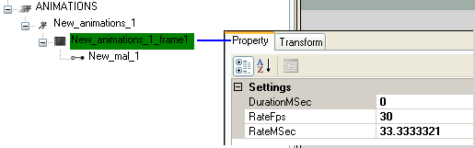
Animations Properties
Click on the ANIMATION container to show the base properties
  Configure either the TFT fps or the VSYNC rate in milliseconds here
  This determines on what rate the animation task needs to be executed at run time
  Individual animations rate can be different than this configuration
Click on the animation frame to show the base properties for a frame
  Duration – indicated the duration of the frame in milliseconds
  If duration is left 0, then the duration is maximum duration needed based on its child animations
  Rate – Configure the rate at which this frame to be animated
Page <number>

Slide 53
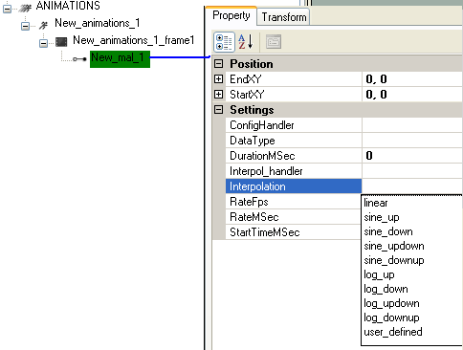
Animation Properties …
MAL Animation Type has the following properties ( All other animations share the similar syntax and there fore not explained in this ppt)
Start and End Position – Based on the start/end configuration elements part of this animation is animated from start to end at the configured rate for the configured duration.
Elements are moved based on relative offset values only and not to Raw position.
StartTime and Duration – If left to zero then the duration is defaulted to the frame duration
Interpolation – Choose from the available options or set to user_defined
If set to user_defined, then a Interpolation_handler will be called where the user can decide the interpolation to be used.
Page <number>

Slide 54
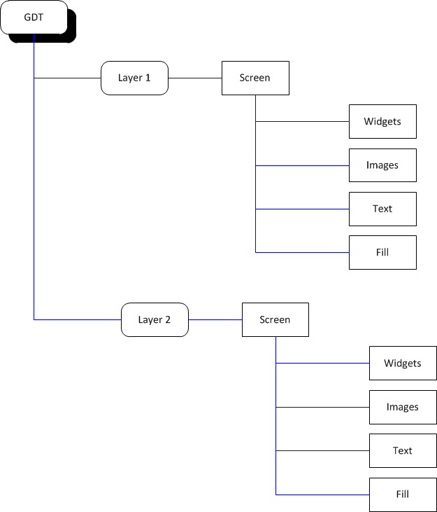
Animations supported by Elements
On high level GDT project is organized as below
Animations are possible on each of the below elements
Page <number>
Notes:
A Layer is the highest possible grouping. It can be termed as a frame buffer which can be assigned to a hardware layer of a TFT controller
A Layer can be consisting of multiple layouts which are called as screens. For exampe an AFE display is a screen, warning popup is another screen.
A screen is constructed by using GDT base elements or group elements

Slide 55
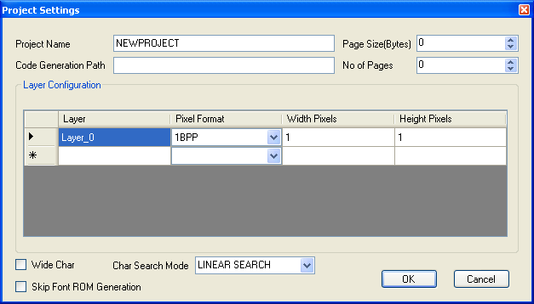
Layer Animations
A GDT layer can be animated for
  XY Offset
When a layer is animated, the animation property propagates to all active screens and its elements
For example if layer XY offset is set to (100, 50), then entire content of the layer is moved by an offset of (100, 50)
In case of Yukawa, the layer offset will be programmed directly to the VDC
In case of Kepler, the layer offset will be added to all active DCU layers
Page <number>

Slide 56

Group Animations
Group animations are applicable for
  Screen element
  Dynamic Widget element
  Dynamic Image element
Group can be animated for
  XY Offset
  Alpha
When XY Offset is adjusted, the offset is passed on to the child elements of the group. Therefore it appears as if the entire group is getting moved.
  Useful for implementing slide in/out animations
Alpha adjustments behaves the same as XY, but with following exception for Kepler
  Alpha adjustment for Dynamic Widget / Dynamic Image are ignored if they are child element of a widget which is built in RAM using eDMA engine.
Page <number>

Slide 57
Image Animations
Following properties of an Image can be animated
  Alpha
  CLUT identifier (Only for Kepler indexed color images)
  Foreground Color (only for transparency & luminance types)
  XY co-ordinates
Restrictions on Kepler
  Alpha adjustment are ignored if it is a child element of a widget which is built in RAM using eDMA engine.
  CLUT animation is only applicable for Kepler DCU
Page <number>

Slide 58
Text Animations
Following properties of an Image can be animated
  Alignment (Left / Right / Center)
  Draw Mode (Normal / Transparent)
  Clip Mode
  Font
  Alpha
  Foreground Color
  XY co-ordinates
Restrictions on Kepler
  Alpha adjustment are ignored if it is a child element of a widget which is built in RAM using eDMA engine.
Page <number>

Slide 59
Fill Animations
Following properties of a fill/tile element can be animated
  Alpha
  Fill Color (valid only for fill element)
  XY co-ordinates
  Dimension (Width & Height)
Restrictions on Kepler
  Alpha adjustment are ignored if it is a child element of a widget which is built in RAM using eDMA engine.
Page <number>

Slide 60
Static Widget Animations
Following properties of a static widget element can be animated
  Alpha
  Foreground Color (valid only for Kepler)
  CLUT id (valid only for Kepler)
  XY co-ordinates
  Clip Area (X, Y, Width & Height)
Restrictions on Kepler
  Alpha adjustment are ignored if it is a child element of a widget which is built in RAM using eDMA engine.
Page <number>

Slide 61


www.visteon.com
Page <number>

