Slide 1

Integrated GDT and
Graphics Manager 02 target framework
Version 1.0

Slide 2
GDG02 Overview
HMI software development for C520 program consist simultaneous development of
  Level 1 NA and Europe
  Level 3 NA and Europe
Level 1 is monochrome LCD and Level 3 used color TFT
Feature and functionality remains same between Level 1 and Level 3
An analysis of issues between L1 and L3 shows that L3 has more number of graphics related issues than L1
Further analysis on L3 graphics issues shows that 50% of the issues would have been prevented if handled differently
Category | L1 | L3
HMI Logic | 75 | 85
Graphics Presentation | 31 | 100
Graphics Design | 21 | 25
Graphics Platform | 3 | 49
Page <number>

Slide 3
L3 Graphics Details
Level3 uses GDG02 graphics framework
There are basic differences in how GDG02 handles graphics with respect to existing method used by HMI team (e.g. MFD, L538, Level1)
Level1 uses the usual graphics framework
Level 3 uses the DCU and it need to manage the available 16 layers
Page <number>
Notes:
Classified the graphics issues as platform/non platform. An issue is considered platform if this wouldn’t have happened if the already existing approach was utilized. Examples would be loading of associated CLUT, setting of blending modes, setting chroma key, layer management etc. There is a drastic increase in platform related issues in graphics compared to L1. So much of the DCU handling was exposed to the applications where it requires highly skilled people who know everything about DCU to implement the software.

Slide 4
Developer Issues with GDG02…
API’s are primitive in nature
There are more number of API’s (10 basic API’s and 10 advanced API’s)
In order to bring a layout user need to make a number API calls
API needs to be sequenced and need to be given only after finishing the first one
  Requires that every feature to implement additional control logic
Handling of Free layer API
  Feature A can free a layer only if all the commands are completed. So there could be a wait time for Feature B to use the layer even though Feature A doesn’t need it any more
  This again means a control logic is needed to poll the status and manage the freeing of layers
Build and Free can be done only when the GDG02 is not busy
Page <number>

Slide 5
Developer Issues with GDG02
GDG02 works on ISR and developer need to be aware of the implications of calling API
  Chances are that the interrupt may fire while/in-between API calls
Developer need to have an in-depth knowledge of DCU and its limitations to correctly implement a layout
Layer management needs to be done by the user during run time as there may be need for more than 16 layers
  While the trip computer is displayed it may be already using 15 layers
  So when a warning which requires > 1 layer is triggered, it may not be able to display its contents.
  This means the warning feature need to be aware of the current layer usage so that it can free up certain layers for its usage.
  This leads to more feature to feature dependency.
Color Look Up Table (CLUT) needs to be managed by the developer
  Need to know the CLUT free area where a CLUT can be loaded
  Need to assign a CLUT to layer correctly
Page <number>

Slide 6
Comparison of Approach in MFD project
Building a Car bitmap with four door indicators
  Simple and Straight forward
  No need to remember status, queue commands
  Presentation layer doesn't need to have any intelligence
void presentation(UINT8 status)
{
case ACTIVATE:
case REFRESH:
{
GfxSendEvent(GFX_VEHICLE_STATUS_SCR, 1);
GfxSendEvent(GFX_LEFT_DOOR_STATUS_SCR, left_fdoor);
GfxSendEvent(GFX_LEFT_DOOR_STATUS_SCR, left_rdoor);
GfxSendEvent(GFX_LEFT_DOOR_STATUS_SCR, right_fdoor);
GfxSendEvent(GFX_LEFT_DOOR_STATUS_SCR, right_rdoor);
}
break;
case DEACTIVATE:
{
GfxSendEvent(GFX_VEHICLE_STATUS_SCR, 0);
}
break;
}
Page <number>

Slide 7
Comparison GDG02 Approach…
Building a Car bitmap with four door indicators
  Need to know about available layers
  Need build layers individually and set its properties
  Need remember status and issue commands one by one
  Presentation becomes more intelligent and lot of work and interactions required
void presentation(int build)
{
if(build == TRUE)
{
if(layer_built == FALSE)
{
layer_built = build_vehicle_status();
}
else
{
update_vehicle_status();
}
}
else
{
free_vehicle_status();
}
}
BOOL build_vehicle_status(void)
{
if(GfxMgrBuildLayer(LAYER_15, LAYER_TYPE_WIDGET, GFX_WDG_VEHICLE_STATUS_WIDGET, ENABLE_BY_DEFAULT) == NO_ERROR)
{
GfxMgrLoadCLUT(VEH_STS_CLUT_OFFSET, GFX_WDG_VEHICLE_STATUS_CLUT);
GfxMgrSetCLUTOffset(LAYER_15, VEH_STS_CLUT_OFFSET);
GfxMgrSetLayerChromaKey(LAYER_15,0xFC, 0x00, 0xFC, 0xFC, 0x00, 0xFC);
GfxMgrSetLayerAttribute(LAYER_15, ENABLE_CHROMA_KEY | ENABLE_ALPHA_BLENDING_2);
update_pending = FALSE;
return TRUE;
}
else
{
return FALSE;
}
}
Page <number>

Slide 8
Comparison GDG02 Approach…
BOOL free_vehicle_status(void)
{
if(GfxMgrFreeLayer(LAYER_15) == NO_ERROR)
{
return TRUE;
}
else
{
return FALSE;
}
}
void update_vehicle_status(void)
{
if(update_pending == FALSE)
{
if(left_fdoor)
{
GfxMgrUpdateWidgetGraphicObject(LAYER_15,
GFX_WDG_LEFT_FDOOR_OPEN_IMAGE,
GFX_WDG_LEFT_FDOOR_OPEN_SLOT,
WIDGET_SHOW);
}
else
{
GfxMgrUpdateWidgetGraphicObject(LAYER_15,
GFX_WDG_LEFT_FDOOR_CLOSE_IMAGE,
GFX_WDG_LEFT_FDOOR_CLOSE_SLOT,
WIDGET_SHOW);
}
step = 0;
}
}
Page <number>

Slide 9
Comparison GDG02 Approach
void vehicle_status_call_back(void)
{
update_pending = TRUE;
switch(step)
{
case 0:
{
if(left_rdoor)
{
GfxMgrUpdateWidgetGraphicObject(LAYER_15, GFX_WDG_LEFT_RDOOR_OPEN_IMAGE,
GFX_WDG_LEFT_RDOOR_OPEN_SLOT, WIDGET_SHOW);
}
else
{
GfxMgrUpdateWidgetGraphicObject(LAYER_15,GFX_WDG_LEFT_RDOOR_CLOSE_IMAGE,
GFX_WDG_LEFT_RDOOR_CLOSE_SLOT, WIDGET_SHOW);
}
step++;
}
break;
case 1:
{
if(right_rdoor)
{
GfxMgrUpdateWidgetGraphicObject(LAYER_15,GFX_WDG_RIGHT_RDOOR_OPEN_IMAGE,
GFX_WDG_RIGHT_RDOOR_OPEN_SLOT, WIDGET_SHOW);
}
else
{
GfxMgrUpdateWidgetGraphicObject(LAYER_15, GFX_WDG_RIGHT_RDOOR_CLOSE_IMAGE,
GFX_WDG_RIGHT_RDOOR_CLOSE_SLOT, WIDGET_SHOW);
}
step++;
}
break;
case 2:
{
if(right_fdoor)
{
GfxMgrUpdateWidgetGraphicObject(LAYER_15, GFX_WDG_RIGHT_FDOOR_OPEN_IMAGE,
GFX_WDG_RIGHT_FDOOR_OPEN_SLOT, WIDGET_SHOW);
}
else
{
GfxMgrUpdateWidgetGraphicObject(LAYER_15, GFX_WDG_RIGHT_FDOOR_CLOSE_IMAGE,
GFX_WDG_RIGHT_FDOOR_CLOSE_SLOT, WIDGET_SHOW);
}
step++;
}
break;
default:
{
update_pending = FALSE;
}
}
}
Page <number>

Slide 10
Program Implications
Side effects due to Layer management
  Missing information on display
  Corruption issues
Side effects due to lack of DCU knowledge
  DCU knowledge is a must
Careful analysis of Critical section implications
  Could result in display Freeze issues
  More time required to debug issues
Maintainability is minimized
Changes cannot be done quickly
More Development Time due to
  Complexity in implementing presentation
  Interactions required to correctly manage the Layers
Page <number>

Slide 11
Proposal…
Create a simplified API set inline with the current approach
Hide the DCU complexity from the developer
No need for applications to take care of the critical sections
Implement the layout manager
  With the call to BuildScreen() a static layout will be built by the framework
  Developer will only need to set any dynamic properties
  Data structures will be auto generated for the layout manager
Implement layer manager
  Framework will decide on what need to go to DCU layer by analyzing the graphic object’s Area , Position and its Transparency
  All hidden objects will be removed and only the visible 16 objects will be sent for the DCU to display
Handle all the required property settings
  CLUT loading
  Chroma Keying
  Blending Modes
Page <number>

Slide 12
Proposal…
Basic APIs
  hmi_gfx_mgr_build_screen()
  hmi_gfx_mgr_set_screen(id,data)
  hmi_gfx_mgr_set_text(id,data)
  hmi_gfx_mgr_select_dwidget(id,data)
  hmi_gfx_mgr_select_dimage(id,data)
Advanced API’s (Required to be used only to get a special effect/animation)
  hmi_gfx_mgr_set_obj_clut(id,data)
  hmi_gfx_mgr_set_obj_tile(id,data)
  hmi_gfx_mgr_set_obj_blend(id,data)
  hmi_gfx_mgr_set_obj_fg_color(id,data)
  hmi_gfx_mgr_set_obj_bg_color(id,data)
  hmi_gfx_mgr_set_obj_fill_color(id,data)
  hmi_gfx_mgr_set_obj_vclip(id,data)
  hmi_gfx_mgr_set_obj_pos_x(id,data)
  hmi_gfx_mgr_set_obj_pos_y(id,data)
Page <number>

Slide 13
Comparison New Approach
Building a Car bitmap with four door indicators
  Inline with what HMI is used to
void presentation(UINT8 status)
{
case ACTIVATE:
case REFRESH:
{
hmi_gfx_mgr_set_screen(GFX_VEHICLE_STATUS_SCR, 1);
hmi_gfx_mgr_select_dimage(GFX_LEFT_DOOR_STATUS_SCR, left_fdoor);
hmi_gfx_mgr_select_dimage(GFX_LEFT_DOOR_STATUS_SCR, left_rdoor);
hmi_gfx_mgr_select_dimage(GFX_LEFT_DOOR_STATUS_SCR, right_fdoor);
hmi_gfx_mgr_select_dimage(GFX_LEFT_DOOR_STATUS_SCR, right_rdoor);
}
break;
case DEACTIVATE:
{
hmi_gfx_mgr_set_screen(GFX_VEHICLE_STATUS_SCR, 0);
}
break;
}
Page <number>

Slide 14
Pros and Cons
Advantages
  Most of the functionality can be achieved by 5 basic interfaces
  API’s to have only two parameters (ID and data), so chances of making mistakes are minimal
  Static screens can be built by a single API call
  Platform/DCU related handling issues are eliminated
  Reduction in Presentation complexity, LOC and development Time
  Platform Knowledge is isolated from developer
  Graphics Issues can be addressed quickly
Disadvantages
  Increased ROM usage because of the additional data structure generation. But this could get off settled by decreased presentation layer ROM usage by the simplified API usage
  May not provide complete freedom to control everything
Page <number>

Slide 15
GDG03 Overview
Graphics manager 02 was initially developed to simplify the graphics development for Kepler
Provides maximum abstraction of DCU by
  No critical sections to be handled by developer
  Layout management
    Static layout will be built by the framework by default
    Developer will only need to set any dynamic properties at run time such a text value
  Layer management
    Framework will decide on what need to go to DCU layer by analyzing the graphic object’s Area , Position and its Transparency
    All hidden objects will be removed and only the visible 16 objects will be sent for the DCU to display
  Handle all the required property settings
    CLUT loading (static loading or runtime dynamic loading)
    Chroma Keying
    Blending Modes
Coming slides explains the changes/updates implemented so far from the initial version of graphics manager 02 (version 1.XX to version 2.XX)
Page <number>

Slide 16
GDG02 vs GDG03 CRE
 | RAM | ROM | QSPI
GDG02 | 18281 | 33306 | 0
AutoGen | 0 | 56223 | 12893751
Fonts | 0 | 28170 | 788639
Presentation | 1501 | 151558 | 0
Total | 19782 | 269257 | 13682390
 | RAM | ROM | QSPI
GDG03 | 1862 | 26034 | 0
AutoGen | 10310 | 123648 | 14470604
Fonts | 0 | 0 | 466152
Presentation (assuming 50% code reduction based on previous analysis) | 750.5 | 75779
Total | 12922.5 | 225461 | 14936756
Savings | 6859.5 | 43796 | -1254366
10K of RAM could be saved
Page <number>

Slide 17
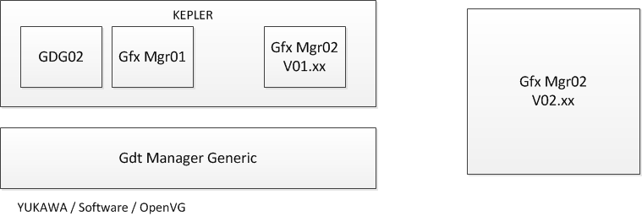
GDT evolution
Integrated GDT will replace individual run time + tool to a integrated single run time environment + tool
Page <number>

Slide 18
Enhancements – Quick overview
Graphics manager 02 will be enhanced to have
  Frame buffer based rendering library
    To support Yukawa and other platforms
    Both Software and OpenVG capability will be added
    DCU targets will have option to utilize either Software or OpenVG to build layer contents
  Sprite engine (DCU) rendering
    Layer usage report generation
    Up to 60fps
  Common
    Memory reports
    Language integration
    Animation integration
GDT is also upgraded to an integrated version to support all targets
Page <number>

Slide 19
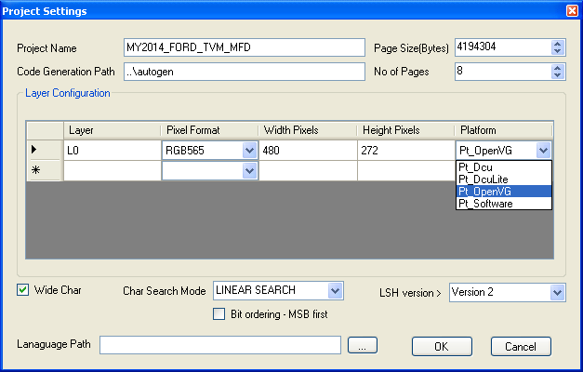
Project Settings
Project settings has additional option per layer to specify the target library
  DCU, OpenVG or Software
  Combination could also be used
Additional option to specify Language xls file
Page <number>

Slide 20
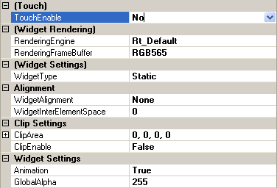
Widget Enhancements (Quick Overview)
TouchEnable – When set to Yes, the widget area is assumed to be an active area and mouse events are passed to application.
Widget Rendering – This option is available if the widget is used in a Kepler target. Default setting is RT_Default which will make the run time to build the widgets in RAM using eDMA. User can override this to either Rt_OpenVG or Rt_Software and also set the buffer pixel format (RGB565, ARGB4444 or ARGB8888) to be used.
Alignment – Set the alignment option if the elements inside widget needs to be aligned. For center and Right alignment, the first element inside the widget will decide the available width/height for performing the alignment
It is possible to control alpha of text elements
Clip – Set the clipping rectangle. If animation is enabled, the rectangle size can be changed during run time. All child elements are clipped to the set area.
Dynamic buffer allocation to the extend needed by the child element is not available in the next planned release. This will be added in next release to save memory in usecases like a pointer needs to be rotated.
Page <number>

Slide 21
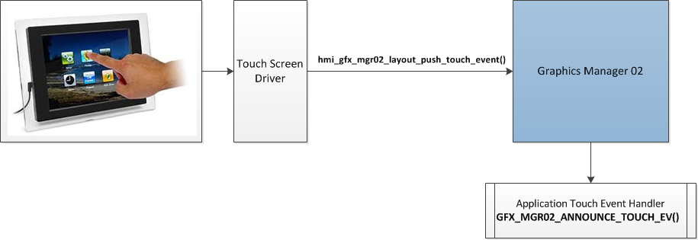
Widget Touch Support
If the passed xy falls inside a touch enabled widget area, application is notified with the widgets ID
Page <number>

Slide 22
Widget Rendering Option (DCU Only)
For Rainbow/Spectrum DCU target widget will have rendering option
  Default
    Uses eDMA
    Combine multiple images/text in to a single RAM buffer with restriction that all images/Text should be of same BPP encoding
  OpenVG
    Uses OpenVG engine to combine all supported element types in to a single RAM layer
    No restrictions on overlaps
    Elements can be blended
    Supports RAM layer formats ARGB8888, RGB565 and ARGB4444
  Software
    Uses a software library to combine all supported elements in to a single RAM layer
    Elements can be blended
    Supports RGB565 and ARGB4444 RAM layer formats
Page <number>

Slide 23
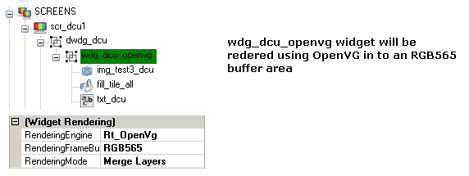
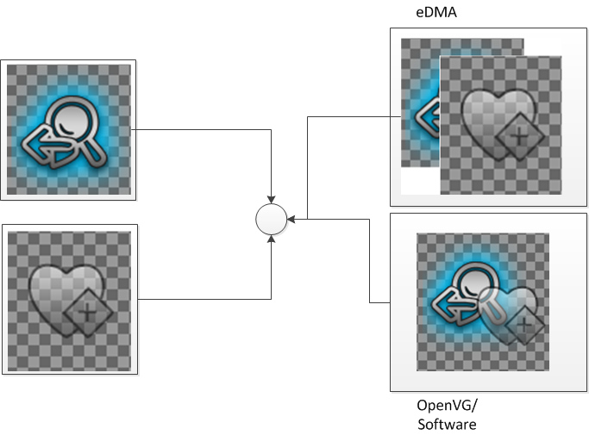
Widget Rendering (Comparison)
Overcoming the restrictions of eDMA widget rendering
Page <number>

Slide 24

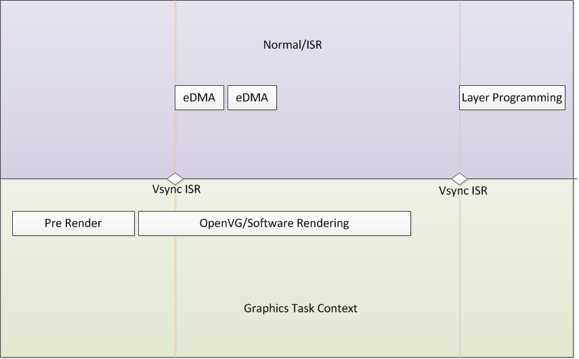
Widget Rendering (Runtime View)
Page <number>

Slide 25
Widget Rendering Buffer handling(OpenVG & Software)
If ClipEnable = True
  Clip area rectangle becomes the area for the widget RAM buffer
  During the building RAM buffer will be allocated to the extend needed to cover the clip area
  For example if the Clip area is set to x=10, y=10, width=100, height=50, then a buffer will be allocated w=100 x h=50 pixels
  Double buffering will be used
  The buffer will be freed if the widget is no longer active in the display
If ClipEnable = False
  The widget area will be calculated during run time by analyzing all child elements and its current bounding box
  The buffer will be allocated to just to hold the elements
  Integer part of the widget area bounding box will be set to DCU layer XY and the fractional part will be used for OpenVG translation
  Especially useful for holding a OpenVG pointer/needle layer in a reduced RAM memory
Page <number>

Slide 26
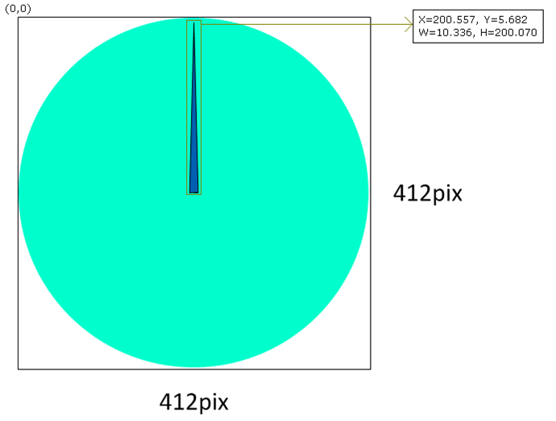
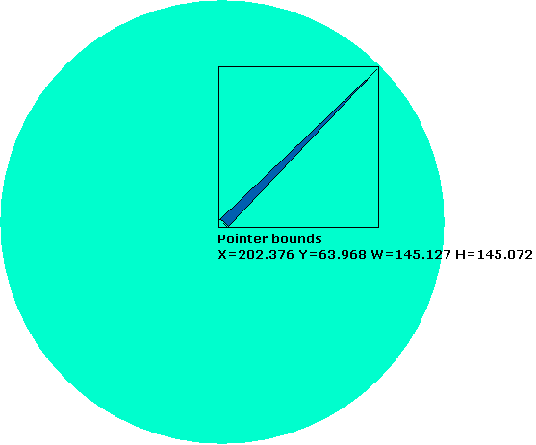
Widget Rendering (Static Buffer vs Dynamic Buffer)
Clip=True will allocate a 412x412 buffer and place the layer at X=0, Y=0
Clip=false, Animation=true will allocate a 11x201 buffer and place the layer at X = 200, Y = 5 and the object will be drawn at X=0.557, Y=0.682 inside the buffer
Page <number>

Slide 27
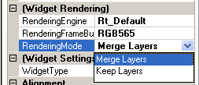
Widget Rendering Mode (DCU)
Rendering Mode can be selected between
  Merge Layers (default)
  Keep Layers
Merge layer behaves the default way as it will combine all the elements inside the widget in to a single RAM buffer
Keep Layer option will make the graphics manager not to combine the elements rather allocate each element its own layer.
  Applicable only if the widget is a root level widget (not a child widget of another static widget)
  Can be used for grouping purpose.
  Example would be Header contents could be grouped and used in multiple screens rather than creating it as a separate screen.
Page <number>

Slide 28
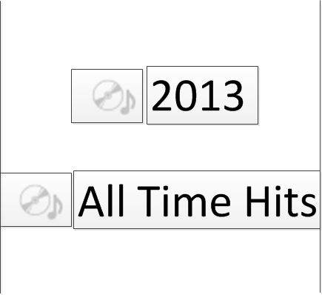
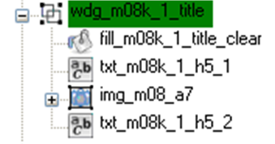
Widget Alignment Option
Alignment option allows to dynamically align contents inside a widget during run time
  Example use case, positioning an icon before a center aligned dynamic text
  As the length of the text changes during run time, the aligned widget property make sure the icon and text are aligned together
First element inside widget determines the area of the widget
Rest of the elements are aligned within the area according to the alignment configuration
Inter element space can be configured to control the spacing between elements
Page <number>

Slide 29
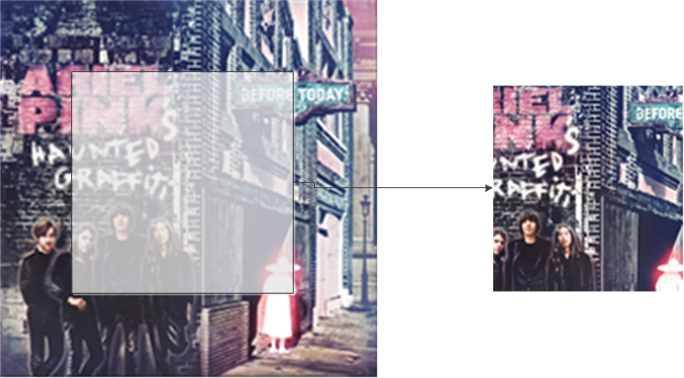


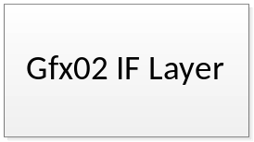
Widget Clipping
Widgets can have a clipping rectangle area
  Set the ClipEnable = True
  Define a rectangular area (contents outside the area will be clipped & not visible)
If Animation set to True, the clip area can be modified during run time
Uses Mechanical Odometer animations, Menu content scrolling etc
Page <number>

Slide 30
Multicolor Widget (DCU only)
By default an eDMA rendering widget will not allow multiple color elements when the base type is 4BPP or 8BPP Transparency
This is due to the fact that the DCU layer can be configured to have a single foreground color and all elements with in the widget will there fore will appear in a single color
In order to overcome this, new support is implemented which will automatically upgrade the widget format if the coder detects that if the elements has multiple draw colors used. Format will be chosen based on whether blending need
8BPP Indexed – (Maximum of 16 different color text/image in one layer )
  Will double the memory usage
  No Blending with Background
ARGB4444 - (Maximum 4096 colors – support available)
  Will increase GRAM usage by 4 times
  Blending with background is possible. Can be placed over a gradient background.
  Color can be animated in run time
Page <number>

Slide 31

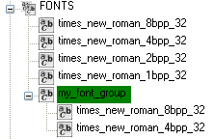
Font Element Enhancements
Support to create a Font Group
  Font group is a collection of Fonts similar to a dynamic image
  User can set the font to be selected at run time
  A text can be configured with a font group
  Based on the user selection, the text gets rendered with chosen font
  Allows the user to display a text in multiple fonts one at a time
How to use
  Right click on FONTS container
  Select the New Font Group menu item
  A new font group element is added
  Now drag and drop the fonts in to the newly created group
Page <number>

Slide 32
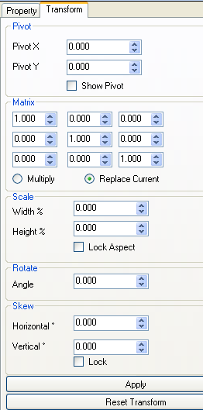
OpenVG property Tab
In order to set OpenVG transformation properties a tab is added.
Tab will be visible only for OpenVG elements
Tab provides editing for
  Pivot point for transformations
  Transformation matrix
Currently only keyboard based editing only is supported for OpenVG transformations
Page <number>

Slide 33
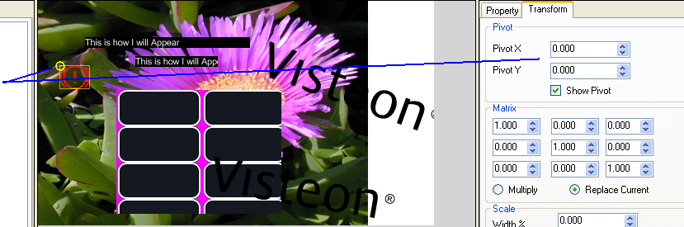
Setting the Pivot
Pivot handling for base elements are entered as an offset from its top left corner
  Default pivot is 0, 0 on element creation
Pivot handling for group elements are entered as an absolute XY location
  Default pivot is 0, 0 for a group element on creation, which is absolute 0, 0
In order to set the pivot
  Enable the Show Pivot check box and drag the pivot point shown as an yellow circle using mouse.
  Or enter the values directly in the Pivot X/Y text box and click the Apply button
Page <number>
Notes:
Visual editing for Pivot is supported only for image elements in this version of the tool

Slide 34
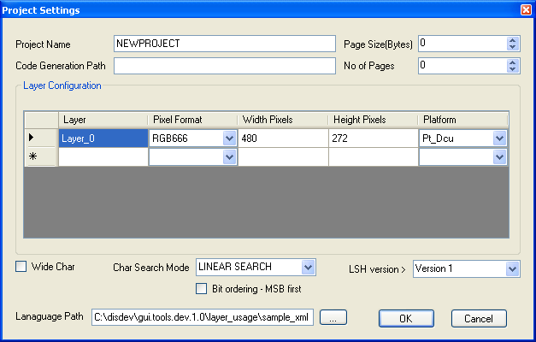
Language Support
A language file could be configured in project settings
The language xls sheet needs to be saved as a Unicode text file and set is input to GDT
Page <number>

Slide 35
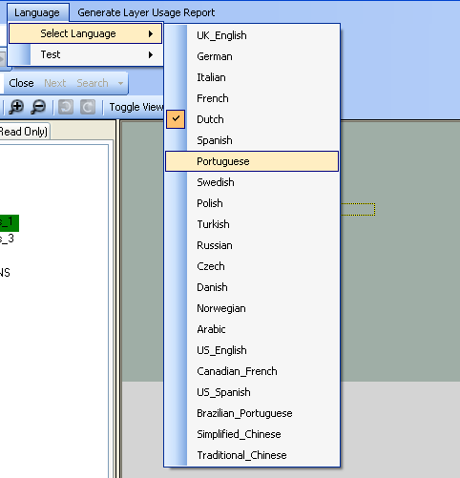
Language Support …
Language File is parsed and language menu is added in GDT
Current display language for text can be selected
Also a test can be initiated to find out whether any text clipping will occur based on current configuration
Test could be run for a single language or all the languages
Test will be run for all possible values possible for a text based on its configuration and checks whether any clipping will occur or not
Page <number>

Slide 36
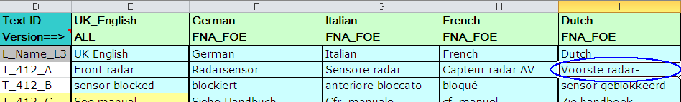
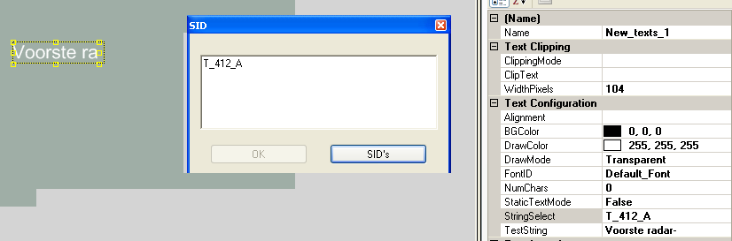
Using SID’s in Text
Click on the StringSelect Property of the text to Open the SID editor
Type in the SID or click SID’s button to open the SID list
Page <number>

Slide 37
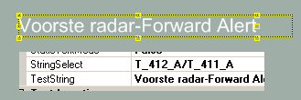
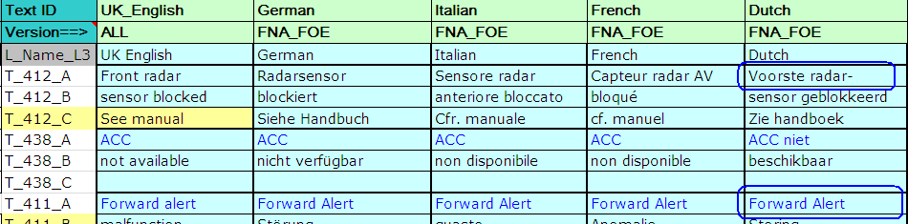
Using SID’s in Text
If the text box needs to display a combination of multiple SIDs, then enter them as a ‘/’ separated list
Page <number>

Slide 38
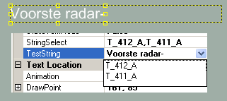
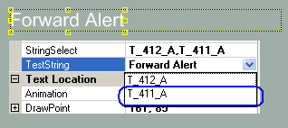

Using SID’s in Text
If the SIDs to be displayed as one at a time use a ‘,’ separated list
Then click on the TextString property to open up a dropdown menu to choose the SID that you wanted to get displayed
Numeric values and Static String also can be specified
Following are the supported types
  SID
  Static String - enter in single quotes
  Dynamic String – enter Y for every character e.g. for length of 4 use YYYY
  Numeric Value – enter as XX.XX, use Z to hide leading zero
    XX.XX -> 00.00 to 99.99
    ZX.XX -> 0.00 to 99.99
Page <number>

Slide 39
Layer Usage Report Generation (Kepler)
Design can be statically analyzed for find number of layers needed for a chosen configuration or all possible combinations
Test runs for all possible combinations (i.e. if there are dynamic images/widgets it switches between them) to find all possible combinations
If the layer requirement is > 16 for any combination report is generated
To run for a specific use case
  add the screens to be tested in arbitrator
  Run the layer usage analyzer
Page <number>

Slide 40
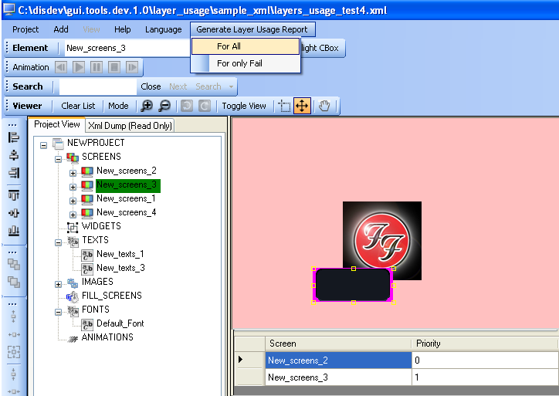
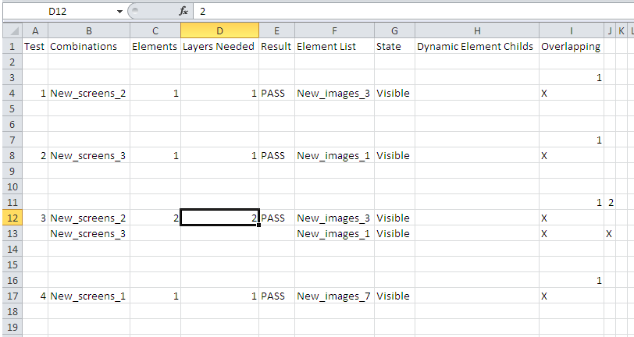
Layer Usage Report Generation (Kepler) …
An excel report will be generated
Page <number>

Slide 41
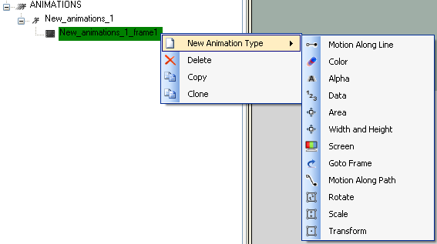
Animation support in GDT
Following animation support is added
  Motion along Line or Path
  Color
  Alpha
  Data
  Area
  Width/Height
  Screen
  GoTo Frame with condition check
  OpenVG Transformations
Page <number>

Slide 42
Animations – Usage Overview
How to use
  Right click and create an animation under ANIMATIONS container
  Right click and add a new frame
  Under the frame right click and add any supported animations
  Drag and Drop GDT elements in to animations (Please under stand animations supported by each GDT element type before dragging, if an unsupported element type is dragged and dropped, then it will not animate)
  Perform the required configurations for animations
When an animation is played
  Animation starts with first frame
  All animations inside a frame is executed in parallel
  Once a frame is completed, execution shifts to the next frame
  Once all frames are completed, animation is stopped
Page <number>
Notes:
There are unused properties still displayed in the current version of the tool

Slide 43

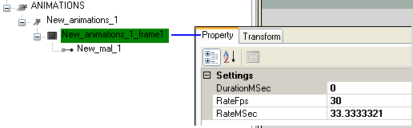
Animations Properties
Click on the ANIMATION container to show the base properties
  Configure either the TFT fps or the VSYNC rate in milliseconds here
  This determines on what rate the animation task needs to be executed at run time
  Individual animations rate can be different than this configuration
Click on the animation frame to show the base properties for a frame
  Duration – indicated the duration of the frame in milliseconds
  If duration is left 0, then the duration is maximum duration needed based on its child animations
  Rate – Configure the rate at which this frame to be animated
Page <number>

Slide 44
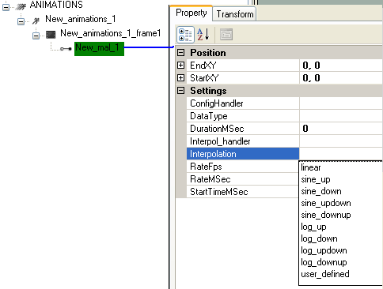
Animation Properties …
MAL Animation Type has the following properties ( All other animations share the similar syntax and there fore not explained in this ppt)
Start and End Position – Based on the start/end configuration elements part of this animation is animated from start to end at the configured rate for the configured duration.
Elements are moved based on relative offset values only and not to Raw position.
StartTime and Duration – If left to zero then the duration is defaulted to the frame duration
Interpolation – Choose from the available options or set to user_defined
If set to user_defined, then a Interpolation_handler will be called where the user can decide the interpolation to be used.
Page <number>

Slide 45
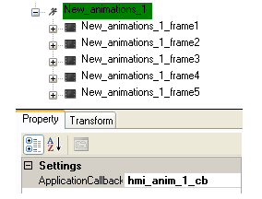
Animation Properties
Application add a callback which will be invoked prior to start of every frame and at end of the animation
Callback could be used to reset or set graphics parameters for the animation
Page <number>

Slide 46
Animation API
Internally handled
  hmi_gfx_anim_engine_init – called by graphics manager IF layer
  hmi_gfx_anim_engine_tick – called by graphics manager on Vblank ISR
  hmi_gfx_anim_engine – called by graphics manager IF layer periodically before scheduling application presentation
  View manager interaction is handled internally via hmi_gfx_anim_vm02_if.c. Animations requested via view manager Add/Remove state will be directly requested to animation core view this file.
External interfaces to start/stop/pause an animation
  hmi_gfx_anim_play_fwd – Plays animation in the forward direction
  hmi_gfx_anim_play_rwd – Plays animation in the Reverse direction
  hmi_gfx_anim_stop
  hmi_gfx_anim_pause
Page <number>

Slide 47
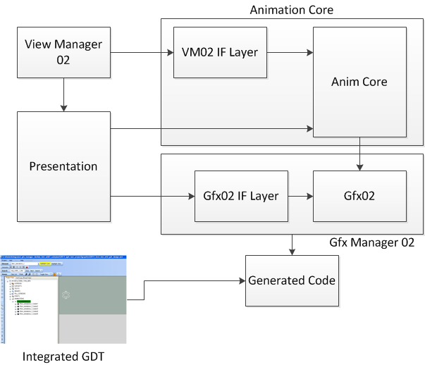
Anim Core interactions
Page <number>

Slide 48
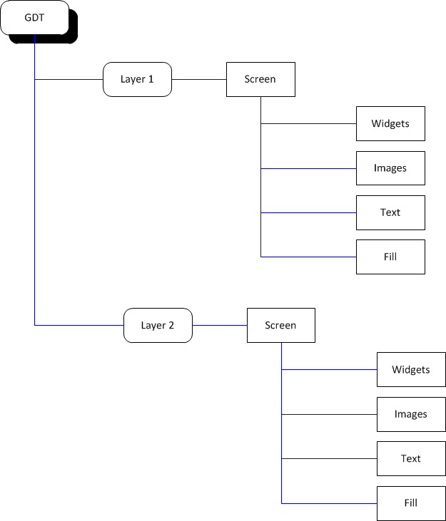
Animations supported by Elements
On high level GDT project is organized as below
Animations are possible on each of the below elements
Page <number>
Notes:
A Layer is the highest possible grouping. It can be termed as a frame buffer which can be assigned to a hardware layer of a TFT controller
A Layer can be consisting of multiple layouts which are called as screens. For exampe an AFE display is a screen, warning popup is another screen.
A screen is constructed by using GDT base elements or group elements

Slide 49
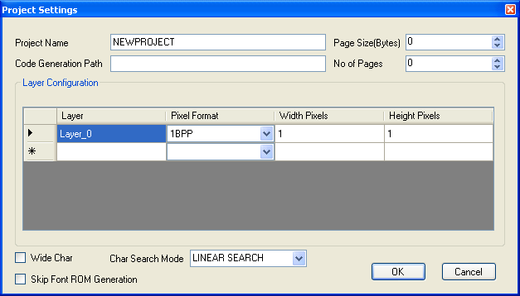
Layer Animations
A GDT layer can be animated for
  XY Offset
When a layer is animated, the animation property propagates to all active screens and its elements
For example if layer XY offset is set to (100, 50), then entire content of the layer is moved by an offset of (100, 50)
In case of Yukawa, the layer offset will be programmed directly to the VDC
In case of Kepler, the layer offset will be added to all active DCU layers
Page <number>

Slide 50

Group Animations
Group animations are applicable for
  Screen element
  Dynamic Widget element
  Dynamic Image element
Group can be animated for
  XY Offset
  Alpha
When XY Offset is adjusted, the offset is passed on to the child elements of the group. Therefore it appears as if the entire group is getting moved.
  Useful for implementing slide in/out animations
Alpha adjustments behaves the same as XY, but with following exception for Kepler
  Alpha adjustment for Dynamic Widget / Dynamic Image are ignored if they are child element of a widget which is built in RAM using eDMA engine.
Page <number>

Slide 51
Image Animations
Following properties of an Image can be animated
  Alpha
  CLUT identifier (Only for Kepler indexed color images)
  Foreground Color (only for transparency & luminance types)
  XY co-ordinates
Restrictions on Kepler
  Alpha adjustment are ignored if it is a child element of a widget which is built in RAM using eDMA engine.
  CLUT animation is only applicable for Kepler DCU
Page <number>

Slide 52
Text Animations
Following properties of an Image can be animated
  Alignment (Left / Right / Center)
  Draw Mode (Normal / Transparent)
  Clip Mode
  Font
  Alpha
  Foreground Color
  XY co-ordinates
Restrictions on Kepler
  Alpha adjustment are ignored if it is a child element of a widget which is built in RAM using eDMA engine.
Page <number>

Slide 53
Fill Animations
Following properties of a fill/tile element can be animated
  Alpha
  Fill Color (valid only for fill element)
  XY co-ordinates
  Dimension (Width & Height)
Restrictions on Kepler
  Alpha adjustment are ignored if it is a child element of a widget which is built in RAM using eDMA engine.
Page <number>

Slide 54
Static Widget Animations
Following properties of a static widget element can be animated
  Alpha
  Foreground Color (valid only for Kepler)
  CLUT id (valid only for Kepler)
  XY co-ordinates
  Clip Area (X, Y, Width & Height)
Restrictions on Kepler
  Alpha adjustment are ignored if it is a child element of a widget which is built in RAM using eDMA engine.
Page <number>

Slide 55
Other Improvements
DCU Specific
  RAM usage is reduced by eliminating the RAM required for the virtual layers
  RAM is allocated only for 16 layers and all the virtual layer processing is done statically
Common
  Text string buffer sharing mechanism to save RAM usage (mutually exclusive texts share a common RAM)
Page <number>

Slide 56
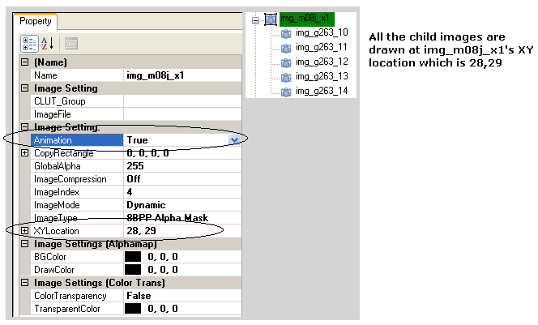
Migration of Kepler
Dynamic Images
  Previous versions had an option to override the child elements XY by dynamic image’s XY incase the Animation set to TRUE for the Dynamic Image
  Integrated GDT doesn't support XY co-ordinates for dynamic images
    Child images will be drawn at its own XY location regardless of the parent dynamic image Animation = True or False
    But application has the ability to move the dynamic image by applying the offset animation in run time
Page <number>

Slide 57
Migration of Kepler …
Integrated GDT doesn't support vertical clipping animation for every elements
Clipping is now supported only via Widgets with clipping property set to True
Existing implementation has to change if they apply clipping animations to elements other than widget
  The elements needs to be moved inside a widget
Page <number>

Slide 58
Features/Issues Explained
Version 1.0

Slide 59
User Controlled Layers
User can reserve a layer to control by adding an image and changing the ImageType property to “USER TYPE”
You need to implement two callback functions, which are common for all the “USER TYPE” that are added to the design
  hmi_gfx_mgr02_load_user_layer_def_info
  hmi_gfx_mgr02_render_user_layer
Page <number>
Applicable : All

Slide 60
User Controlled Layers ….
hmi_gfx_mgr02_load_user_layer_def_info :
  void hmi_gfx_mgr02_load_user_layer_def_info(UINT32 p_base_id, GFX_MGR02_IMAGE_DEF_T * p_image_def)
  This function shall update the format, width, height, CLUT id and pointer to image data etc in to the p_image_def
  p_base_id will have the ID of the image for which the data should be updated in to p_image_def
  E.g implementation :-
  void hmi_gfx_mgr02_load_user_layer_def_info(UINT32 p_base_id, GFX_MGR02_IMAGE_DEF_T * p_image_def)
  {
  switch(p_base_id)
  {
  case 0: // currently these base id definitions are not exposed outside, so use hard defined numbers.
  //It will be exposed in later releases
  {
  p_image_def->format = GFX_MGR02_16BPP_RGB565; // or any format that you want
  p_image_def->width = 80;
  p_image_def->height = 40;
  // loding of clut is not required for RGB565 image, but shown here just as an info.
  p_image_def->clut = ?? /*load the user defined clut ID, refer below for details*/
  p_image_def->pixel_data = (void *)&lc_user_anim_rgb565_data[0];
  }
  break;
  }
  }
Page <number>
Applicable : All

Slide 61
User Controlled Layers ….
void hmi_gfx_mgr02_render_user_layer(UINT32 p_base_id)
This function is provided, if the user needs to render the contents for the pixel_data of user type image
If the pixel_data is already available, then this function can be left empty
Page <number>
Applicable : All

Slide 62
Adding custom CLUT tables
When we use user type images, it might be required to load the custom CLUT for that image since the GDT may not have the CLUT information for the custom images
It might also be that the user wants to apply a custom CLUT to a GDT image to create some animations
To support these cases, graphics manager provide the ability to append custom CLUT in to its CLUT table
Steps to add a custom CLUT
  Open the hmi_gfx_mgr02_clut_table.cfg file
  Set the number of CLUTS that you wanted to add to GFX_MGR02_PROD_SPEC_CLUT_TABLE_NUM configuration item
  For example, for one CLUT
    #define GFX_MGR02_PROD_SPEC_CLUT_TABLE_NUM 1
Now update the CLUT table information in to GFX_MGR02_PROD_SPEC_CLUT_TABLE
Page <number>
Applicable : DCU/DCULite/2DAce

Slide 63
Adding custom CLUT tables …
For example to add one CLUT
  #define GFX_MGR02_PROD_SPEC_CLUT_TABLE \
  { \
  &lc_your_clut_table1[0] , \
  256 /*number of colors in clut */, \
  0 /* dummy entry always 0 */ \
  }
If you have to add multiple CLUT entries, repeat the block with in “{}” and separate each entry by a “,”
Since this user defined CLUTs will be placed after the GDT cluts, its ID will start from (GFX_MGR02_NUM_OF_CLUTS- GFX_MGR02_PROD_SPEC_CLUT_TABLE_NUM) onwards
Use the ID value based on above calculation when ever you as API or with in hmi_gfx_mgr02_load_user_layer_def_info function to update the CLUT
Page <number>
Applicable : DCU/DCULite/2DAce

Slide 64
Creating a Single CLUT for set of images
When there lot images used in a sequence of animation, there are chances that it might result in generation of lot of CLUT entries
In cases where you know for sure that a set of images shares most of the colors and it would be really nice to a have a common CLUT generated for all those similar color images
How to generate single CLUT
  GDT provides a “CLUT_Group” property for all indexed color images
  Enter a unique name in to this property field for the first image
  Copy this unique name and paste it to the CLUT_Group proeprty of all other images that you wanted to have common/single CLUT
  Now all the images that are tied with the same CLUT_Group name will have a single CLUT generated
Page <number>
Applicable : DCU/DCULite/2DAce

Slide 65
What if the total CLUT size exceeds CLUT RAM size
DCU CLUT RAM size is limited (8K for Spectrum/Rainbow)
When the total size of the All CLUT generated by GDT and custom CLUTs exceeds this limit, the graphics manager cannot load all the CLUTs in to the CLUT RAM during startup/initialization
This will result is some of the images to appear weird
To fix this we have to change the CLUT loading from a static loading during startup to a dynamic loading during run time
  Load only the CLUTs that are required based on what is on the display at that point of time
Dynamic loading can be enabled by defining GFX_MGR02_DYNAMIC_CLUT_LOAD_SUPPORT_NEEDED macro in the hmi_gfx_mgr02.cfg file
  #define GFX_MGR02_DYNAMIC_CLUT_LOAD_SUPPORT_NEEDED
To switch back to static loading, comment out the above definition
Page <number>
Applicable : DCU/DCULite/2DAce

Slide 66
Indexed color images appears differently in target
When an image is generated by GDT as an indexed color image, GDT generates a CLUT table
The CLUT table has fixed size such as 256 color entries for a 8BPP Indexed image
When the total number of colors present in the source image is > this limit, GDT performs a color quantization
  GDT uses the FreeImage library to reduce the number of colors to the allowed limit
  Being a free library it may not always result in the best conversion
  Which will result in a color loss and the image quality is affected
Another side effect of this is that the transparent color set inside GDT might also get generated differently by the FreeImage color quantization and the portion of the image may not appear transparent in the target
Solution : Use a commercial editing tool such as Adobe Photoshop and preprocess the image to the required number of colors before using in GDT
Page <number>
Applicable : DCU/DCULite/2DAce

Slide 67

Images repeat in target
Issue : In the target every APAL8 image repeats twice instead of a single image and also some corrupted pixels are also seen
In the hmi_gfx_mgr02_image_data.c there are typedefines that specify the storage type for various image type
If it has been wrongly defined, then this kind of issue may be seen
E.g typedef UINT8 GFX_IMG_DATA16_T makes the 16bit image data to a 8bit data type. That means the generated 16bit array will be treated by the compiler as a 8bit array resulting loosing all MSB and only half the memory
To fix make typedef UINT16 GFX_IMG_DATA16_T
Page <number>

Slide 68


www.visteon.com
Page <number>

