Slide 1
GDG03 (hmi_gfx_mgr02) for Kepler
-Shekhar.A
July 12, 2012

Slide 2
Topics
Overview
Features Supported
  API’s
Design Overview
  Layer Management
  GRAM Management
  CLUT Handling
  Pre Rendering
  Rendering
Integrating GDG03
Q&A

Slide 3
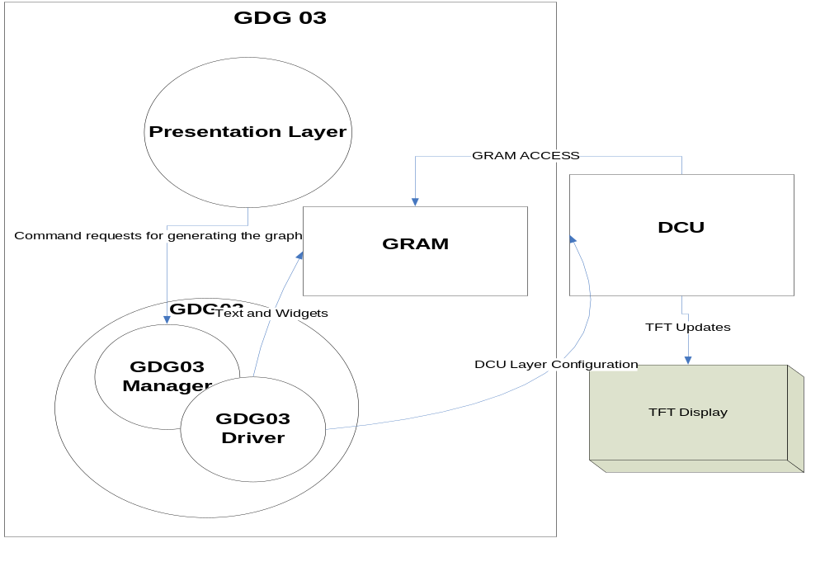
Overview
GDG03 developed for Kepler platform
To reduce the complexity at presentation layer

Slide 4
Features Supported
Image building
Widget building
Text building (Dynamic/ Static)
Tile
Alpha Blending
Chroma Setting
Vertical Clipping
X, Y position animation
User Layer (for OpenVg support)
QSPI Checksum
EOL Support

Slide 5
API’s supported
Basic APIs
  hmi_gfx_mgr02_if_set_screen(id,data)
  hmi_gfx_mgr02_if_set_text(id,data)
  hmi_gfx_mgr02_if_select_dwidget(id,data)
  hmi_gfx_mgr02_if_select_dimage(id,data)
Advanced API’s
  hmi_gfx_mgr02_if_set_obj_clut(id,data)
  hmi_gfx_mgr02_if_set_obj_tile(id,data)
  hmi_gfx_mgr02_if_set_obj_blend(id,data)
  hmi_gfx_mgr02_if_set_obj_fg_color(id,data)
  hmi_gfx_mgr02_if_set_obj_bg_color(id,data)
  hmi_gfx_mgr02_if_set_obj_vclip(id,data)
  hmi_gfx_mgr02_if_set_obj_pos_x(id,data)
  hmi_gfx_mgr02_if_set_obj_pos_y(id,data)
  hmi_gfx_mgr02_if_get_obj_pos(id, data)
  hmi_gfx_mgr02_if_force_update()
  hmi_gfx_mgr02_init_for_EOL_mode(Patteren)
  hmi_gfx_mgr02_SetColorBarRGB(color_bar_num, rgb_value)

Slide 6
Design Overview
Presentation Tick
Presentation
State
1
Application
Presentation
Functions
DONE
2
GDG03 IF
GDG03
Interfaces (API)
Normal Tasks
Building
State
Graphics Task (background)
Control Data
4
GDG03 CORE
3

Slide 7
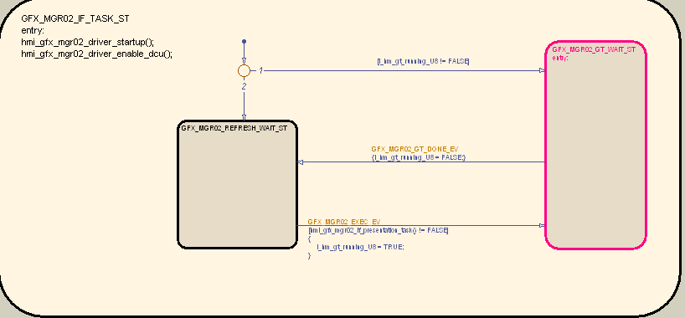
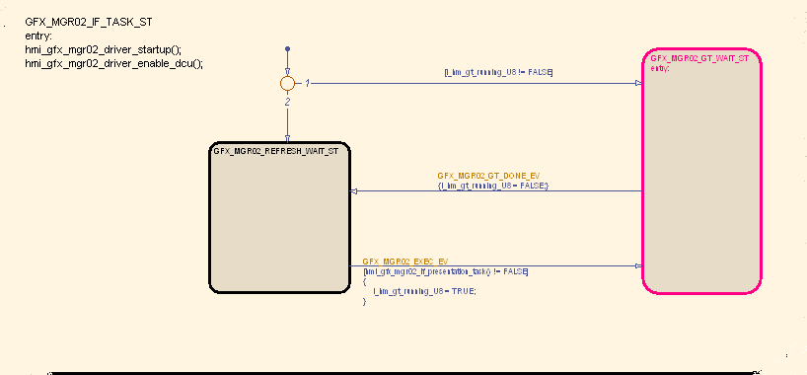
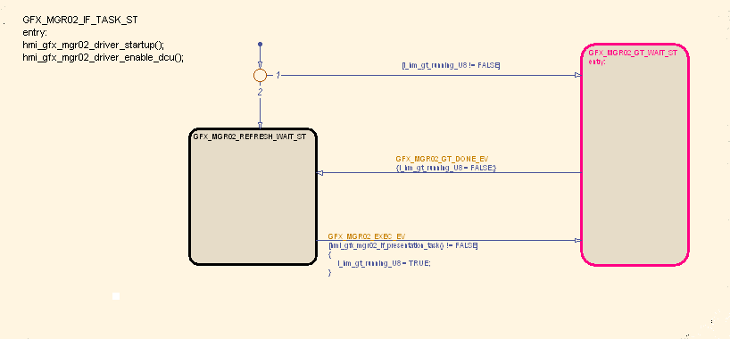
Design Overview
GFX_MGR02 TASK

Slide 8
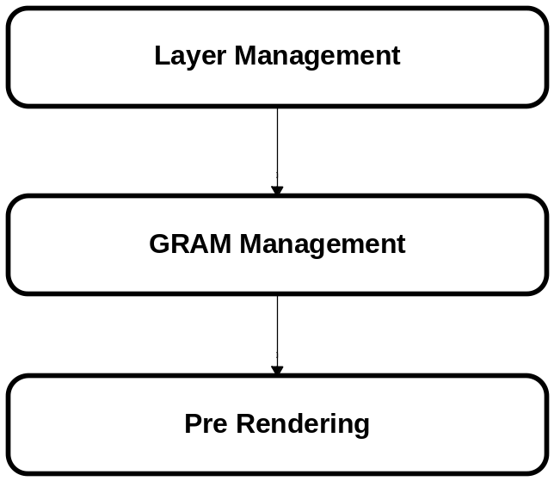

Design Overview

Slide 9
GDG03 Design – Layer Management
Identify Active Elements
Identify Visible Layers
Apply Virtual DCU layer allocation based on Option configured
  Output is 16 or less elements to be displayed
Option 1
  The layer allocation starts from bottom to top always
  Chances are that Top elements may not get displayed in cases where there is a need for > 16 layers
Option 2
  Layers are reserved for high priority active screen
  Rest of the layers are allocated for the remaining elements as in type 1
  With this approach even though we can’t display all the layers, we still can guaranty that high priority information's are always displayed

Slide 10
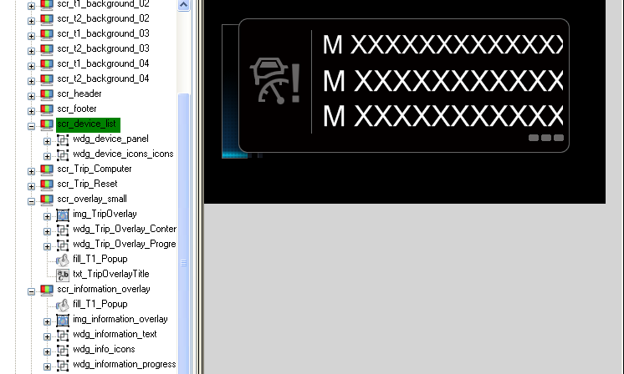
Layer Management
Total Elements in the selected 3 screens are (devicelist 2, scr_overlay_small – 5, scr information overlay – 5).

Slide 11
GDG03 Design – GRAM Management
Allocate GRAM according to the scheme for all dynamic contents
  Widgets and Text are the dynamic content in GDG03
  Scheme1 is implemented now
  Scheme2 is with gallo which is planned
Perform GRAM initialization and configure virtual layers
Identify new and changed elements and in the next vblank period,
  Build all new elements in allocated GRAM
  Rebuild changed elements in allocated GRAM
  Copy or remap unchanged elements
Copy the virtual layers to DCU layers in the next vblank period

Slide 12
GRAM management – Type 1
During the first build request GRAM allocated from start of the GRAM memory
For the next build, the GRAM allocation is done from the bottom of the GRAM memory
  For elements which are not changed, a copy is performed from the active memory to the new memory
In case where the new allocation is detected to be overlapping with existing allocation,
  Overlapped allocations are marked and not initialized or copied
  In the next vblank period, the new buffers are built and DCU is programmed
  The update happens in a single vblank period in this case

Slide 13
GRAM management – Scheme 2
Scheme 2 uses gallo to perform dynamic allocation
For unchanged elements no allocation is made and they remain at the current allocation
  So the copy of current to new location is not necessary in this case
This option will result in a reduced GRAM usage in most cases (unless we have a case where all the elements requires an update) due to the fact that only changed elements are double buffered.
Disadvantage is that fragmentation can happen in long run and a periodic defragmentation is required

Slide 14
CLUT management schemes
Scheme 1
  if the total size of CLUT is <= 8K then this scheme can be chosen
  In this scheme all the CLUTs are loaded during the startup
  No run time CLUT loading is performed
Scheme 2
  if the total size of CLUT is > 8K
  CLUT is loaded at run time based on active elements on the screen

Slide 15
Pre Rendering & Rendering
Identify new and changed elements
Reconfigure the Virtual DCU layers
Clear allocated GRAM with SCR background color
Apply widget animation settings
Copy the virtual layers to DCU layers in the next vblank period
Render widgets / text.

Slide 16
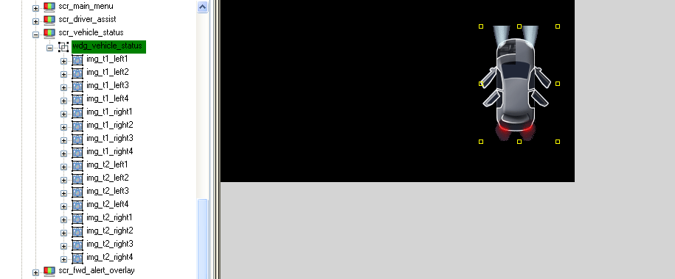
Example

Slide 17


Example: Building
Building a Car bitmap with four door indicators
  Inline with what HMI is used to
void presentation(UINT8 status)
{
case ACTIVATE:
{ … … … …
hmi_gfx_mgr_set_screen(GFX_VEHICLE_STATUS_SCR, 1);
}
break;
case REFRESH:
{
hmi_gfx_mgr02_if_select_dimage(GFX_IMG_T1_LEFT2, 2);
hmi_gfx_mgr02_if_select_dimage(GFX_IMG_T1_LEFT3, 0);
hmi_gfx_mgr02_if_select_dimage(GFX_IMG_T1_RIGHT2, 1);
hmi_gfx_mgr02_if_select_dimage(GFX_IMG_T1_RIGHT3, 0);
}
break;
case DEACTIVATE:
{
hmi_gfx_mgr_set_screen(GFX_VEHICLE_STATUS_SCR, 0);
}
break;
}

Slide 18
Future Enhancements / Pending Activities
Option for Dynamic allocation of GRAM
Exclusive QSPI access option
Animation Engine
Bitmap Rotation/Mirroring function using DMA
RLE decompression Support
Enhanced widget support
  Group objects with different types
  Use software rendering to convert and combine objects

Slide 19
Integrating GDG03
From the GDT design following files are generated
  <font name 1>.c, <font name 2>.c etc and hmi_gfx_mgr02_font.h - Font tables for all the fonts in the design
  hmi_gfx_mgr02_clut_table.c/.h – contains all CLUT tables
  hmi_gfx_mgr02_cfg.h – contains all enumerations for element IDs and defines
  hmi_gfx_mgr02_image_data.h - interface file for GDG03 for all images
  hmi_gfx_mgr02_config.dat – Contains configuration data tables for GDG03
  hmi_gfx_mgr02_code_gen.txt – contains information, warnings and error messages about code generation.
  <image 1>.dat, <image 2>.dat – Image data files
User created files
  GALLO.cfg – dummy file to resolve the freescale library compilation error (this will be fixed later)
  hmi_gfx_mgr02.cfg – configuration for GDG03
  hmi_gfx_mgr02_clut_table.cfg – Configuration file to specify any custom CLUT tables
  hmi_gfx_mgr02_font.cfg - Configuration file to control the placement of font data in memory
  hmi_gfx_mgr02_image_data.c – List of all image .dat files and their placement in memory
  qspi.cfg – configuration option for the QSPI

Slide 20
Integrating GDG03 ..
Kernal Interfaces
  hmi_gfx_mgr02_if_KSColdInit
  hmi_gfx_mgr02_if_KSWarmInit
  hmi_gfx_mgr02_if_KSWakeUp
  hmi_gfx_mgr02_if_KSSleep
  hmi_gfx_mgr02_if_KSTimedTask
Invoke hmi_gfx_mgr02_if_start() when ready to start GDG03
  GDG03 starts scheduling the configured presentation task
  Presentation task can invoke GDG03 APIs
    hmi_gfx_mgr02_if_set_screen
    hmi_gfx_mgr02_if_set_text
    hmi_gfx_mgr02_if_set_sid
    hmi_gfx_mgr02_if_select_dwidget
    hmi_gfx_mgr02_if_select_dimage
    hmi_gfx_mgr02_if_set_obj_clut, tile, _blend, _alpha, _fg_color, _bg_color, _vclip, _pos_x, _pos_y
    hmi_gfx_mgr02_if_force_update
Hook hmi_gfx_mgr02_driver_dcu_isr to DCU0_VS_BLANK ISR
Hook DMA_CHx_ISR to DMA2X_CHANNEL_x (x is the channel number 0-N)

Slide 21


Demo

