Slide 1
Animation

Slide 2
Overview
Animation Sequence
Animation Frame
Animation Types
Page <number>

Slide 3
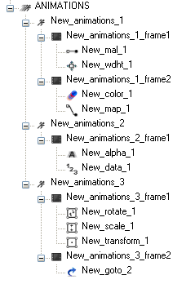
Animation Sequence and frames
  Each animation supports addition of multiple frames.
  Max 255 frames can be added to a single animation.
  An animation time is sum of all the frames time duration.
  Each frame supports addition of multiple animation types
  Max 255 animation types can be added to a single frame.
  A frame time is calculated by considering the start time and duration of all the child animation types inside the frame.
Page <number>

Slide 4
Animation types
MAL (Motion along the Line)
Color (element color can be changed)
Alpha (change of element alpha)
Data (Indexing Dimages and Dwidgets)
Area (change of visual area)
Width height (change of width and height)
Screen (screen sequencing)
Goto (repeating the frame fro a given no of times)
MAP (motion along the path )
Rotate (rotate the elements)
Scale (scale the element s)
Transform (transform the element properties)
Page <number>

Slide 5
Animation Properties
All the animations have some common properties mentioned below
  Data type – Not used
  Duration – Specifies in how much duration this animation needs to be completed.
  Interpolation – Different types of interpolations
  Interpolation – Handlers to the defined interpolation
  RateFps – Frames per sec
  RateMSec – Frame duration
  Start time – Specifies when this animation needs to be started after the frame is activated
Apart from this each animation has their own properties
Goto animation doesn’t have the above properties
Page <number>

Slide 6

MAL - Motion Along the Line
This animation moves the specified set of elements from current point to a new Point (offset x, y). The elements X,Y position will be changed based on the run time calculation by the animation.
The offset XY property is to be updated to achieve the MAL animation and this is to be different from the original XY
Elements allowed
  Image
  Text
  Fill screen
  Tile screen
  Widget
  screen
Interpolation
Offset X, Y
Original X, Y
Page <number>

Slide 7



Color
This animation changes the specified set of elements color from start color to end color. The elements color will be changed based on the run time calculation by the animation. The color interpolation is done on each individual component (Alpha, Red, Green and Blue)
The start color and end color must be differing to achieve the color animation and this is to be different from elements color.
Elements allowed
  Image
  Text
  Fill screen
  Tile screen
Interpolation
Start color
End color
Page <number>

Slide 8



Alpha
This animation changes the specified set of elements alpha value from start alpha to end alpha. The elements alpha will be changed based on the run time calculation by the animation. The alpha component of each pixel is interpolated.
The start alpha and end alpha must be differing to achieve the alpha animation.
Elements allowed
  Image
  Text
  Fill screen
  Tile screen
  Widget
  screen
Interpolation
Start alpha
End alpha
Page <number>

Slide 9



Data
This animation changes the index value of the dynamic widget/image from start data to end data. The elements index will be changed based on the run time calculation by the animation.
The start data and end data must be differing to achieve the data animation and must be in allowed limits of the dynamic widget/image.
Elements allowed
  Dynamic Image
  Dynamic Widget
Interpolation
Start data
End data
Page <number>

Slide 10


Area
This animation changes the visible area of the elements from original area to offset area. The elements visible area will be changed based on the run time calculation by the animation.
The offset area and original area must be differing to achieve the area animation.
Elements allowed
  Fill screen
  Tile screen
  Widget
Interpolation
Original area
Offset area
Page <number>

Slide 11
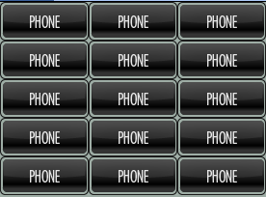
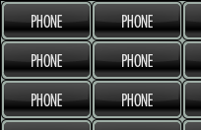
Width Height (WH)
This animation changes the visible width and height of the elements from original width/height to offset width/height. The elements width/height will be changed based on the run time calculation by the animation.
The offset width/height and original width/height must be differing to achieve the width/height animation animation.
Elements allowed
  Fill screen
  Tile screen
  Widget
Interpolation
Original W/H
Offset W/H
Page <number>

Slide 12
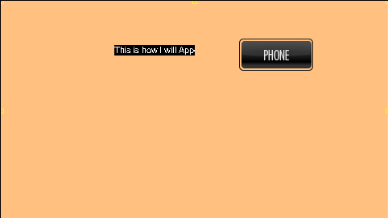
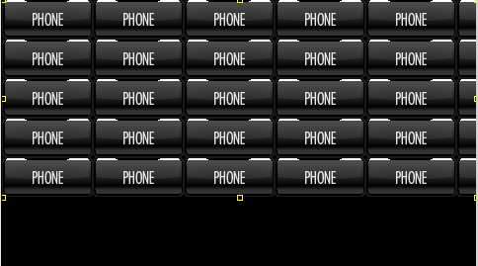
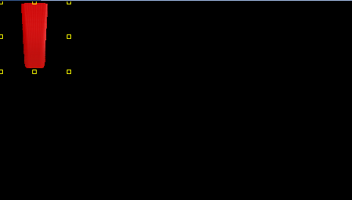
Screen Sequence
This animation changes the shows the screens in the list one by one. The screens will be changed based on the run time calculation by the animation.
Elements allowed
  Screens
Interpolation
Screen 1
Screen N
Page <number>

Slide 13
Go to
This animation is used when an animation sequence is to be repeated for a defined number of times.
Go to has 2 properties
  Goto_counts : Defines how many times the animation has to be repeated
  Goto_frame_no : specifies the start frame number (considering the first frame
Go to animation must be in last frame so that all the other frames in animation can be selected for repeated occurrence.
Once this animation is triggered, all the frames are executed until sequence reaches go_to frame. Based on the properties of go_to animation execution sequences goes back to the frame number specified and repeats this sequence as specified in the properties.
Page <number>

Slide 14
MAP - Motion Along the Path
This animation moves the specified set of elements from current point to a new points along the specified path. The elements X,Y position will be changed based on the run time calculation by the animation.
The path for the new X,Y points must be a SVG file which contains a single path.
Elements allowed
  Image
  Text
  Fill screen
  Tile screen
  Widget
  screen
Interpolation
Original X, Y
Path of X, Y
Page <number>

Slide 15

Rotate
This animation Rotates the specified set of elements with an angle specified. The elements angle will be changed based on the run time calculation by the animation.
The angle will be the offset angle to the existing element position. This property must be other than zero to achieve the rotation animation.
Elements allowed
  Image
  Text
  Fill screen
  Tile screen
  Widget
Interpolation
Original angle
End angle
Page <number>

Slide 16




Scale
This animation scales the specified set of elements with an scale factor specified. The elements size will be changed based on the run time calculation by the animation.
The scale is done based on the original element size and scale factor. This property must be other than zero to achieve the scale animation.
Elements allowed
  Image
  Text
  Fill screen
  Tile screen
  Widget
Interpolation
Original size
End size
Page <number>

Slide 17



Transform
This animation transforms the specified set of elements with offset matrix values specified. The elements properties will be changed based on the run time calculation by the animation.
The transformation is done based on the original element properties and new transformation properties. This property must be other than zero to achieve the transformation animation.
Elements allowed
  Image
  Text
  Fill screen
  Tile screen
  Widget
Interpolation
Original image
Transformed image
Page <number>

Slide 18


Thank You
www.visteon.com
Page <number>

