Slide 1
ui.iceapple
Message Core

Slide 2
Agenda
Overview and features of message core
Message core context with IceApple
Designing warning in GDT
Using Message configurator tool
Demo of popup and messages in simulation

Slide 3
Overview of Message Core
Message detection from application-provided functions. These are arranged in a priority order such that the highest priority message request is always presented to the subsequent layers.
Ordered display of active messages with optional timeout and user acknowledgement for each message depending on the configuration of each message.
Message storage facility so that messages that have been cleared from the display can be reviewed on demand (normally through the menu system).

Slide 4
Features of Message Core
It’s a plug in component which is being included in iceapple to meet specific warning requirements.
Message core & Popup core comparison
  Message core offers storage facility.
  Various options in message core – Cycling, cycling with timeout, first time show of the message for specific time period, acknowledge after minimum time, allow inactive warning to timeout, bring the warning to display after specific duration.
  From a set of user input functions, scanning will be done for all messages and messages that are active will be fetched and prioritized based on configuration. Message Core round robin task need to be invoked periodically.

Slide 5
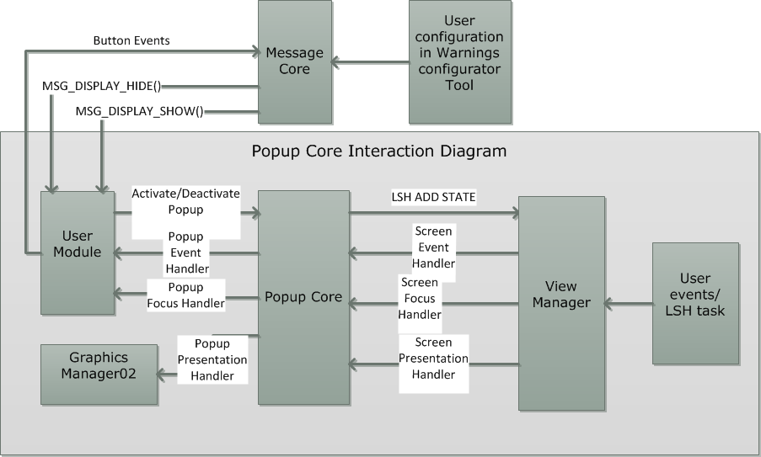
Message core Context with IceApple

Slide 6
Message Core – Data design
Structures
typedef struct _msgMessageStruct
{
U08SIF_GET_DATA CheckActiveCondition;
U08SIF_GET_DATA MsgEventCallback;
UINT8 ConditionQualifier;
UINT8 EventQualifier; /* See callback indication */
UINT16 DisplayTimeout;
UINT16 HoldTimeout;
eMessageCategory Category;
UINT8 Priority;
UINT16 Options;
UINT8 ActiveStates;
#ifdef HMI_MSG_ENABLE_NEW_MESSAGE_SEQ_QUEUE_TIMEOUT
UINT16 SeqQTimeout;
#endif
#ifdef HMI_MSG_UNIQUE_DISP_IND_TIME
UINT16 DispIndTimeout;
#endif
} MSG_MESSAGE_STRUCT;

Slide 7
Message Core – Data design
MSG_MESSAGE_CATEGORIES
/*--------------------------------------------------------------------------*/
/* Define the set of message types that are present in the application. */
/* These must be in DESCENDING priority order. */
/*--------------------------------------------------------------------------*/
#define MSG_MESSAGE_CATEGORIES \
mcOpFeedback, \
mcHardWarning, \
mcSoftWarning, \
mcInformation, \
mcOkCondition \
typedef enum
{
MSG_MESSAGE_CATEGORIES,
mcMaximum
} eMessageCategory;

Slide 8
Message Core – Data design
MsgEventCallback
  MSG_EVENT_ACKNOWLEDGED
  MSG_EVENT_TIMEOUT
  MSG_EVENT_HIDDEN
  MSG_EVENT_SHOW
  MSG_EVENT_ACTIVE
  MSG_EVENT_INACTIVE

Slide 9
Message Core – Data design
Options
  MSG_OPTION_SEQUENCE
  MSG_OPTION_CLEARABLE
  MSG_OPTION_STORE
  MSG_OPTION_CYCLE
  MSG_OPTION_ACK_AFT_MIN_TOUT
  MSG_OPTION_DISP_INDICATIONTIME
  MSG_OPTION_ALLOW_LOW
  MSG_OPTION_OVERRIDE_HIGH
  MSG_OPTION_SEQ_LIFO
  MSG_OPTION_ALLOW_INACTIVE_TO_TIMEOUT
  MSG_OPTION_NEW_MSG_SEQ_Q_TIMEOUT

Slide 10
Message Core – Interfaces
Application interfaces
  MSG_GET_IGNITION_STATE() –
    This macro is called to obtain the current ignition (or operating) state. Assign to an application function that will return each state as a separate bit.
External Interface (called by message core)
  MSG_DISPLAY_SHOW(msg)
    Called when there is a new message to be shown in “Alert” mode.
    “msg” is a pointer to a MSG_VIEWINFO_T Structure.
  MSG_DISPLAY_HIDE(msg)
    Called when no more messages are required in “Alert” mode.
    “msg” is the ID of the message being hidden.

Slide 11
Documents
Ui.core.iceapple.doc\message.core.01\design\
Ui.core.iceapple.doc\popup.core.02\design\
Ui.core.iceapple.doc\core.release\training.docs\

