Slide 1
ui.iceapple
Menu core

Slide 2
Agenda
Overview of Menu Core
Types of Menu and Menu Items
Menu Core Features
Menu Navigation
Menu Core Context with Iceapple
General Workflow
Menu Design in GDT
Configuration in Menu Configurator Tool
Integrating menu core
Demo of menu in simulation

Slide 3
Overview of Menu Core
Considered as the backbone for the display structuring and building.
Menu core possesses the general Menu functionalities acted upon by the predefined configuration.
Key Responsibilities
  Menu Open
  Menu Close
  Menu Button Action(Up,Down,Right,Left,Ok)
  Menu Fast Scroll
  Menu Rebuild/Reload

Slide 4
Types of Menu
Static Menu
  Menu contents are predefined and available while loading
  E.g. Radio Band list Menu, Settings Main Menu.
Dynamic Menu
  Menu contents are not known while loading and waits for the other nodes response
  E.g. CD Folder list Menu, IPOD songs Menu.

Slide 5
Menu Item Entry Type
Text
Submenu
Toggle
Executable

Slide 6
Menu Item Configuration
Item Configuration
  Each Menu item can be configured dynamically as Active, Inactive or Greyed out
  Active - Item displayed inside the menu
  Inactive - Item removed from the menu
  Greyout - Item displayed but it will be greyed out

Slide 7
Menu Rebuild
Menu Rebuild
  Rebuild checks menu item configuration and update
  Items inside the menu
  Rebuild request the view manager to update the menu in display
  Application calls this interface whenever there is a change in vehicle/item configuration.

Slide 8
Menu Reload
Menu Reload
  Reload checks whether parent menu is active, if not active, menu core close the child menu and goes to parent menu
  If parent menu active, then rebuild the child menu
  Application calls this interface whenever there is a change in vehicle/item configuration.

Slide 9
Multi Instance
Menu Core supports Multi Instance i.e., multiple menu’s can be active at the same time.
Instance Id for each menu is configured based GDT Screen priority.
Menu instance with highest screen priority receives the button commands

Slide 10
Other Menu Features
  Wrap Around
  Fast window Movement
  Content Menu
  Back
  Exit

Slide 11
Other Menu Features
  Limited window Focus Movement
  Go to parent on zero item entries in menu
  Content Menu
  Menu button to Menu action Mapping Table
  Menu close on timeout

Slide 12
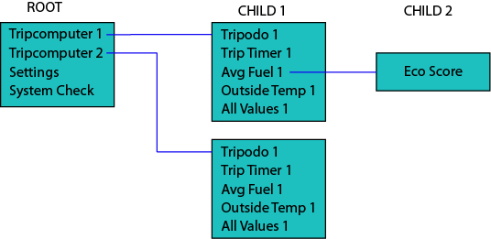
Menu Core - Typical Example
Entries in list can be dynamically enabled/ disabled/ grayed out
User can browse the menu tree structure
Can Manage Remote List such as CD tracklist
Allows Menu Tree Creation

Slide 13
Menu Core - Typical Example
Supports History – Auto activation of last history menu when active menu closes by timeout
Can trigger transition Animations
Supports Multiple Instances
Supports Vertical and Horizontal List

Slide 14
Menu Core - Navigation

Slide 15
Menu Core - Navigation

Slide 16
Menu Core - Navigation

Slide 17
Menu Core - Navigation

Slide 18
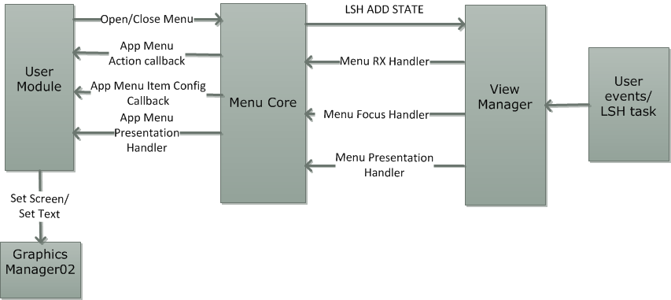
Menu Core Context with Iceapple
Menu Core Interaction Diagram

Slide 19
General Workflow
A tool is used to capture the requirement
Configuration data for the core component is generated
Hand code is written for event handling and presentation
Customer Requirement
Auto code
Configuration Data
Configuration tool
Manual
Event Handler
Focus Handler
Presentation Handler

Slide 20
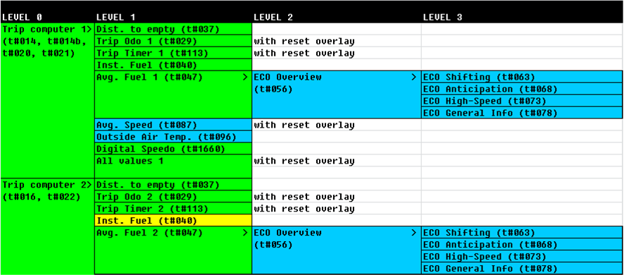
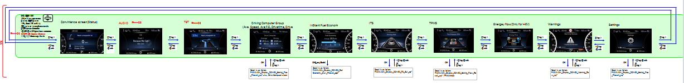
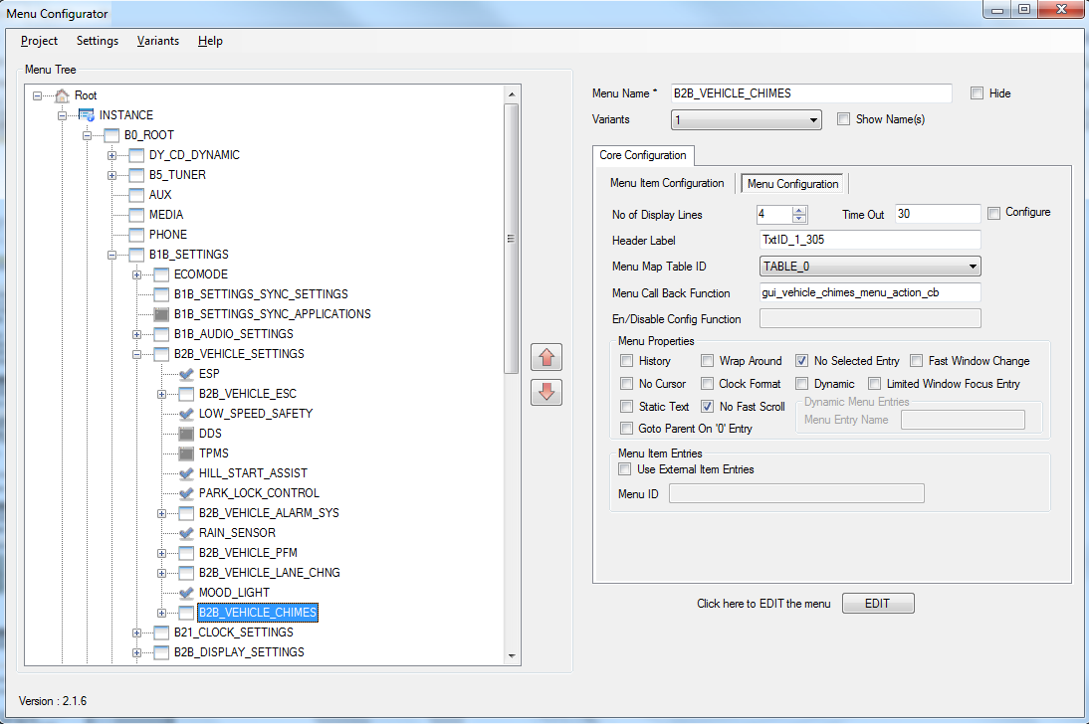
General Workflow of Menu
Customer Requirements
Auto code
Menu Configuration Data
Manual
Event/Focus Handler
Config. Check Handler
Presentation Handler

Slide 21
Menu Design in GDT
GDT design has to be made for each of the menu screen
In the GDT, for each menu screen the focus, event and presentation handler has to be configured as follows
  hmi_menu_rx_button_handler
  hmi_menu_set_focus_handler
  hmi_menu_presentation_handler

Slide 22
Configuration in Menu Configurator
Run \ui.core.iceapple.doc\menu.core.01\menu_configurator_tool\MenuConfigurator.exe
Click File->New to start a new configuration
Specify the GDT xml file as input for priority validation
Configure the menu as per the requirement

Slide 23
Integrating Menu core
Following steps are involved
  Create the app specific configurations
  Add the core and generated files into build
  Provide necessary support functionality

Slide 24
Final steps
Files for build
  hmi_menu_def_1 (autogenerated)
  hmi_menu_config_1(autogenerated)
  hmi_menu_core_01_logic (core file)
  hmi_menu_core_01_chart
  hmi_menu_core_01_model_autocode
Init and sched needs
  hmi_menu_initialize() to be called during startup
To activate/deactivate Menu, use following API
  hmi_menu_logic_Menu_Open
  hmi_menu_logic_Menu_Close

