Slide 1
Popup core

Slide 2
Agenda
Overview of Popup Core & Types of popup
Popup core Context with IceApple
Integrating popup core
Adding popups

Slide 3
Overview of Popup Core
Used to display popups from various modules.
Decides which popup need to be displayed among all the active popups based on the configuration done in Popup Configurator Tool.
Key Responsibilities
  Time Management
  Layer wise Priority Management
  Popup Queue Management
  Button Event Management
  Automatic deactivation of popup on expiry of timer/button event/demand from application.

Slide 4
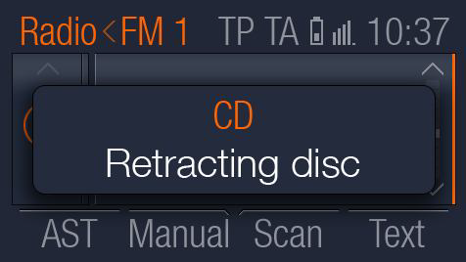
Types of Popup
Info Popup
  Information popup, no button events will be handled.
  Will be closed once timeout happens
  Prioritized based on the configuration in tool

Slide 5
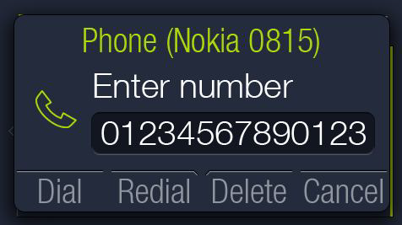
Types of Popup
Keypad Popup
  User can enter the data(Numeric/Alphabetic/Alphanumeric)
  Configure the button events in popup configurator tool.

Slide 6
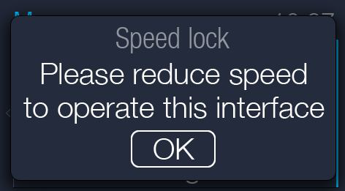
Types of Popup
Acknowledge Popup
  Displays as an info popup and waits for user acknowledgement.
  Configure the acknowledge events in popup configurator tool.

Slide 7
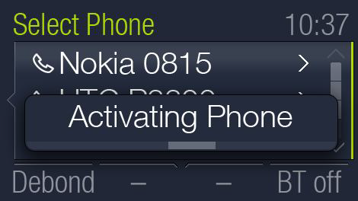
Types of Popup
Progress bar Popup
  Shows the percentage of completion to user.
  Configure the progress rate in popup configurator tool.

Slide 8
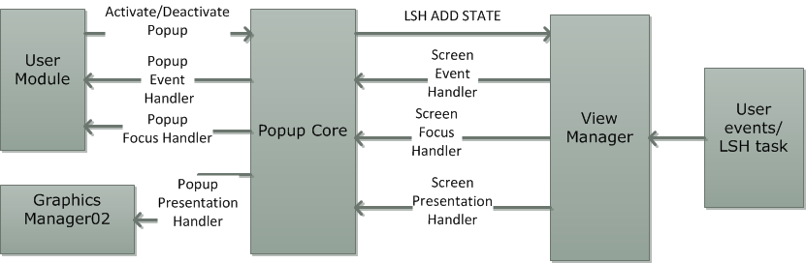
Popup core Context with IceApple
Popup Core Interaction Diagram

Slide 9
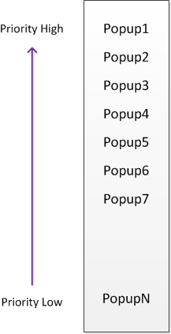
Priority Management
Popups are statically allocated priority from Low to high

Slide 10
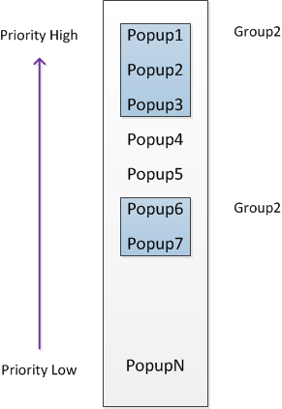
Priority Management
Popups can be grouped
Once grouped, the group shares the same priority
The popup added last to the group gets displayed (LIFO)

Slide 11
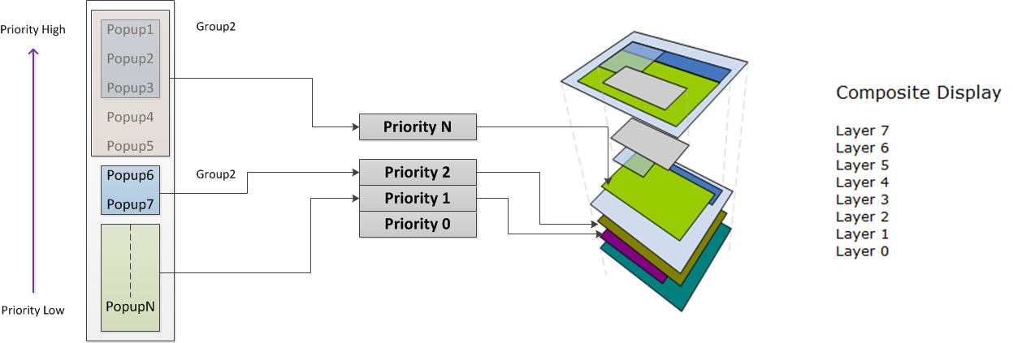
Priority Management
Set of Popup / Group can be mapped to a view manager priority
This is called as a popup Layer
Collectively popup core runs a parallel priority arbitration to output a single popup per layer manager

Slide 12
Integrating Popup core
Following steps are involved
  Create the app specific configurations
  Add the core and generated files in to build
  Provide necessary support functionality

Slide 13
Creating the Configurations
Run \ui.core.iceapple.doc\popup.core.02\Popup_Configurator\Popup_configurator.exe
Click File->New to start a new configuration

Slide 14
Timer configuration
In the general tab, specify the timer interfaces to be used by popup core to start, stop and check a timer
Lets give the following name for the timer interface functions
  hmi_popup_core_support_timer_start
  hmi_popup_core_support_timer_stop
  hmi_popup_core_support_timer_check
Popup core needs a callback notification when a timer expires (hmi_popup_core_timeout_callback)

Slide 15
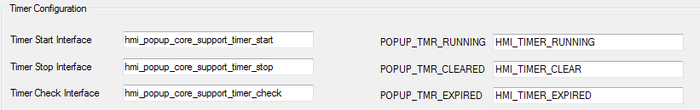
Timer Configurations
Map the timer support functions in general tab of the tool
Map the Timer Check Interface return values for
  TMR_RUNNING
  TMR_CLEARED
  TMR_EXPIRED

Slide 16

Timer Configurations
Popup core needs a maximum of two timers per layer
  General Timeout timer (GUI_POPUP_<layer>_TMR_ID)
  Minimum timeout timer (GUI_POPUP_<layer>_MIN_TMR_ID)
Implement a timer support module to realize the timer support functionality
Refer hmi_timer_support.c/.h which realizes this in the reference application
Specify the timer module header file in include paths

Slide 17
Adding popup
<< demo now, to be updated later>>

Slide 18
Graphics Design & VM configurations
After the configurations are made and code generated, a GDT design has to be also made for each of the popup screen
In the GDT, for each popup screen the focus, event and presentation handler has to be mapped to a handler inside popup core.
The name of the callback depends on which popup layer the popup screen belongs to
  hmi_popup_core_<layer>_rx_button_handler
  hmi_popup_core_<layer>_disp_foucus_handler
  hmi_popup_core_<layer>_ disp_presentation_handler
For Popup Layer0, <layer> will be layer0

Slide 19
Final steps
Files for build
  hmi_popup_core_if.c (autogenerated)
  hmi_popup_core.c (core file)
Init and sched needs
  hmi_popup_core_initialize() to be called during startup
  hmi_popup_core_task() to be called periodically
To activate/deactivate popup, use following api
  hmi_popup_core_activate_popup
  hmi_popup_core_deactivate_popup

Slide 20
Further reading
Refer \ui.core.iceapple.doc\popup.core.02\design

