Slide 1
UMD Robotics Reading Group

Slide 2
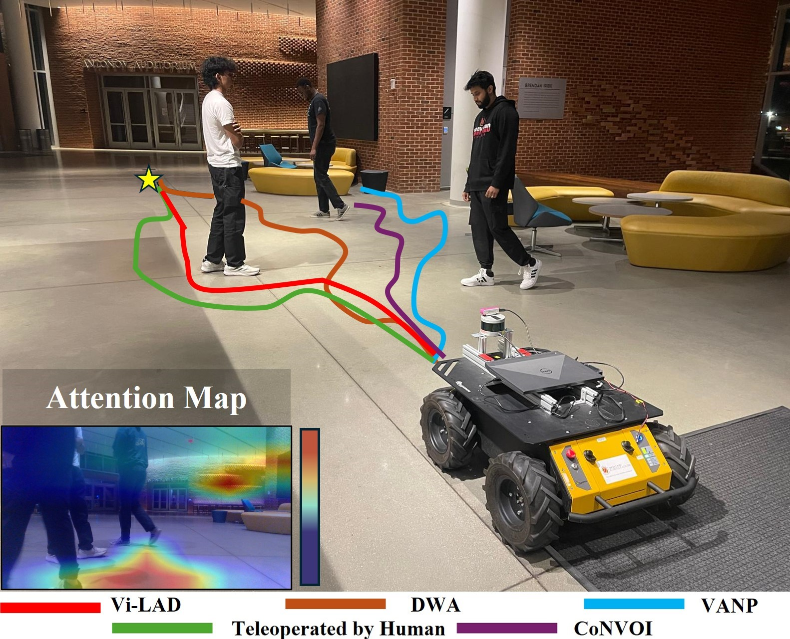
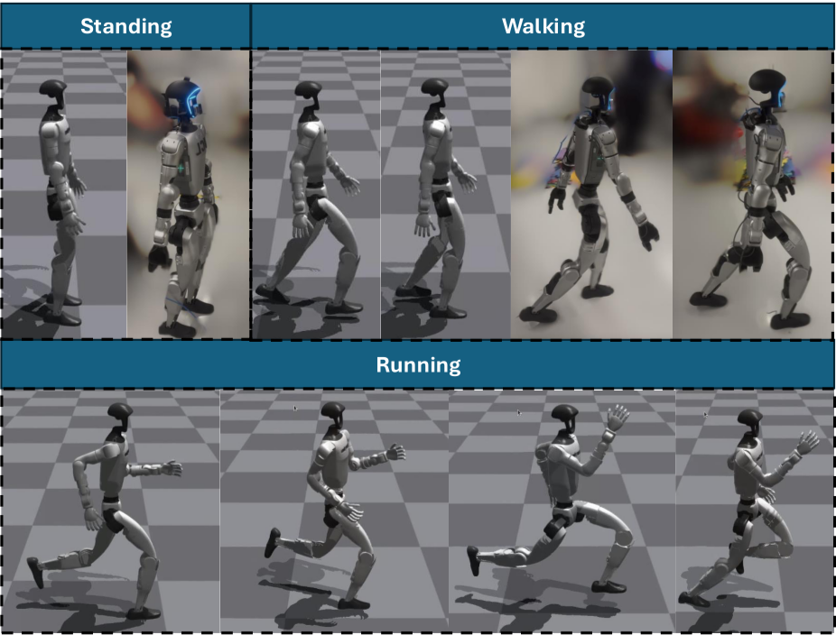
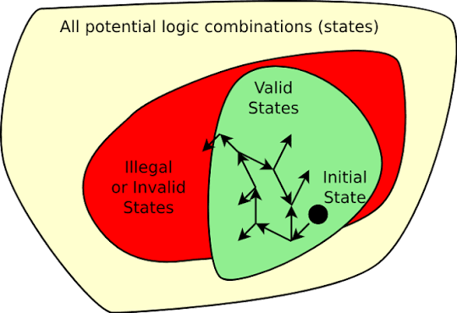
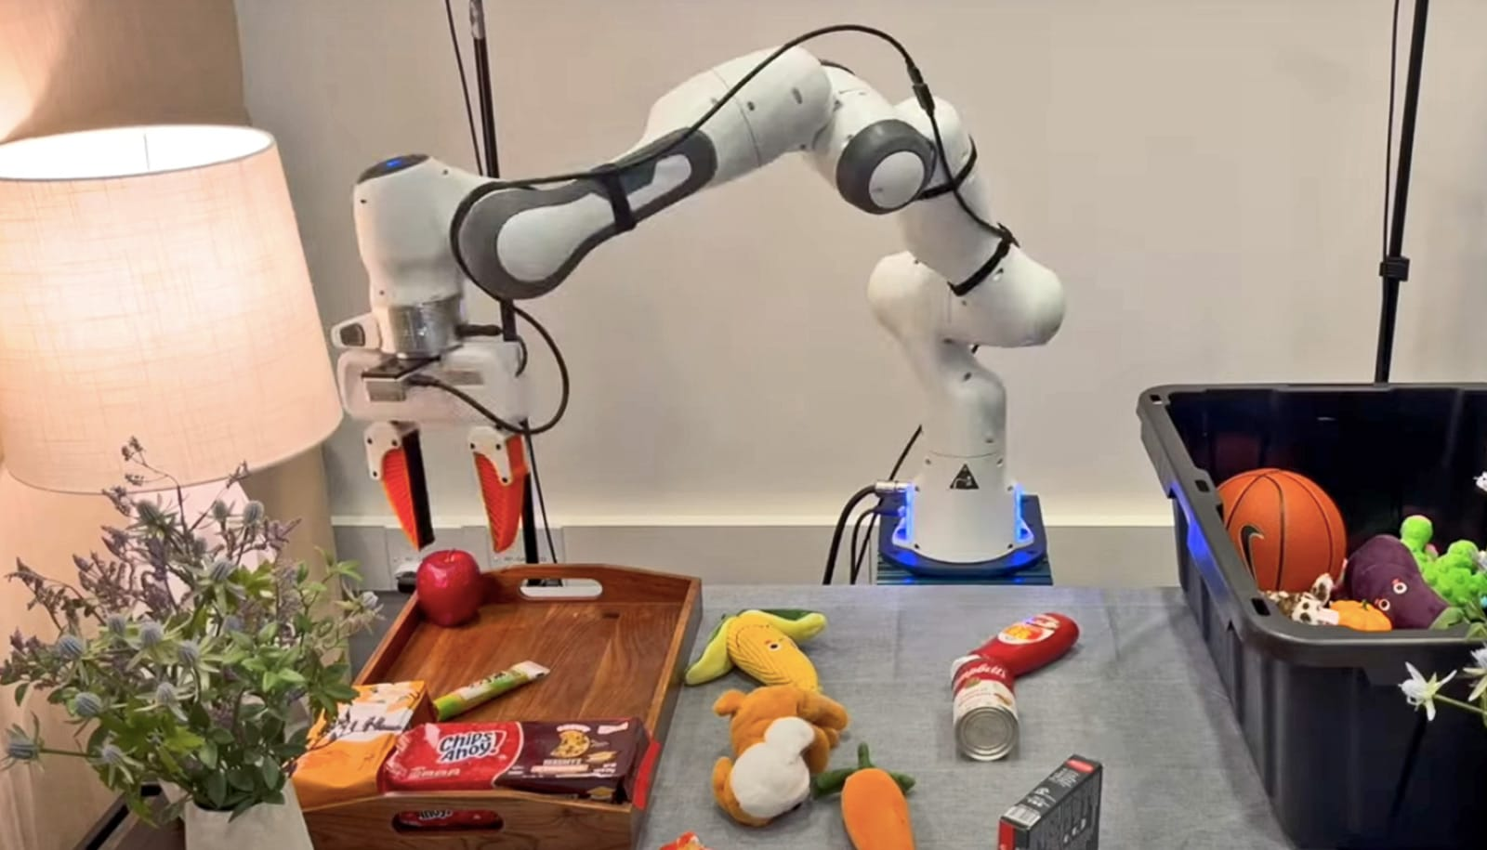
Focus This Semester
Where our sessions will concentrate
Each week we present on one topic below — manipulation most often, the others as presenters appear.
Manipulation
Navigation
Locomotion
Formal Verification
Grasping, dexterous & bimanual control — our main track
Mapping, planning & goal-driven movement
Legged & whole-body control over terrain
Provable safety & correctness guarantees

Slide 3
How We'll Categorize the Field
We read robotics research along three axes — the brain, the world it acts in, and the body it acts with.
1 Policy
2 Environment
3 Hardware
The brain
The world
The body
VLAs, World-Action Models & LLM agents
Data collection strategies
Model architecture & training recipes
Scaling laws for robot learning
Scene understanding & perception
Physics-based modeling of the world
World models & simulation
Real-to-sim-to-real workflows
Tactile & skin sensors
Gripper & end-effector design
Data-collection interfaces (UMI)
Embodiment & co-design

Slide 4
Example Papers — Policy & Environment
POLICY
POLICY
Skild AI — S1
Generalist AI — GEN-1.5
Skild AI blog, Aug 2026
Generalist AI blog, Aug 2026
A robot foundation model built as an in-context learner: shown one video demo, it executes new tasks with no fine-tuning — including unseen 10-minute-long tasks.
An embodied foundation model that one-shot learns a task from 3–12 s of demonstration, or adapts in 1–10 gradient steps — capabilities emerging from large-scale physical pretraining.
ENVIRONMENT
ENVIRONMENT
World Labs — Atlas
RealWonder
World Labs blog, Sep 2026
Geng et al. 2026
An omni world model over text, image, video & 3D. Generates, reconstructs and simulates scenes with camera control, aiding real-to-sim for robot navigation and manipulation.
Using physics simulator as an interface to improve physics of a video generation model.

Slide 5
Example Papers — Hardware
The body: sensors, grippers, interfaces and the embodiment itself.
GRIPPER
SENSOR
CO-DESIGN
UMI
DexSkin, AnySkin, FlexiTac
Transformer Transformer
Chi et al., 2024 (arXiv:2402.10329)
Bhirangi et al., 2024, Wisreich et al., 2025
Ha, Liu & Song, 2026 (arXiv:2607.25798)
Universal Manipulation Interface: hand-held grippers for portable, low-cost in-the-wild demo collection. Policies are hardware-agnostic and deploy zero-shot across robots.
Non-vision based tactile sensors.
A diffusion transformer for motion-conditioned robot co-design. Generates robot embodiments that track target trajectories; a fabricated ALOHA design cut tracking error by >70%.

