Slide 1

华中科技大学电子信息与通信学院
电信2303班
共享学报
（英语）
2023年9月28日

Slide 2
PART 1
写作

Slide 3
段落的写作 主题句与推展句
1． 主题句
主题句（topic sentence）是表达段落主题的句子。它用以概括段落大意，要求全段其他文字都围绕它展开。请看下例：

Slide 4
My mother has passed along to me certain rules for getting along with others. Don't argue with parents; they will think you don't love them. Don't argue with children; they will think themselves victimized. Don't argue with spouses; they will think you are a tiresome mate. Don't argue with strangers; they will think you are not friendly. My mother's rules, in fact, can be summed up in two words: Don't argue.

Slide 5
1． 主题句
1．1 主题句的位置
主题句通常放在段落的开端，其特点是开门见山地摆出问题，然后加以详细说明。

Slide 6
例1 Our life today depends very much on energy. In towns and in villages, on farms and in factories, machines have made life easier than it used to be. The machines use energy, and energy is needed for heating, lighting, communications, carrying goods --- everything. Factories and industrial plants use a great deal of energy to make the things that we use and buy and sell.

Slide 7
推展句
主要推展句(major supporting statement) 的主要特点是：围绕段落主题句展开的每一个推展句本身都不要求作进一步的说明或证明，句与句之间的关系是相互独立又是互相连接的。
例如：

Slide 8
(主题句) There are several factors affecting climate. (推展句1)One factor is the mount of sunlight received. (推展句2)Altitude, or the height above sea level, also determines climate. (推展句3)The oceans have an effect on the climate of adjacent land. (推展句4)In addition, climate is influenced by the general circulation of the atmosphere.

Slide 9
次要推展句
次要推展句（minor supporting statement）是指对主要推展句作进一步事实分析和举例说明。它从属于某一个或某几个推展句。

Slide 10
（主题句）I don’t teach because teaching is not easy for me.（主要推展句1）Teaching is the most difficult of the various ways I have attempted to earn my living： mechanic，carpenter，writer.（主要推展句2）For me，teaching is a red-eye，sweaty-palm，sinking-stomach profession.（次要推展句1）Red-eye，because I never feel ready to teach no matter how late I stay up preparing.

Slide 11
（次要推展句2）Sweaty-palm，because I’m always nervous before I enter the classroom，sure that I will be found out for the fool that I am.（次要推展句3）Sinking-stomach，because I leave the classroom an hour later convinced that I was even more boring than usual.

Slide 12
段落发展的几种手段
1． 列举法(details) 作者运用列举法，是通过列举一系列的论据对topic sentence中摆出的论点进行广泛、全面地陈述或解释，列举的顺序可以按照所列各点内容的相对重要性、时间、空间等进行。

Slide 13
Yesterday as one of those awful days for me when everything I did went wrong. First，I didn’t hear my alarm clock and arrived late for work. Then，I didn’t read my diary properly and forgot to get to an important meeting with my boss. During the coffee break，I dropped my coffee cup and spoilt my new skirt.

Slide 14
At lunch time，I left my purse on a bus and lost all the money that as in it. After lunch，my boss was angry because I hadn’t gone to the meeting. Then I didn’t notice a sign on a door that said “wet Paint” and so I spoilt my jacket too. When I got home I couldn’t get into my flat because I had left my key in my office. So I broke a window to get in and cut my hand.

Slide 15
根据本段主题句中关键词组everything I did went wrong，作者列举了8点内容，分别由first，then，during the coffee break，after lunch time等连接词语引出，使得该文条理清楚、脉络分明、内容连贯。
常用于列举法过渡连接词有：for one thing ，for another，finally，besides，moreover，one another ，still another，first，second，also等。

Slide 16
2. 举例法(example)
作者通过举出具体事例来阐述、说明主题句的内容，严格地讲，举例法也是列举法的一种，它们的区别在于：列举法侧重罗列事实，所列事实力求全面；而举例法侧重通过举出典型事例来解释作者观点，且事例可多可少。

Slide 17
There are many different forms of exercises to suit different tastes. For example，those who enjoy competitive sports may take up ball games. For another example，if they prefer to exercise alone，they can have a run or take a walk in the morning or in the evening. Besides，people can go swimming in the summer and go skating in the winter. In short，no matter what their interests are，people can always find more than one sports that are suitable to them.

Slide 18
本段采用了三个事例来说明主题句中关键词组different forms of exercises，这三个例子分别由连接词for example，for another example 和 besides引出，最后由引导结尾句总结全段内容。
举例法中常用连接词有：for example（instance），one example is，besides，furthermore，moreover，in addition等。

Slide 19
4． 对比法或比较法(comparison & contrast)
将同类的事物按照某种特定的规则进行比较分析是一种常用的思维方法。通过对比，更容易阐述所述对象之间的异同和优缺点 。
5． 分类法(classification)
在阐述某一概念的段落中，常用分类法。通过对概念中所包括的事物进行分门别类，分别加以叙述，使读者有更为清晰的认识。

Slide 20
6. 定义法(definition)
在科普文章的写作中，定义法是必不可少的。通过下定义，可以使读者对该事物有一个更直接的认识。
7．因果分析法(cause and effect )
在阐述某一现象的段落中，常采用因果分析法。

Slide 21
The role of women in today’s society is changing. One reason is that women have begun to assert themselves as independent people through the women’s movement. Also，women are aware of the alternatives to staying at home.

Slide 22
Another reason is that increasing numbers of women who enter new fields and interests serve as role models for other women. Moreover，men are becoming more conscious of the abilities of women and have begun to view their independence positively.

Slide 23
本段中，主题句提出了一种社会现象，推展句则对产生这种现象原因作出各种解释。
常用于因果分析法连接词有：one reason, because，so，as a result等。

Slide 24
结尾段
文章结尾也很重要，好结尾会使读者对全文中心思想留下深刻印象，可以增添文章效果和说服力，让人深思，回味无穷。确切地说，结尾作用就是概括全文内容，进一步强调或肯定文章中心思想，使读者加深印象；有时也用于展望未来，提出今后方向或令人深思问题给读者留下回味和思考余地。

Slide 25
几种写结尾段最常用方法：
1．重复中心思想 回到文章开头阐明的中心思想或主题句上，达到再次肯定和强调的效果。

Slide 26
例1：A sense of humor is really one of the keys to happiness. It gives zest to life to make it worth living.
例2：with all these benefits，it is no wonder that sports and games have now become more popular with people than ever.

Slide 27
2．作出结论：文章最后用几句话概括全文内容，并进一步肯定文章的中心思想或作者的观点。
例1：In conclusion，a good teacher-student relationship can be mutual beneficial. The students gain knowledge eagerly and enjoyably，and the teacher gains satisfaction from his job.

Slide 28
例2：On the whole, there are more advantages than disadvantages in the use of TV. Yet different people may have different attitude toward TV. But we must realize that television in itself is neither good nor bad. Its value to people and society depends on how we look at it.

Slide 29
用于做出结论的短语及句型：
in general, in conclusion, in short, in a word, in all,
in brief, on the whole, to sum up
1）In short，it can be said that …
2）It may be briefly summed up as follows…
3）From what has been mentioned above，we can come to the conclusion that …
例如： From what has been mentioned above，we can come to the conclusion that examination is necessary，however， its method should be improved．

Slide 30
3．应用引语 用格言、谚语或习语总结全文，既言简意赅又有更强的说服力。

Slide 31
例1：If you have anything to do，try to do it yourself，for that is the safest way to permanent success. Remember the famous saying. “God helps those who help themselves.”
例2：If we stick to studies day after day，there is nothing that can’t be achieved. As an old saying goes： “Constant dropping of water wears away a stone.”

Slide 32
4．用反问结尾:虽然形式是问句，但意义却是肯定的，具有明显的强调作用，引起读者思考。

Slide 33
例1：Therefore，listening skills must be consciously improved. Since it is such an important means of learning and communication，why should we not develop this ability as far as possible？
例2：So，what can we benefit from wealth if we do not have health？

Slide 34
5．提出展望或期望:表示对将来的展望或期待读者投入行动。
例1：I am sure that Chinese will become one of the most important languages in the world in the next century. As China will open further to the outside world, the language is sure to be spread world widely.

Slide 35
例2: If everyone has developed good manners，people will form a more harmonious relation. If everyone behaves considerately towards others and social ethics, people will live in a better world. With the general mood of society improved，there will be a progress of civilization.

Slide 36
例文分析：
On Overseas Study
1. 有人认为出国留学是个人发展的最佳选择；
2. 也有人坚持在国内也能实现自己的理想；
3. 我的看法。

Slide 37
When it comes to the choice of whether to study abroad or at home, different people have different opinions. Some see more advantages to overseas study, while others believe that the disadvantages outweigh its advantages.

Slide 38
With the deepening of reform and opening-up of our country, many people can go abroad for further study. They insist that there are more modern research facilities, world famous professors and excellent environment in some foreign colleges and universities, which lay a perfect foundation for their future development.

Slide 39
However, there are still many people who favor studying at home. They argue that, for one thing, studying abroad is too expensive and therefore doesn’t pay off. For another, there are no language and cultural barriers if they study in our country.

Slide 40
Just as the old saying goes, “Every advantage has its disadvantage,” so I believe both opinions are acceptable in some sense. If students have the chances and financial resources, they should seize the opportunity to go abroad and broaden their eyes. On the other hand, if conditions don’t permit, they can pursue their studies at top universities in our country. What counts is not the place where they study, but what they can learn.

Slide 41
PART 2
阅读理解题

Slide 42
I
题型详解

Slide 43
1.细节题
（1）细节题表现形式
这类题在考试中题量较大，占到60%——70%的题量，可以说是考试成败的关键这类题特点是题干的信息比较具体，考查文章中的重要细节。
如“Free play has been introduced in someJapanese kindergartens in order to”，
本题通过“free play”，“some Japanese kindergartens”反映了原文考查对象，题干内容比较具体，属于细节分析。
又如：“What did the handball player do when he was not allowed a time out to change his gloves? ”
本题handball player 是中心话题，when引导状语从句，这两部分明确指定了考查的细节内容，在原文中找答案十分方便。
（2）细节题注意点
考生做细节题时，要注意合理但不正确的选项。很多考生在做题时，忽视了题目与原文的联系，凭着合理性的主观猜想选择答案。结果很多考生感觉做得很好，但对答案时发现错了很多。另外，很多表示程度、范围、频率等的副词或形容词可能会导致选项错误

Slide 44
（3）细节题解题方法
细节题考查信息查找能力和句子的理解能力。由于考试时间非常紧张，对于考生来说，做好细节题，首先是要在原文找到相关信息。正是由于这点，我们看文章需要目的。
有同学先看文章再做题，导致做题时还得回去在文章中寻找相关内容，或者干脆凭着对文章的主观印象匆忙求解，结果是浪费时间或者错误较多。
建议考生先看题干再看文章，这样就会有方向感，目的感。所以，细节题的重要做题方法就是：先看题干，再看原文，带着题干个别的特有信息或者带着题干的中心话题在原文定位。如“What did the handball player do when he was not allowed a time out to change his gloves? ”就可以结合handball player这个中心话题在原文找答案。
细节题干有时会有比较明显的信息，如时间数字，专有名词，中心名词。
例：What was confirmed by the Boston University Medical Centers study?题干中Boston University Medical Center这个专有名词可以让考生迅速找到考到的原文内容。如果用题干信息在原文找答案没有结果，可以根据题目的先后顺序来确定大概范围(除个别例外，四级细节题大体上还是按照出题的先后顺序找答案的)。

Slide 45
2.态度题
（1）态度题表现形式
态度题一般提问方式是：The author’s attitude towards…is _____.
或者是What is the author‘s attitude towards _______?
（2）态度题注意点
考生应该熟练掌握在态度题中经常出现的单词
如positive, negative, optimistic,pessimistic, approving, concerned, objective, compromise等。
另外，从以前考试的情况来看，作者的态度一般是或褒或贬，或乐观或担忧，中性评价为正确答案的较少。

Slide 46
(3)态度题解题方法
从原则上来讲，态度题可以考查作者对一个中心话题的看法，也可以考查作者对某一具体细节的态度，但是从历年考法来看，阅读更注重考查文章中心话题。
所以，态度题经常可以通过文章主题来判断作者的态度.
如某篇原文首句：It’s no secret that many children would be healthier and happier with adoptive parents than with the parents that nature dealt them.
题目：The author’s attitude towards the judge‘s ruling could be described as______.
A) doubtful B) critical C) cautious D) supportive
全文首句可以体现文章讨论的中心话题，它明确道出了作者的观点：有时小孩与养父母在一起比与亲生父母在一起更好。而原文中judge’s ruling的结果就是把小孩判给了养父，所以作者一定会持支持态度，故选D。

Slide 47
3.主旨题
(1)主旨题表现形式
阅读中，主旨题主要可以表现为“What’s the best title for this passage”；
“What is the main idea of the passage”；
“The author’s purpose of writing this passage is to _____”
(2)主旨题解题方法
从理论上来讲，主旨题是各类题型中要求最高的，因为它要求考生看完文章后，能对文章的大概框架作一个宏观把握，从而解答后面的题目。但是把握文章框架对很多考生来说，是不能做到的。庆幸的是，一般的四级文章，都可以找到文章主题句，或者是可以体现文章主题的句子或单词。 文章主题一般在前两段出现，所以考生要比较关注前两段结论性的语言。阅读在全文首句出现文章主题的情况比较多见。另外，第一段转折性的语言，通常也能体现作者的观点偏好。

Slide 48
(3)主旨题注意点
如果是考文章主题，那么正确答案一定具有概括性和结论性，细节性的选项肯定是错的。
What is the author’s purpose in writing this article?
A)To justify the study of the Boston University Medical Center.
B)To stress theimportance of maintaining proper weight.
C)To support the statement made by York Onnen.
D)To show the most effective way to lose weight.
一看这四个选项，就可以发现A和C里面包含十分具体信息“the Boston University Medical Center”和“York Onnen”，是利用原文中的具体话题，某个细节内容而设计的干扰选项。
值得注意的是很多干扰选项还以“以偏概全”的形式出现的，所以分析时要注意正确答案概括的全面性。而利用扩大主题的范围来设计干扰选项的方式相对较少为了说明主题，为了论证，作者会引用一些人讲的话，而这些观点也很可能被考到

Slide 49
4.推理题
(1)推理题表现形式
推理题提问的方式有很多，比如suggest，imply，indicate，conclude，infer等。
然而，suggest，imply和indicate这些单词提问，这个题目往往按照细节题的方法来处理即可，真正难把握的是conclude和infer两个单词，这也是四级阅读推理题经常用来提问的方式。
(2)推理题解题方法
推理题难度高，不在于推理难，而在于找答案没有方向。比如，题目可能会问What can be inferred from the passage? What can be concluded from the passage? 如果我们对历年考题作一个仔细分析，可以发现conclude和infer还是有些答案查找的方向的。
Conclude提问的题目，一般会涉及原文中结论性，观点性的语言，尤其是段落首末的句子。而infer提问的题目，如果题干信息比较多比较具体，一般可以当作细节题来处理，如果题干信息比较少，则考查原文观点结论的语言比较多，甚至考文章主题。

Slide 50
(3)推理题注意点
很多考生在做推理题时，有一种思维误区，认为一个选项与原文相去越远，就越可能是正确答案，所以在找不到原文的依据时，就随心所欲地推导。其实，很多情况下，推理题的正确答案相差并不大，不应把这类题想得太难了。
比如： It can be inferred from the passage that____.
A)killing foxes with poison is illegal
B)limiting the fox population is unnecessary
C)hunting foxes with dogs is considered cruel and violent
D)fox-hunting often leads to confrontation between the poor and the rich
正确答案选择C，而原文相关信息是：┄ because they think it is brutal(残酷的)(原文已经给出brutal的含义)。可见两者相差并不大。

Slide 51
5.词汇题
（1）词汇题表现形式
词汇题一般会明确地告诉考生出题点在哪里，不需要考生查找所考查内容。它可以考一个单词的含义，一个词组的意思，或者考一个句子的弦外之音。
（2）词汇题解题方法
词汇题是考生得分率较低的一类题，因为它需要考生从上下文中进行分析，推敲单词背后的意思。问单词或词组的意思，加强调上下文逻辑分析；有时用转折逻辑，但更多是利用并列逻辑
his is the Shadowland of hope, and anyone with a dream must learn to live there.
“Shadowland”in the last sentence refers to____ .
A) the wonderland one often dreams about
B) the bright future that one is looking forward to
C) the state of uncertainty before one's final goal is reached
D) a world that exists only in one's imagination

Slide 52
此题解法有多种，其中可以利用并列关系来求解。首先，and后面的句子告诉我们“任何有梦想的人必须要学会在那里生活”，这暗含了“那里”不好的环境。再从and可知，两个分句的逻辑是一致的，据此Shadowland也应该是不利的环境，故选择C
查找答案的方向还得做一个细分：
如果句子简单，一般在上下文中寻找答案；如果句子复杂，则更加倾向于在句子内部找答案。
(3)词汇题注意点
如果考简单单词，正确答案会与该单词的常用意思没有多大关系；
如果考难词，感觉很难有分析的线索时，就把四个选项代到原文中，使得原文逻辑正确，意思同学的为正确答案；
如果考句子的含义而导致分析完全没有思路时，不妨结合文章问题来分析，可以体现主题，或与主题的逻辑一致，一般就是答案。

Slide 53
II
答题技巧

Slide 54
1. 答题技巧
答题技巧一： 详略得当
对于大学英语快速阅读测试来说，根据题目的“题眼”快速在文章中找到答案是最关键的，这样我们就要在阅读时注意详略得当。克服精读精益求精的习惯，做到有信息处精读，无信息处略读，略读处一扫而过。
对所要解释或证明的观点的细节举例处或者通常有数个名词的并列项，它们不是完整的主谓宾的句子，因此无法与问题对应的详细列举处，都可以略读。那么题目中数字、人名等信息（题眼）在原文中对应的部分必须详读。

Slide 55
CET-4样卷原文中有这样一段： There are two ways to bury trash:
Dump — an open hole in the ground where trash is buried and that is full of various animals (rats, mice, birds). (This is most people’s idea of a landfill!)
Landfill— carefully designed structure built into or on top of the ground in which trash is isolated from the surrounding environment (groundwater, air,rain). This isolation is accomplished with a bottom liner and daily covering of soil. Sanitary landfill — landfill that uses a clay liner to isolate the trash from the environment
Municipal solid waste (MSW) landfill — landfill that uses a synthetic (plastic) liner to isolate the trash from the environment
文章是对Dump和Landfill分别做了一个解释，这些就应该是考生略读的地方。

Slide 56
答题技巧二：显性信息
查读的信息通常是显性信息，只要将问题在原文中进行准确定位就能得到正确答案，一般不需要做推理。
[例2] The death rate on highways is half that of all other U.S. roads (0.86 deaths per 100 million passenger miles compared to 1.99 deaths per 100 million on all other roads).
[题目] In spite of safety considerations, the death rate on interstate highways is still higher than that of other American roads.
[解析] 从题干中的关键信息短语 the death rate on interstate highway可采取寻读法找到最后一句话为原文出处。原文中明确指出高速公路上的死亡率只是其他公路的一半（half that of…）与题干中的 is still high than（仍高出）相矛盾，可判断此句话错误。

Slide 57
特别提示：考生对于以下一些显性信息也应注意
(1) 表示因果关系的词或词组：because, reason, due to, since,
so that, therefore等
(2) 表示目的关系的词或词组：in order to, so as to, by等 (3) 表示转折关系的词或词组：but, however, yet等 (4) 表示对比关系的词或词组：contrary to, unlike, like等
答题技巧三：题文同序
大学英语考试的快速阅读部分，问题顺序与原文顺序一致（有时判断题和填空题交汇处顺序不一致），这就要求考生应该按照题目的顺序依次做题。对于所有的四级快速阅读文章这个技巧都适用，在此就不做特别举例 。

Slide 58
答题技巧四：分解对应
分解对应四分法（快速阅读的解题核心）：快速将问题分解成4个部分（主A 谓B宾C+其他D），与原文进行对比。
[例3] A landfill is not like a compost pile, where the purpose is to bury trash in such a way that it will decompose quickly.
[题目] Landfills are like compost piles in that they speed up decomposition of the buried trash.
[解析] 我们可以将题目简单划分句子成分：主语为Landfills，谓语为are，宾语为like compost piles，speed up decomposition of the buried trash.与原文bury trash in such a way that it will decompose quickly相对应，这样我们就很容易的看到题目Landfills are like compost piles，可是原文中却是A landfill is not like a compost pile，很明显我们就可以得到正确答案。
答题技巧五：一段一题、长段两题、平均分配
大学英语考试的快速阅读的出题方式一般都为一段出一题、长段出两题，遵循平均分配题目所在位置的原则，在此也不做特别举例。

Slide 59
答题技巧六：选小不选大
快速阅读中，问题的范围必须小于原文范围，反之则判定为错。
[例4] In the United States, taking care of trash and building landfills are local government responsibilities.
[题目] In the United States the building of landfills is the job of both federal and local governments.
[解析] 原文明白无误地告诉考生“清理垃圾以及建造清埋场是由当地政府负责的”。据此可断定，该论断不准确。
在此特别提示考生，如果题目中所表述的内容与原文明显不符、矛盾或相反，可判断为N 确定为N的情况：
(1) 题目中的信息与原文内容相反
(2) 题目将原文的意思张冠李戴
(3) 将原文中的不确定因素转化为确定因素
(4) 改变原文中的条件、范围等

Slide 60
答题技巧七：两段判定（判断NG最好方法）
在四级快速阅读中，如果上一题已经确定了在原文中的位置，读过两段后仍无下一题所需信息，则可以判定该题为NG，而不用通读全文。
答题技巧八： 主宾判定
四级快速阅读中，将题干的句子进行简单分解后，问题中的主语、宾语在原文未出现或被偷换概念的情况：
(1) 题目中的表述无中生有
(2) 原文中作者的目的、意图、愿望等内容在题目中作为客观事实陈述
(3) 将原文中的特殊情况推广为普遍现象
(4) 将原文的内容具体化
(5) 随意比较原文中的两个事物

Slide 61
答题技巧九：相关信息准确合并
快速阅读文章中有时可能会问到所面临的问题是什么？某事情的原因是什么？等等，这样的问题在文中可能是在不同的位置都有表述，所以考生遇到这样的问题时，不能只局限在某一段里面找答案，可以先做后面的题目，在后面的阅读中发现还有该题的答案时，将相关信息合并后再确定答案
[例5] Water woes may seem remote to people living in rich countries like the United States. But Americans could face serious water shortages, too especially in areas that rely on groundwater. Groundwater accumulates in aquifers, layers of sand and gravel that lie between soil and bedrock. (For every liter of surface water, more than 90 liters are hidden underground.) Although the United States has large aquifers, farmers, ranchers, and cities are tapping many of them for water faster than nature can replenish it. In northwest Texas, for example, over pumping has shrunk groundwater supplies by 25 percent, according to Postal.
Americans may face even more urgent problems from pollution. Drinking water in the United States is generally safe and meets high standards. Nevertheless, one in five Americans every day unknowingly drinks tap water contaminated with bacteria and chemical wastes, according to the Environmental Protection Agency.In Milwaukee, 400,000 people fell ill in 1993 after drinking tap water tainted with cryptosporidium,a microbe that causes fever, diarrhea and vomiting.
[题目] The problems Americans face concerning water are ground water shrinkage and tap water pollution.
[解析]根据上面2段文章，美国人面临水的问题主要有两个：But Americans could face serious water shortages, too especially in areas that rely on groundwater.和Americans may face even more urgent problems from pollution.这两句话决定了题目的答案，故为Y

Slide 62
x.附加的tip：
刚开始做这个题的时候，等大家自己做完之后，根据答案把每个题的关键句在文中划出来，再反复思考为什么做错了，错在哪里了，需要注意的点和忽略的点
阅读是提升词汇最好的方式，二者相辅相成，背单词一个好方法就是在阅读里面画出来自己不认识的单词，再通过翻译查出中文意思，每天有时间的时候就背一背。
把单词放在文章里更容易背过，而且背了几篇之后发现，有很多单词高频率出现
一开始可能会很困难，甚至是一篇文章几乎都查了一遍，但也担心，万事开头难。坚持下来背，会发现不认识的单词一篇比一篇少，到了熟悉之后就查几个而已了

Slide 63
PART 3
听力图表题

Slide 64
引言
听力，往往是一场英语考试的开端，而填表类题目则是英语听力的重头戏之一，因此对这一类别的题目的应对能力，会影响到整场考试的基调与考生的心态。本次共享学报将从以下几个方面对如何提升学生对于英语填表题的掌握程度进行一次简析与讨论。
考场上的心态管理
答题技巧
例题解析

Slide 65
考场上的心态管理
考试是对学生学业水平的检测，因而在面对卷子的那一刻，考生便应该抛去不必要的懊悔和紧张，以避免影响自己的正常发挥：
不要纠结与某一道题是否一定正确，过分纠结反而会让自己在其他题上丢更多的分，相信自己的运气可以帮助得到期望为25%的分数
听的时候要摆平心态，听不清楚时更要冷静下来继续往下听，尽量简略记录连贯的重点与逻辑关系

Slide 66
答题技巧
在考场上，考生所能差使的知识水平是有限的，但发挥能力的可能性是无限的，掌握合适的答题技巧，可以达到事半功倍的效果：
关注听力原文整体结构和人物，如果是选择题，听听力前先把选项看一遍，想象可能的语境，便于听的时候的提前代入；如果是填空题，听听力前先看清前后文，关注主语和指示代词等，防止在时态和语法上出错，同时要理解文意，尽可能对要填的答案有大概的方向，对模糊的选项采取理解前后文填入，并相信自己的第一印象
听力部分会有一些是视听说教程课本里的原材料，考前可以将那些听力再听一遍，时间不够的话，也可以直接从网上找原文了解材料的大概。对于听力，重点要先搞清楚文章的主体结构与大致内容，知道了文章的结构与大致内容，再注意一些关键词，就差不多能了解文章的内容，把握住关键的细节。之后不论是做题，还是蒙题的准确率都能有所提高

Slide 67
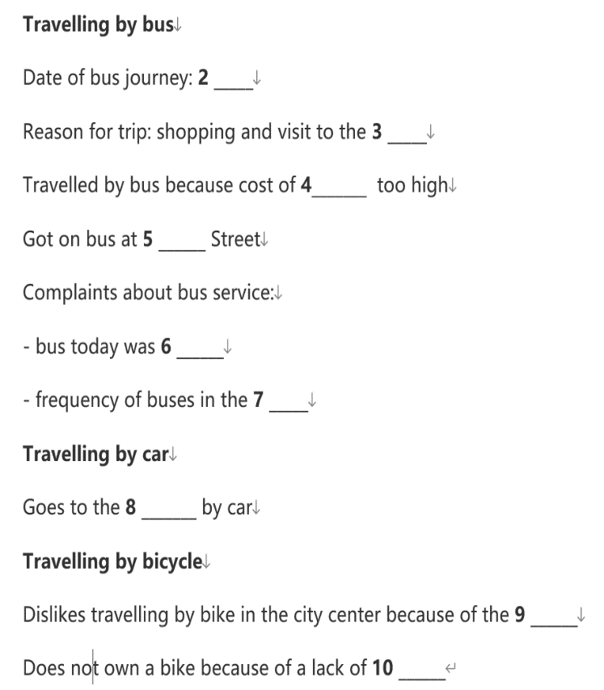
例题解析1
题目特点
空格密集，且答案大多为单个词语或短词组
可以从上下文判断个别空格处所缺失内容
文章结构清晰，信息点出现顺序在题目与音频中不对应，容易漏听
应对方法
在听力开始前仔细阅读文本，记住要点
联想可填入词汇，写在对应空格作为笔记
试着把握听力音频总体框架，将注意力放在音频上，对关键知识点进行笔记

Slide 68
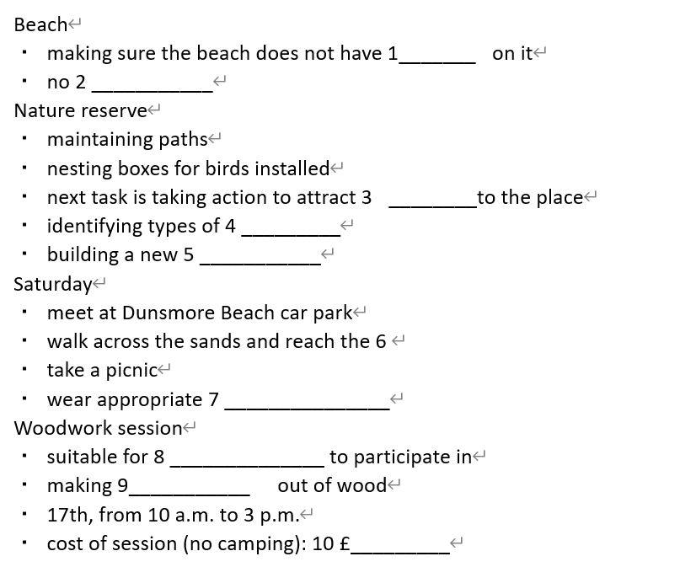
例题解析2
题目特点
答案大多为长词组或短句格式
题干不清晰，主题不明确
答案大多为名词或形容词
应对方法
音频播放时可以比对文章内容，时刻参考对应题目
反复阅读，在音频第一次播放时试着不关注答案而是构造文章整体结构
把握关键词语，进行笔记

Slide 69
总结
尽管听力填表部分仅是整张考卷的一部分，但并不代表在考试的一开始，考生就要将精力全部投入，进行合理的资源分配，心态调控才是把握整场考试的关键，走好一步，才能以更佳的精神面貌应对其余题目，以上便是此节共享学报的全部内容。

Slide 70
THE END

