Slide 1
Gene-Based Pangenome of Cucumber
Rocky Shao, Xuebo Zhao, Zhangjun Fei

Slide 2
Background
Global challenges such as climate change and population growth -> needmore robust crop varieties.
Tech advances -> DNA sequencing technologies, Pangenomic studies
Cucumber ->important vegetable crops worldwide, model plant for sex determination and vascular biology studies.
Notes:
Advances in DNA sequencing technologies made it easier to generate pangenomes from representative individuals of target species. Pangenomic studies have also helped identifying beneficial traits and provided insight into breeding efforts to develop more robust crop varieties These studies have demonstrated success in recent plant research, uncovering evolution and diversity of different plant species and identifying deleterious mutations to facilitate breeding .

Slide 3
Background
These studies success in recent plant research -> uncovering evolution and diversity of different plant species & identifying deleterious mutations to facilitate breeding .

Slide 4
Background
Previous studies have shown patterns in cucumber domestication, highlighted key genes associated with important agronomic traits and the domestication process, providing valuable information for future breeding.

Slide 5
Background
To capture the entire genomic diversity for future biological research, it is needed to construct a complete gene-based pan-genome from diverse cucumber accessions.

Slide 6
Procedure
Protein Sequence
Orthofinder
Core-Pan Gene
Code
PAV gragph
Bl2Go
Enrichment

Slide 7
Expected Results
Pan and core genes of cucumber orthogroups are expected to be classified. Additionally, this project aims to identify enrichment patterns of candidate genes involved in important agronomic traits, particularly stress tolerance, nutritional enhancement and yield improvement.

Slide 8
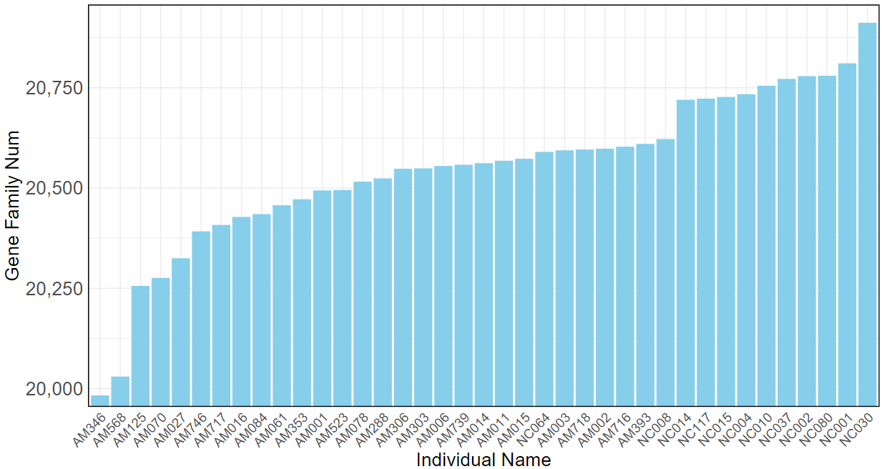
Original Data

Slide 9
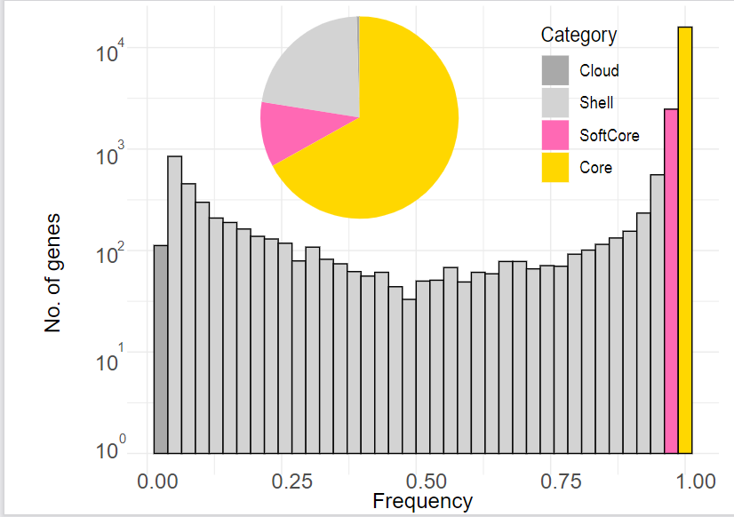
PAV Analysis

Slide 10
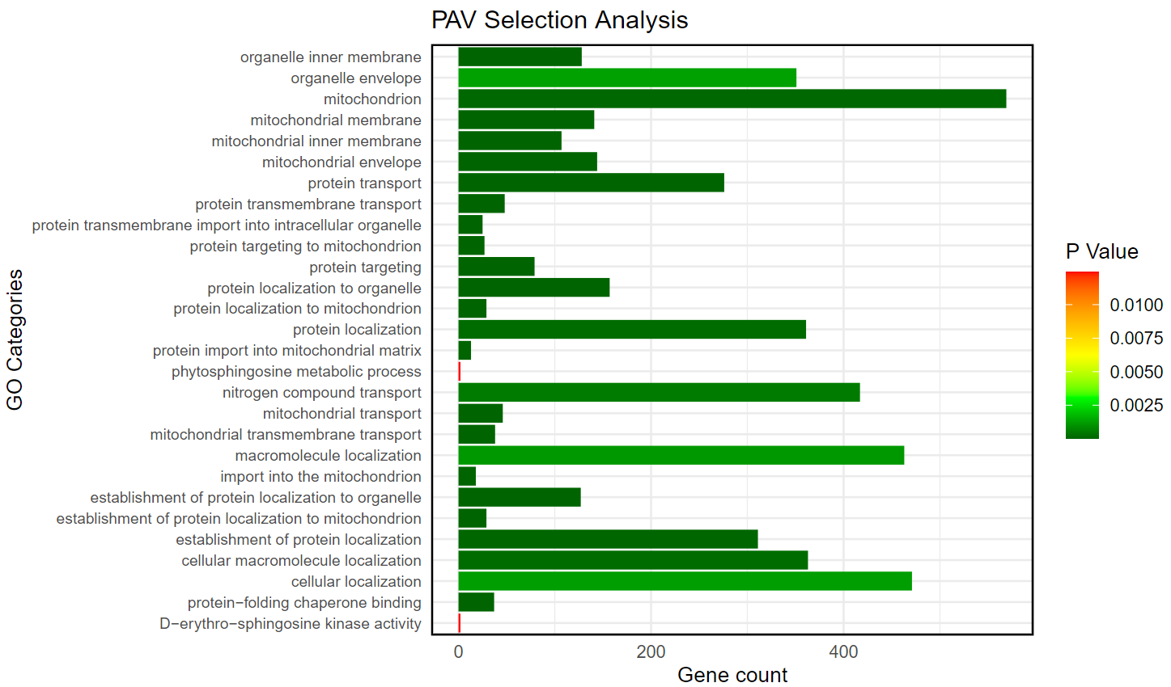
Enrichment Selection

