Slide 1
Gene-Based Pangenome of Cucumber
Rocky Shao
2024/08/02

Slide 2



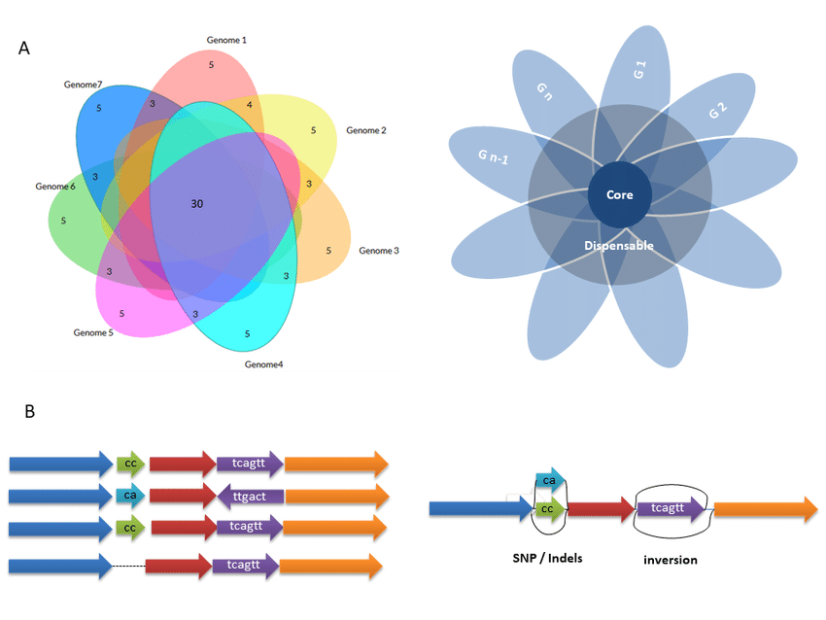
Background
Global challenges
Need more robust crop varieties
Google
Google
Technology advances
Easier to generate pangenomes
Help identify candidate genes for beneficial traits
Google
Google
Notes:
Advances in DNA sequencing technologies made it easier to generate pangenomes from representative individuals of target species. Pangenomic studies have also helped identifying beneficial traits and provided insight into breeding efforts to develop more robust crop varieties These studies have demonstrated success in recent plant research, uncovering evolution and diversity of different plant species and identifying deleterious mutations to facilitate breeding .

Slide 3
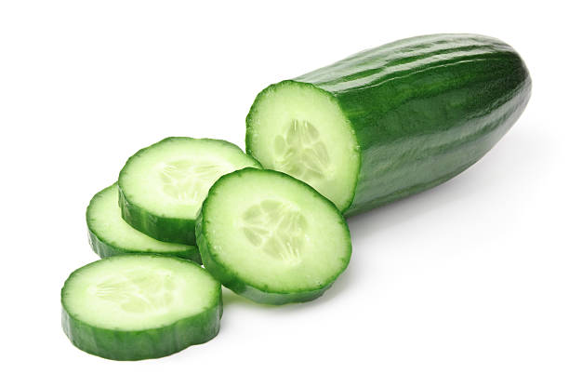
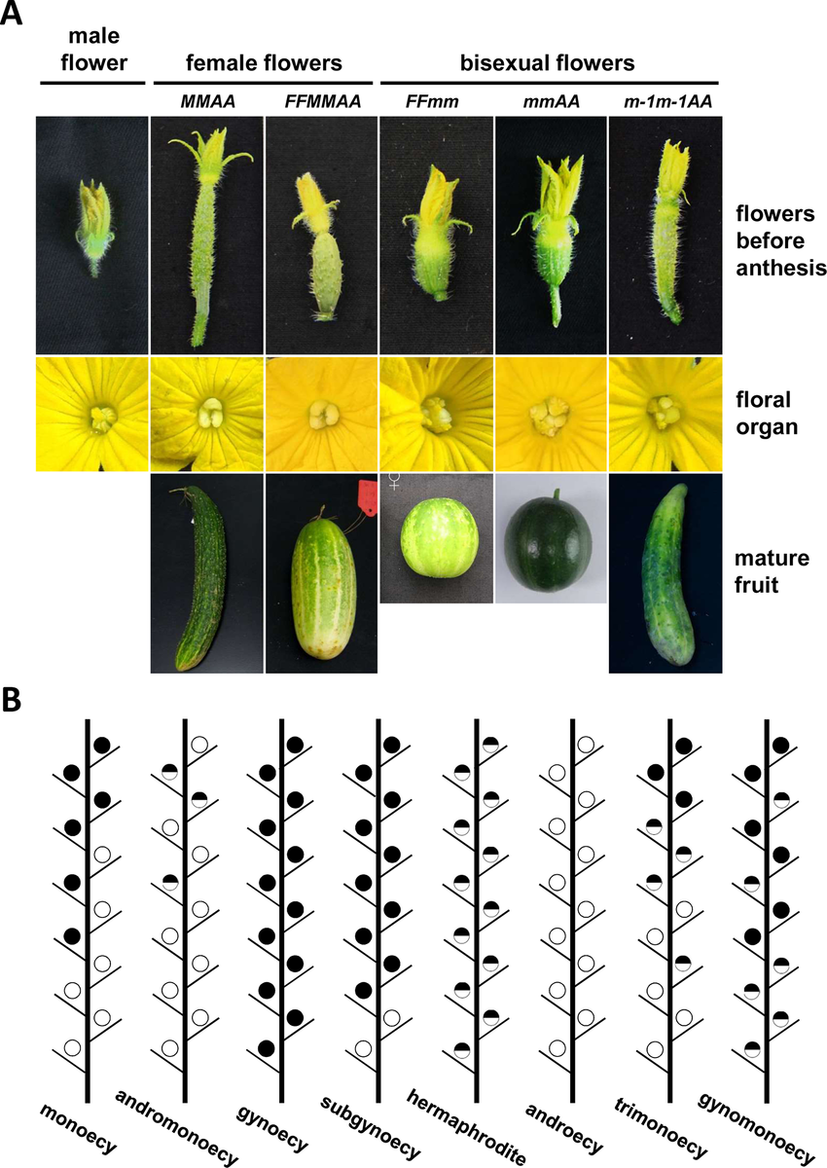
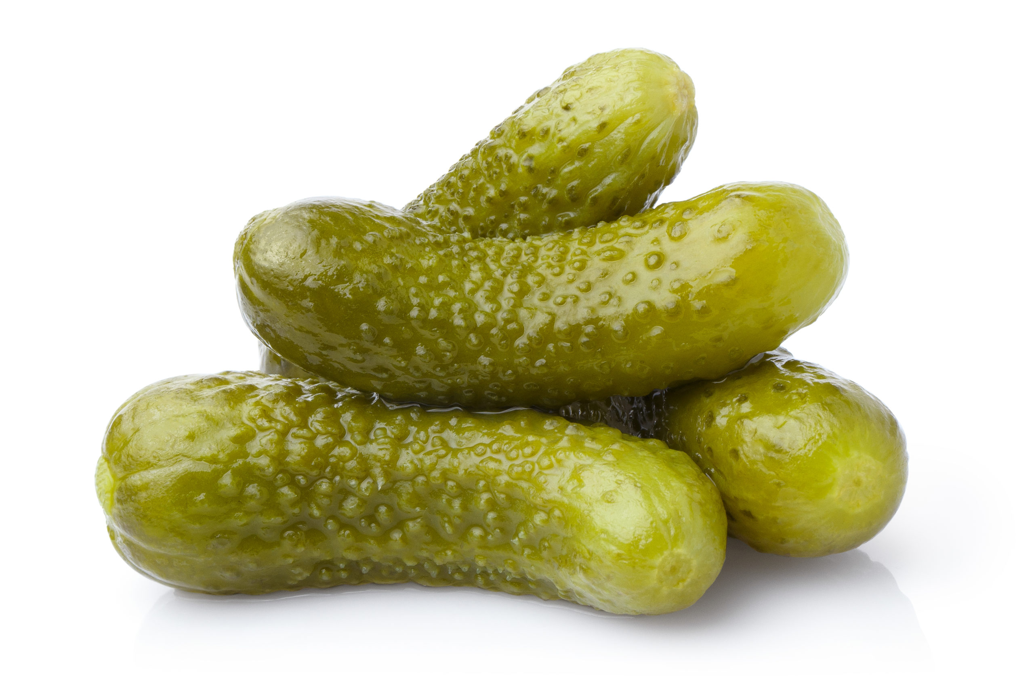
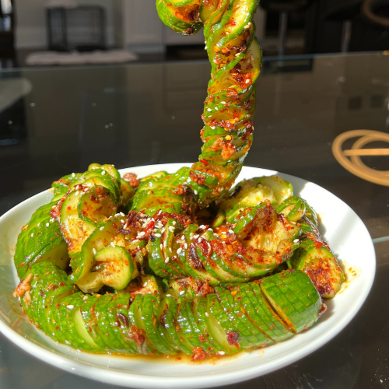
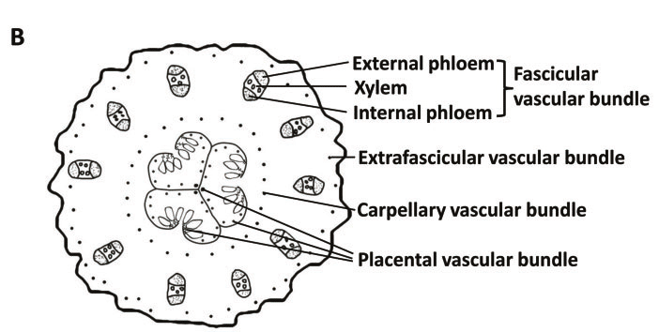
Studied Species: Cucumber
Model plant for sex determination and vascular biology studies
Important vegetable crop worldwide
Google
Google
Google
Dandan Li et.al, 2015, Frontiers in Plant Suty
Jianyu Zhao et.al, 2015,Plant and Cell Physiology

Slide 4
Procedure
Orthogroup Identification
Protein Sequence
Gene Family
PAV Calculation
Gene Family
PAV Calculation
Pan-Core Identification
PAV Calculations
Pan-Core Identification
Enrichment Analysis
Genes with high present frequency
Enrichment

Slide 5
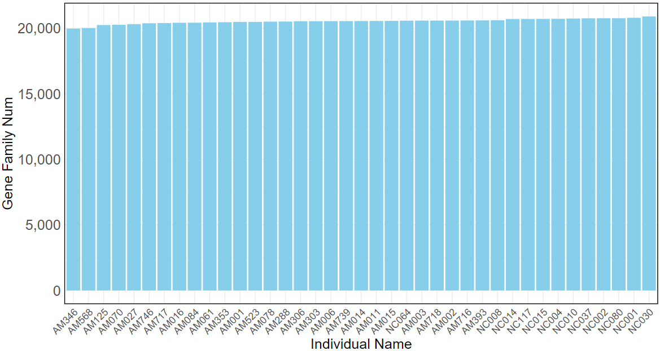
Orthogroup Identification
Protein Sequence of 39 cucumber species
Orthofinder
Gene Family
Graph shows Gene-Family
Number for each sequenced cucumber individual
Highest: 21,132 gene families Mean: 20,820 gene families Lowest: 20,154 gene families
Small diversity among cucumber species

Slide 6
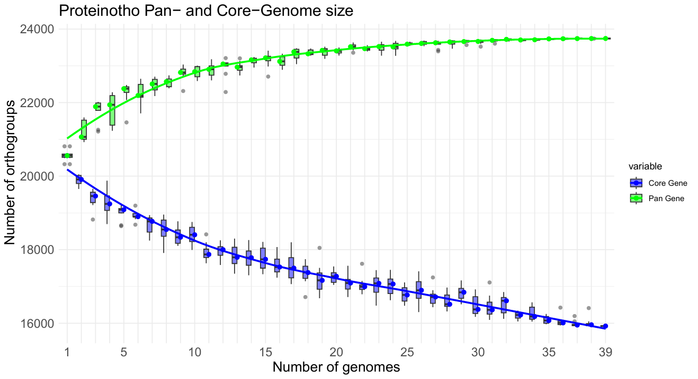
Pan-Core Identification
Figure shows the curve of Pan- and Core- orthogroups with respect to increment of genomes
Orthogroup number stables around 25 genomes, suggests 39 species are suffeciet for pangenome study

Slide 7
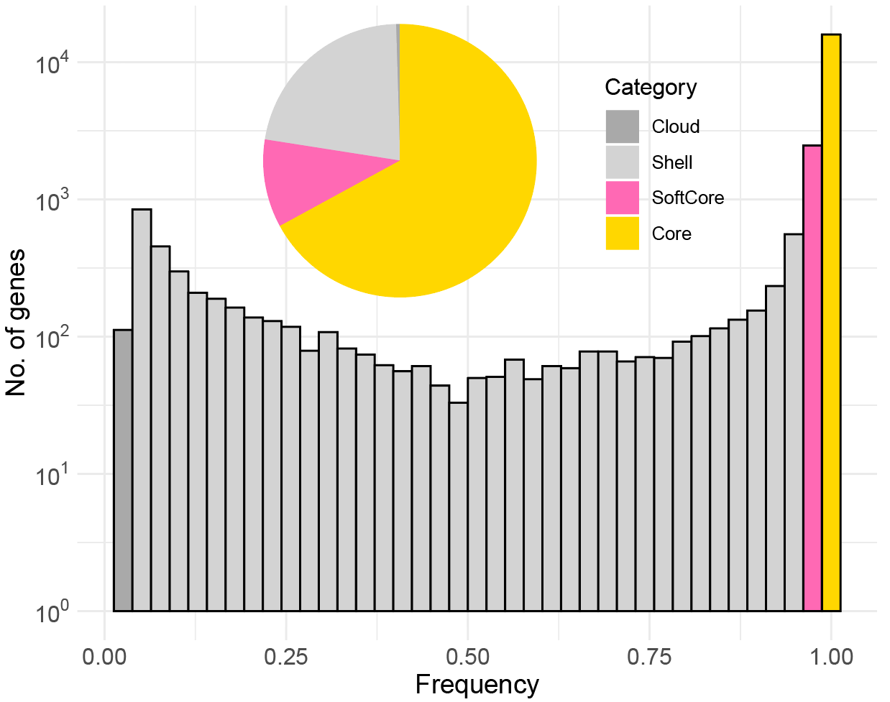
PAV Calculation
Core: 100% SorftCore: 95% ~ 100% Shell: 5% ~ 99% Cloud: < 5%
Core: 67.06% SorftCore: 10.42% Shell: 22.05% Cloud: 0.47%
High potential to identify functionally important genes, Possible to reveal genetic changes through breeding history

Slide 8
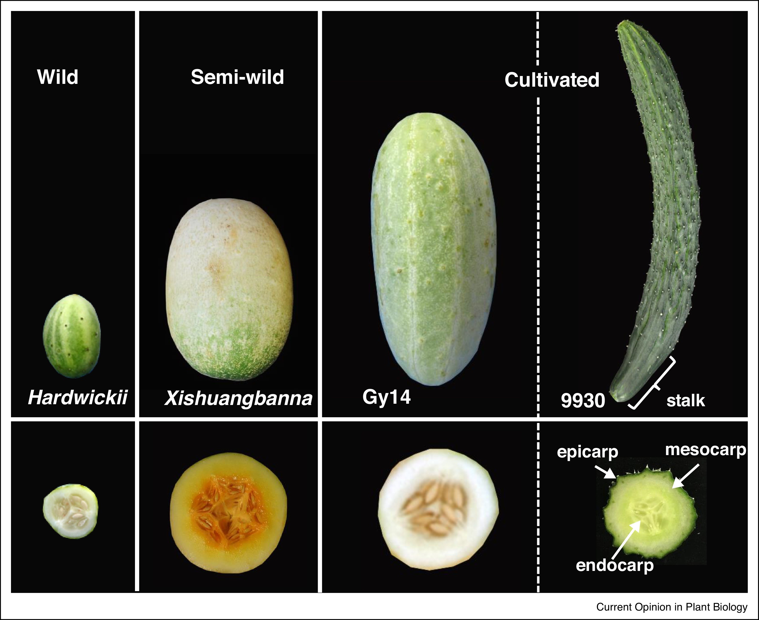
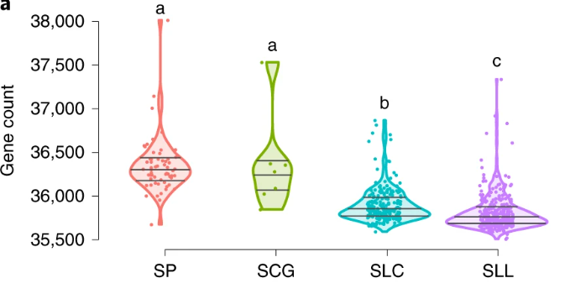
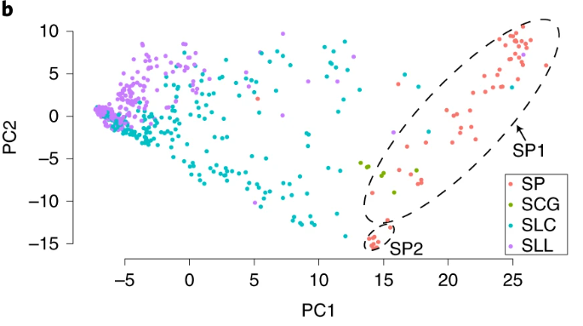
Domestication Process
,
Recent study suggest modern crop with narrow genetic diversity
Lost genes during domestication are enriched for important traits
Gen Che, Xiaolan Zhang, Elsevier, 2018
Will genes lost during cucumber domestication process also enrich for important traits?
Lei Gao et.al, Nature Genetics,2019

Slide 9
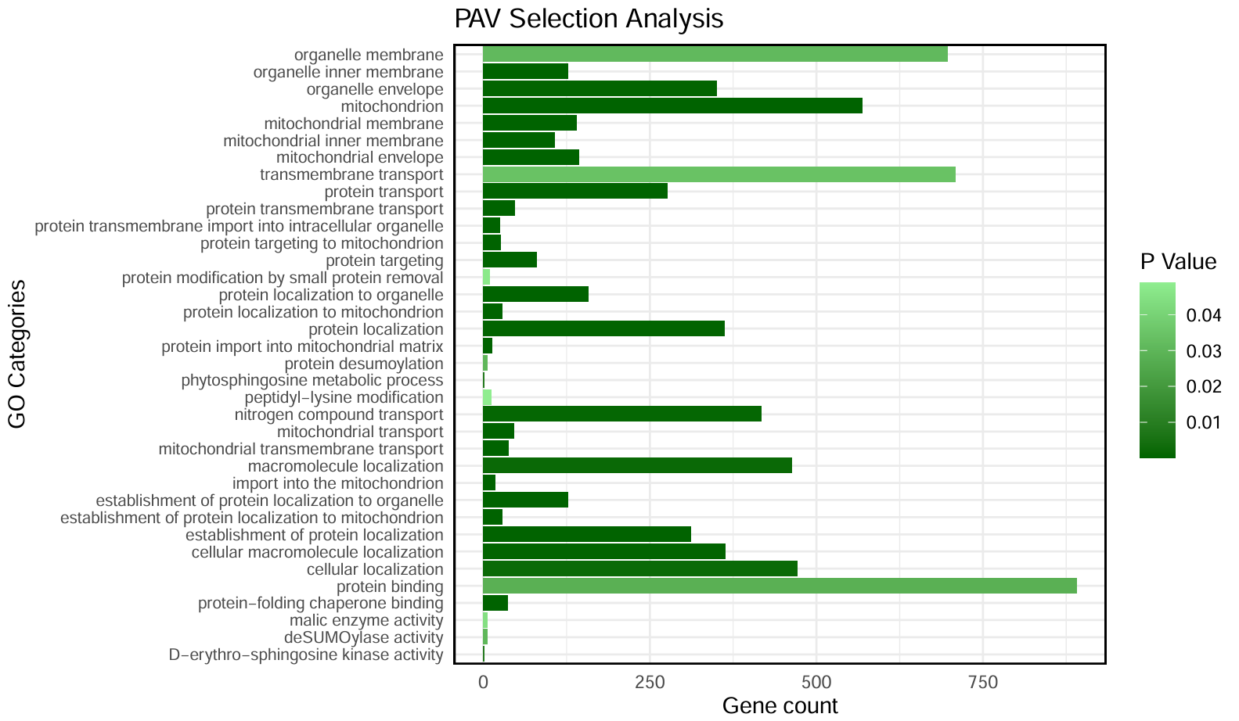
Enrichment Analysis
Genes high difference of PAV in wild vs cultivated
Enrichment
Cucumber species exhibit significant gene enrichment in mitochondrial functions and protein transport, indicating essential roles in energy production and cellular organization.

Slide 10
Summary
Constructed gene-based pangenome of 39 cucumber genome.
Identified 15,924 core-genes, 2,474 soft-core genes, 5,235 shell genes and 112 Cloud-genes in cucumber gene-based pangenome
Through PAV calculation, identified 2193 genes with high present frequency in wild vs cultivated cucumber species, enriched in mitochondrial functions and protein transport
This project provided resource for cucumber pangenome studies, identified genes with different PAV in wild vs domesticated species, and provided value in future cucumber breeding

Slide 11
Thank U :P

