Slide 1



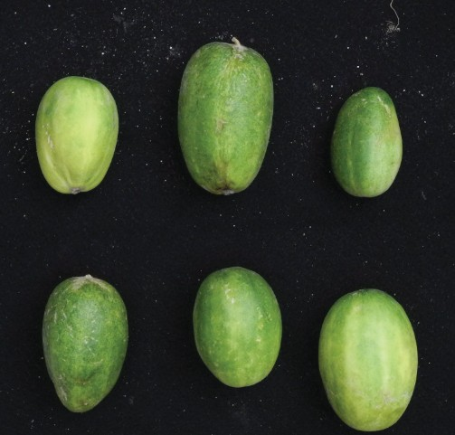
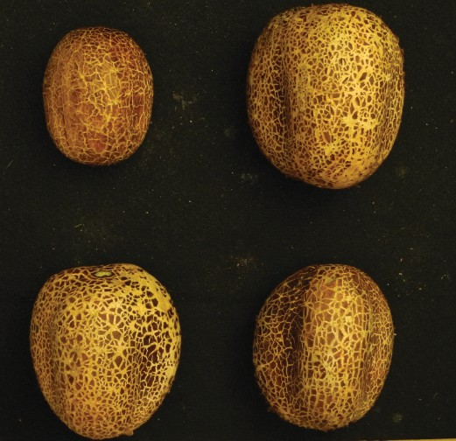
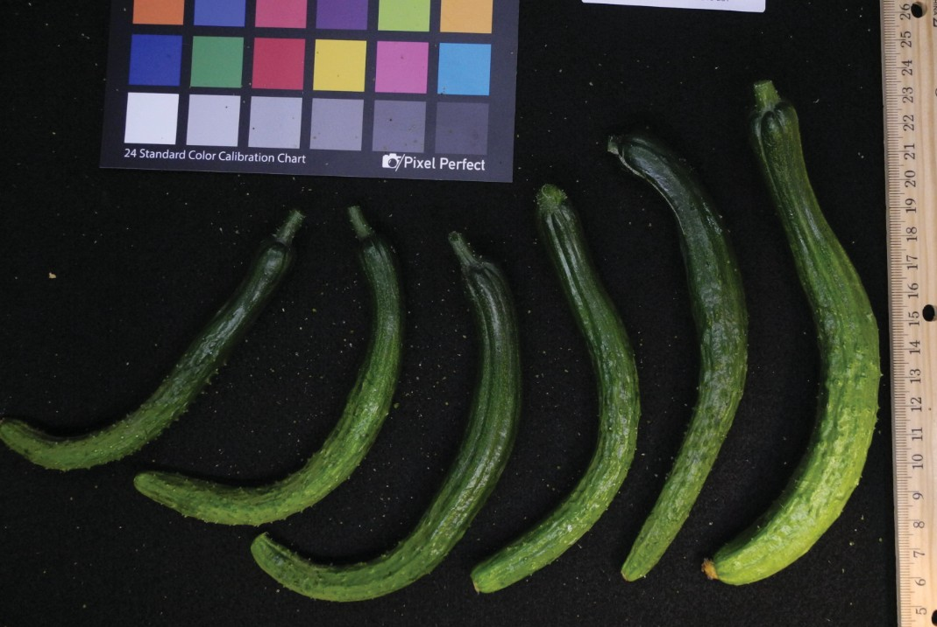
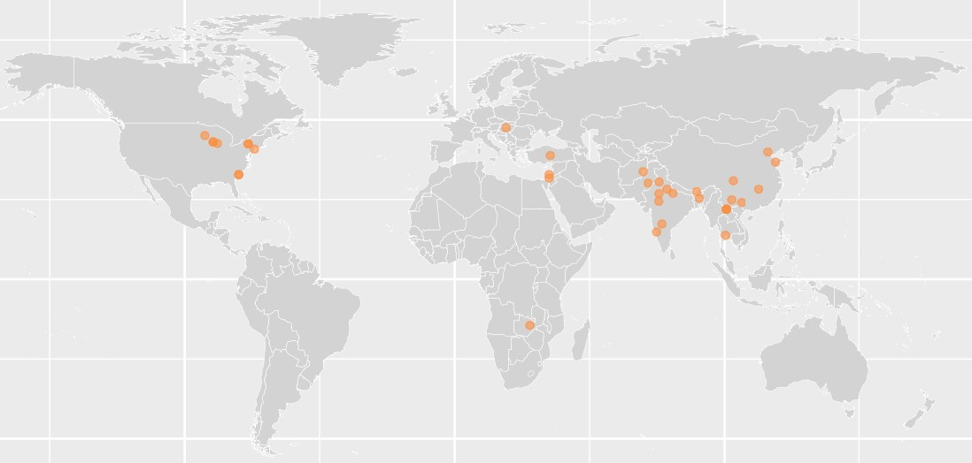



Gene-based Pan-genome Analysis of Cucumber
Rocky Shao¹, Xuebo Zhao², Zhangjun Fei³
¹Ithaca High School, 1401 N Cayuga St, Ithaca, NY 14850, USA
²Boyce Thompson Institute, Ithaca, NY 14853, USA
³USDA-ARS Robert W. Holley Center for Agriculture and Health, Ithaca, NY 14853, USA
Abstract
Workflow & Results
20,000
Global challenges such as climate change and population growth have intensified the need for more robust crop varieties. Advances in DNA sequencing technologies have made it easier to generate pangenomes from representative individuals of target species. Pangenomic studies have also helped identifying beneficial traits and provided insight into breeding efforts to develop more robust crop varieties (Schreiber et al., 2024). These studies have demonstrated success in recent plant research, uncovering evolution and diversity of different plant species (Tang et al., 2022) and identifying deleterious mutations to facilitate breeding (Wu et al., 2023). Cucumber (Cucumis sativus L.) is not only one of the most important vegetable crops worldwide, but also serves as a model plant for sex determination and vascular biology studies (Li et al., 2019). Previous studies have shown patterns in cucumber domestication, such as reduction in genetic diversity (Qi et al., 2013). These studies also highlight key genes associated with important agronomic traits and the history of the domestication process, providing valuable information for future breeding programs (Li et al., 2022). To capture the entire genomic diversity for future research and breeding, a complete gene-based pangenome from diverse cucumber accessions is needed.
Background
Protein Sequence
No. of Gene Families
15,000
Identify orthogroups (gene families) of cucumber pangenomes
10,000
Gene-Families
5,000
Highest: 21,132 genes
Mean: 20,820 genes
Lowest: 20,154 genes (Figure 3)
Orthogroup number stables around 25 genomes (23,800 gene families), suggests this pan-genome captures sufficient genetic diversity in cucumber (Figure 4)
0
NC080
NC001
NC015
NC030
NC004
NC010
NC037
NC064
NC008
NC002
NC014
AM061
NC117
AM353
AM001
AM523
AM078
AM288
AM306
AM303
AM006
AM739
AM014
AM011
AM015
AM003
AM718
AM002
AM716
AM346
AM393
AM568
AM125
AM070
AM027
AM746
AM717
AM016
AM084
Figure 3. Gene family number in cucumber accessions
Identify core- and pan-genes with increasing number of genomes
24000
Number of orthogroups
22000
Presence/absence variation (PAV)
20000
Core Gene
Pan Gene
Calculate occurrence frequency of each gene family across the pangenome and among different cucumber groups
Identified 15,924 core, 2,474 soft-core, 5,235 shell and 112 cloud genes in the cucumber gene-based pangenome (Figure 5)
18000
Cumber is one of the most important agricultural crops worldwide
Different cucumber species/accessions have unique genes to express unique traits for climate adaption, and great potential for future breeding
Pangenomic studies have advantages over singe reference genome approaches, as a pangenome covers the complete genetic variation of the target species.
16000
1
5
10
15 20 25
Number of genomes
30
35
39
Gene Selection Analysis
Figure 4. Pan- and core-gene analysis of cucumber pangenome
Identify genes with significantly different occurrence frequencies between cultivated and wild accessions
Identified 3,451 genes with different presence frequencies between wild cucumbers and landraces; and 2,895 genes between landraces and cultivars
10⁴
Category
Cloud
Materials
Shell
SoftCore
Assembled genomes of 39 cucumber accessions covering different breeding status: Wild (10), Landrace (8), Cultivar (21), and from 10 different countries (Figures 1 and 2).
No. of genes
10³
Core
Functional Analysis
10²
Wild vs. Landrace: Enrichment in mitochondrial functions and protein transport, indicating essential roles in energy production and cellular organization (Figure 6a)
10¹
Figure 1(a) Wild
Figure 1(b) Landrace
Figure 1(c) Cultivar
GO enrichment analysis to determine significantly enriched process
10⁰
0.00
0.25
0.50
Frequency
0.75
1.00
Landrace vs. Cultivar: Enrichment in mitochondrial functions and protein transport, indicating essential roles in energy production and cellular organization
(Figure 6b)
Figure 5. PAV Analysis of cucumber pangenome
organelle inner membrane organelle envelope mitochondrion mitochondrial membrane
mitochondrial inner membrane mitochondrial envelope protein transport
protein transmembrane transport
Wild vs. landrace
Figure 2: Originating locations of the sampled cucumber accessions
Breeding Applications
protein transmembrane import into intracellular organelle
P Value
0.04
Summary
protein targeting to mitochondrion
protein targeting protein localization to organelle protein localization to mitochondrion
protein import into mitochondrial matrix phytosphingosine metabolic process
mitochondrial transport mitochondrial transmembrane transport import into the mitochondrion
establishment of protein localization to organelle establishment of protein localization to mitochondrion
establishment of protein localization protein−folding chaperone binding D−erythro−sphingosine kinase activity
0.03
0.02
Constructed a gene-based pangenome from 39 cucumber genomes.
Identified 15,924 core genes, 2,474 soft core genes, 5,235 shell genes and 112 cloud genes in the cucumber gene-based pangenome.
Identified 3,451 genes with significantly different presence frequencies between wild and landraces, enriched with those involved in energy production and cellular organization; and 2,895 genes between landrace vs. cultivars, enriched with those involved in plant growth and stress responses.
0.01
References
0
200 400
Gene number
Li, H., et al. (2022). Graph-based pan-genome reveals structural and sequence variations related to agronomic traits and domestication in cucumber. Nature Communications. 13, 682
Li, N., et al. (2023). Super-pangenome analyses highlight genomic diversity and structural variation across wild and cultivated tomato species. Nature Genetics. 55, 852-860
Qi, J., et al. (2013). A genomic variation map provides insights into the genetic basis of cucumber domestication and diversity. Nature Genetics. 45, 1510-1515
Schreiber, M., et al. (2024). Plant pangenomes for crop improvement, biodiversity and evolution. Nature Reviews Genetics.
Tang, D., et al. (2022). Genome evolution and diversity of wild and cultivated potatoes. Nature. 606, 535-541
Acknoledgement
protein modification by small protein removal
Landrace vs. cultivar
This 2024 High School Research Internship Experience was made possible by Cornell University USDA, NSF, and Boyce Thompson Institute as well as Individual donors
protein desumoylation
P Value
0.04
peptidyl−lysine modification
0.03
peptidyl−amino acid modification
0.02
polygalacturonase activity
0.01
deSUMOylase activity
cysteine−type peptidase activity
0
20
40
Gene number
60
Figure 6. Enrichment pattern of genes with significantly different occurrence frequencies

