Slide 1
4.1 Global Optimality of pg = pdata
4.2 Convergence of Algorithm 1
还需要再看看

Slide 2
Generative Adversarial Nets
Ian J. Goodfellow∗, Jean Pouget-Abadie†, Mehdi Mirza, Bing Xu, David Warde-Farley, Sherjil Ozair‡, Aaron Courville, Yoshua Bengio§
Notes:
第一页

Slide 3
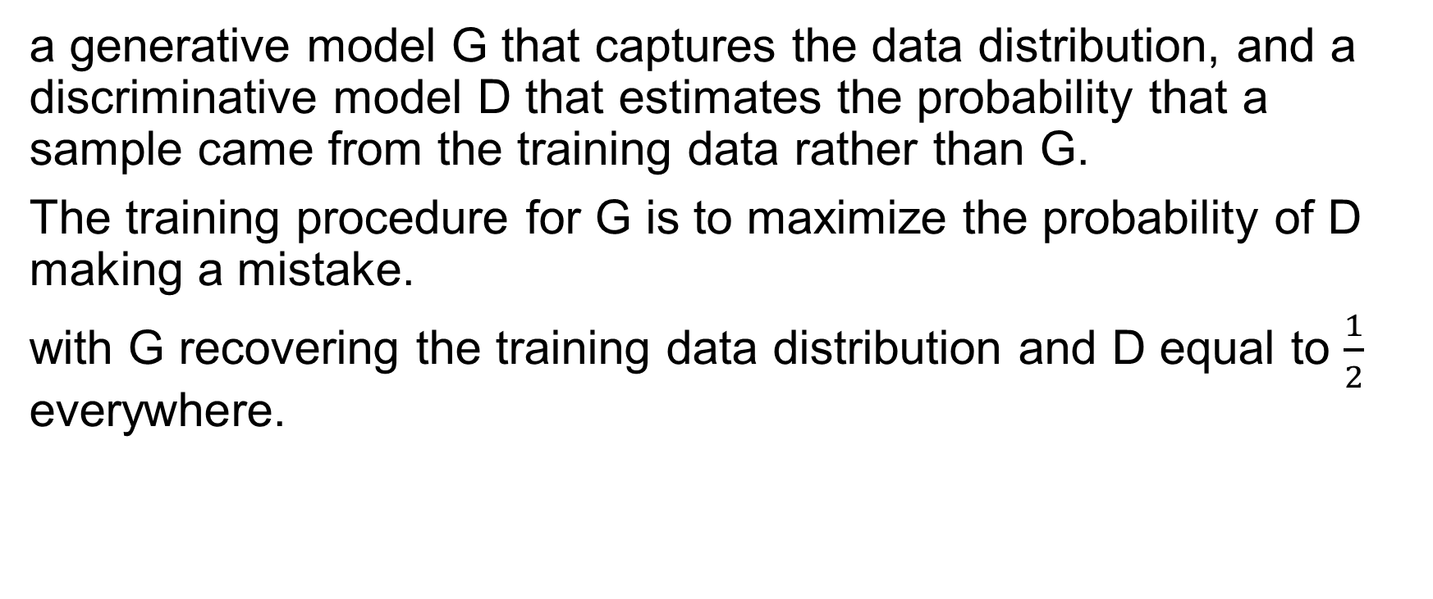
Abstract
a generative model G that captures the data distribution, and a discriminative model D that estimates the probability that a sample came from the training data rather than G.
The training procedure for G is to maximize the probability of D making a mistake.
with G recovering the training data distribution and D equal to $\frac{1}{2}$ everywhere.
Notes:
第二页

Slide 4
Introduction
Discriminative model that learns to determine whether a sample is from the model distribution or the data distribution.
The generative model generates samples by passing random noise through a multilayer perceptron, and the discriminative model is also a multilayer perceptron.

Slide 5
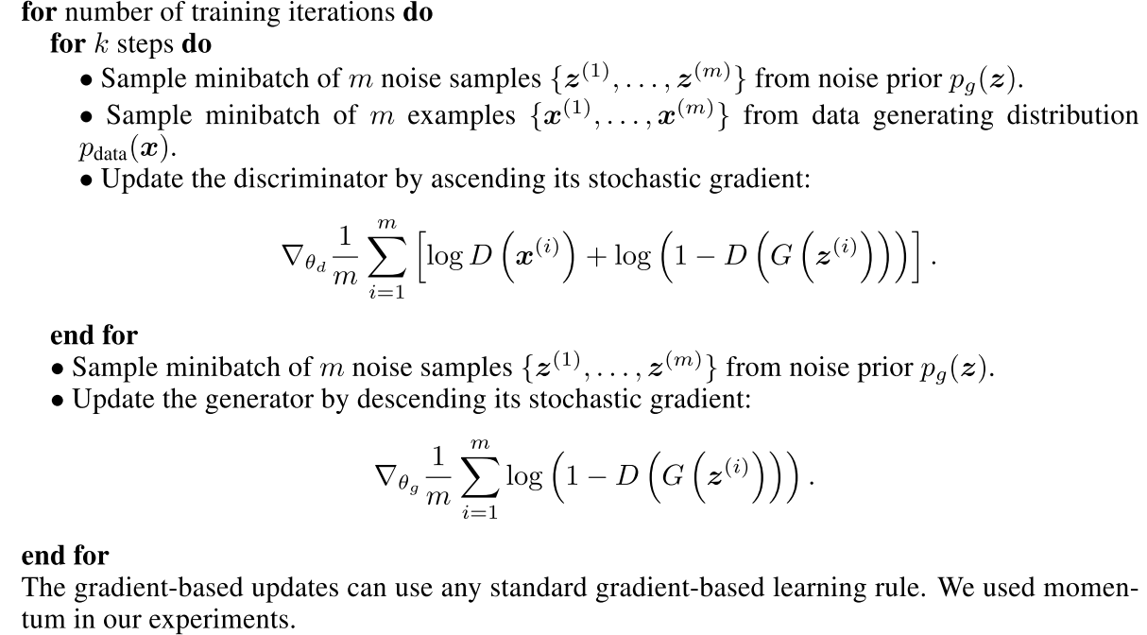
Adversarial nets

Slide 6
